Slide 1
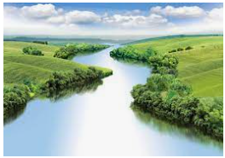
Mountains, Volcanoes and Earthquakes.
Outcomes for this topic:
To locate and name areas of interest in relation to mountains, volcanoes and earthquakes.
Describe and understand the key aspects of mountains, volcanoes and earthquakes.
Discuss how volcanoes affect human life eg. Settlements and spatial variation.
To discuss whether mountains and volcanoes affect weather in an area.

