Slide 1
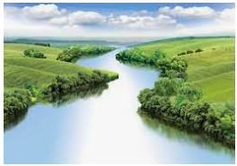
Rivers
Outcomes for this topic:
To use the language of rivers eg. Source, waterfall, rapids, meander, ox-bow lake, flood plains, delta, mouth.
To explain and present the process of rivers from source to mouth.
To locate rivers of the world on a map.

