Slide 1
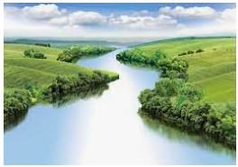
Russia
Outcomes for this topic:
To locate Russia on a map and make assumptions about the terrain.
Identify how land in the country is used.
Identify the main economies and trade.
Draw conclusions about the location of settlements and compare to the UK.

