Slide 1
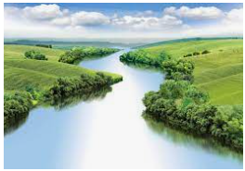
Skara Brae
Outcomes for this topic:
To identify and name areas of interest on a map.
To identify the key physical and human features.
To describe and understand the types of settlements and land use.

