Slide 1
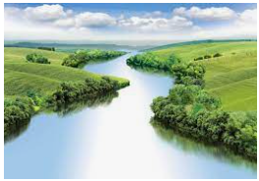
South America
Outcomes for this topic:
To locate the countries in North and South America.
To describe and understand the land use and economic activity in South America.
To locate the key physical and human features and relate these features to the locality, eg. Population sizes near landmarks/rivers/transport links.
Use photographic evidence to raise questions about the climate and living conditions in South America.

