Slide 1
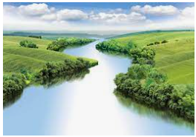
The Water Cycle
Outcomes for this topic:
To be able to identify key terms in the water cycle.
To be able to explain the process of the water cycle.

