Slide 1
Art Planning in Sholing Junior School
 | Autumn I | Autumn II | Spring I | Spring II | Summer I | Summer II
Year 3 | Cave Sculpture Hand splatters, animal drawing in pastel, clay skills and make a cave with a texture, designs and animal drawing on it. |  | Egyptian Hieroglyphic Printing Draw Egyptian hieroglyphics, create a printing block and polystyrene tiles to create prints on a range of papers and fabric. |  | Indian Paisley Sewing Architect study on Lawrence Baker and Indian Henna designs. Create a layered Paisley design from felt with 3 stitch types and decoration.
Year 4 | Greek Sewing Draw repeating patterns in the ancient Greek style using different mediums. Practice new stitches and use them to design and make a bookmark on Binka. | Collage Make a collage on canvas. Layer images and decorate to create a book cover. | Matisse and Gillian Ayres artist study - Collage Paint with scissors! Create a collage in the style of the artist. | Greek Clay Pots Draw Greek style patterns and practice clay skills, create a coil clay pot with handles inspired by the Greek design. | Alice In Wonderland Printing Make printing tiles with texture to create a backdrop to a ‘Drink me bottle’. | St Basil’s Cathedral and Architecture Study Study famous architecture from around the world with landmark buildings. Focus on St Basil’s Cathedral and draw own version using water colour and wax relief.
Year 5 | Artist Study and Willow Sculpture Create a willow weaving ‘universe’ with hanging pastelled planets. | Collage based on book – Cogheart. Layer collage on a canvas to create a book cover with adornments. | Vikings – Drawin Artist study of Arturas Slapsys. Portrait drawing, watercolour / pastel of Viking face in his style. | Modern Artist Study – Part 1 Recreate drawing in the style of David Hockney and Keith Haring. | Modern Art Batik – part 2 Recreate drawing in the style of David Hockney and Keith Haring. Practice batik and fabric dying skills to create a pillow finished on sewing machines. | Printing based on book - Skellig Print papers to create a bird collage. .
Year 6 | People Wire Sculptures Look at artist, Giacometti’s people and recreate the look in ink looking at mannequin figures. Make 3D wire sculptures of people. |  | Macbeth Create 3 colour printing in pop art style of a character or scene inspired by Shakespeare's Macbeth. | Mayan Drawing Artist Study, Satareh (Deviant Art). Draw/felt tip a modern take on Mayan gods. | Felt Monsters Design a ‘monster’ template’ and recreate it as a felt sewn toy.

Slide 2
What Art Looks Like In Sholing Junior School?
All classes do 1 hour a week or block it. Art topics are mainly linked to the creative curriculum.
1. Where possible, start with a great artist. Learn about the them and copy their style, practicing skills in sketchbooks (drawing and painting).
2. Children create their own version based on their topic and in the style of the artist (referring to sketchbooks).
4. At the end of the project the children write a review and stick in pictures of them and their finished work. This forms assessment.
3. Work is added to the sketchbooks throughout the learning journey. Children try out with different mediums and have the freedom to extend their work with their own ideas.

Slide 3
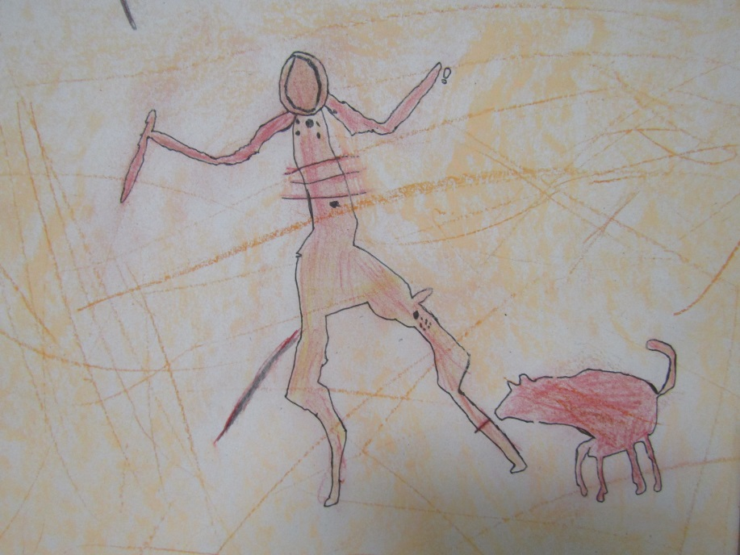
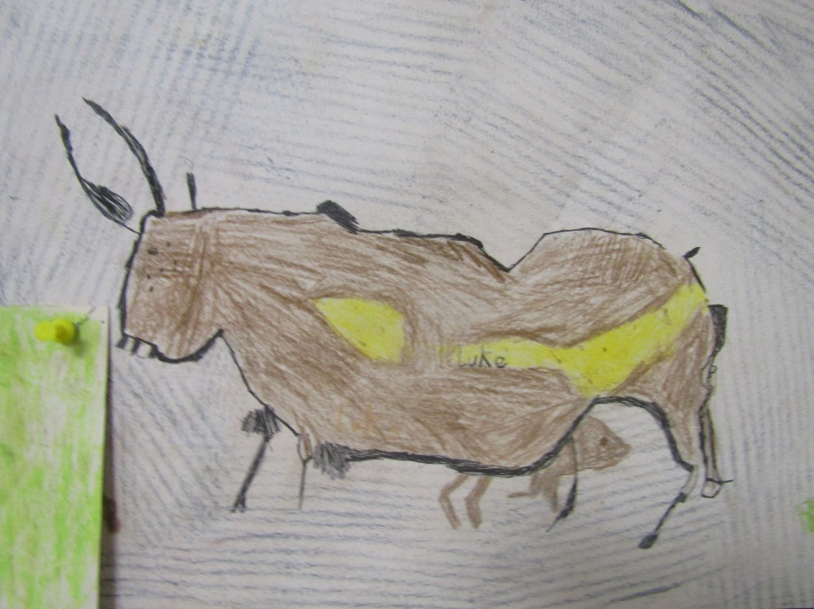
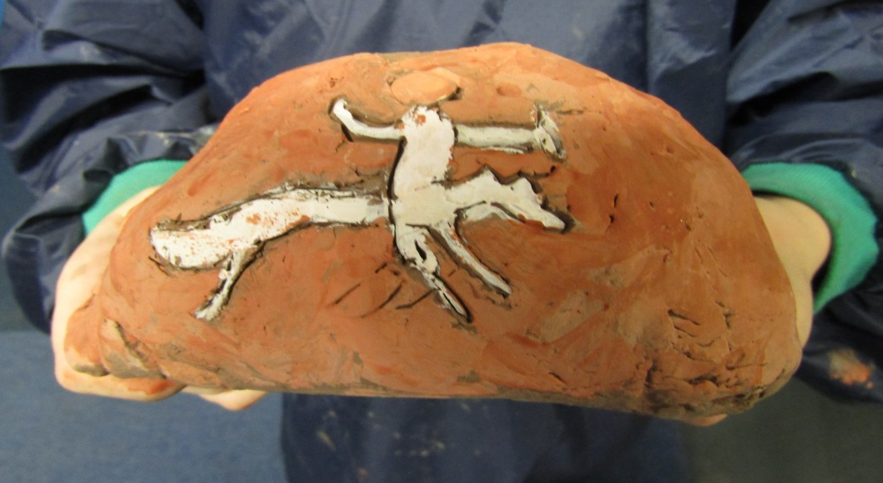
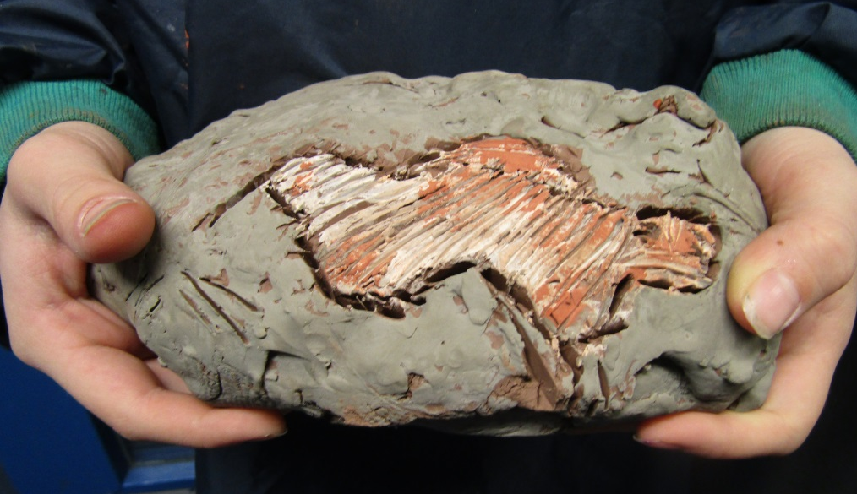
Year 3 sculpture – Pastel drawings and clay caves

Slide 4
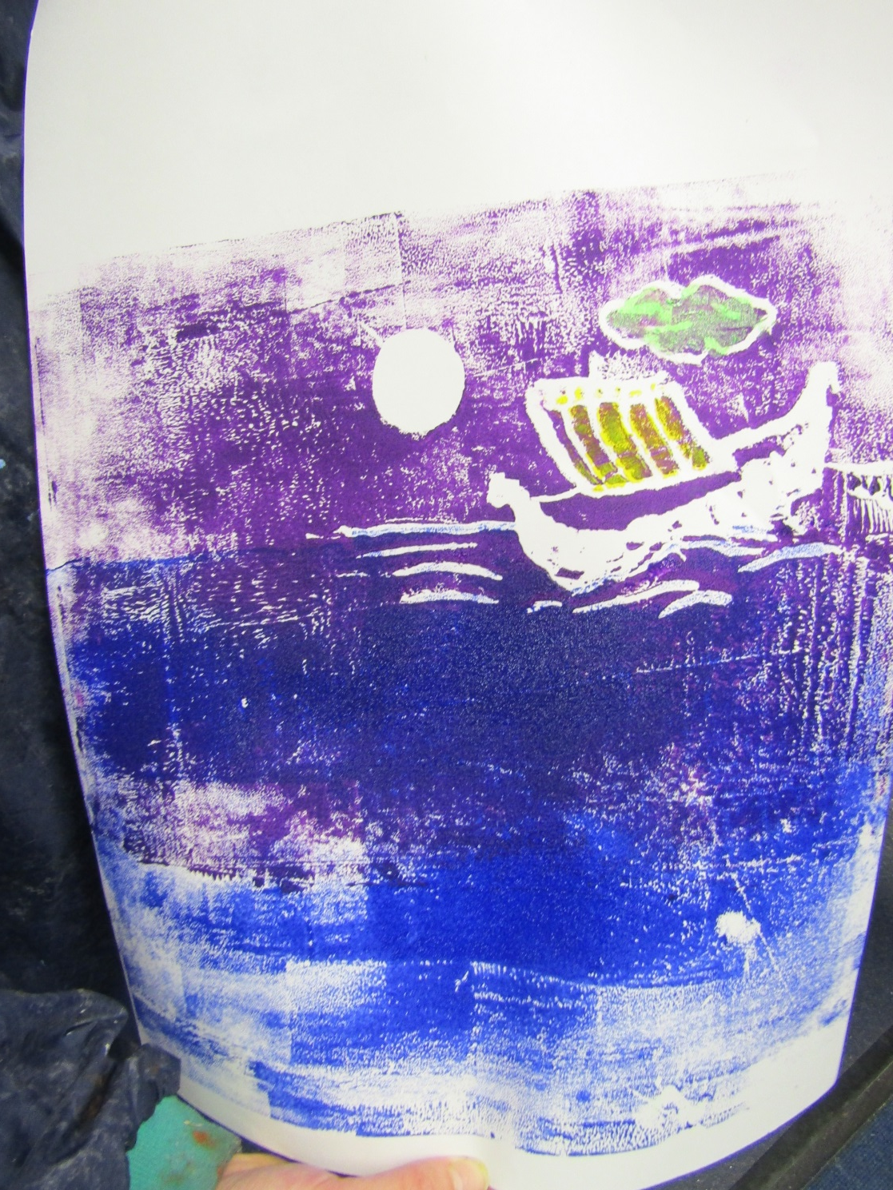
Year 5 Printing – Multicolour printing using polystyrene tiles

Slide 5
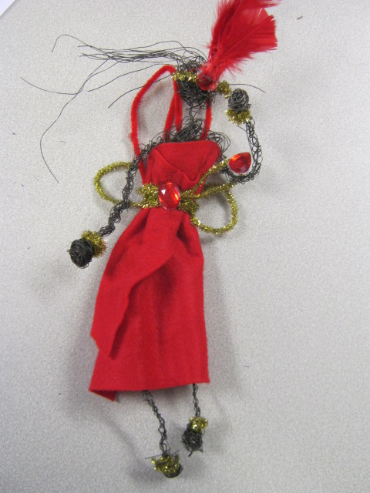
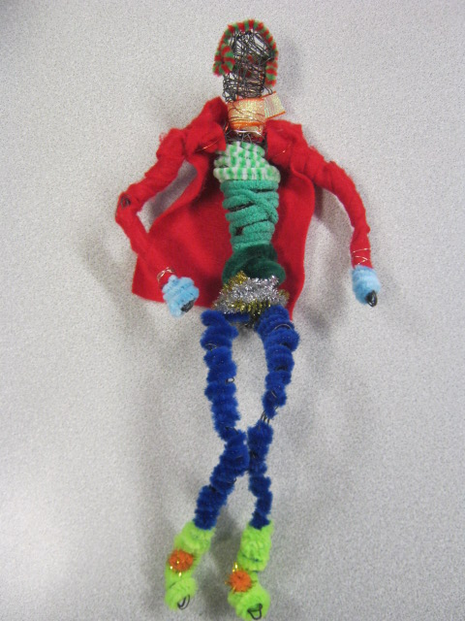
Year 6 Wire Sculpture

Slide 6
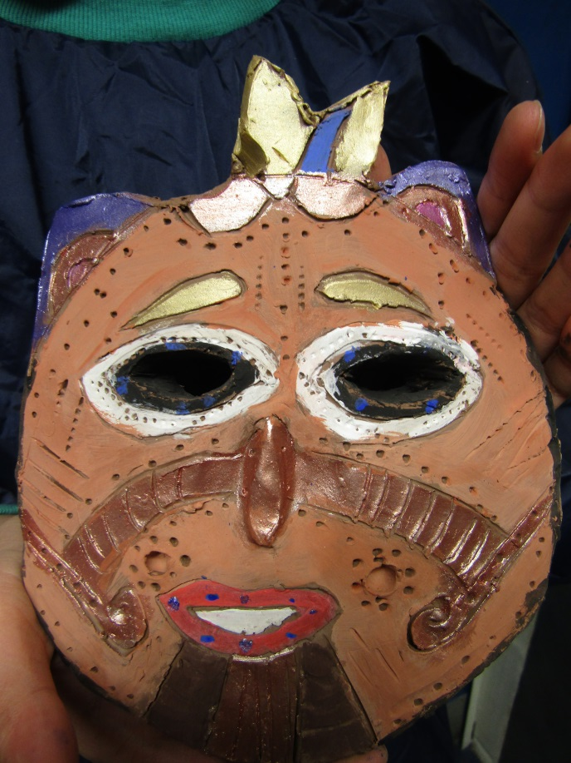
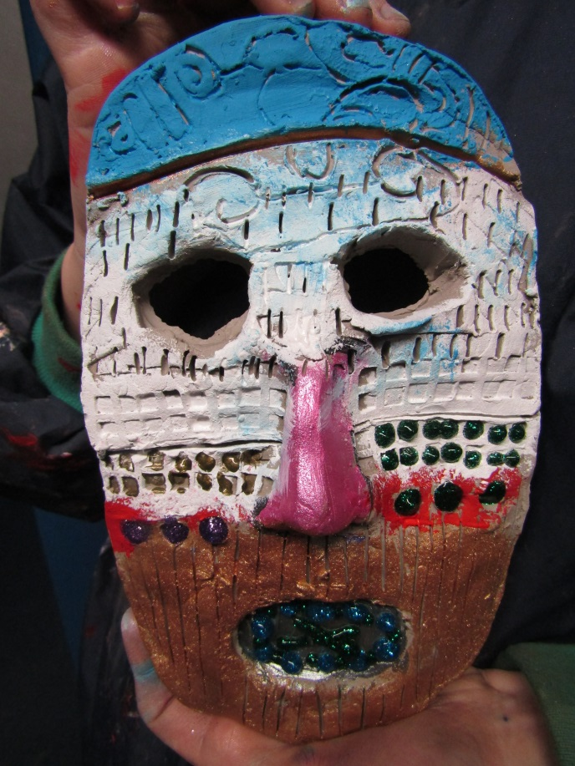
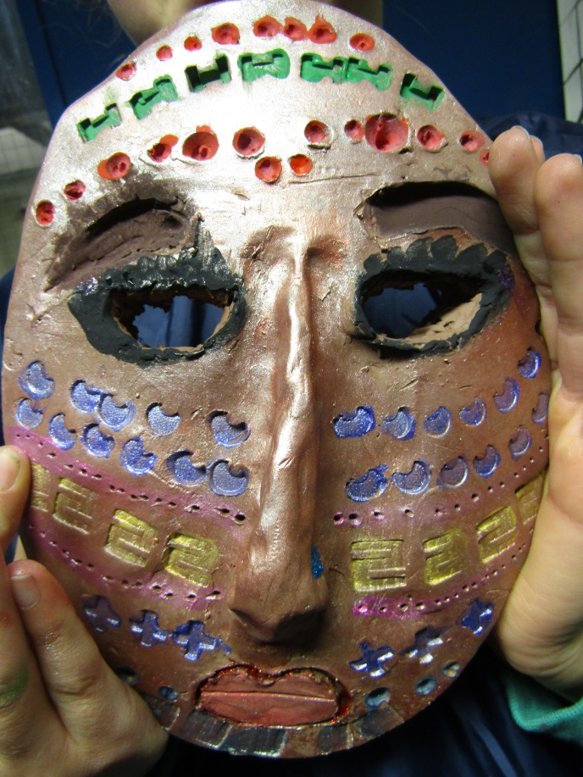
Year 6 Mayan Clay Masks

