Slide 1
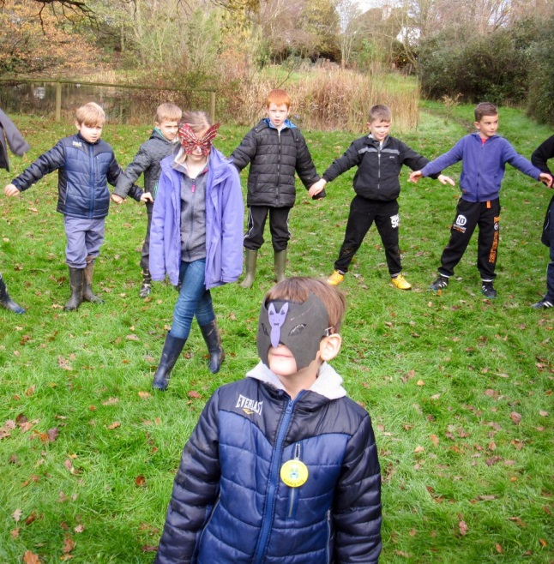
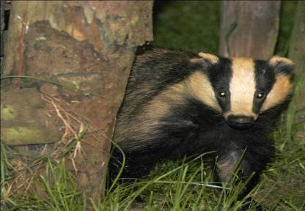

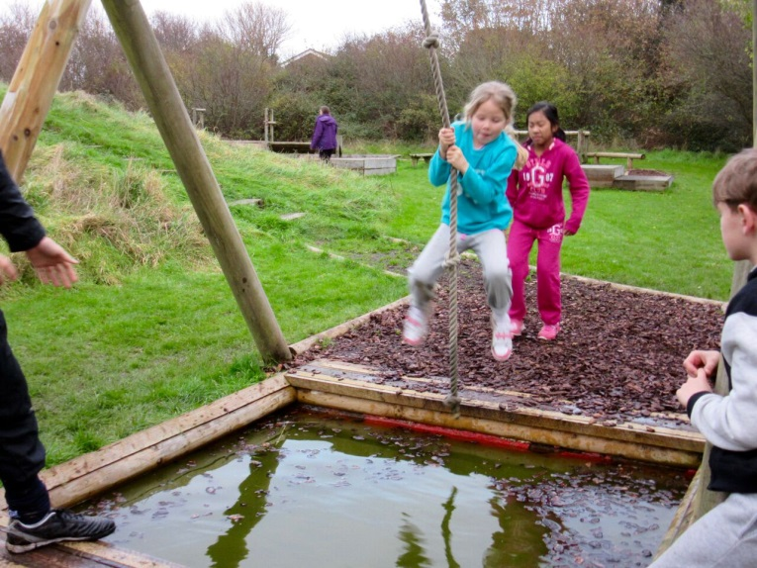
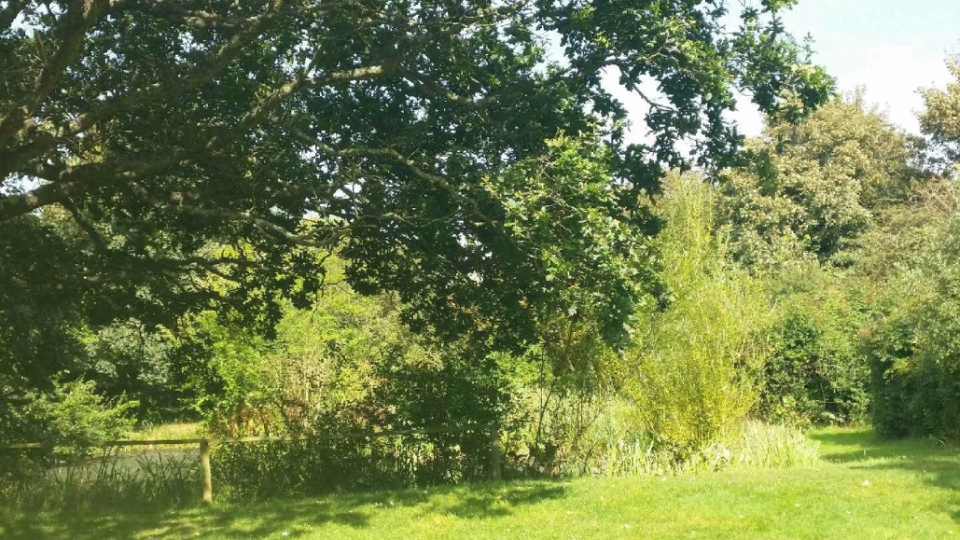
Where learning comes to life!

Slide 2
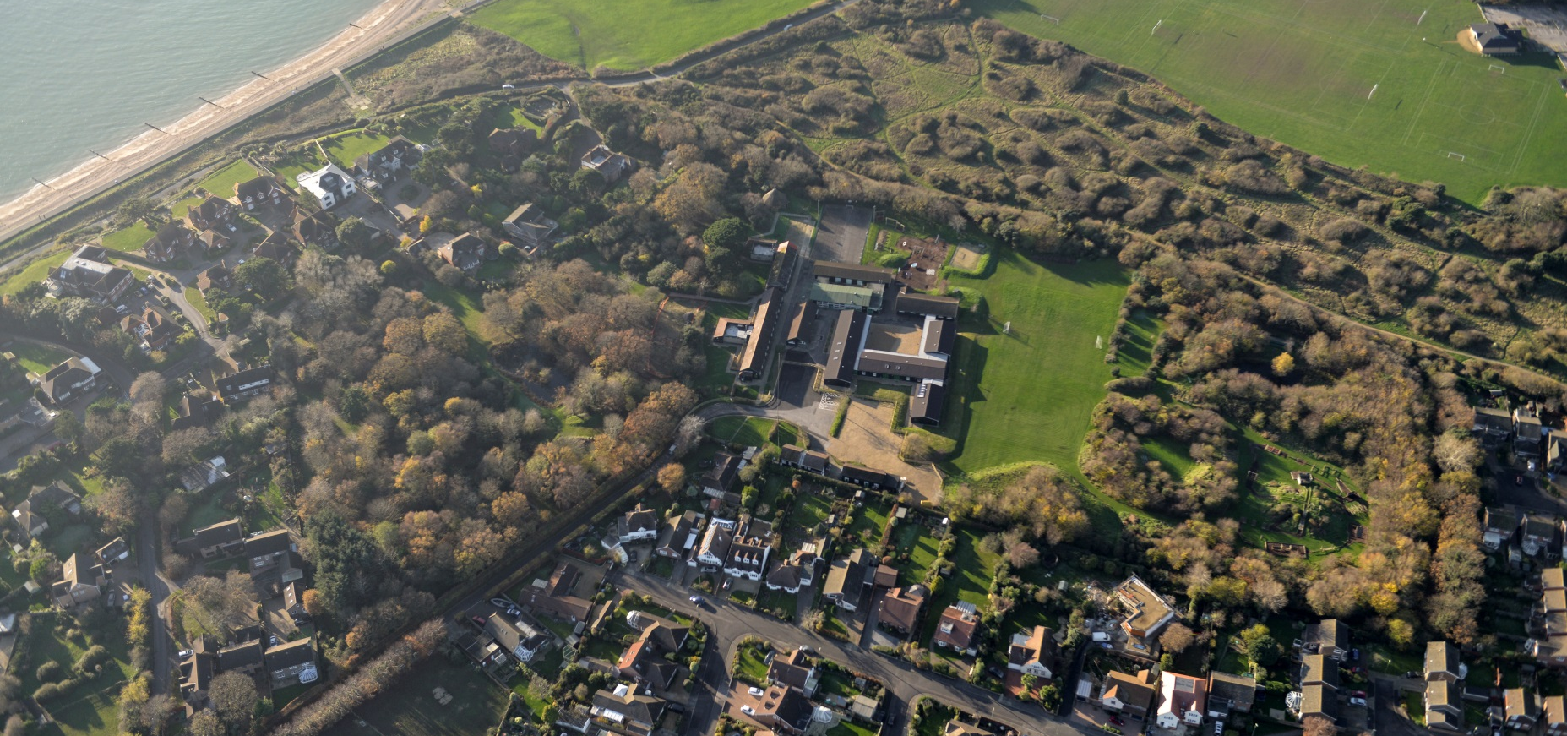
Where are we?

Slide 3
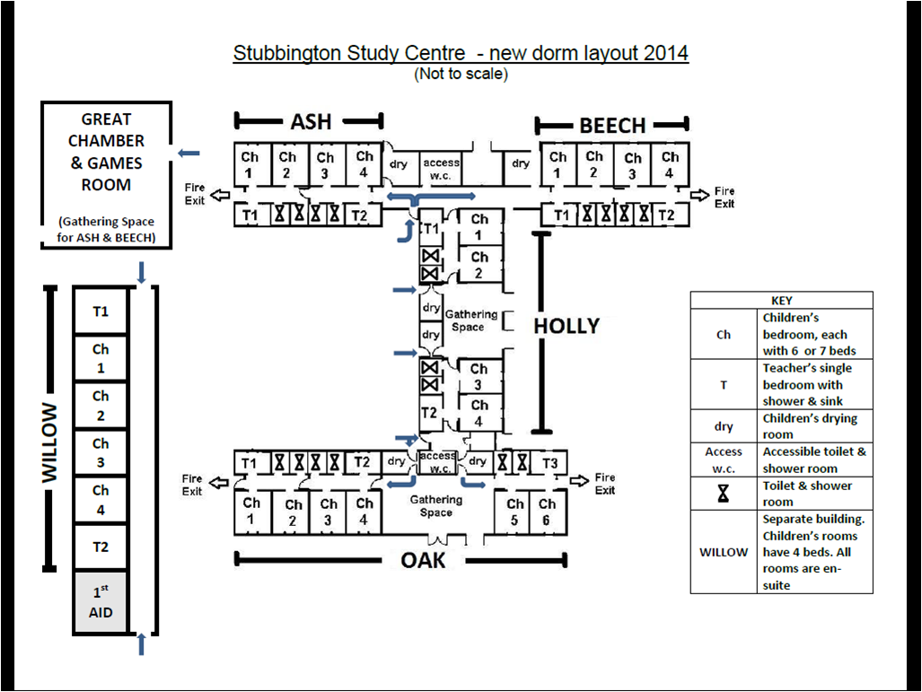

Slide 4
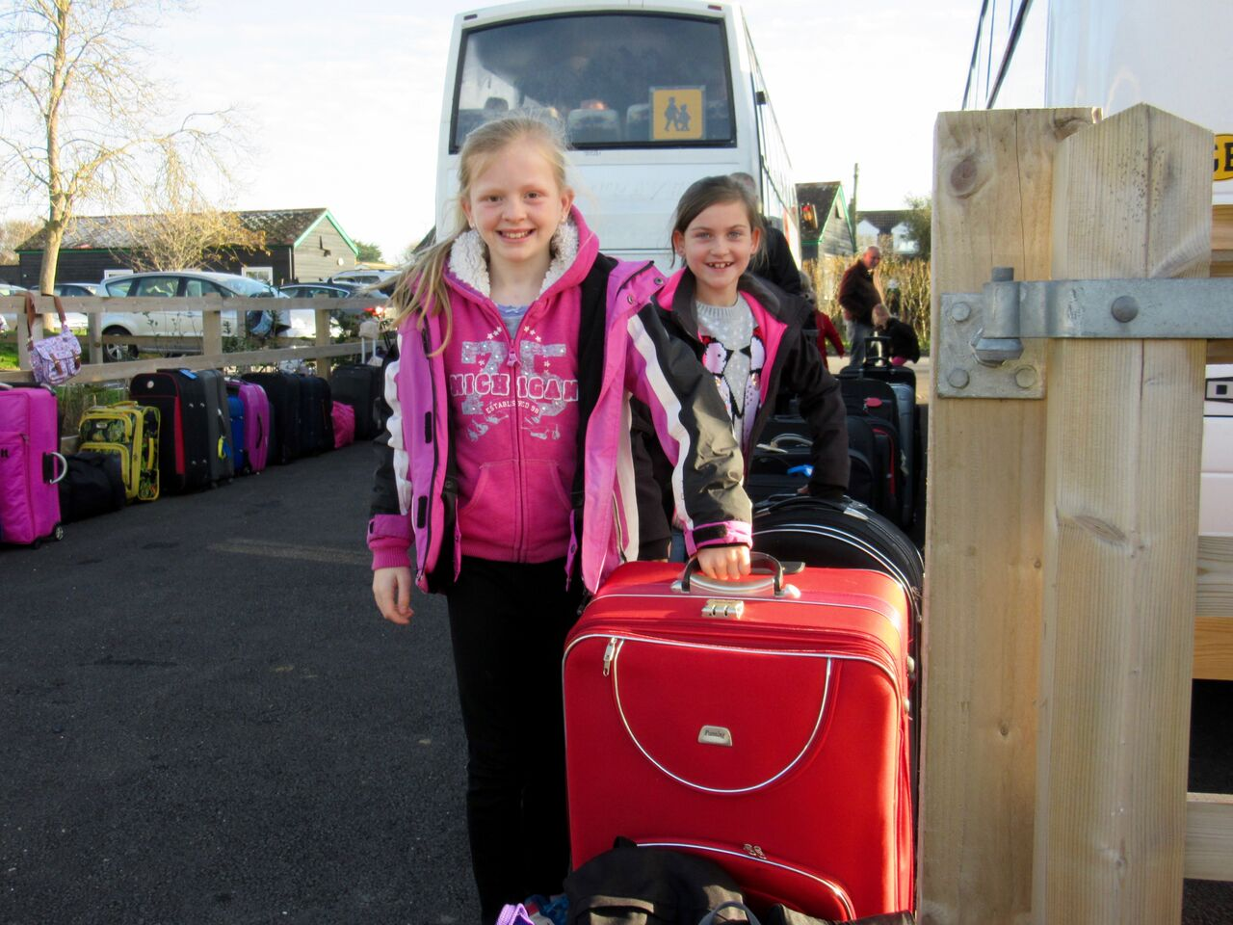
Children should be dropped off at around 10:15am

Slide 5
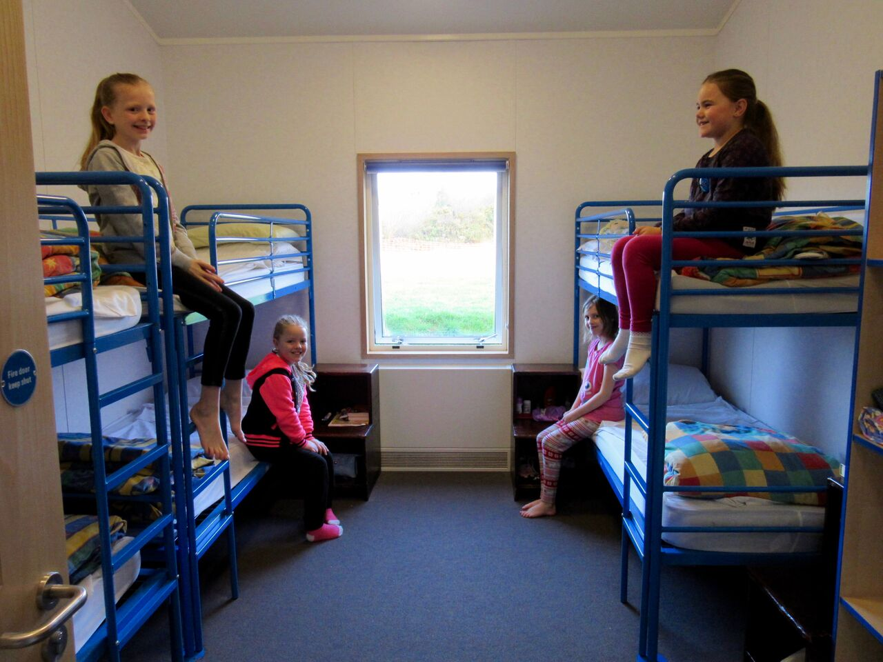
Children are shown to their dormitories.
They begin to think about our three key words:
Teamwork
Responsibility
Respect

Slide 6
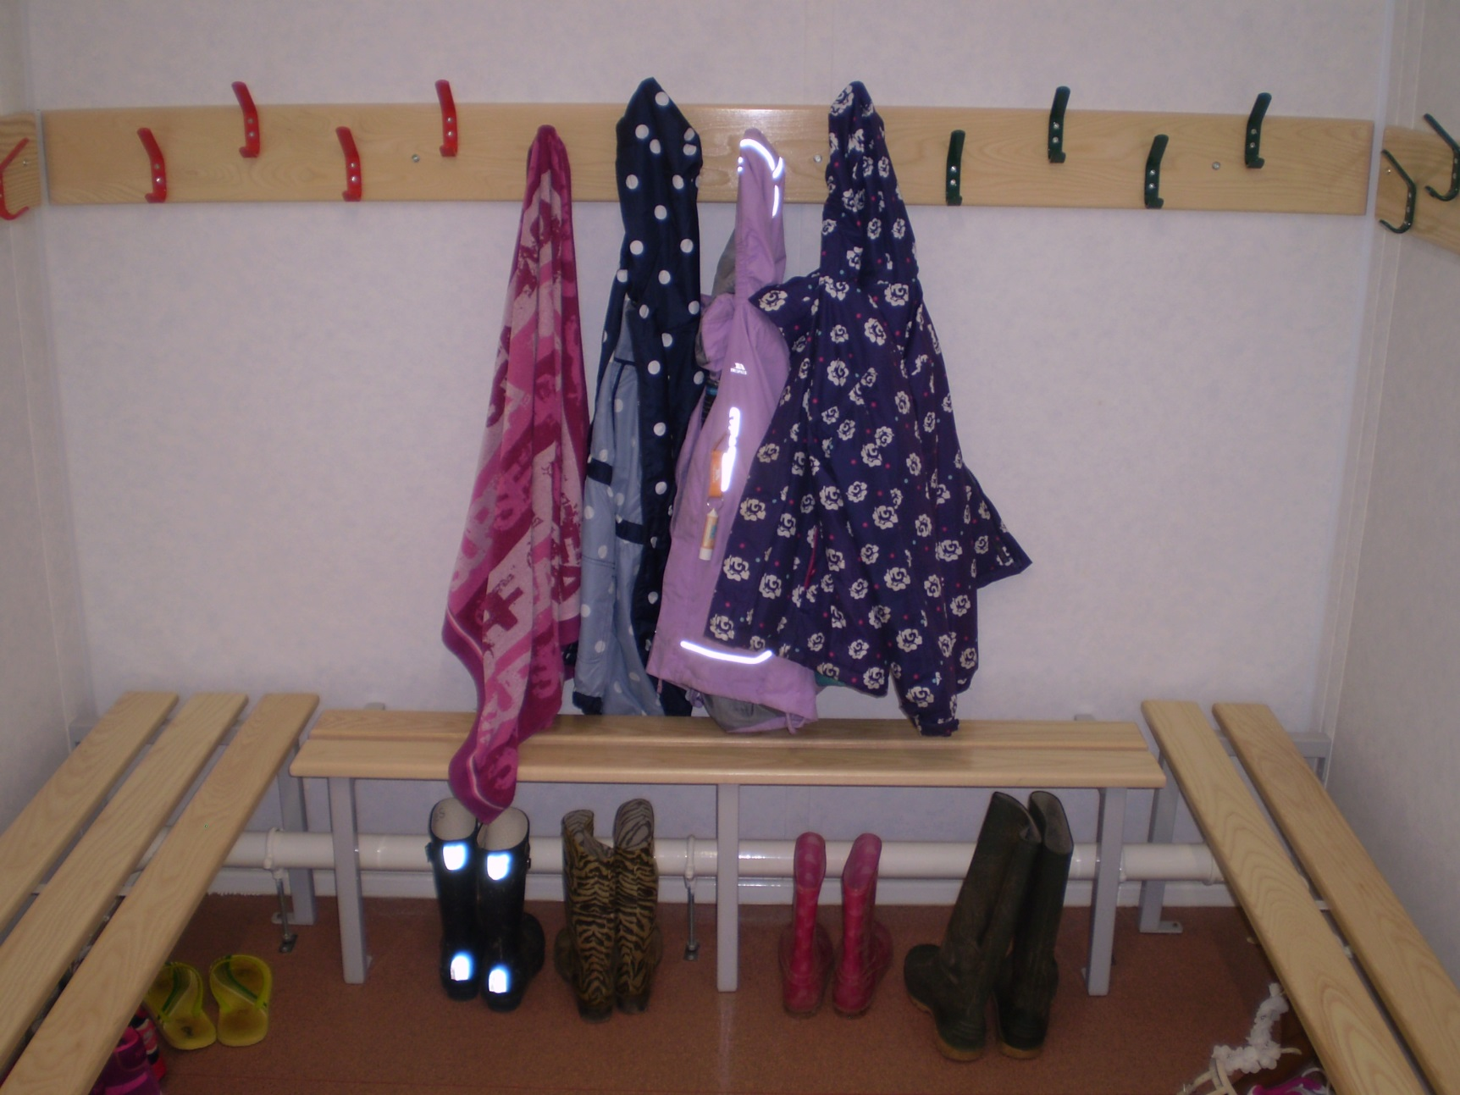
Our towels will soon dry in here!
Drying Rooms

Slide 7
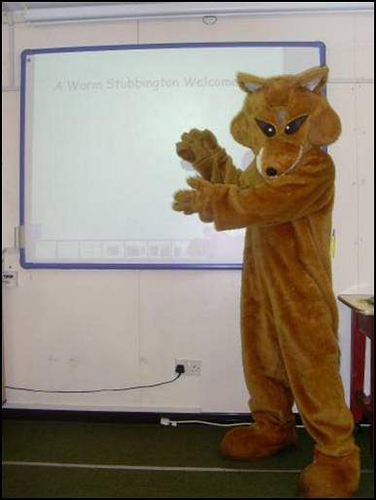
We all meet in the Great Chamber for a welcome and introduction.
Welcome to
Stubbington

Slide 8
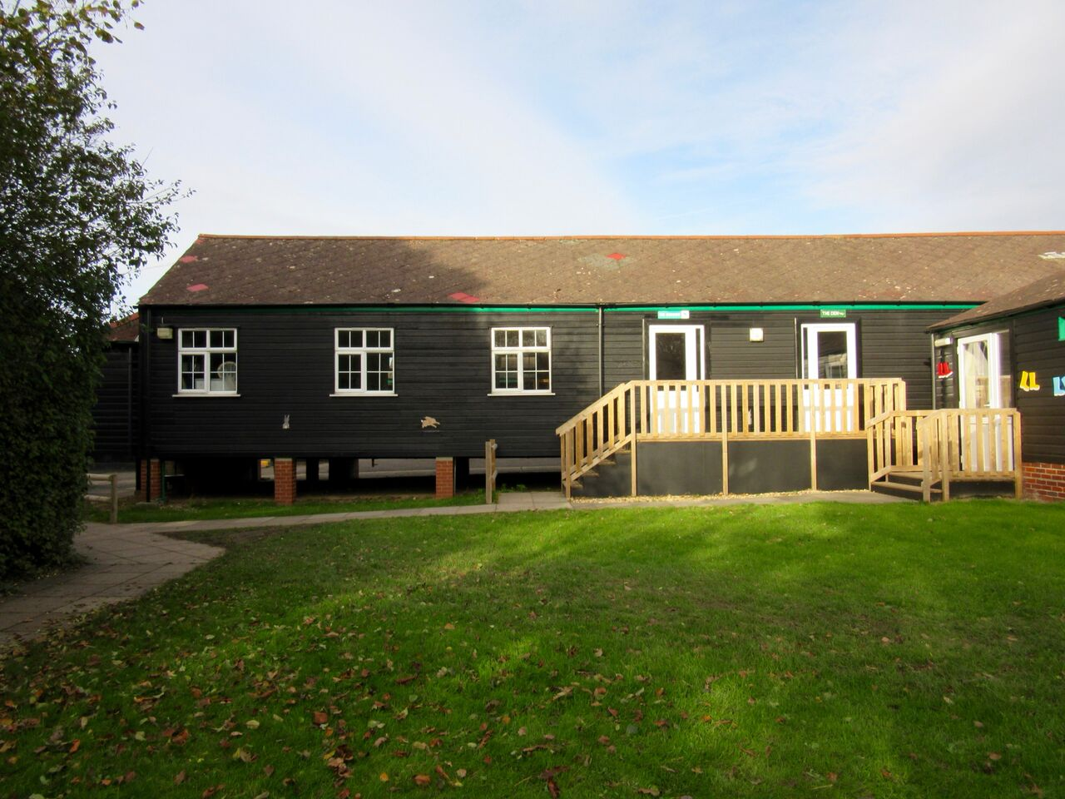
Study Bases for indoor work

Slide 9
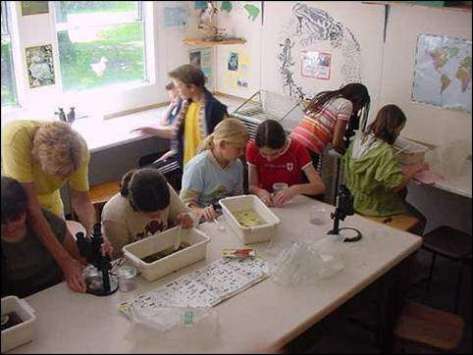
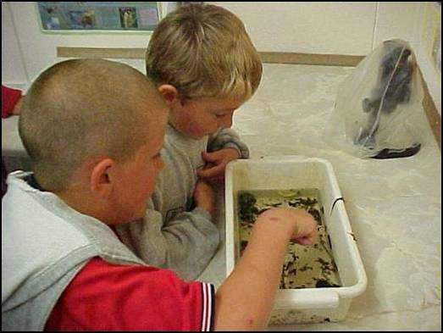
Study Bases
Ooh! Is that a stick insect?
No! It is a stick!

Slide 10
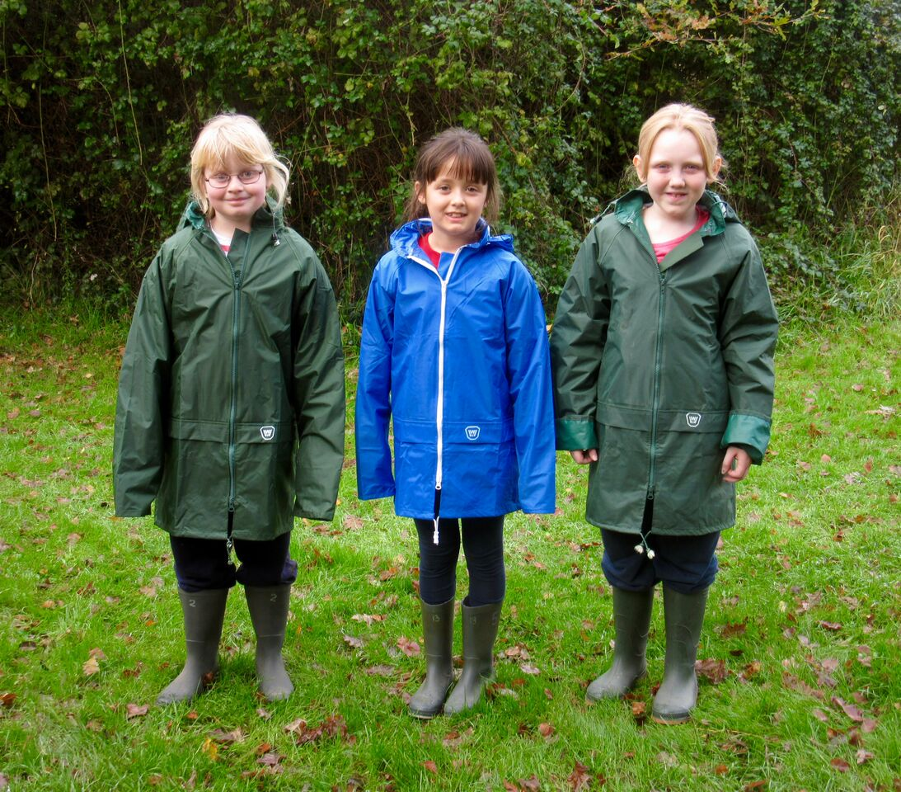
We can provide wellingtons, waterproofs, clipboards etc.

Slide 11
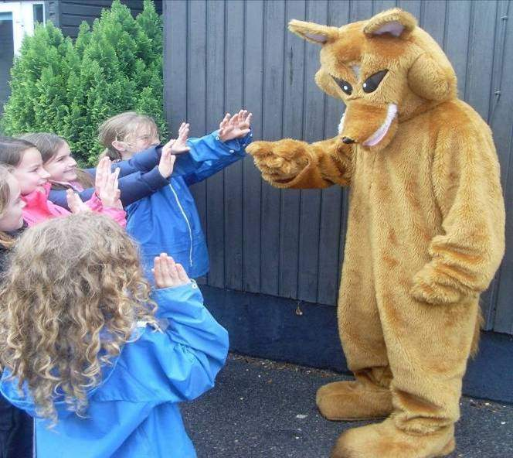
Children ready for breakfast at 8:20am
Have you all washed your hands?

Slide 12
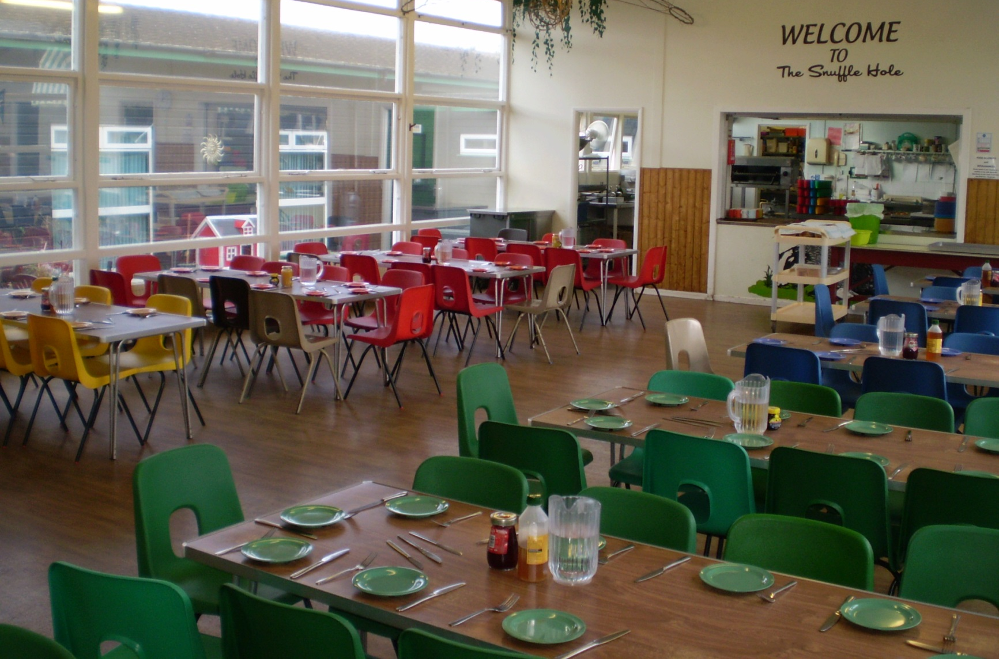
Inside the dining room

Slide 13
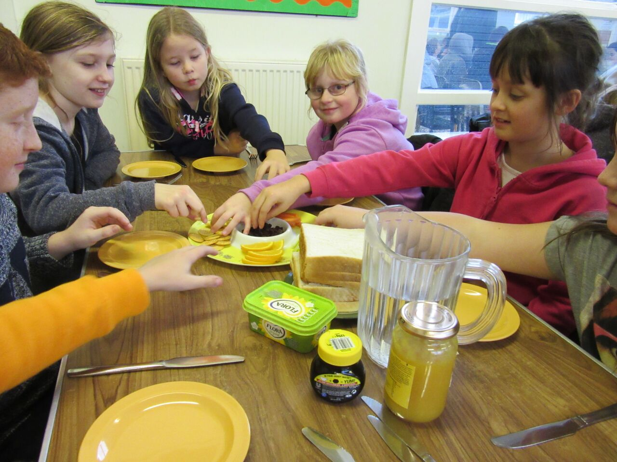
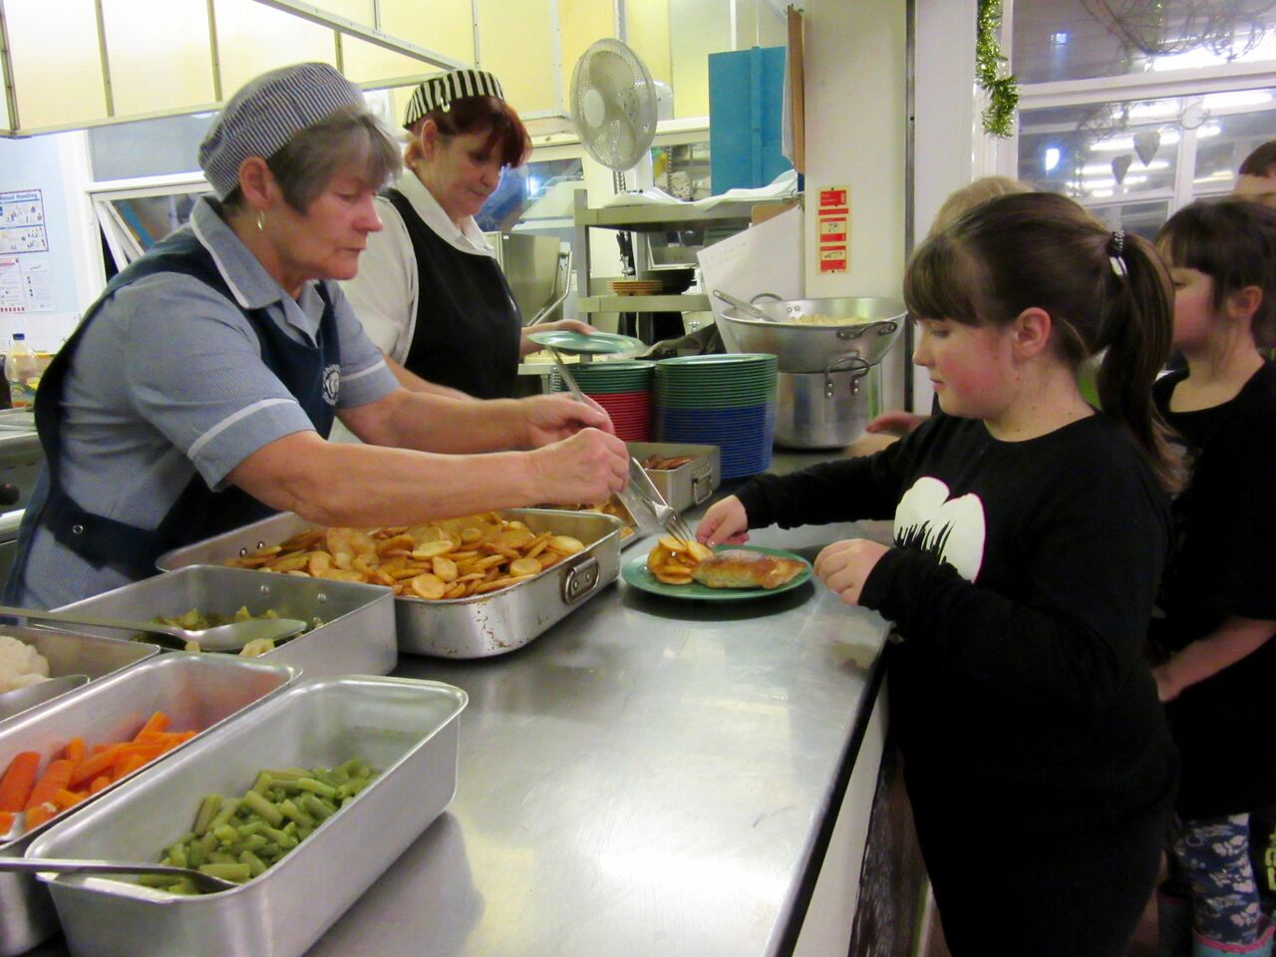
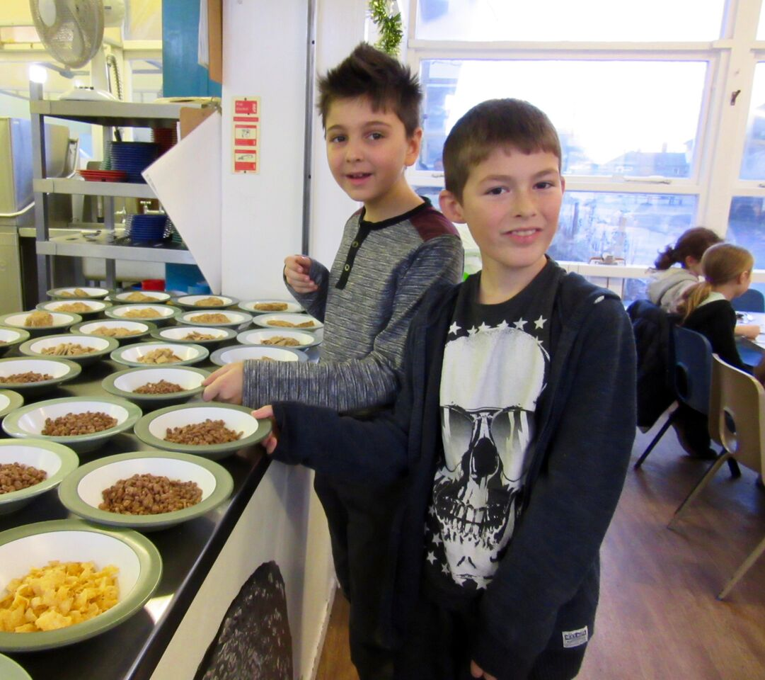
Children build a healthy appetite!

Slide 14
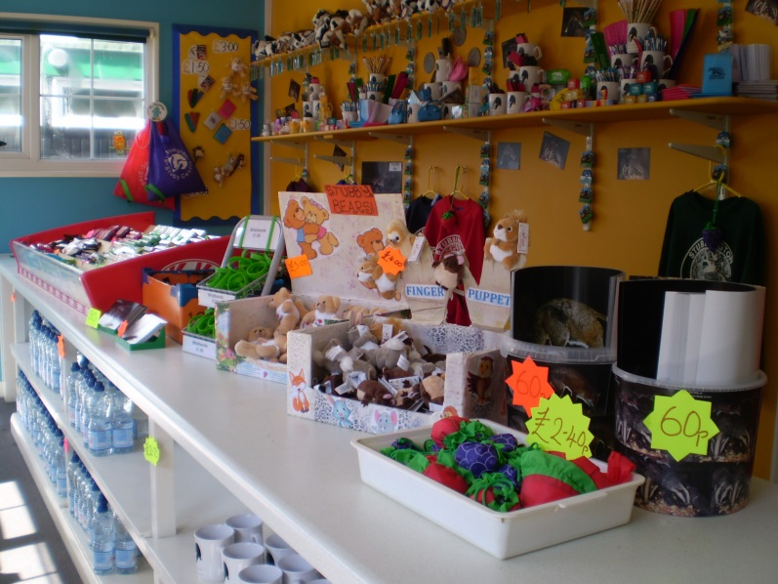
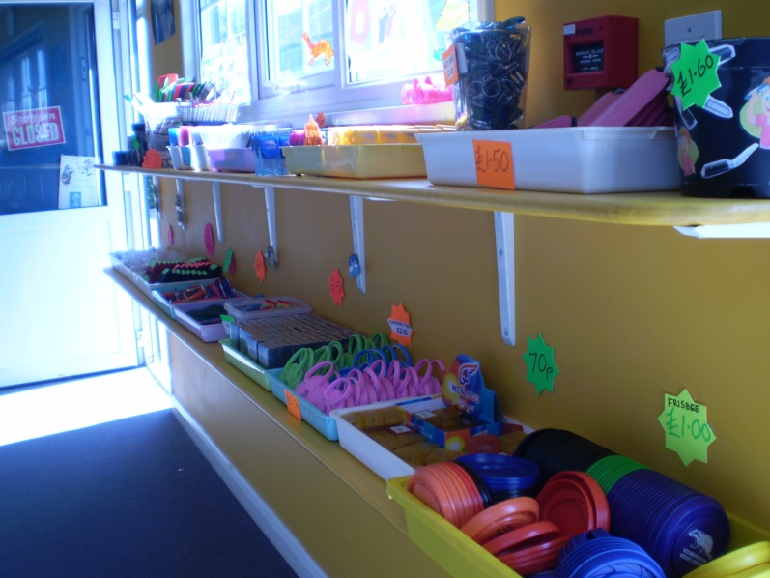
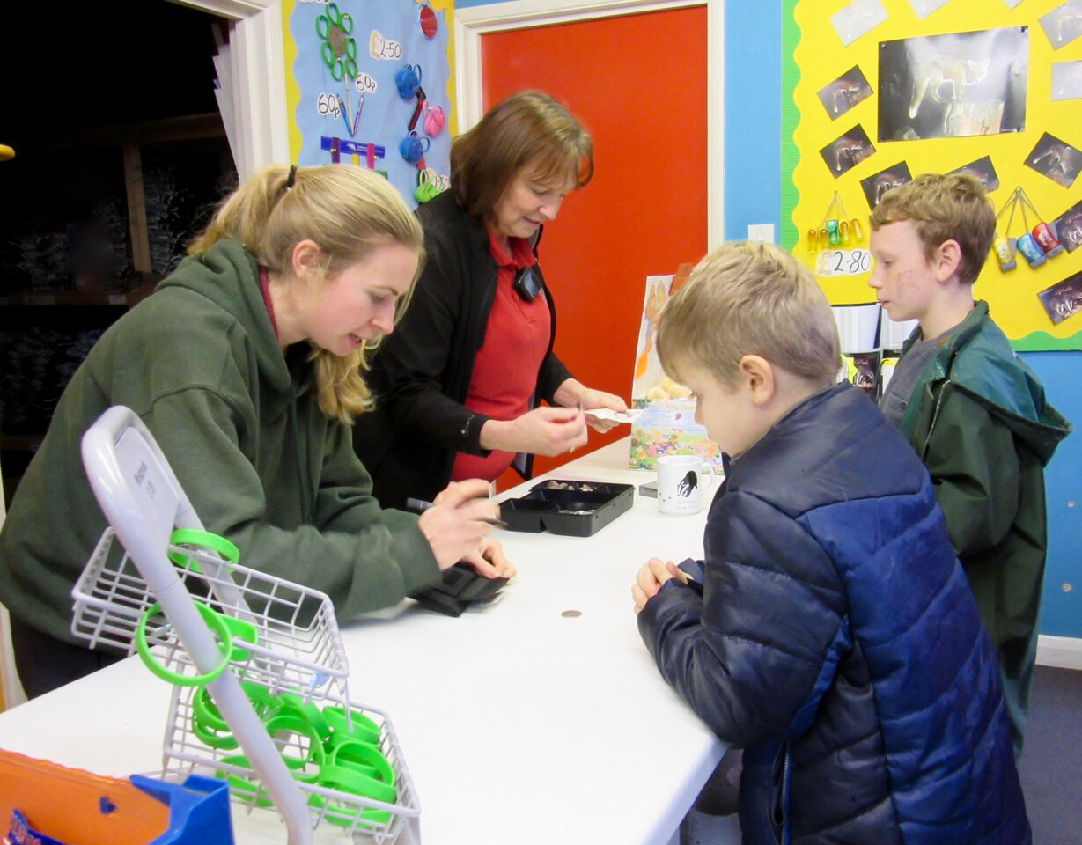
Tuck shop opens after lunch

Slide 15
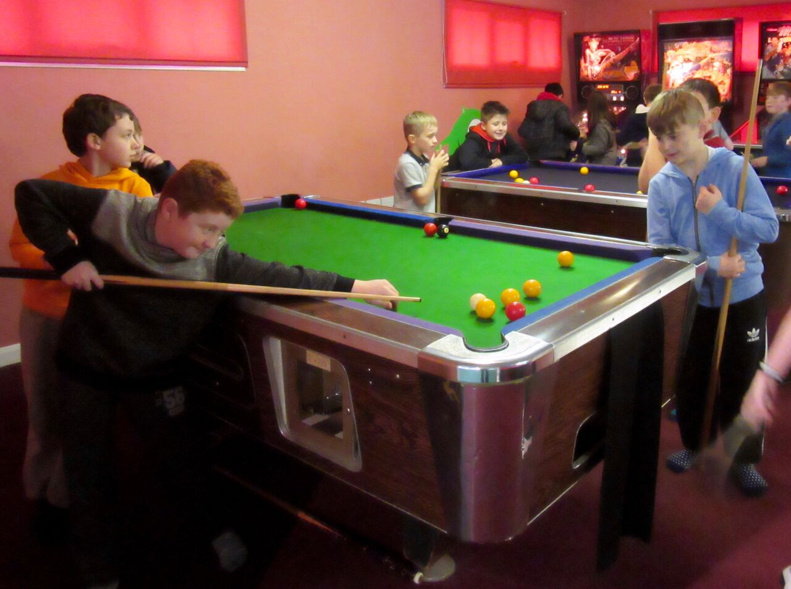
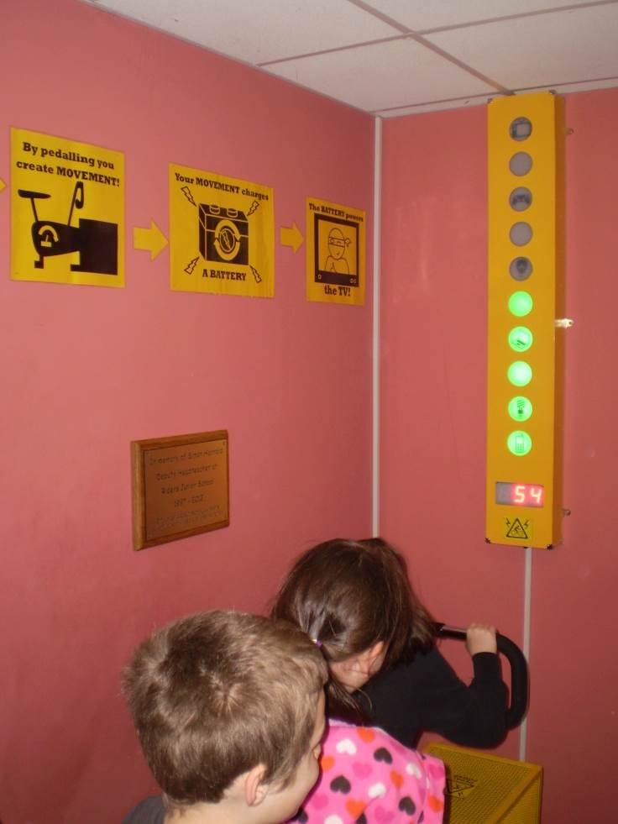
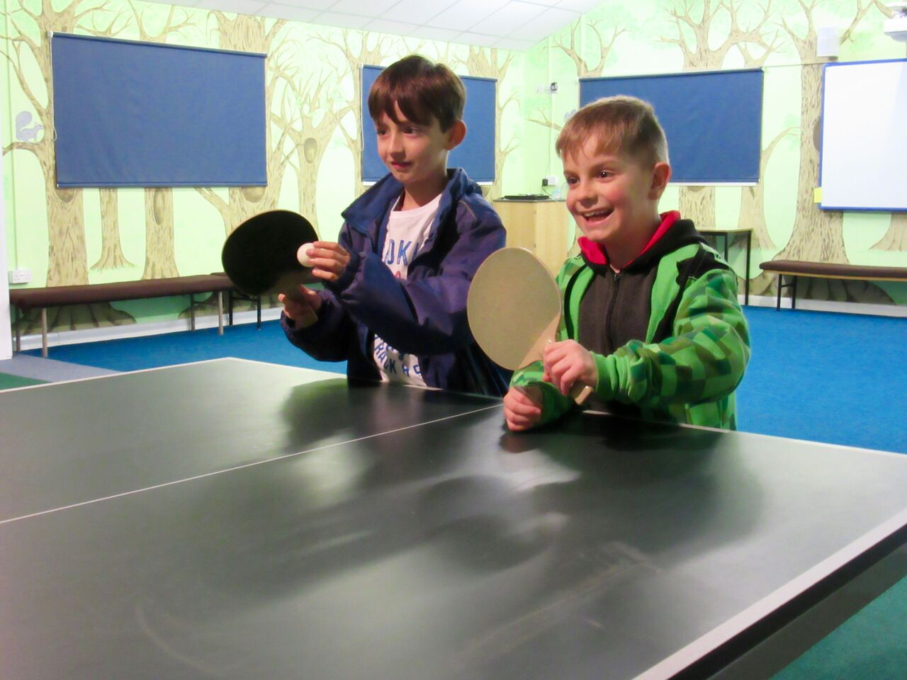
Games Room
Pool, Table tennis, Games machines and more…

Slide 16
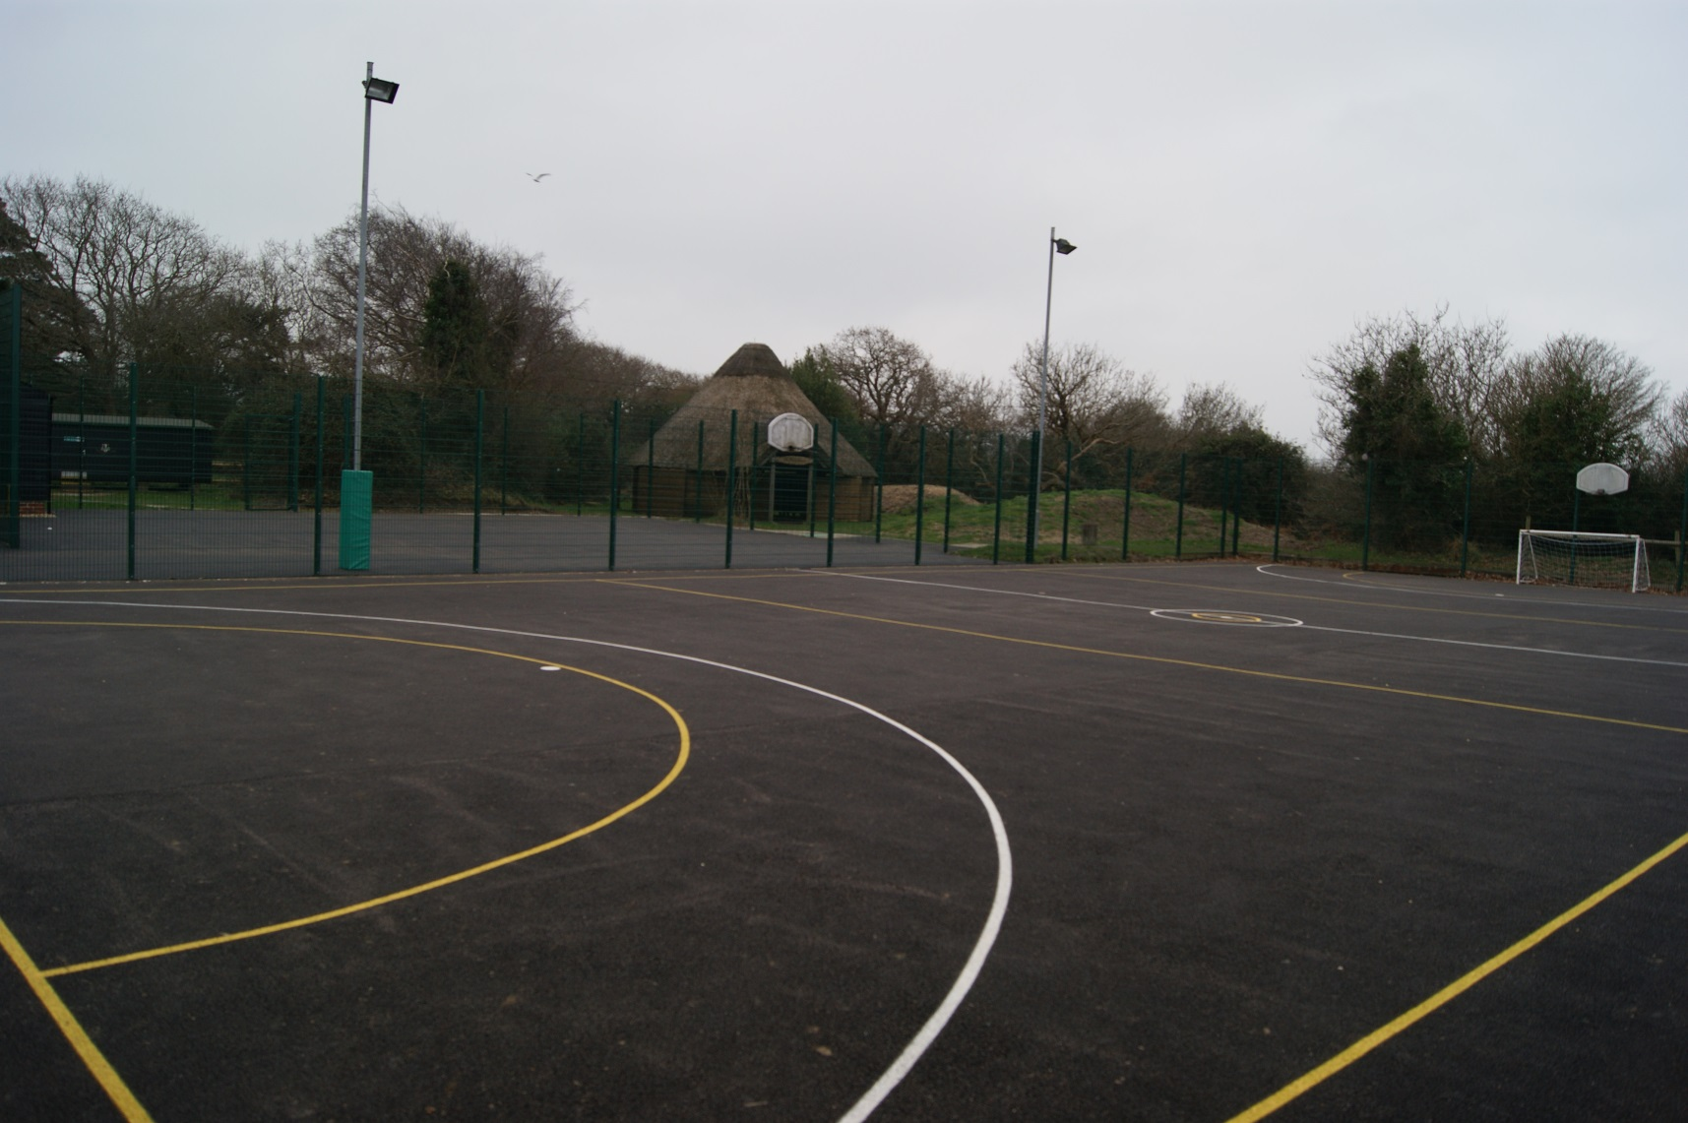
Our hard court areas

Slide 17
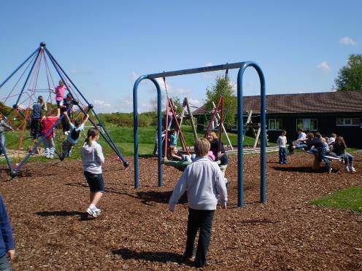
Our Adventure Playground
…only used under adult supervision.

Slide 18
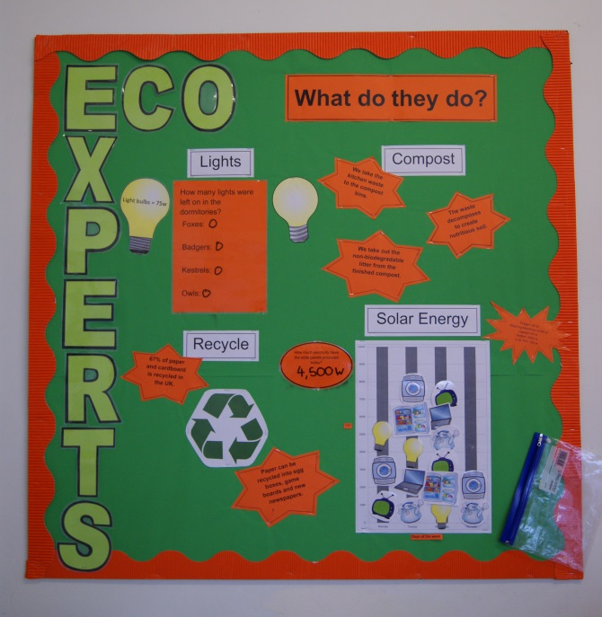
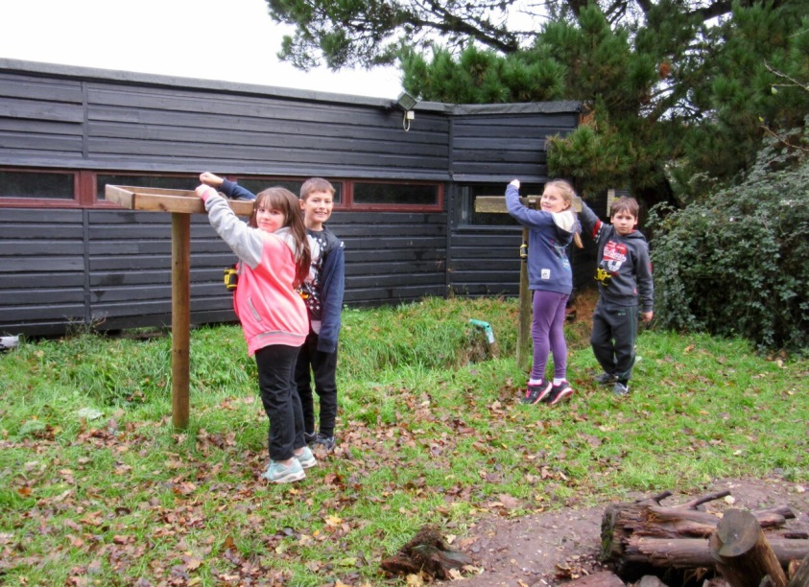
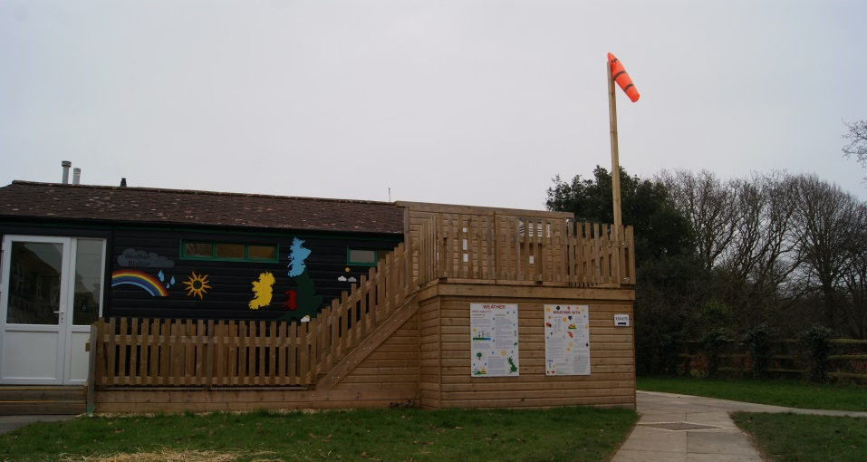
Weather, Bird and Eco-Experts

Slide 19
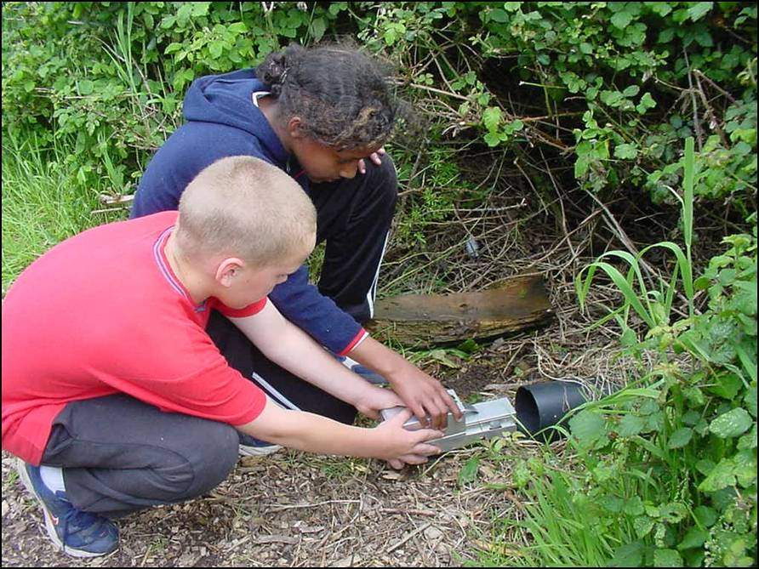
A Longworth small mammal trap
Good Luck!

Slide 20
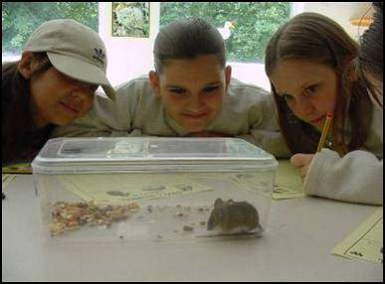
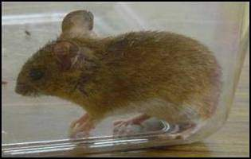
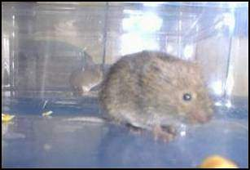
Mammal Study
I’m a Woodmouse
I’m a Bank Vole

Slide 21
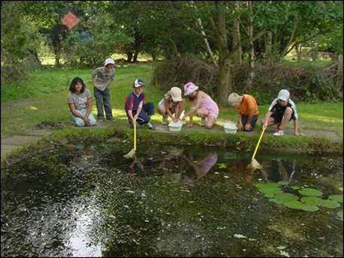
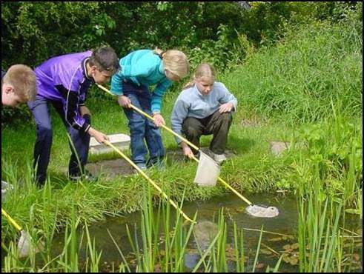
There are 7 well stocked ponds
Sunny Pond
Murky Marsh

Slide 22
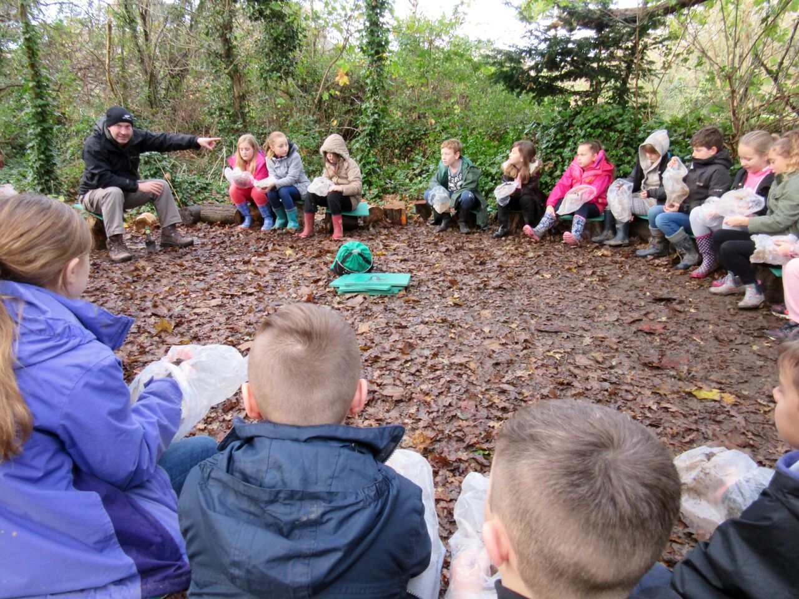

Most of the time will be spent working in our 'outdoor classroom‘!

Slide 23
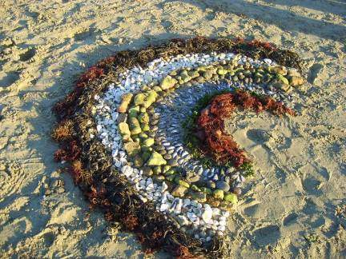
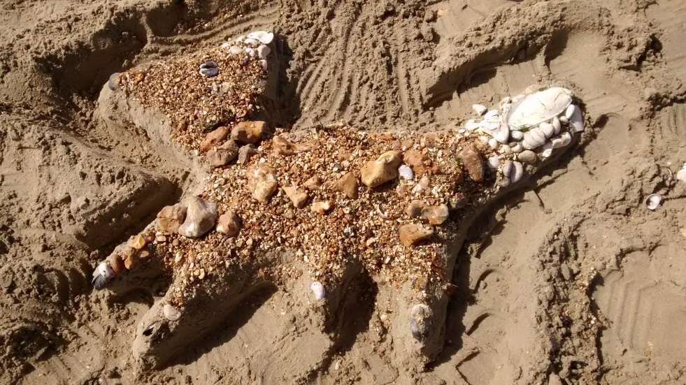
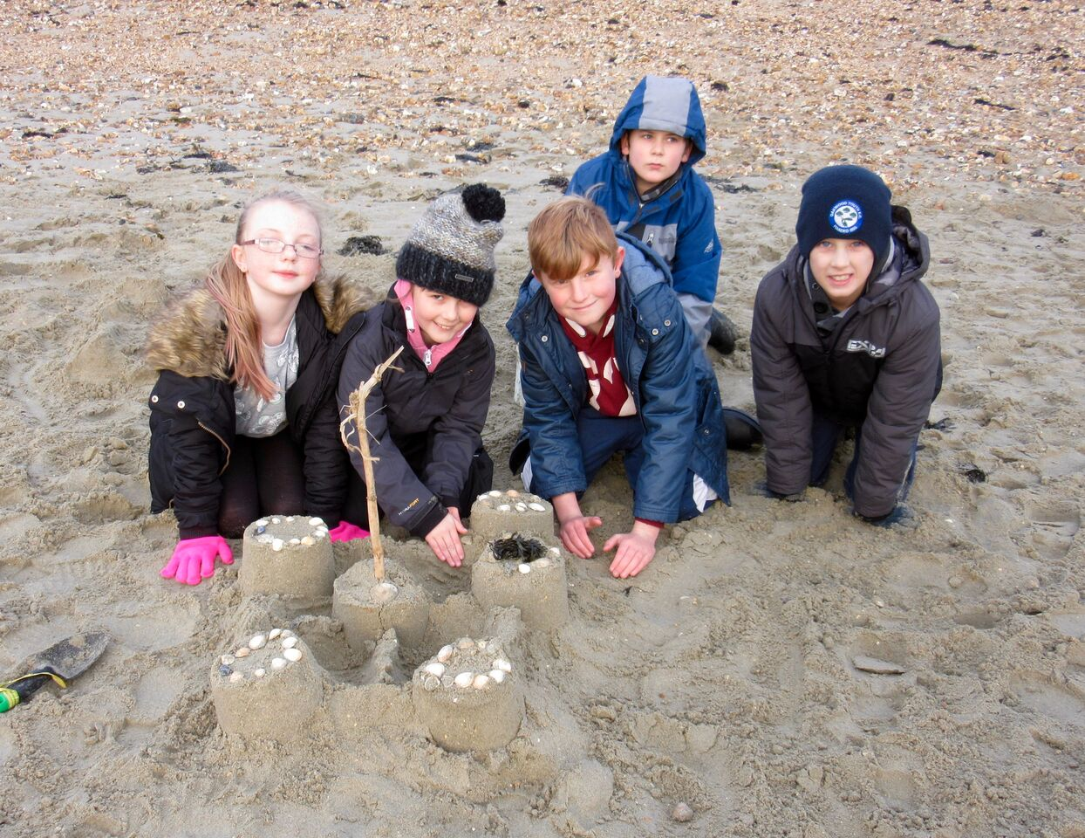
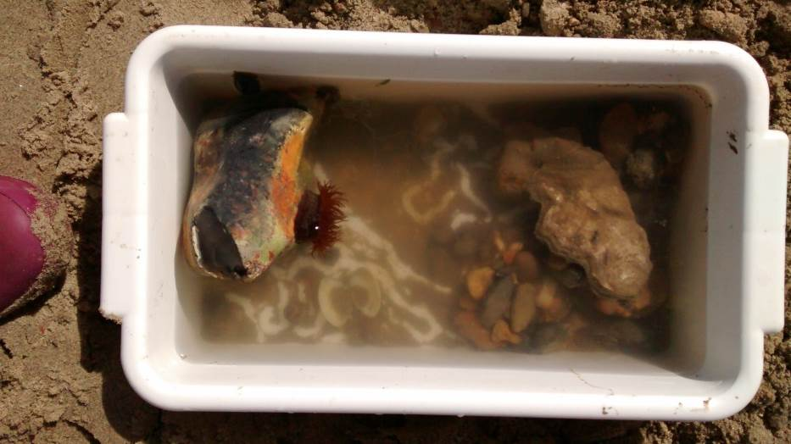
Seashore Activities: all seashore activities are led by a member of Centre staff.

Slide 24
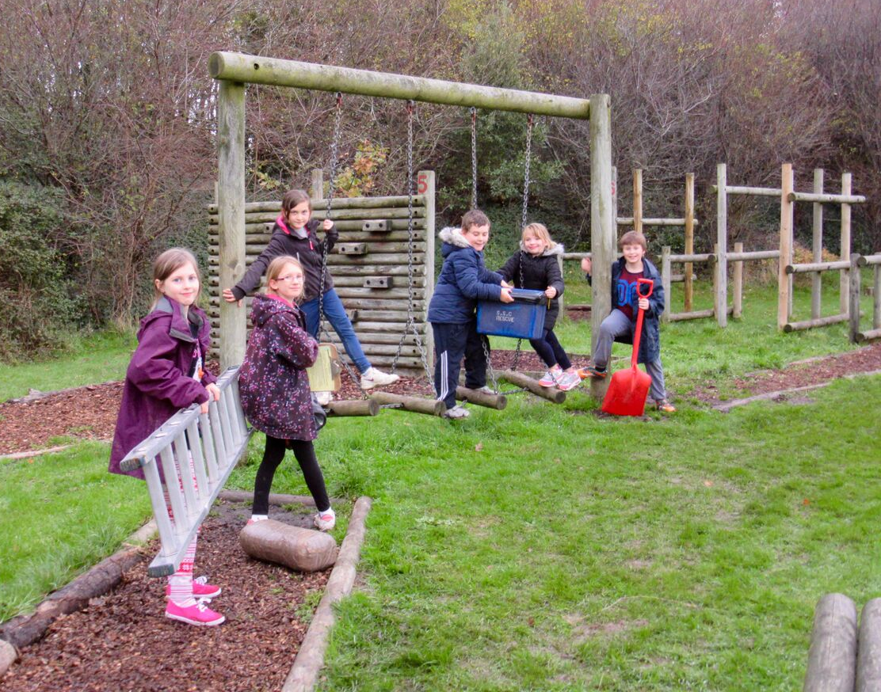


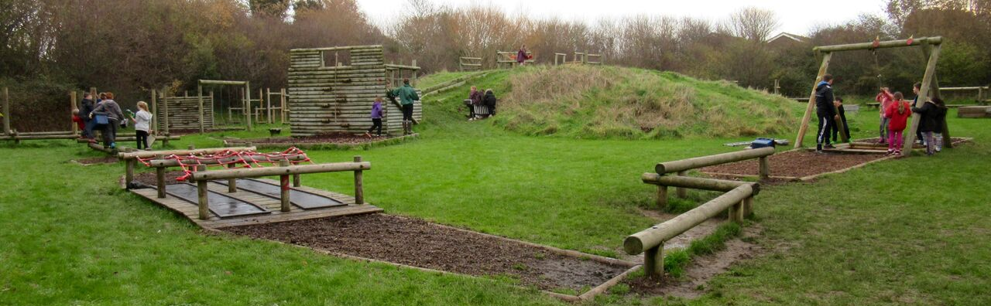

Slide 25
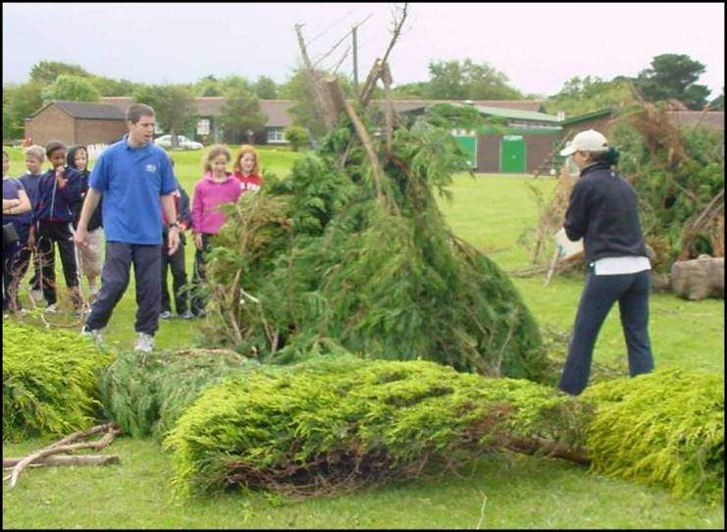
Shelter building and testing!
‘Here comes the rain !’

Slide 26
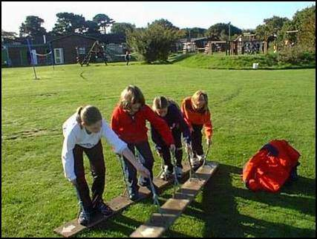
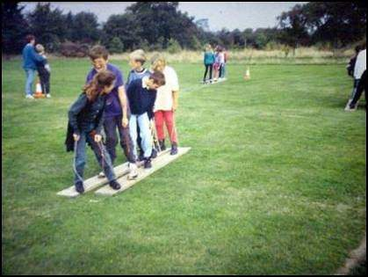
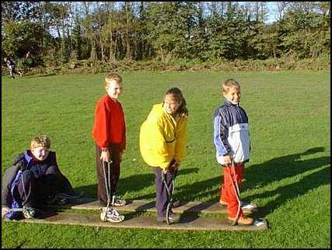
Walking
the
plank

Slide 27
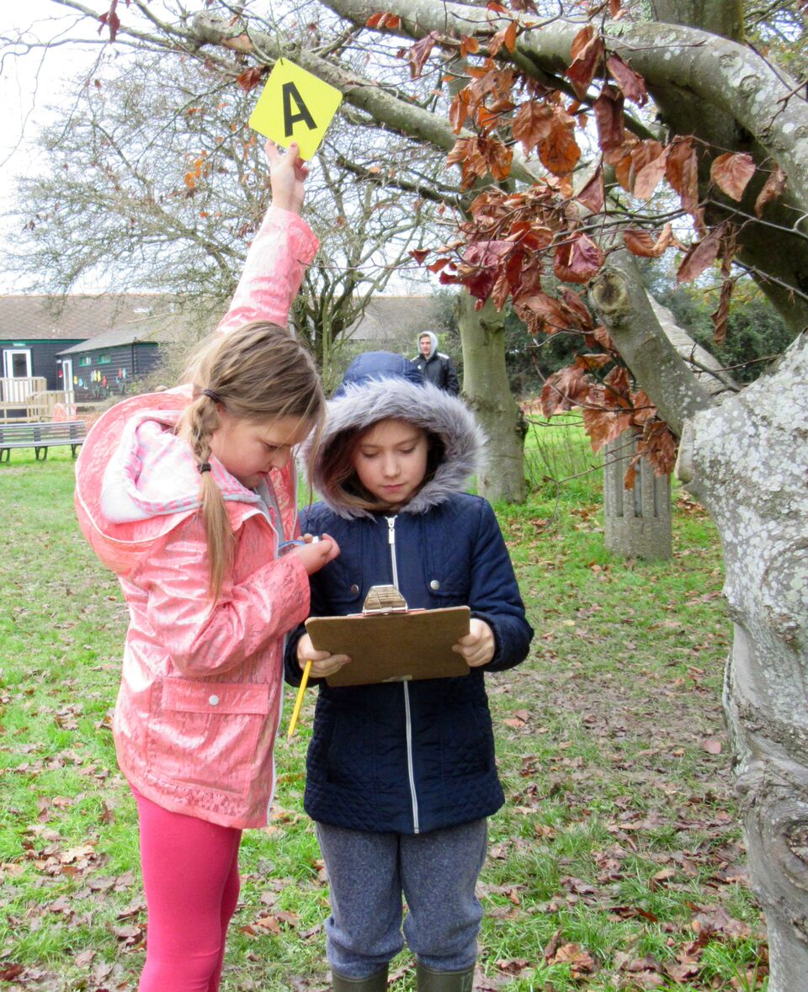
Orienteering

Slide 28
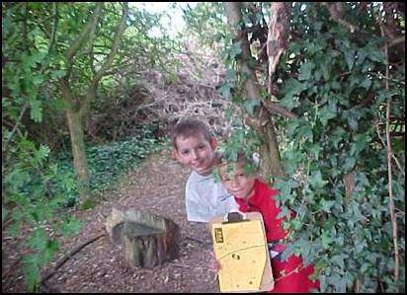
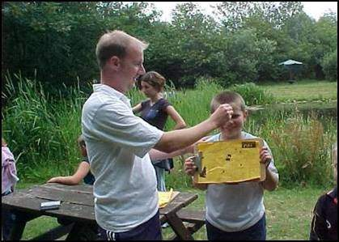


Stubbington Fox
Gotcha!

Slide 29




House Challenges

Slide 30

On-site first aid support

Slide 31



Children will visit the hide late one evening to spy on the wildlife.
Shhh! Here they come!

Slide 32


Bedtime Games

Slide 33
Lights out. Night night!
21:30
Good night!
Z
z
z

Slide 34

Friday 1:15pm the centre staff wave the children off (not necessarily on a coach though!).

Slide 35
When?
February 3rd, 4th, 5th, 6th, 7th
Who?
We are still checking which staff are available to support the trip. At least one member of staff who has experience of the trip will be leading (Probably Mr Abbott).
How much?
£250 in total. We would ask for an initial deposit of £50 then payments of £50 per month for 4 months, payable before December.

Slide 36
What has changed? The transport remains the same as last year with parents dropping off and picking up from Stubbington – this helps to reduce the overall cost; This year is a 5 day option; this time we are likely to have other schools with on site with us.
Why Stubbington?
It is unique, fantastic for nature and scientific study, good value for money, well-run, near to home but also far away. Overall, it a fantastic experience that creates lasting memories.

Slide 37
What if my child has any specific needs?
Talk to us at school first. SSC are very experienced at dealing with a whole host of medical and other issues.
They provide vast experience and great service every week of the year!
What next? We will send out a letter with details of signing up, payments etc…shortly.

