Slide 1
Notes:
The Sustainable Transport Team at Southampton City Council is encouraging schools to take part in International Walk to School Month.​
​
To celebrate we have created a special challenge for you!​
​
The “Step Up for Walktober Challenge” runs for the whole of October.​
​
We would like as many pupils, families, and staff as possible to travel actively to school for the month! ​
​
We’ll now tell you how to take part and why it’s a great thing to do!

Slide 2
What is Active Travel?
LEAVE THE CAR AT HOME
WALK
SCOOT
CYCLE
WHEEL
For longer journeys, you could Park and Stride or use the bus or train!
Notes:
The Step up for Walktober Challenge is all about Active Travel. But what exactly is Active Travel?
Active travel involves leaving your car at home as much as possible and choosing more active and environmentally friendly ways to make your journeys.
You could;
Walk,
Wheel,
Scoot,
Cycle,
If it is too far to travel actively for the whole journey, you can use the bus, train or, Park and Stride: travelling by car part-way and travelling actively for the last bit of the journey.

Slide 3
Step up and make a difference!
PLANET
WELLBEING
COMMUNITY
Leave the car at home to create less pollution! Cleaner air for all!
Exercise and time in nature is great for body and mind!
Active communities are busy friendly communities!
Do you think it is important to step up?
Notes:
Travelling actively can help make a positive change for our planet, our wellbeing and our community.
By choosing to leave the car at home in October you can make a big difference to:
The Planet. By walking, wheeling, scooting or cycling instead of using the car you create less pollution and cleaner air!
Your Wellbeing. Exercise and time in nature is good for our bodies and our minds!
Your Community. When we leave our cars at home we create vibrant, well-used streets, more time to spend with family and friends and opportunities to get to know your community.
Put up your hands if you think it is important to Step Up!

Slide 4
Walktober Pupil Challenge Card
STEP ONE:
MAKE AN ACTIVE TRAVEL PLEDGE
A pledge is a goal that you set for yourself.
Make your Active Travel Pledge fun and achievable!
You could pledge to:
"Walk to school at least once a week!"
"Use the Park and Stride to get to school."
"Go for a fun family bike ride!"
Notes:
I'm now going to tell you about the challenge we have for you!
The pupil challenge card is your opportunity to tell us how much and what kind of active travel you have done during Walktober.
The first step is to make an Active Travel Pledge- a pledge is a goal that you set for yourself. You could pledge to walk to school once a week or to go on a family bike ride. Whatever you decide, it is important to make it fun, achievable and active!

Slide 5
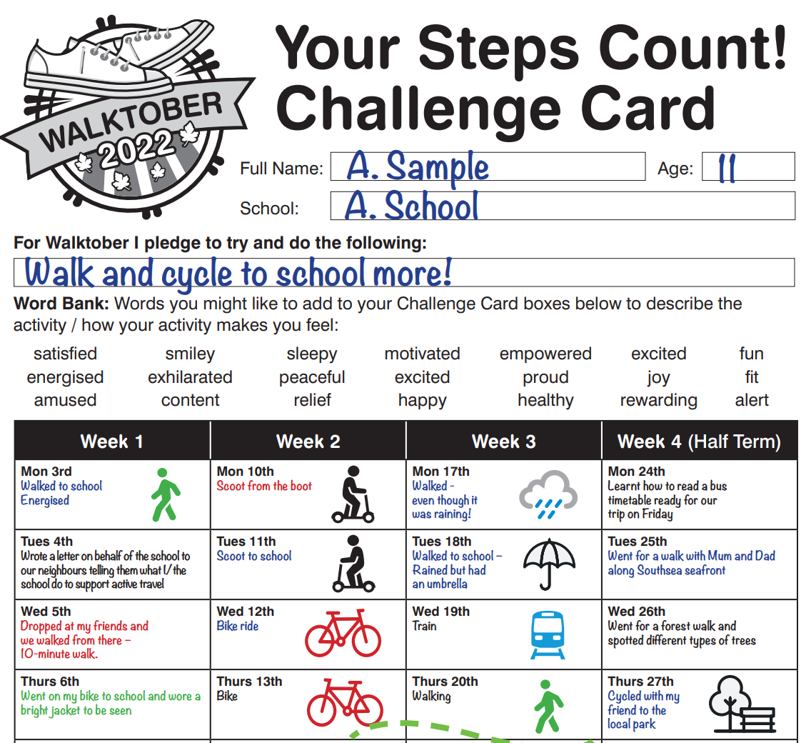
STEP 2:
RECORD YOUR ACTIVE TRAVEL ON THE WALKTOBER PUPIL CHALLENGE CARD
You don't need to record activity every day- just be as active as you can!
Top Tips
Include the activity you do during the evenings, weekends and holidays!
If you are already very active encourage others to join you!
Notes:
The next step is to keep a record of all your active travel on the Pupil Challenge Card. There's lots of different activities you can include- walking/wheeling to school, scooting to the park, cycling to a local shop, using Park and Stride, taking a bus instead of the car on a day trip- just to name a few!
Here you can see an example of a completed challenge card. You don't have to add an activity every day but rather as often as you can!
Why not also extend being active to after school, your weekends and half term – an autumnal visit to a local park, a family bike ride, a scavenger hunt, exploring your local area on a pumpkin trail?
These active choices are not only fun but make a big difference!

Slide 6
STEP 3:
SUBMIT YOUR CHALLENGE CARD
Parents and carers should submit challenge cards by
Friday 11 November.
WIN A PRIZE!
Family day out ticket and a goodie bag!
Please do share your fun-filled Walktober activities with us tagging #Walktober
Facebook - @myjourneyhants
Twitter - @MyJourneyHants
Instagram - @myjourneyhampshire
Notes:
The final step is for your parent or carer to submit your completed challenge card.
The deadline is Friday 11th November so you have plenty of time to get all your active travel recorded.
There are some fantastic prizes to be won including a family day out voucher and goodie bag for Early Years and Primary level.
Put your hand up if you are going to be extra active this October and Step up for our Planet, Wellbeing and Community!
Fantastic! Please do share your fun-filled Walktober activities online tagging #Walktober

Slide 7
Thank you. Have fun and good luck!
Notes:
We hope you have a fun-filled and active Walktober!
Remember, all you have to do is,
Make an active travel pledge,
Record your active travel,
Ask a parent or carer to submit your Challenge Card.
Thank you for listening.

