Slide 1
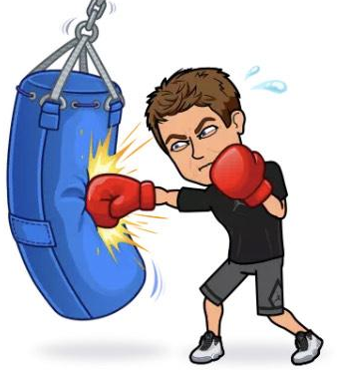
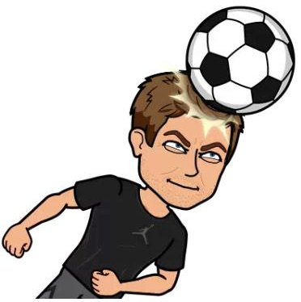
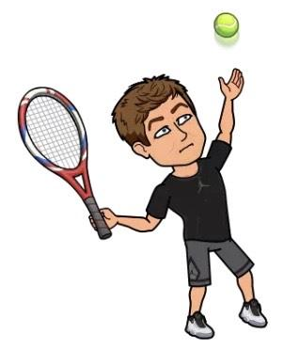
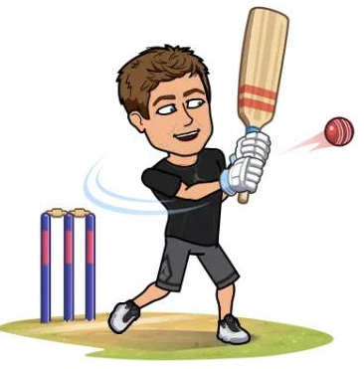
Transition Day 2
SWS PE “Train like a pro” Challenge

Slide 2
The aim of this challenge is to improve your personal fitness levels, and keep you active and healthy.
These challenges are physical and will require you to be sensible and thoughtful when completing them. Please consider your clothing, the equipment you are using and the area in which you are exercising.
Please give this task your best, as you would in your PE lessons in school. As always in PE we value integrity and sportsmanship, so be honest with the results of your workout or fitness challenge. Strive to beat your personal best, and achieve greatness.
Good luck and have fun!
Team SWS PE!

Slide 3
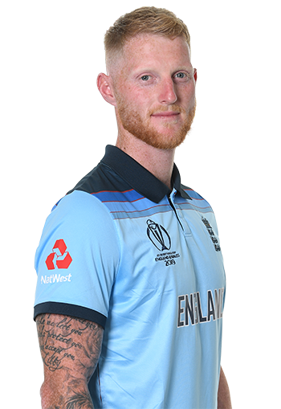
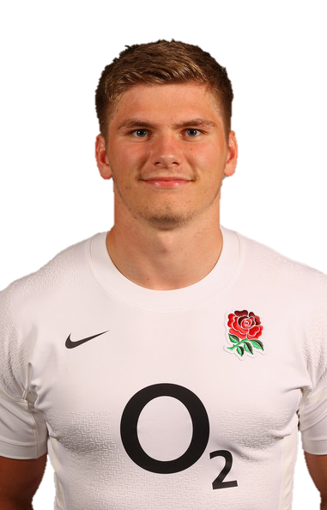
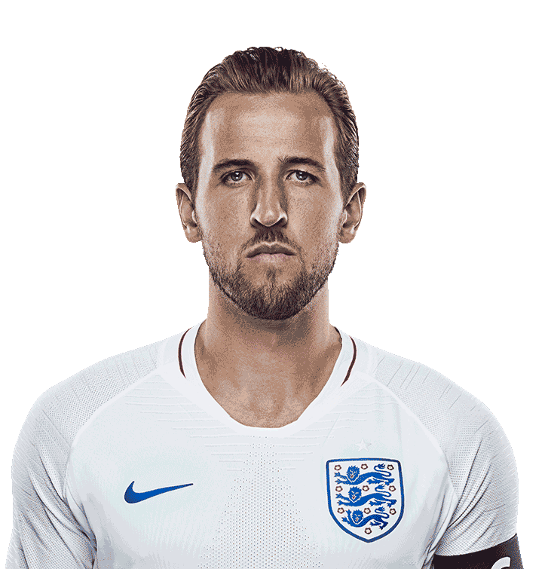
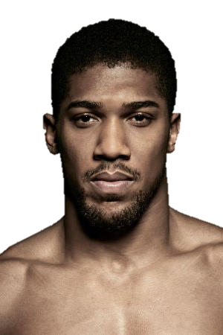
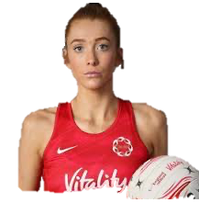
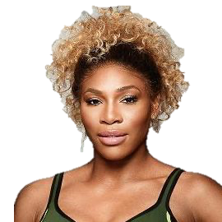
Train like a pro
Within professional sport, athletes require specific fitness to remain at the top of their game. You will be selecting your favourite athlete today to complete a specific workout.
Each athlete has their own workout and scoring system to help you track your progress.
How many of the 6 athletes can you name before moving on?

Slide 4
Train like a pro- How to compete the challenge
Step 1- Select one of the 6 athlete workouts for the lesson.
Step 2- Complete the workout listing your score.
Step 3- You can complete the chosen workout as many times as you like to score as many points as possible within each workout.
Step 4- Let your know teacher know which athlete you selected and how you found their workout.

Slide 5
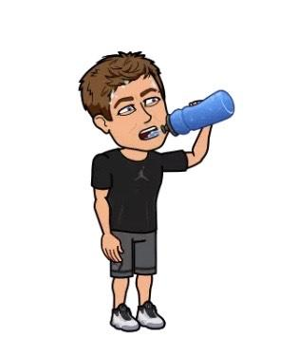
Before you start
Make sure you have your water bottle
Make sure you are in a safe space
Read through all of the exercises
Ensure you are in a safe space and wearing comfortable clothing.

Slide 6
Athlete 1- Ben Stokes (Cricket Fitness)
Exercise | Runs Scored
Shuttle Runs x10 | 6
Star Jumps x20 | 6
High Knees (1 min) | 4
Sit-ups x20 | 2
Crunches x20 | 6
Mountain Climbers (1 min) | 4
Plank (1 min) | 4
Squats x20 | 4
Squat Jumps x20 | 6
Burpees x15 | 4
Press Ups x10 | 2
Bicep Curl x20 | 6
How many runs did you score?

Slide 7
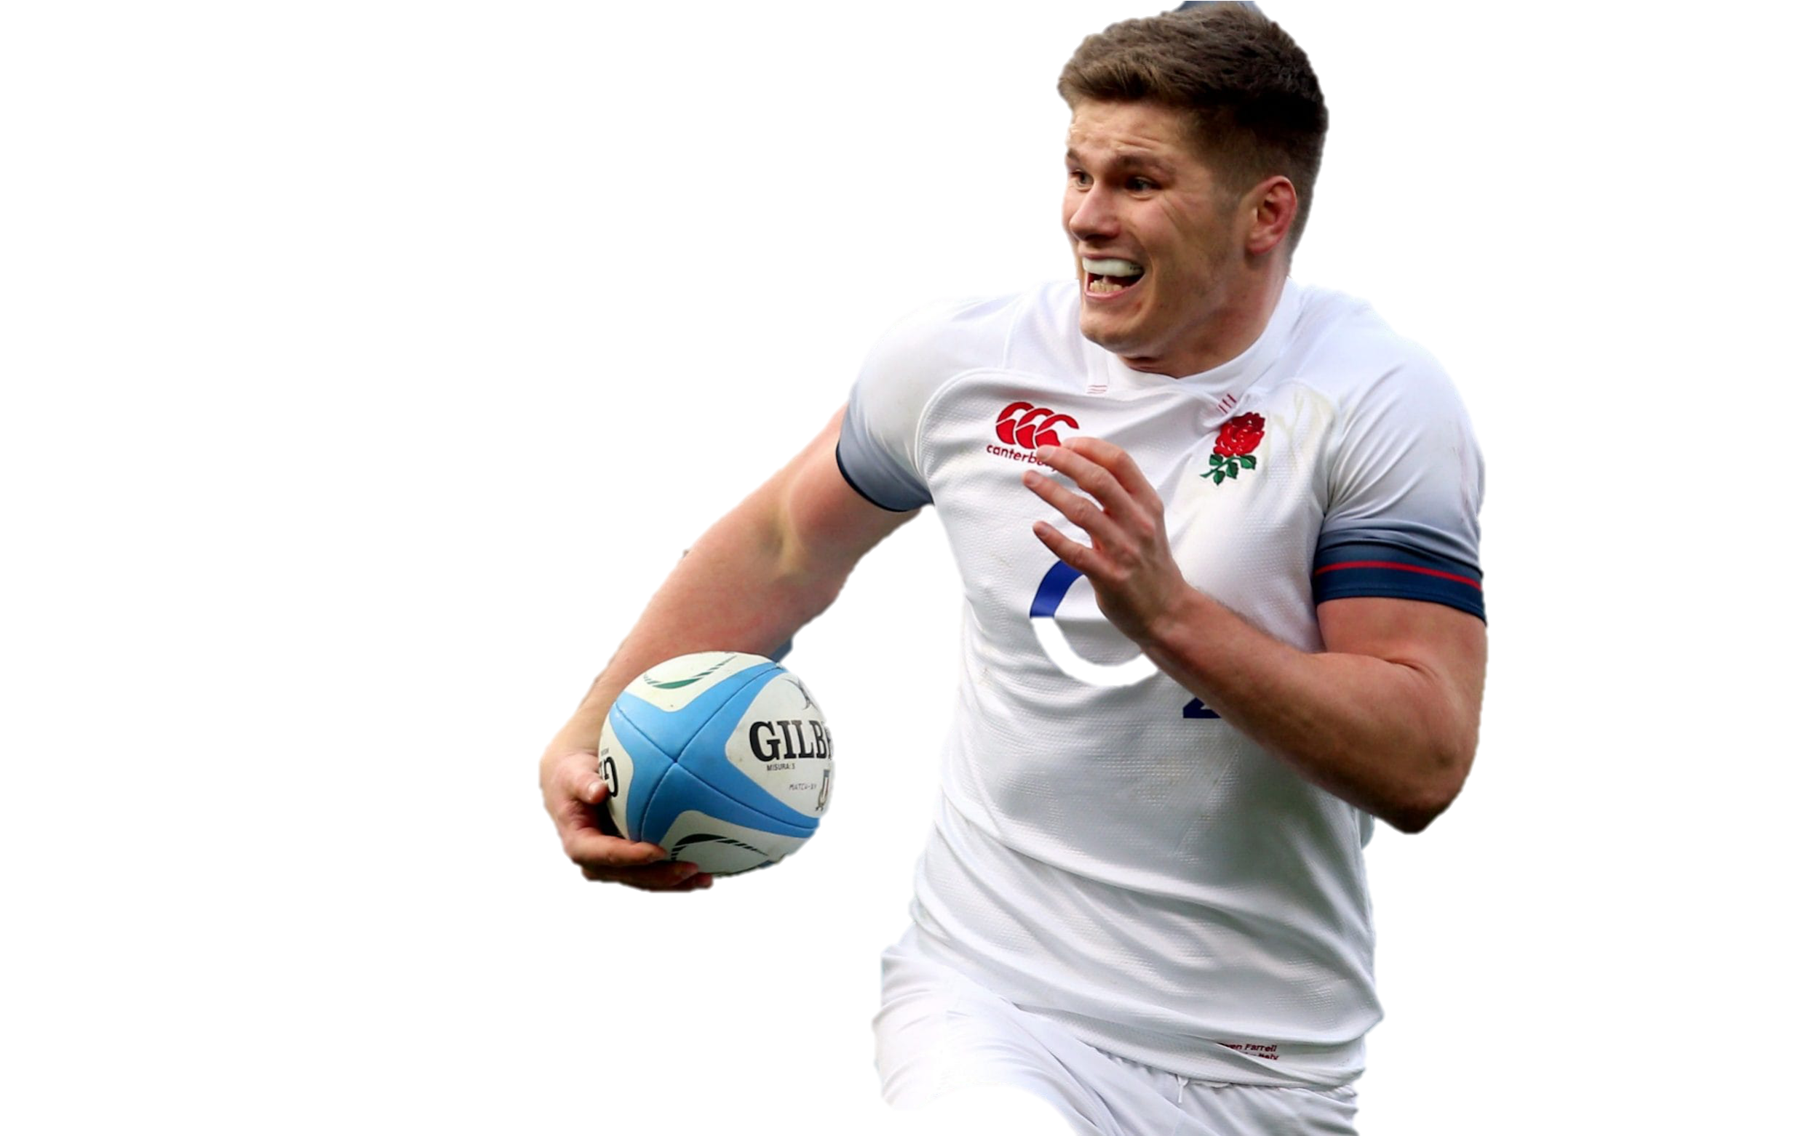
Athlete 2- Owen Farrell (Rugby Fitness)
Click on the picture of Owen to witness him in action
Exercise | Points Scored
Shuttle Runs x10 | 5
Star Jumps x20 | 2
High Knees (1 min) | 5
Sit-ups x20 | 2
Crunches x20 | 2
Mountain Climbers (1 min) | 5
Plank (1 min) | 5
Squats x20 | 2
Squat Jumps x20 | 5
Burpees x15 | 5
Press Ups x10 | 2
Bicep Curl x20 | 2
How many points did you score?

Slide 8
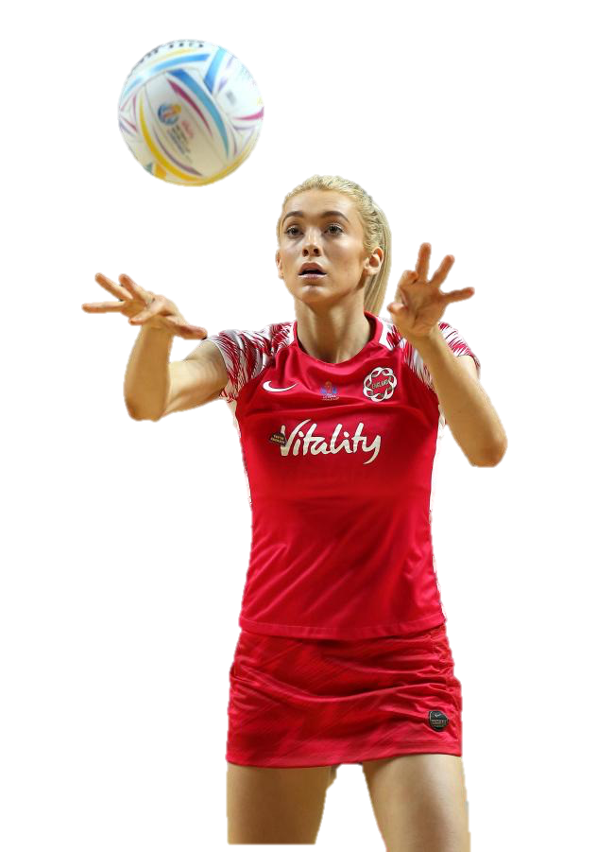
Athlete 3- Helen Housby (Netball Fitness)
Click on the picture of Helen to witness her in action
Exercise | Points Scored
Shuttle Runs x10 | 2
Star Jumps x20 | 1
High Knees (1 min) | 1
Sit-ups x20 | 2
Crunches x20 | 2
Mountain Climbers (1 min) | 1
Plank (1 min) | 2
Squats x20 | 2
Squat Jumps x20 | 2
Burpees x15 | 1
Press Ups x10 | 2
Bicep Curl x20 | 2
How many points did you score?

Slide 9
Athlete 4- Harry Kane (Football Fitness)
Exercise | Goals Scored
Shuttle Runs x10 | 2
Star Jumps x20 | 1
High Knees (1 min) | 1
Sit-ups x20 | 2
Crunches x20 | 2
Mountain Climbers (1 min) | 1
Plank (1 min) | 2
Squats x20 | 2
Squat Jumps x20 | 2
Burpees x15 | 1
Press Ups x10 | 2
Bicep Curl x20 | 2
How many goals did you score?

Slide 10
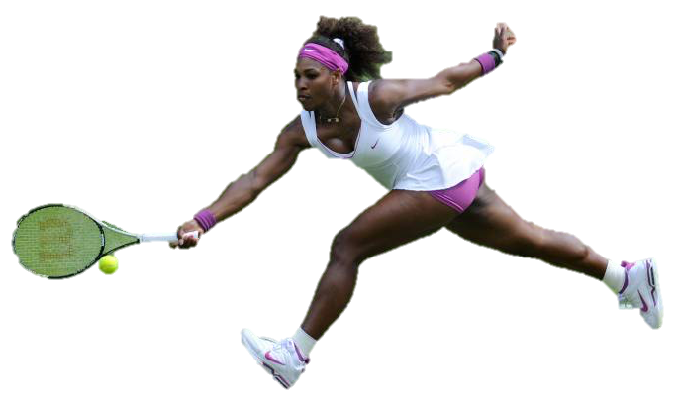
Athlete 5- Serena Williams (Tennis Fitness)
Exercise | Games Won
Shuttle Runs x10 | 2
Star Jumps x20 | 1
High Knees (1 min) | 2
Sit-ups x20 | 1
Crunches x20 | 1
Mountain Climbers (1 min) | 2
Plank (1 min) | 2
Squats x20 | 1
Squat Jumps x20 | 2
Burpees x15 | 2
Press Ups x10 | 2
Bicep Curl x20 | 1
How many games did you win?

Slide 11
Athlete 6- Anthony Joshua (Boxing Fitness)
Rounds | Points Won
Shuttle Runs x10 | 10
Star Jumps x20 | 10
High Knees (1 min) | 10
Sit-ups x20 | 10
Crunches x20 | 10
Mountain Climbers (1 min) | 10
Plank (1 min) | 10
Squats x20 | 10
Squat Jumps x20 | 10
Burpees x15 | 10
Press Ups x10 | 10
Bicep Curl x20 | 10
How many points did you win?

Slide 12
You’re all done! Let your teacher know how you did to pass onto the SWS PE staff!

