Slide 1
WELCOME TO SIR WILLIAM STANIER
NEW CATERING EXPERIENCE
We are delighted to introduce ourselves as the new catering partner at Sir William Stanier School. We are excited to be working in collaboration with the brilliant team at the school to bring a fresh, new outlook to the catering experience.
MORE THAN FOOD
Whilst first and foremost, we are caterers, we believe that what we do is more than just food. We are in a unique position where we are able to nurture and educate through the food we serve.
Forming healthy eating habits is a valuable part of your child’s education. 85% of our food is freshly prepared on site and is in line with the English Government guidelines, ensuring that the students at Sir William Stanier School are fuelled by good food, enabling them to reach their full potential.
INSIGHT & INNOVATION
The food that we serve is created with insight in mind and shaped by the latest food trends throughout the world. We create brands and dishes that rival the high street and whilst we do have traditional favourites on our menus, our street food and global cuisine prove extremely popular.
The food that we serve is ever evolving and is complimented by a calendar of events, filled with seasonal campaigns, theme days and new menu launches.
A PARTNERSHIP
Most importantly, we are here as an extended part of the school’s family. If your child has any specific dietary requirements, or you just want to talk to us, our team will be more than happy to talk to you to answer any questions or queries that you may have.
Above all, we are here to ensure that the food we serve is tasty, the pupils are happy and that we make dining at Sir William Stanier School as exciting and as fun as possible!
We can’t wait to get started
Gwen Davies
Group Manager | Aramark
davies-gwen@aramark.co.uk

Slide 2
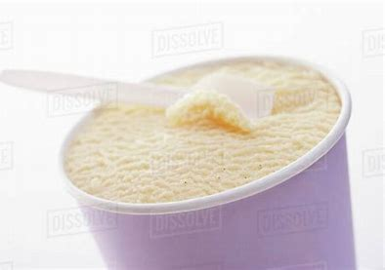
COMPANY THEME DAYS
Celebrating Summer
Ice Creams, Lollies & Shakes
Japan Theme day 8th June
Simply Meal Deal
Food Waste Hero Recipes
National Picnic Week 19th – 23rd
Eat the Seasons
BBQ Theme Day 29th June
Lunchtime Competitions

