Slide 1
Welcome to Drama
Treasure Island

Slide 2
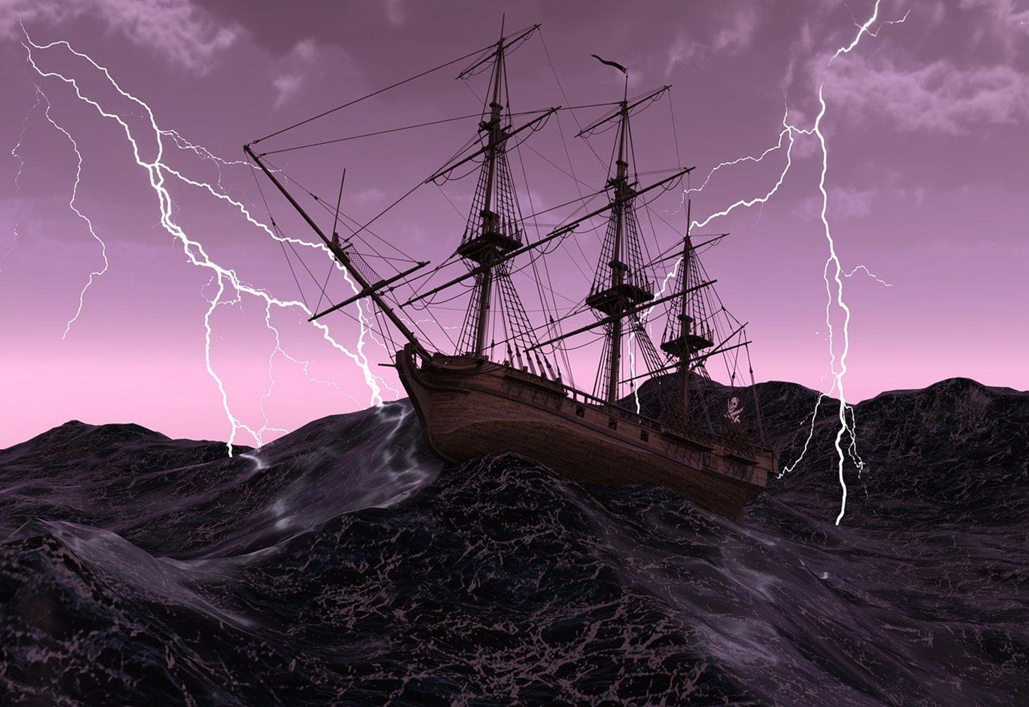
Welcome Young Pirates….
I want you to hop on one leg for 15 Seconds!
Hard isn’t it?
Try and walk around the space on the opposite leg, how does this affect your walk?
I now want you to give us your best pirate voice and say…
“Arr give me all your treasure”
Notes:
https://www.youtube.com/watch?v=f7Cpkup4g3I
https://www.youtube.com/watch?v=9A6XcFE4CL8

Slide 3
LEARNING OBJECTIVES
To look at the story of Treasure Island
To create a character and write a short pirate monologue
To design a costume for a pirate
Drama Faculty

Slide 4
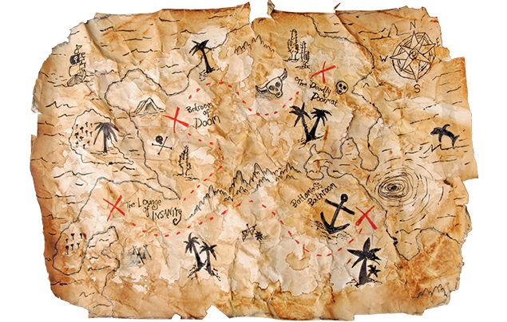
Treasure Island
The Plot-
Fifteen men on a dead man's chest...
The story follows young Jim Hawkins who finds himself a treasure map. Yearning for adventure he decides to follow the map and find the treasure. He enlists the help of several local “sailors” to help obtain this treasure
Or what he believes to be sailors……….
Notes:
https://www.youtube.com/watch?v=9wuCkgL_44s&feature=emb_title

Slide 5
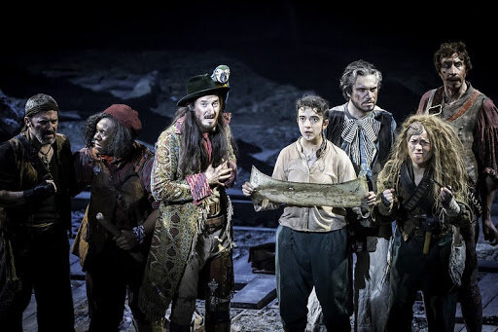
Treasure Island
Characters-
This the crew of the Hispaniola to join their adventure you must first declare you alliance…..
Notes:
https://www.youtube.com/watch?v=9wuCkgL_44s&feature=emb_title

Slide 6
Treasure Island
You are going to make your oath to Jim as to why you should join his ship. Are you a pirate or are you just looking for adventure-
I Oreo Cheesedodger, Swear that I will be the most scariest and loyal shipmate you have ever seen. I am the best at fighting sea creatures and I have sword fighted the most deadliest pirates even Captain Jack Sparrow of the black Pearl. I will jump onto any ship and sweep any deck. My adventure awaits…….
Notes:
https://www.youtube.com/watch?v=9wuCkgL_44s&feature=emb_title

Slide 7
Treasure Island
You are going to make your oath to Jim as to why you should join his ship. Are you a pirate or are you just looking for adventure-
I________, Swear that I will be the most _______shipmate you have ever seen. I am the best at _______________
____________ The most deadliest pirates are even _____ of me even Captain ________of the black Pearl. I will___________________. My adventure awaits…….
Key Words:
Dangerous
Brave
Bold
Scary
Funny
Kind
Key Words:
Fighting
Cleaning
Video Games
Jumping
Football
Dancing
Notes:
https://www.youtube.com/watch?v=9wuCkgL_44s&feature=emb_title

Slide 8
Treasure Island
What does your Pirate look like?
You have been accepted onto the Hispanolia but what does your pirate wear…..
Use the examples and design me what costume would your deadly pirate wear.
Is it a big red coat, do you have a hook for a hand? Are you missing a eye? Are the clothes damaged?
Notes:
https://www.youtube.com/watch?v=9wuCkgL_44s&feature=emb_title

Slide 9
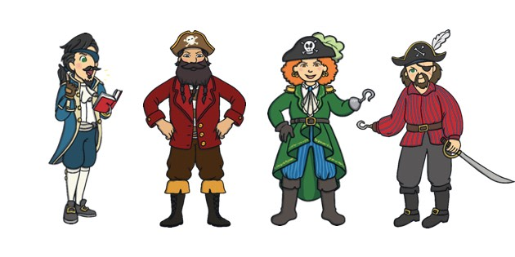
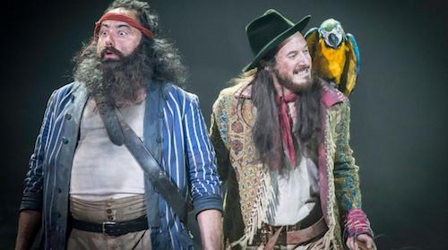
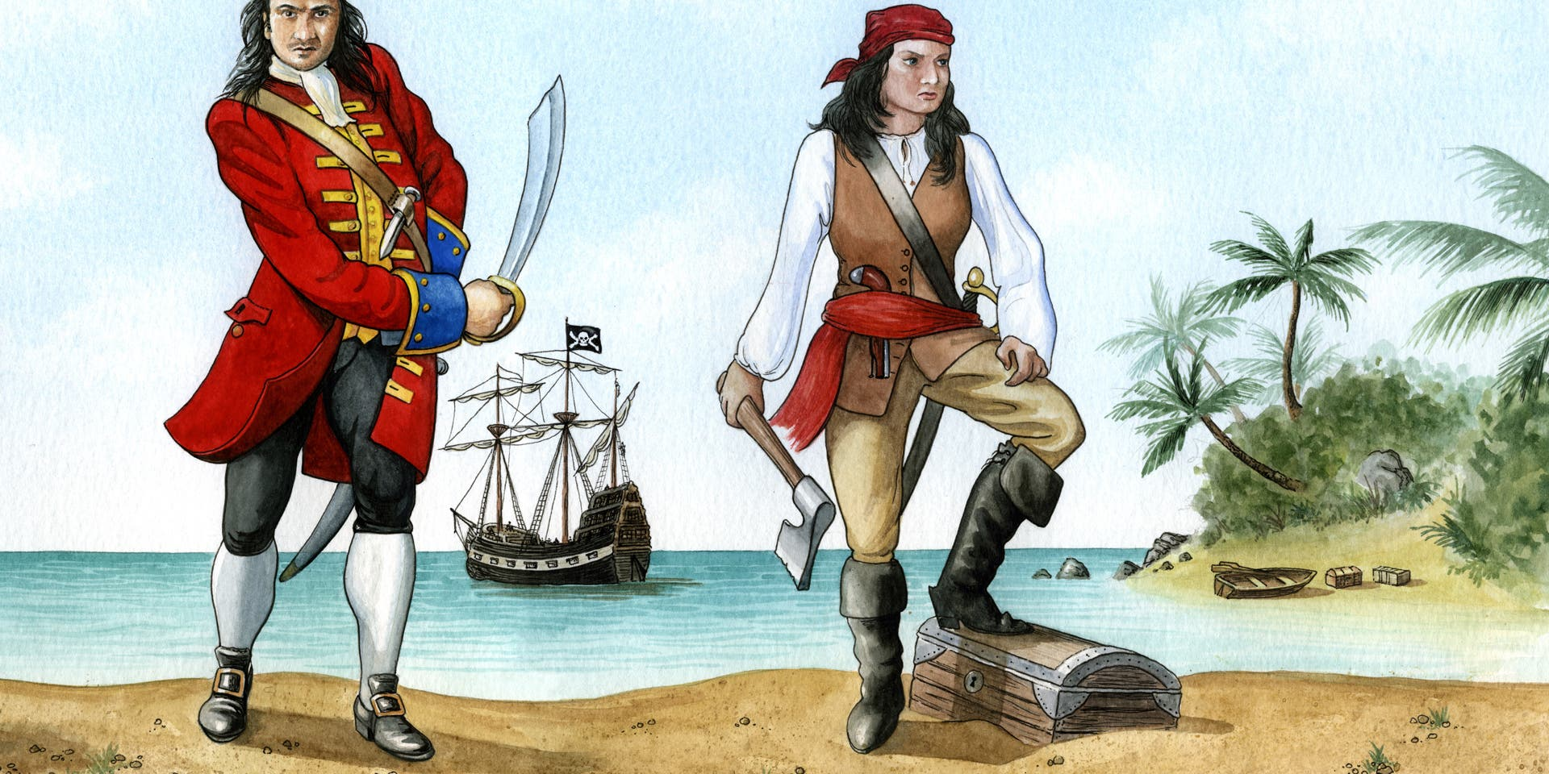
Treasure Island
What does your Pirate look like?
Notes:
https://www.youtube.com/watch?v=9wuCkgL_44s&feature=emb_title

Slide 10
Treasure Island
What does your Pirate look like?
Notes:
https://www.youtube.com/watch?v=9wuCkgL_44s&feature=emb_title

Slide 11
What does your Pirate look like?
What costume would your deadly pirate wear.
Is it a big red coat, do you have a hook for a hand?
Are you missing a eye? Are the clothes damaged?
Wooden hook for a hand
Big black metal boots
Notes:
https://www.youtube.com/watch?v=9wuCkgL_44s&feature=emb_title

