Slide 1
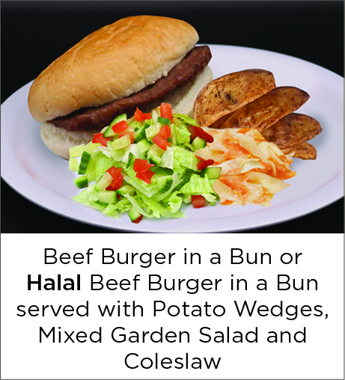
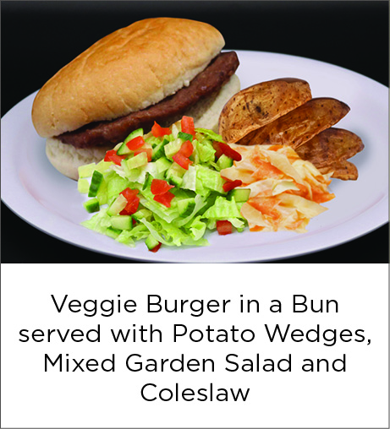
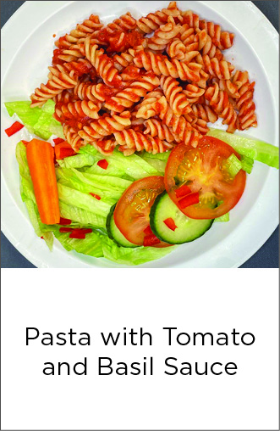


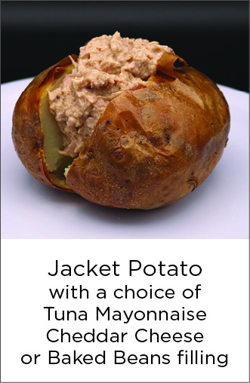
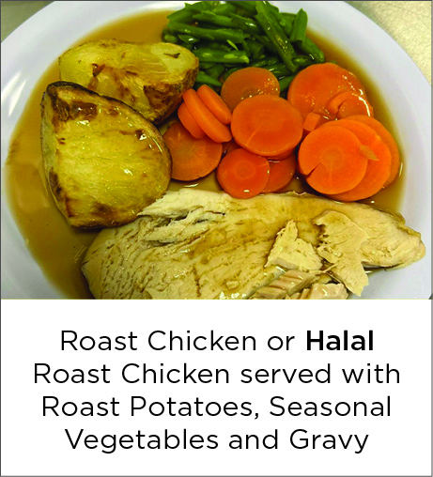




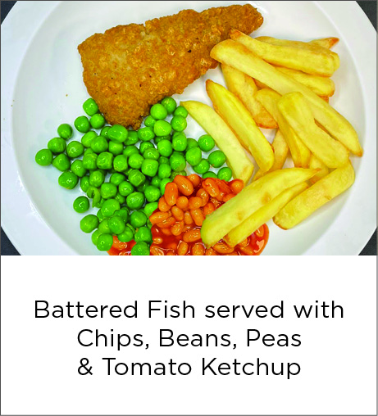

Sitwell Infants & Juniors - Week 1 Menu
Week Commencing: 13th April, 4th May, 1st June, 22nd June, 13th July, 31st August,
21st September, 12th October 2026

Slide 2





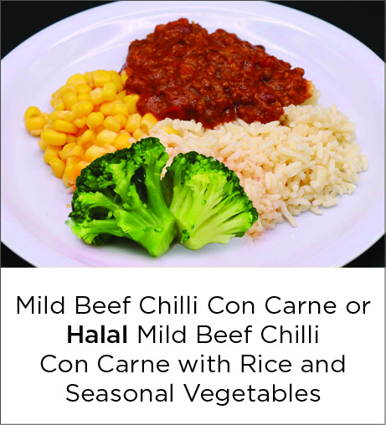
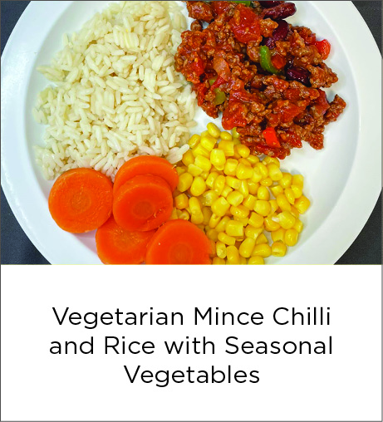
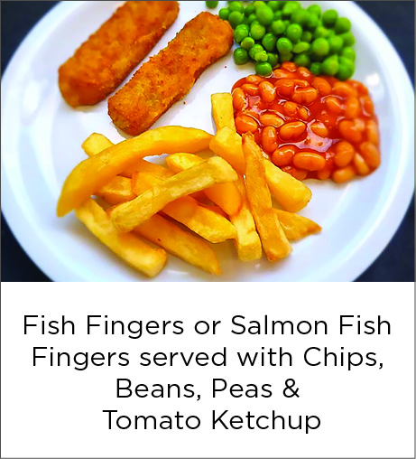

Sitwell Infants & Juniors - Week 2 Menu
Week Commencing: 20th April, 11th May, 8th June, 29th June, 7th September,
28th September, 19th October 2026

Slide 3







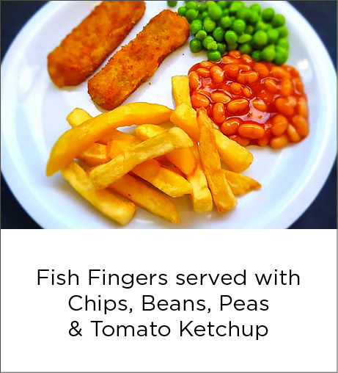
Sitwell Infants & Juniors - Week 3 Menu
Week Commencing: 27th April, 18th May, 15th June, 6th July, 14th September,
5th October 2026

