Slide 1
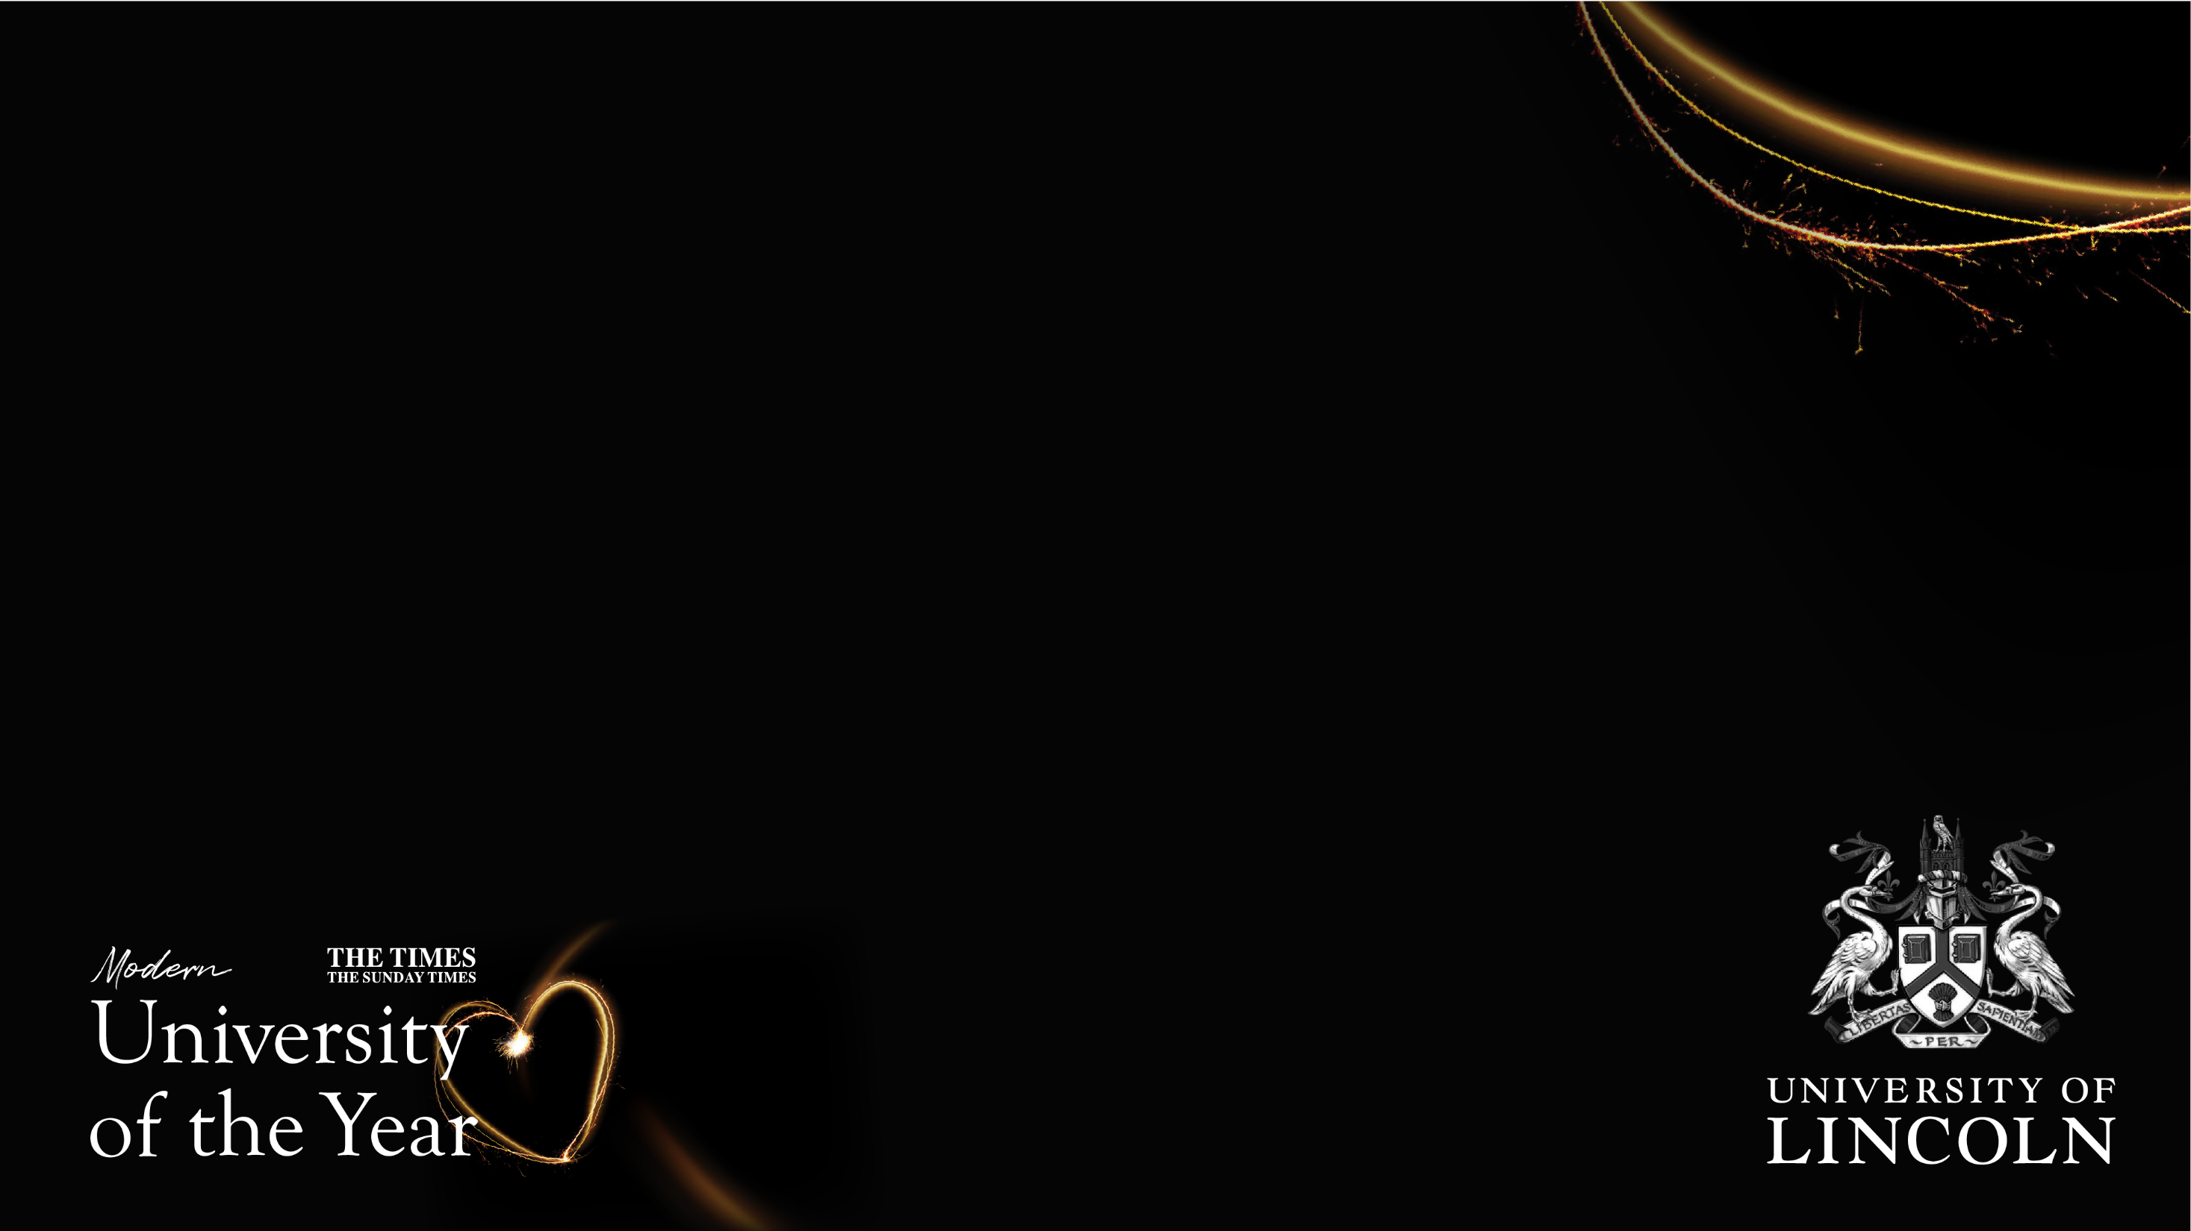
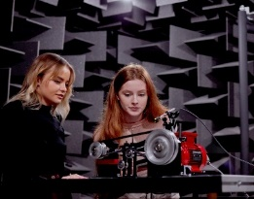
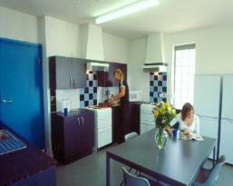

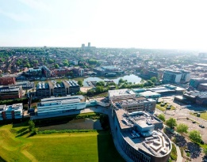
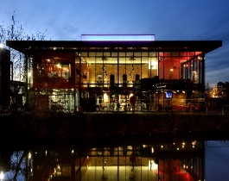
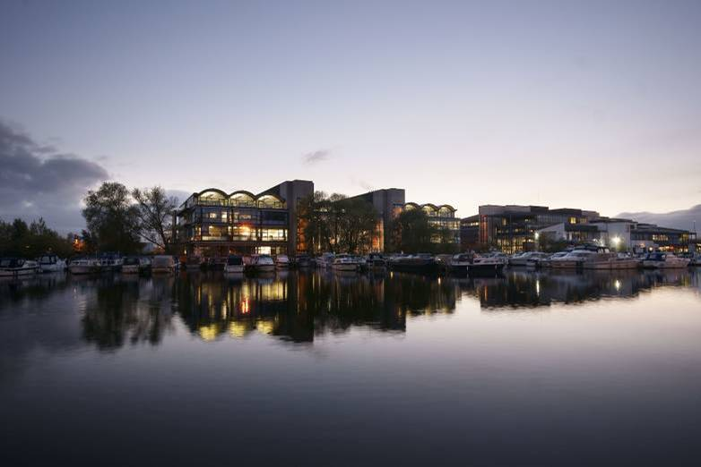
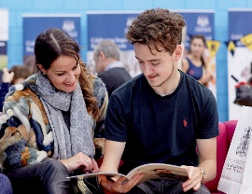


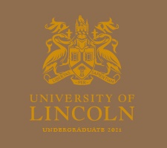



There are many great reasons why our students and staff are proud of the University of Lincoln, including our award-winning teaching, world-leading research, and close links with industry. Situated in the heart of a beautiful and historic city, we are the Modern University of the Year in The Times and The Sunday Times Good University Guide 2021. Employers are increasingly looking for individuals who can make a difference in today’s global workplace. With our expert staff, modern facilities, close links with business, and pioneering research we aim to provide the tools you need to achieve your career aspirations.
Be the change at Lincoln
Accommodation
Student Support
Campus Tour
Student Union
University of Lincoln
Find your course
Parents’ Zone
Scholarships and Bursaries
Your prospectus
Open days & campus visits
Chat with a student
Lincoln on Demand

