Slide 1
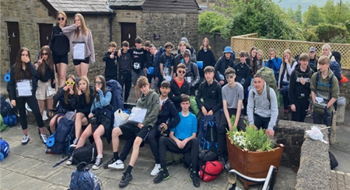

Duke of Edinburgh Scheme Volunteering Scheme

Slide 2
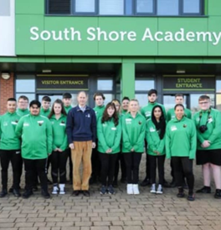
Opportunities
The Duke of Edinburgh Award Scheme challenges young people aged 14 to 25 throughout the world to serve others, acquire new skills, experience adventure, and make new friends. The Duke of Edinburgh Award is a nationally recognised student qualification. The DofE Award can give you the edge when you apply for college, university or a job.
For the young people that take part in D of E, the benefits of achieving a DofE Award are endless.
It’s difficult to list them all here… but it’s about having fun, how pushing yourself to do new things will help you to grow in confidence, improving resilience and developing useful life skills.
The DofE is about helping young people along the path to a productive and prosperous future.
Students at SSA participating in DofE can expect to gain valuable experience of working with others both through voluntary work and through teamwork. Students can build their self-confidence by setting individual goals. They will go exploring, discover new things about the world around them, and hopefully also discover something new about themselves. It’s all about setting personal challenges and pushing personal boundaries.
This will involve them helping the community/environment, becoming fitter, developing new skills, planning, training for and completing an expedition.

Slide 3
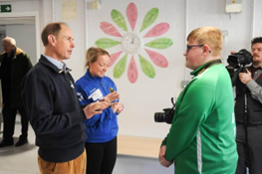
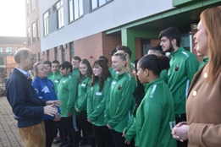
South Shore Academy
At SSA we ensure that any young person can do their DofE award regardless of ability, gender, background, or location. We work closely with the D of E Award and bid for funding throughout the year, that allows our young people to participate for free, ensuring inclusion and achievement for all. We were honoured to host HRH Prince Edward Duke of Edinburgh, who came to see first hand the fantastic award scheme we have here at SSA
We hold our own Independent Operating Authority License and are also a recognised Directly Licenced Centre.
Achieving the award isn’t a competition or about being first, it’s about finding the right path for themselves as an individual.

Slide 4
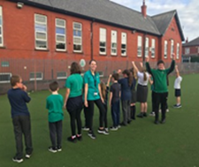
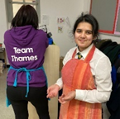

Enrolment for the Bronze Award
Here at South shore Academy, we invite students in Year 10, to enrol on the Bronze Award.
There are four sections to complete for this Award level. These are:
Volunteering – all students must volunteer for a minimum of 3 months; at least an hour a week in something that involves helping others. We have good relationships with our feeder primary schools and students will support these primaries in their afterschool club delivery of their extra-curricular programme. This can involve helping in sports clubs, drama, lexonics and all number of different activities. We also have an amazing library within the school who run events and recruit student librarians that help to facilitate the running of it.

Slide 5
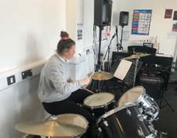
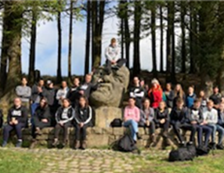
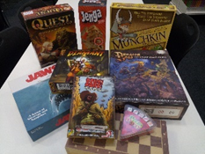
Enrolment for the Bronze Award
Skill Section – students must commit to learning a new skill. This must again be for a minimum of 3 months for 1 hour a week. Here is a link to some ideas for the skill section programme_ideas_-_skills.pdf (dofe.org)
Physical – In this section students have committed to 6 months of physical activity. Here at Southshore we run a Wednesday Afterschool D of E Physical night, where students attend and take part in a range of physical activities from Trampolining, Dodgeball and Football. We also have great links within the Blackpool Active community that allow our participants use of the Palatine Sports Centre gym facility.
Expedition – This always seems to be the most exciting section, where students must spend a few days away camping. They are partly supervised but must remain self-sufficient throughout the weekend.

Slide 6
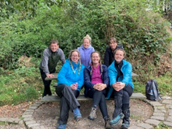
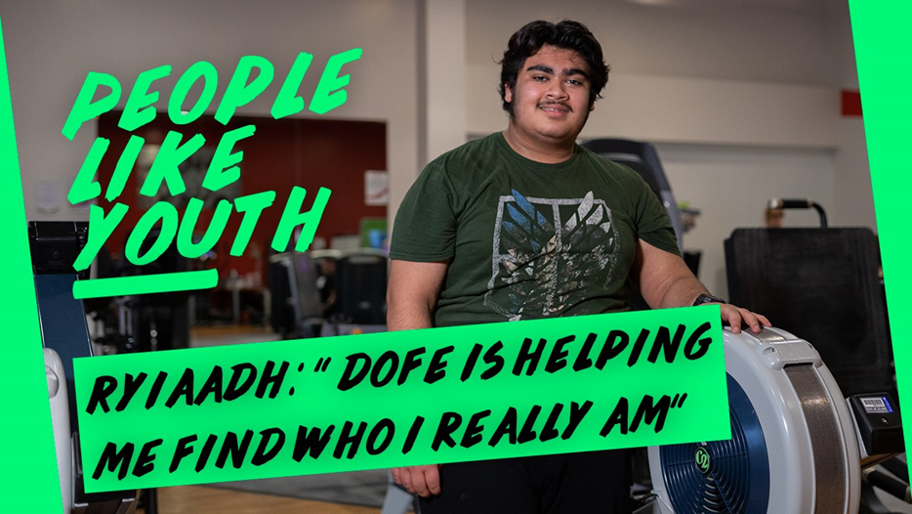
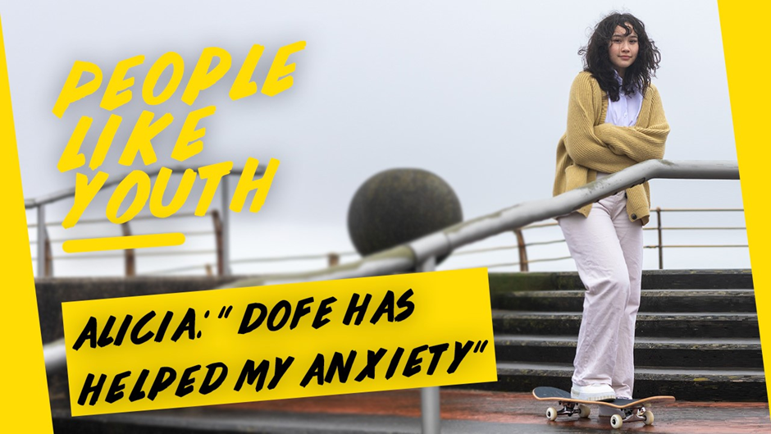
DofE paperwork and enrolment is dealt with by the DofE Manager in school, Miss Leach. She will monitor the progress through each section and will be available for support and queries. Her base is down in the PE Department. The award verifier in school is Miss Cheston. She will check and verify all awards to make sure all requirements have been met so that the certificate and badge can be presented to the participant.
Check out a few of the dofe videos below for more information. The videos are of our ex-students who completed the Duke of Edinburgh programme whilst at South shore Academy
People like YOUth: Alicia (youtube.com)
People like YOUth: Corron (youtube.com)
This video link introduces the D of E Managers in the area and our very own SSA Manager, Miss Leach and her role at the school.
Introducing our DofE Leaders (youtube.com)

