Slide 1
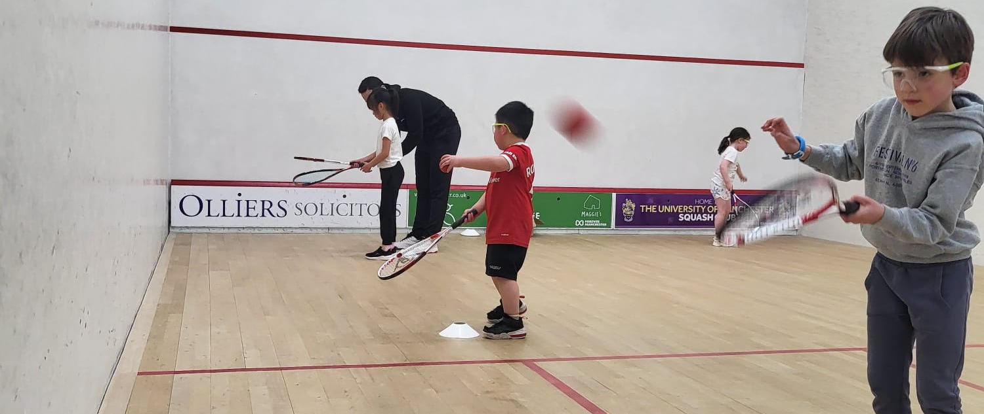


NextGen
SQUASH
£15
6 sessions
Taster Sessions as follows:
> Friday 16th January 2026 16:20 to 17:20
> Friday 23rd January 2026 16:20 to 17:20
Blackpool Cricket and Squash Club
6-week course from Friday 30th January 2026 16:20 to 17:20
Ages 8 to 18 welcome
Fee includes 6 introductory group sessions on Friday evenings, a racket, a ball, and goggles.
To book your place at the open day please contact:
Stephen Holliday
sphsquash@hotmail.co.uk
07425167712
Blackpool Cricket & Squash Club
Barlow Crescent, West Park Drive
Blackpool, FY3 9EQ
Cheetham Hill
Sports Club
Lightfoot Green Lane, Preston, Lancashire. PR4 0AP

