Slide 1
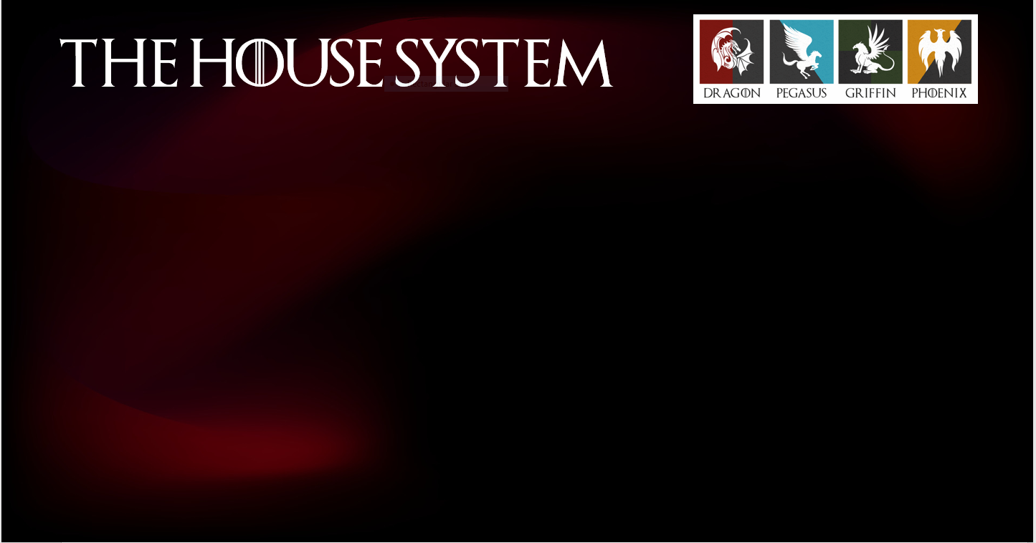




At Southchurch High School each tutor group is attached to one of FOUR houses.
The houses are represented by 4 mythical creatures.
PEGASUS
A winged horse from Greek mythology, born
from the blood of the Gorgon Medusa.
Symbolizes freedom, poetic inspiration and
artistic imagination.
DRAGON
A reptilian creature appearing in the folklore
of many global cultures.
Symbolizes strength, power, and good fortune
PHOENIX
A fiery bird from various mythologies,
including Greek and Chinese folklore.
A powerful symbol of rebirth, immortality, and renewal, often depicted rising from ashes.
GRIFFIN
A creature with the body of a lion and
the head and wings of an eagle.
A protector from evil and slander, it embodies strength and vigilance.

Slide 2


THE House System
You will receive ONE house point if you attend a club, trip or participate in any school activity.
You will also have an opportunity to collect house points during interform and interhouse competitions throughout the year.
House points will be updated every week and shared with you during form time.
Every term students from the winning house will have a special treat.

Slide 3
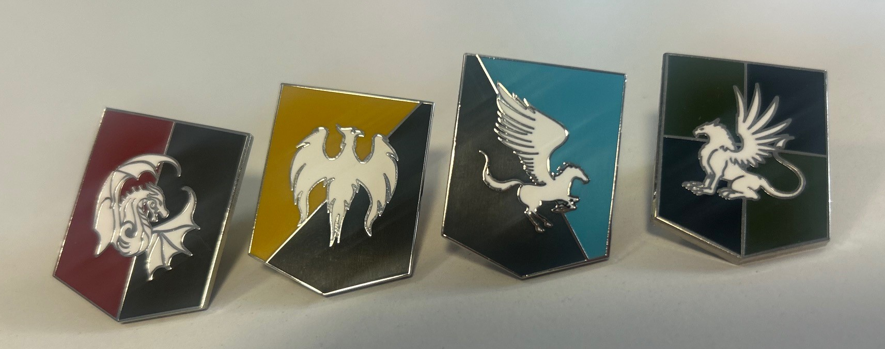
BADGES
You will also get a new house badge to wear on your blazers.
Your badge is now part of the school uniform expectation and
MUST be worn at ALL times.

