Slide 1
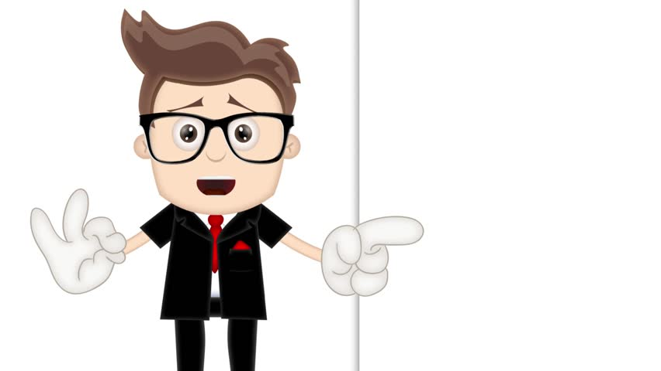
Welcome to 4G and 4S Quiz
Read the questions and write down the answers to
e mail back to Mrs Greenhough and Mr Scholes.

Slide 2
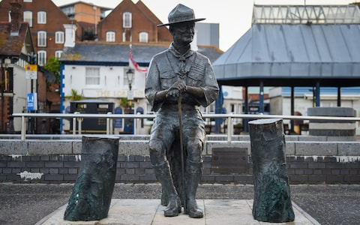
Question 1. This statue amongst others has been in the news lately. It sits in a place called Poole in Dorset. Who is this a statue of

Slide 3
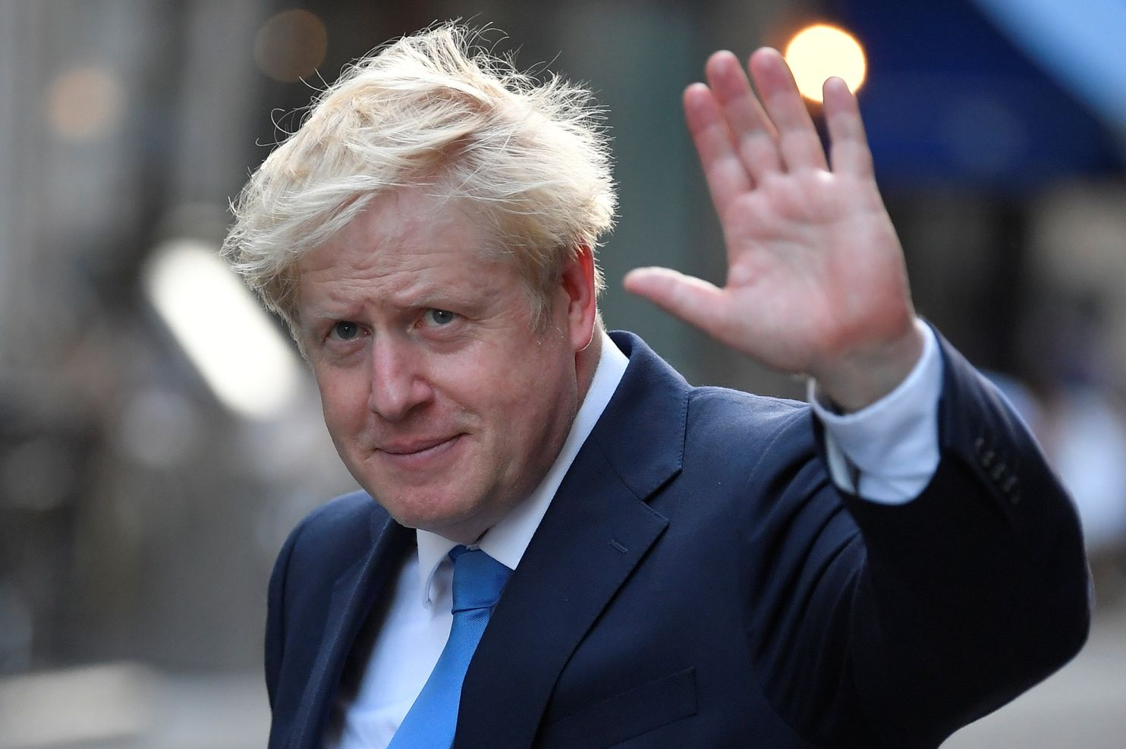
Question 2.
Have a look at the picture of the man below. He has been in the news quite a lot lately. Who is he and where does he live

Slide 4
Question 3.
It is really important we wash our hands 6 times a day. How long should we take to wash them

Slide 5
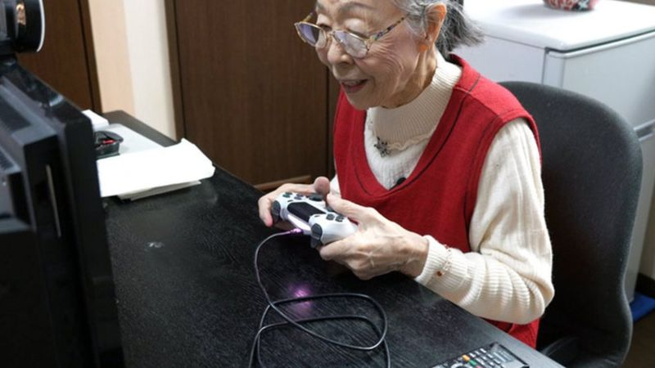
Question 4.
Hamako Mori, known as the 'Gamer Grandma', is now officially recognised as the oldest gaming YouTuber in the world. "It looked so much fun, and I thought it's not fair if only children played it." Hamako said.
How old is the oldest gamer and where does she live

Slide 6
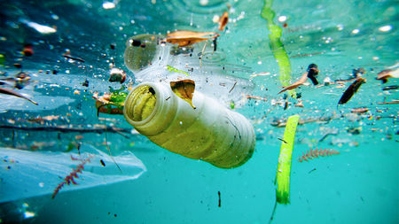
Question 5 .
What happens after we throw it away is causing a big problem for our planet.
It's thought more than five trillion pieces of plastic are in the world's oceans and it can take years for it to break down.
What is plastic?

Slide 7
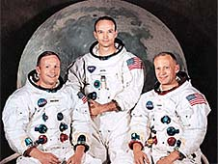
Question 6.
Apollo 11 was the spaceflight that first landed humans on the Moon. It was called the Apollo Lunar Module Eagle.
What were the names of these 3 men that landed on the Moon and what year did they land there

Slide 8
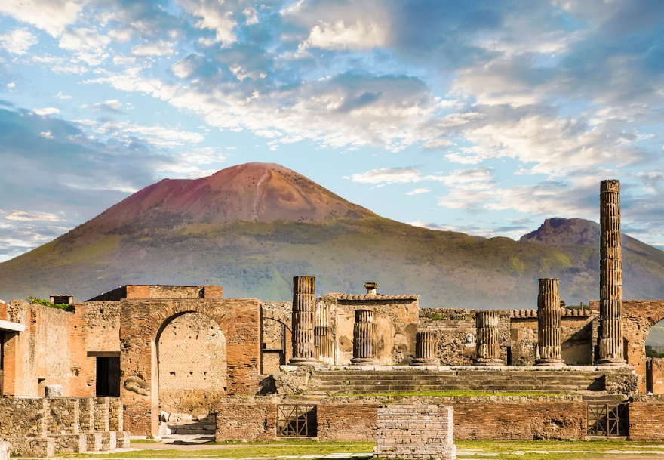
Question 7.
This is a place in Italy called Pompeii. The Romans lived here around 2,700 year ago until the something happened.
What happened

Slide 9
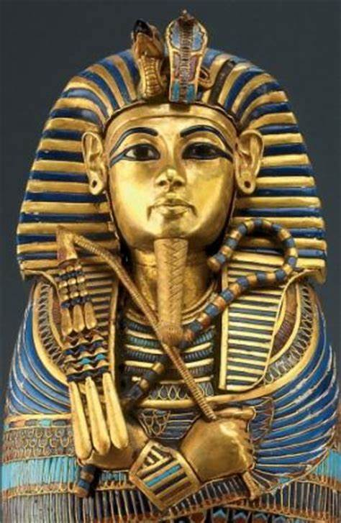
Question 8.
This is a very famous Ancient Egyptian Pharaoh
Found in a tomb in the Valley of The Kings where he had been for over 3,500 years.
Who is he

Slide 10
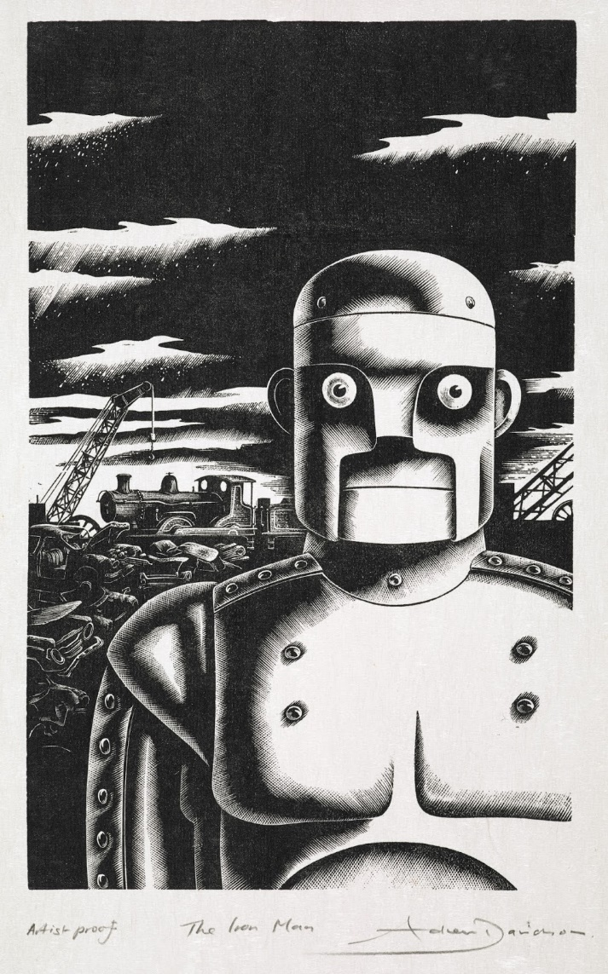
Question 9.
Do you remember the story about this giant in the picture
Who is he and who wrote
the story

Slide 11
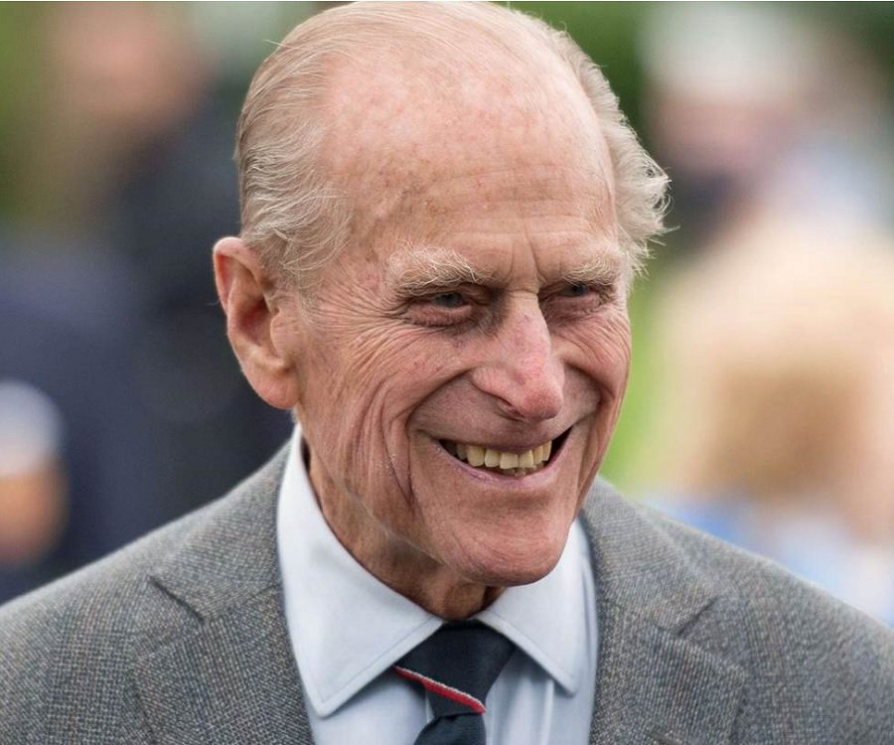
Question 10.
This man in the picture is Prince Philip, the husband of The Queen. He has been on the television
and in the newspapers this week for a special reason.
What is that reason

