Slide 1
Year 3 – Summer Block 3 – Properties of Shapes
Step 4: Draw Accurately
© Classroom Secrets Limited 2018

Slide 2
Introduction
Find items around your classroom
that match the following measurements:
3cm
5cm
12cm
20cm
30cm
© Classroom Secrets Limited 2018

Slide 3
Introduction
Find items around your classroom
that match the following measurements:
Answers will vary, some examples could include:
3cm: paperclip
5cm: crayon
12cm: scissors
20cm: paintbrush
30cm: lunchbox
© Classroom Secrets Limited 2018

Slide 4
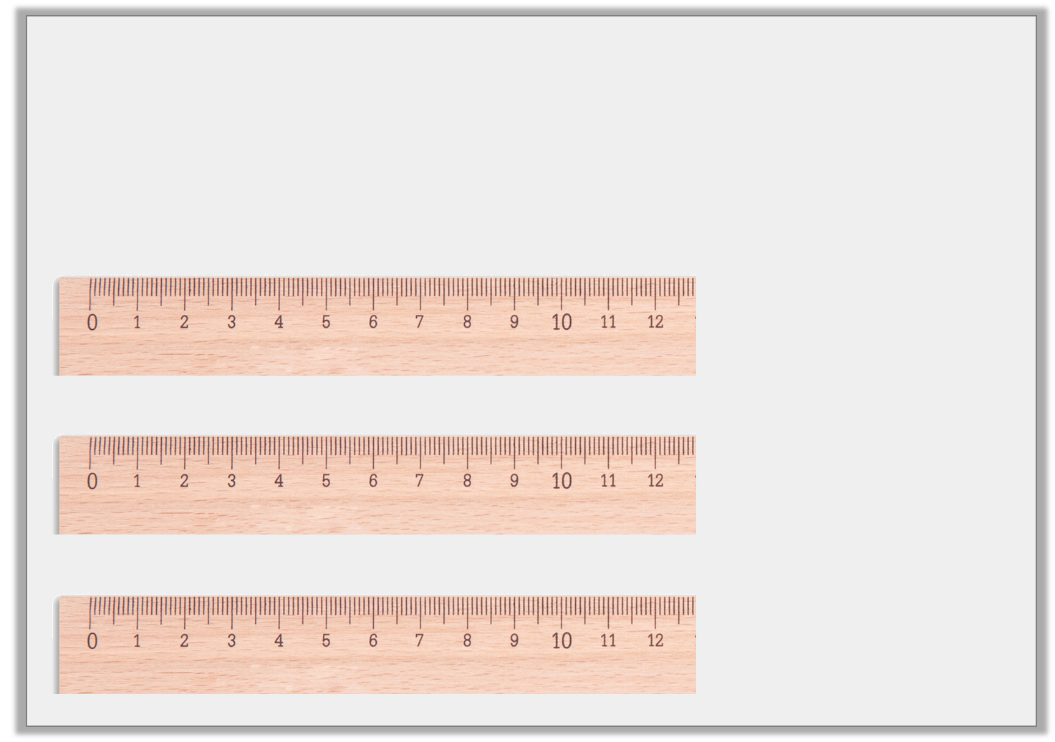
Varied Fluency 1
Measure these lines to the nearest cm and match them to their label.
12cm
11cm
10cm
© Classroom Secrets Limited 2018

Slide 5
Varied Fluency 1
Measure these lines to the nearest cm and match them to their label.
12cm
11cm
10cm
© Classroom Secrets Limited 2018

Slide 6
Varied Fluency 2
Round these lengths to the nearest cm.
 | 8cm 7mm |  |  | 1cm 8mm
 | 7cm 1mm
© Classroom Secrets Limited 2018

Slide 7
Varied Fluency 2
Round these lengths to the nearest cm.
 | 8cm 7mm |  |  | 1cm 8mm
9cm
2cm
 | 7cm 1mm
7cm
© Classroom Secrets Limited 2018

Slide 8
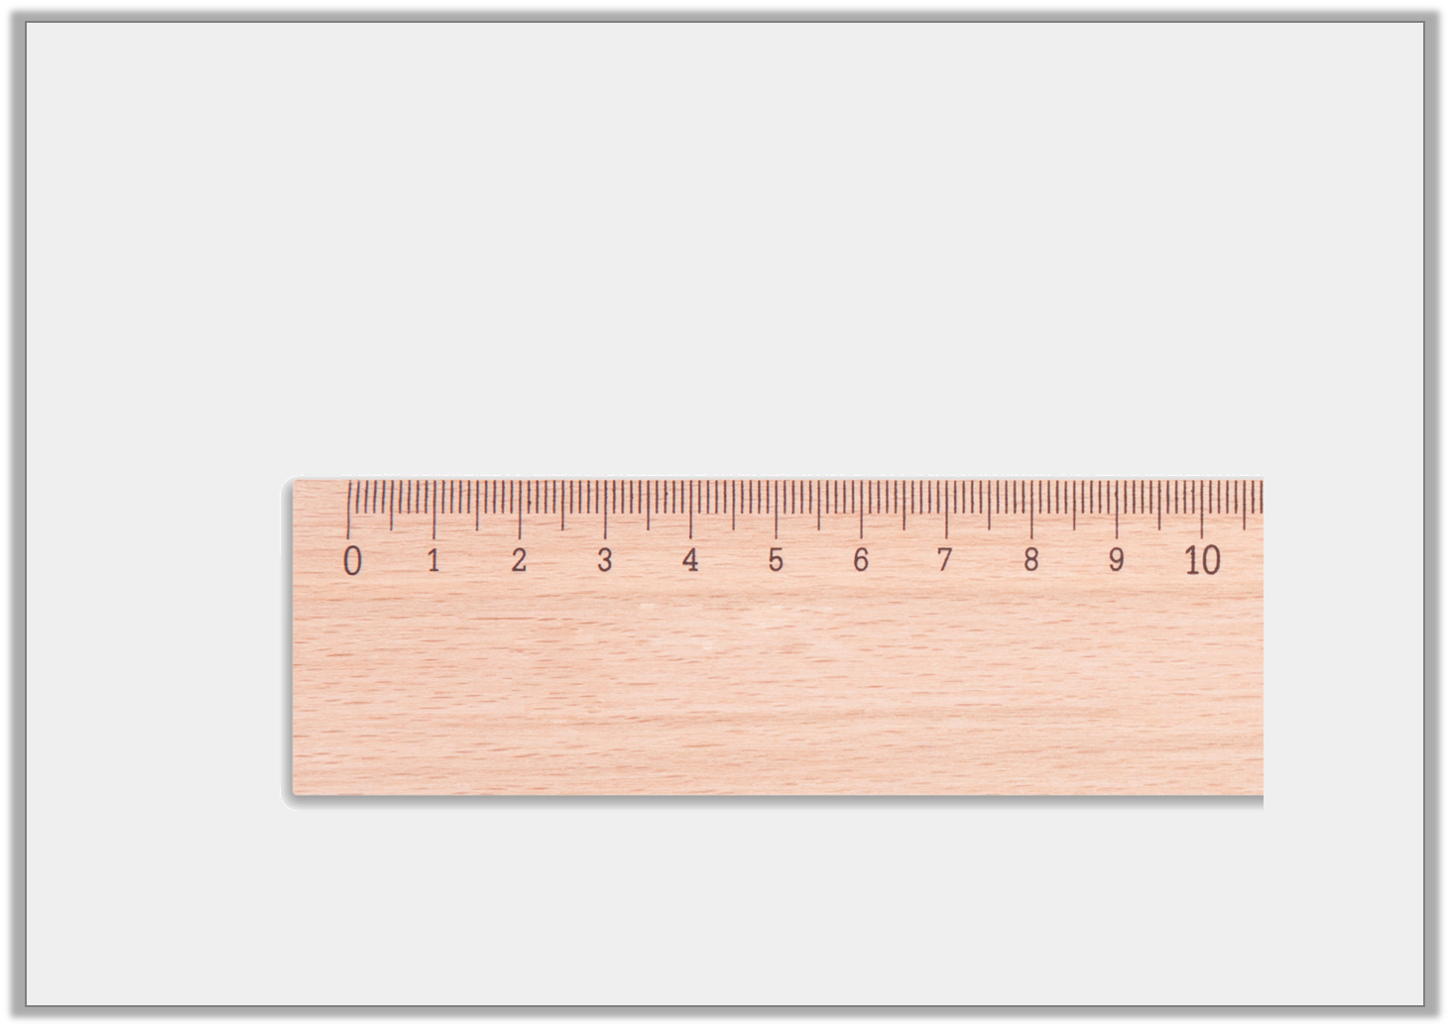
Varied Fluency 3
This line is 5cm long.
True or false?
© Classroom Secrets Limited 2018

Slide 9
Varied Fluency 3
This line is 5cm long.
True or false?
False, it is 5cm 4mm long.
© Classroom Secrets Limited 2018

Slide 10
Varied Fluency 4
Using a ruler, draw these measurements accurately.
 | 1cm 9mm |  |  | 4cm 1mm
 | 5cm 6mm
© Classroom Secrets Limited 2018

Slide 11
Varied Fluency 4
Using a ruler, draw these measurements accurately.
Lines drawn should be exact.
 | 1cm 9mm |  |  | 4cm 1mm
 | 5cm 6mm
© Classroom Secrets Limited 2018

Slide 12
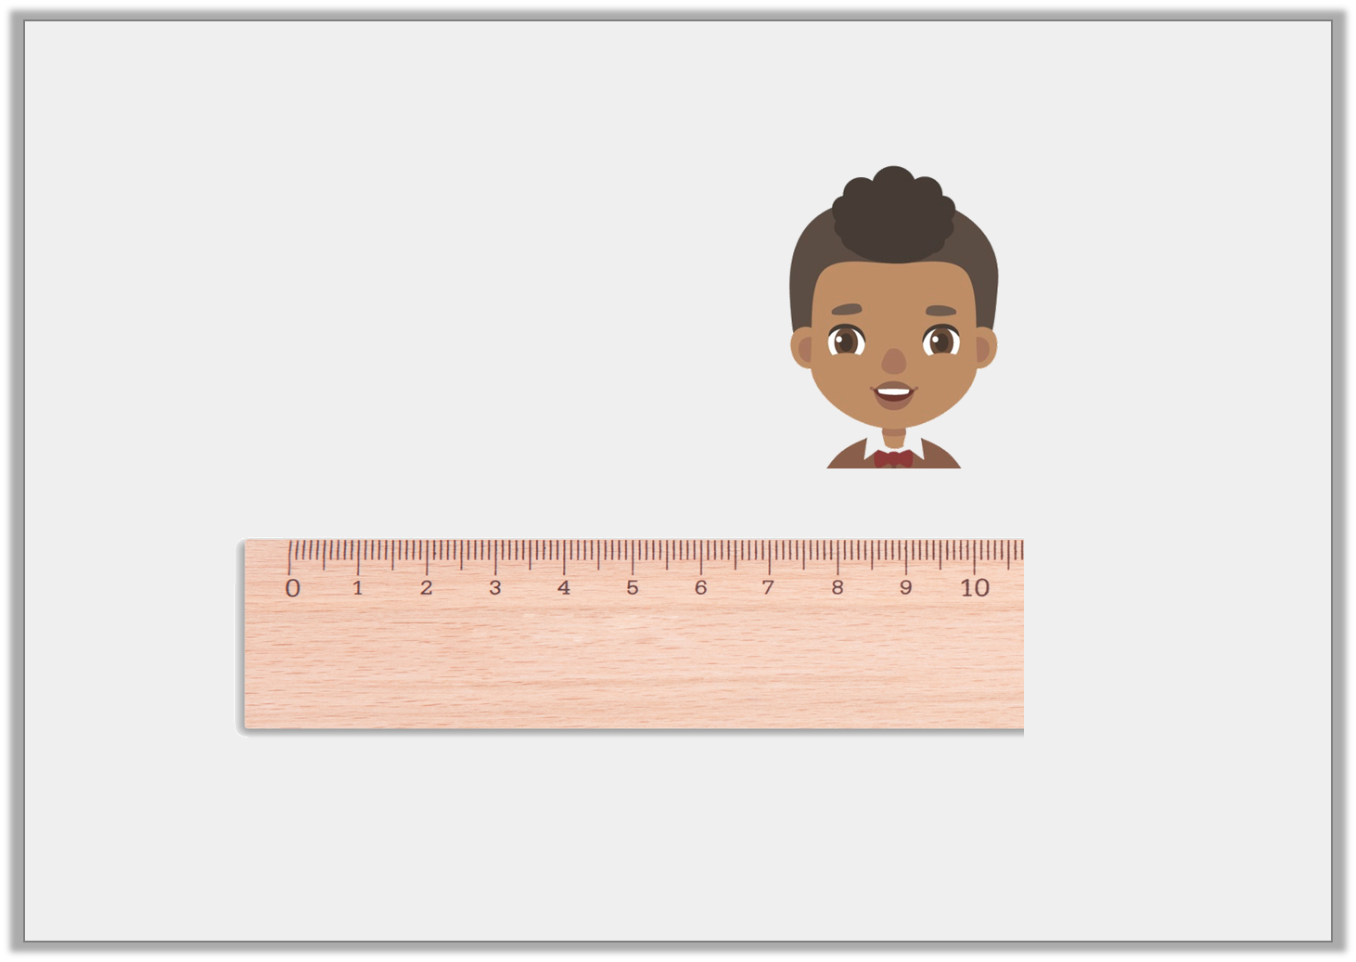
Reasoning 1
Simon has been measuring lines accurately.
Is he correct? Explain how you know.
My line is 9 cm 1mm long.
© Classroom Secrets Limited 2018

Slide 13
Reasoning 1
Simon has been measuring lines accurately.
Is he correct? Explain how you know.
No he is not correct because…
My line is 9 cm 1mm long.
© Classroom Secrets Limited 2018

Slide 14
Reasoning 1
Simon has been measuring lines accurately.
Is he correct? Explain how you know.
No he is not correct because his line is 9cm 6mm long.
My line is 9 cm 1mm long.
© Classroom Secrets Limited 2018

Slide 15
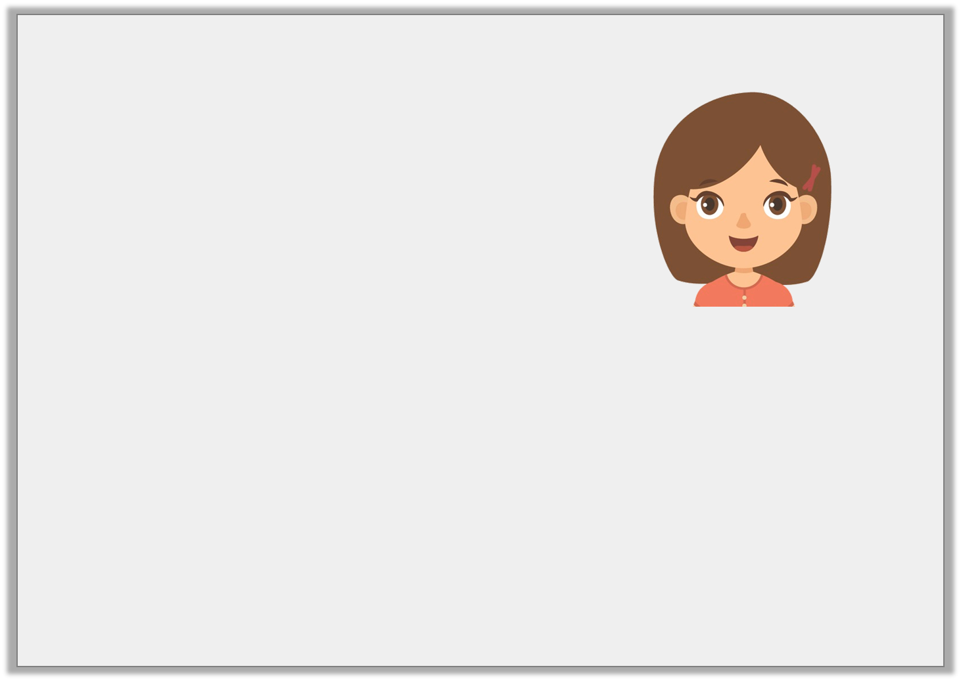
Problem Solving 1
Elsa has drawn some lines.
Draw and label 2 more possible sets of lines in cm and mm that Elsa could have drawn.
5cm 3mm | 3cm 3mm | 3 cm 4mm
My 3 lines make a total of 12cm.
© Classroom Secrets Limited 2018

Slide 16
Problem Solving 1
Elsa has drawn some lines.
Draw and label 2 more possible sets of lines in cm and mm that Elsa could have drawn.
Various possible answers,
for example:
5cm 3mm | 3cm 3mm | 3 cm 4mm
My 3 lines make a total of 12cm.
3cm 5mm | 4cm 4mm | 4 cm 1mm
© Classroom Secrets Limited 2018

Slide 17
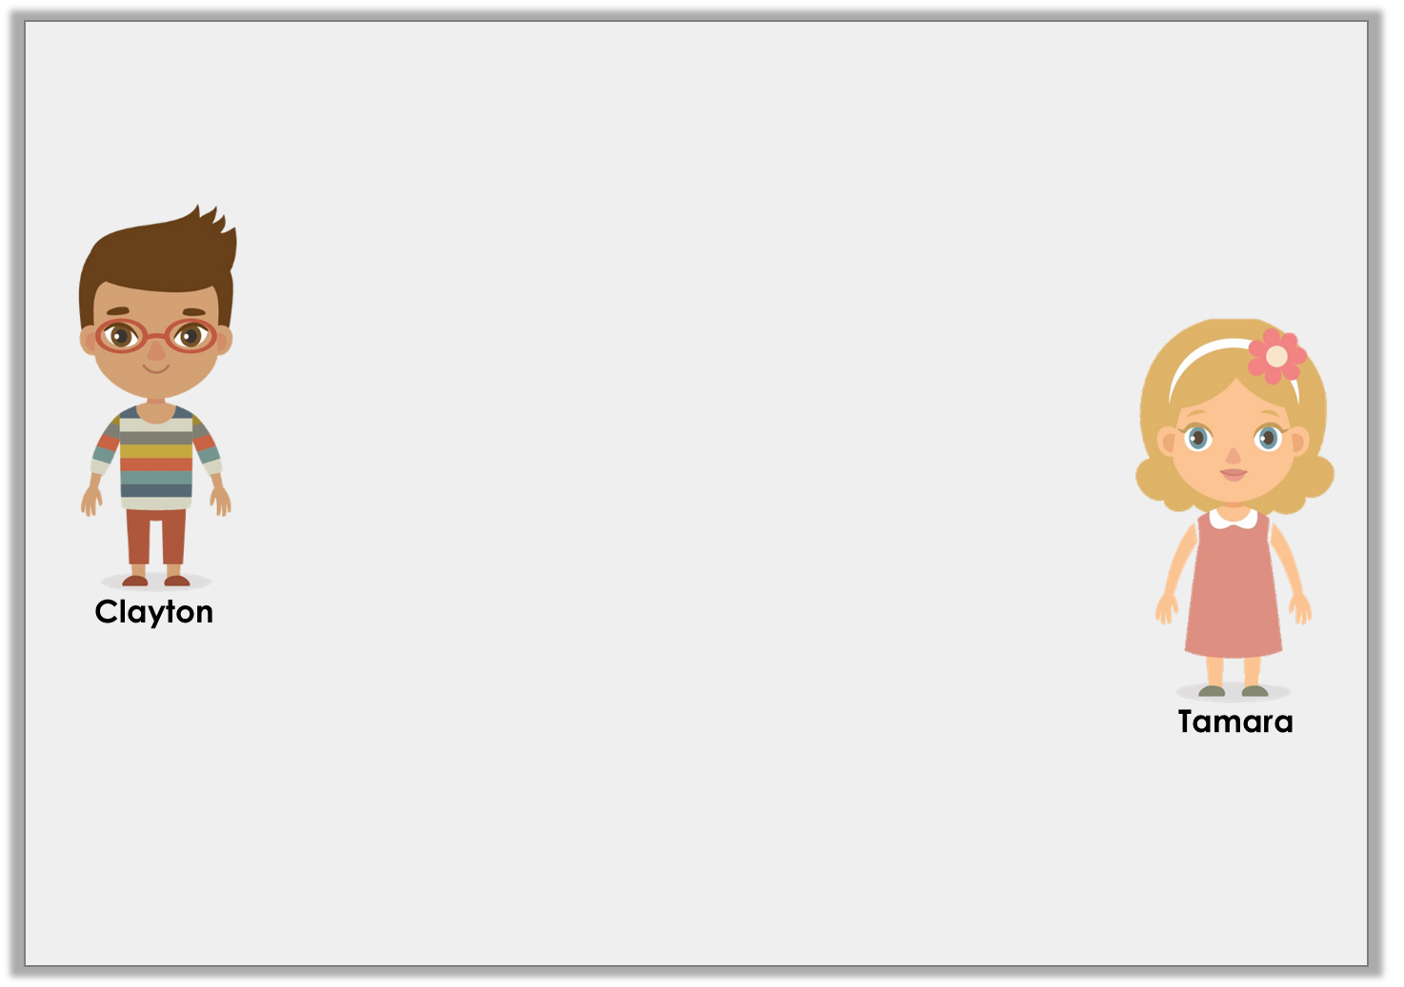
Reasoning 2
Clayton and Tamara are using a ruler to measure lines.
Who is correct? Why?
It doesn’t matter which side of the ruler you use to measure in centimetres, as long as you start on the ‘0’ line.
You have to make sure you are using the correct unit of measurement before you start measuring.
© Classroom Secrets Limited 2018

Slide 18
Reasoning 2
Clayton and Tamara are using a ruler to measure lines.
Who is correct? Why?
Tamara is correct as…
It doesn’t matter which side of the ruler you use to measure in centimetres, as long as you start on the ‘0’ line.
You have to make sure you are using the correct unit of measurement before you start measuring.
© Classroom Secrets Limited 2018

Slide 19
Reasoning 2
Clayton and Tamara are using a ruler to measure lines.
Who is correct? Why?
Tamara is correct as rulers generally measure in both inches and centimetres.
It doesn’t matter which side of the ruler you use to measure in centimetres, as long as you start on the ‘0’ line.
You have to make sure you are using the correct unit of measurement before you start measuring.
© Classroom Secrets Limited 2018

