Slide 1
Year 3 – Summer Block 3 – Properties of Shapes
Step 8: Recognise and Describe 3D Shapes
© Classroom Secrets Limited 2018

Slide 2
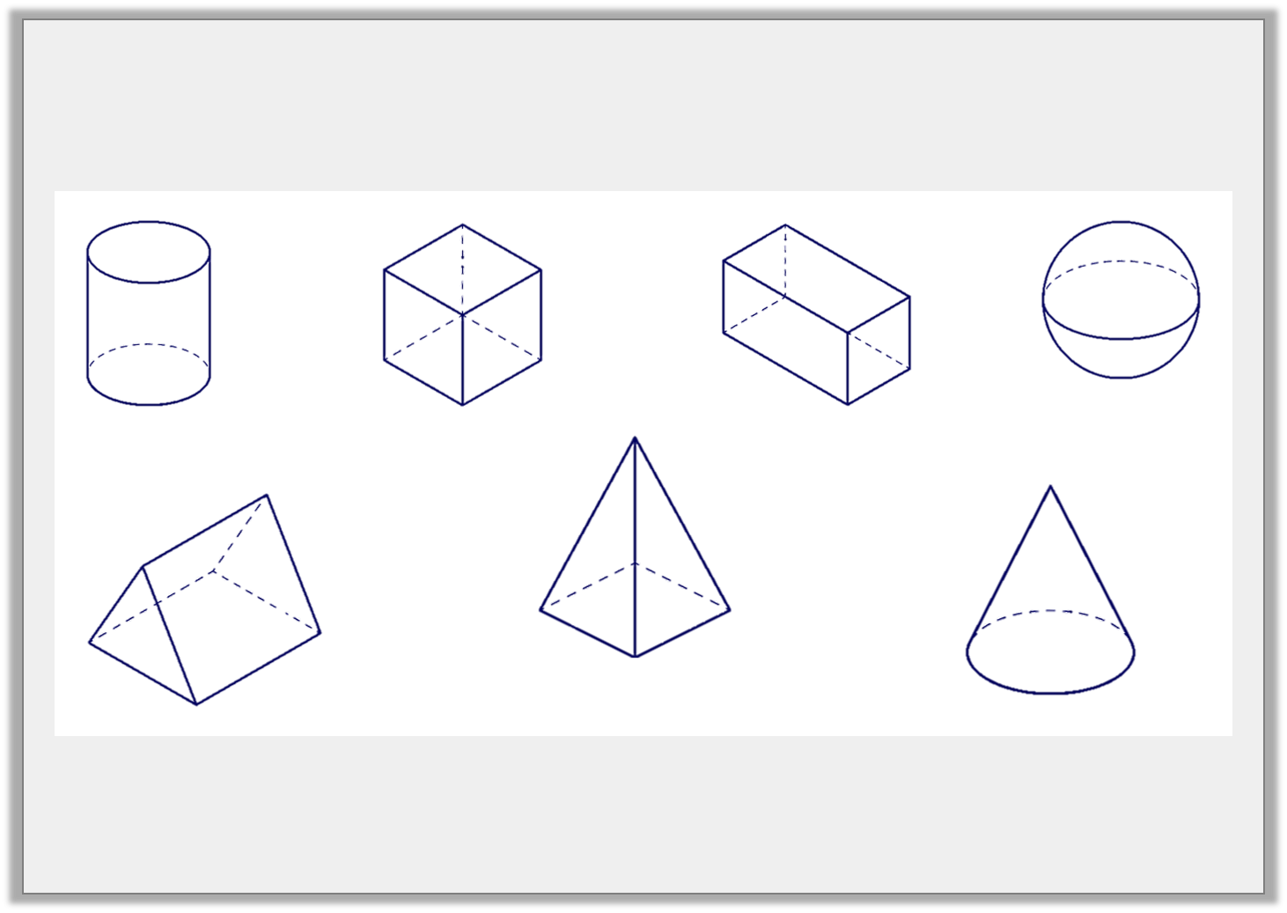
Introduction
Match the name to the 3D shape.
sphere
cylinder
cone
cube
cuboid
triangular prism
square based pyramid
© Classroom Secrets Limited 2018

Slide 3
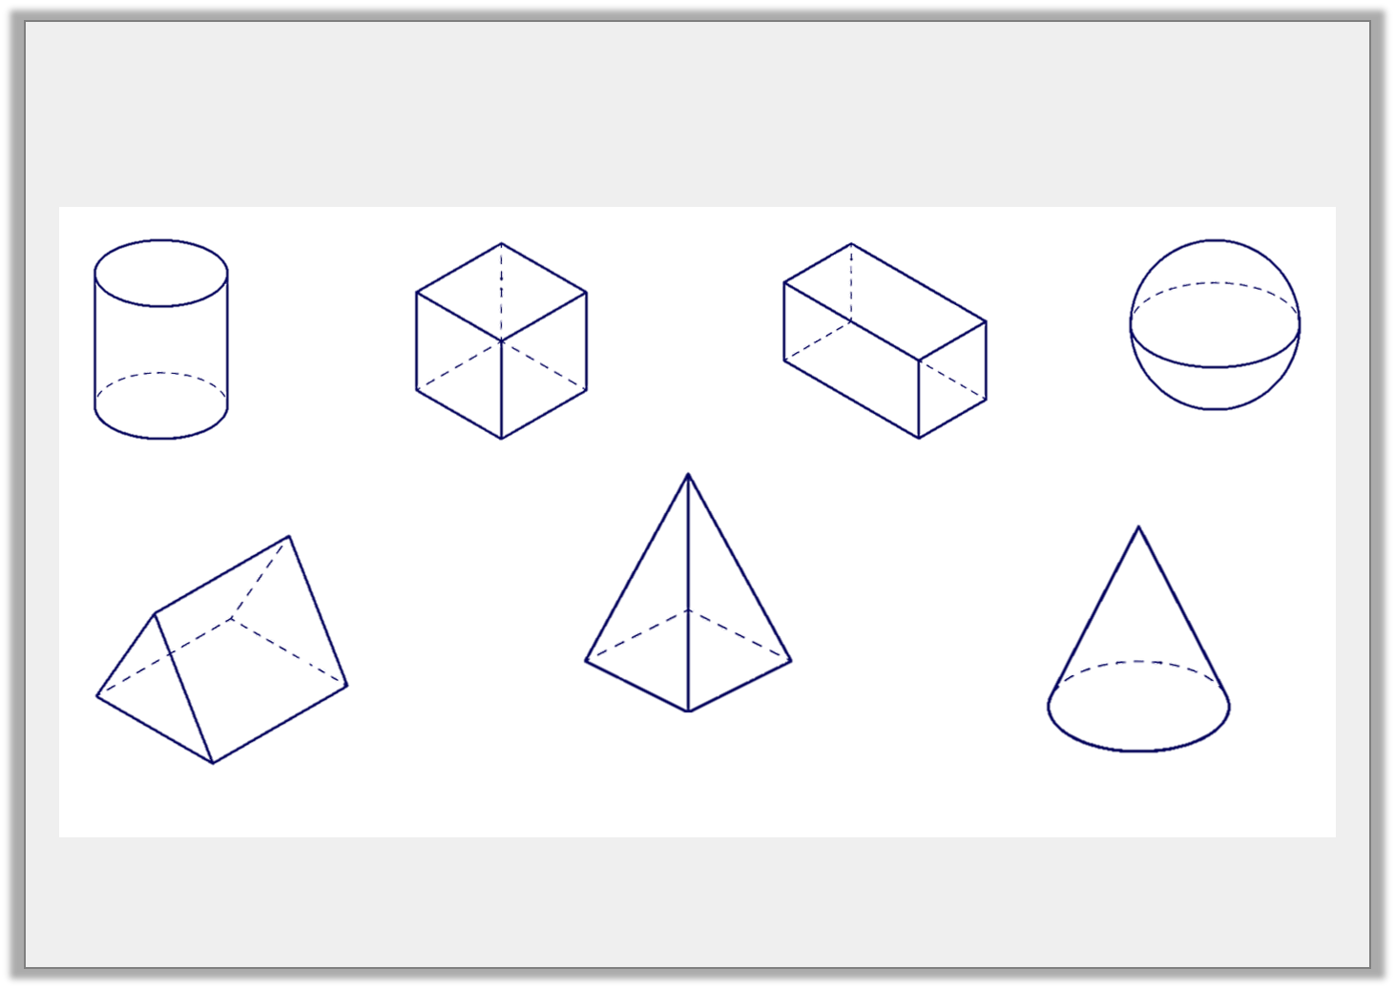
Introduction
Match the name to the 3D shape.
cylinder
cube
cuboid
sphere
square based pyramid
triangular prism
cone
© Classroom Secrets Limited 2018

Slide 4
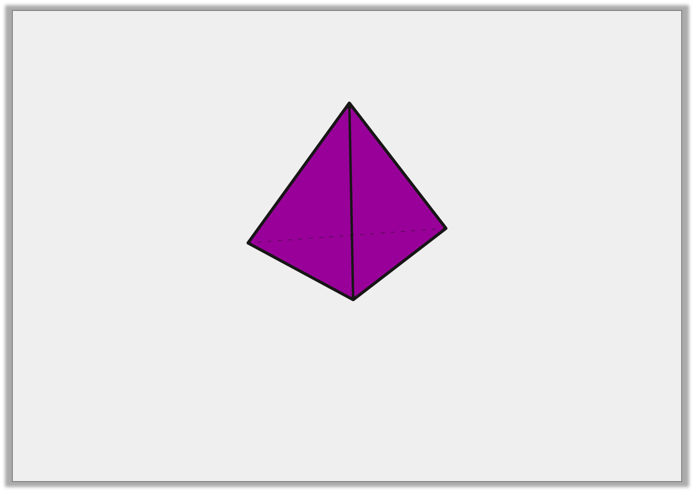
Varied Fluency 1
True or false?
A triangular based pyramid has 4 vertices.
© Classroom Secrets Limited 2018

Slide 5
Varied Fluency 1
True or false?
True
A triangular based pyramid has 4 vertices.
© Classroom Secrets Limited 2018

Slide 6
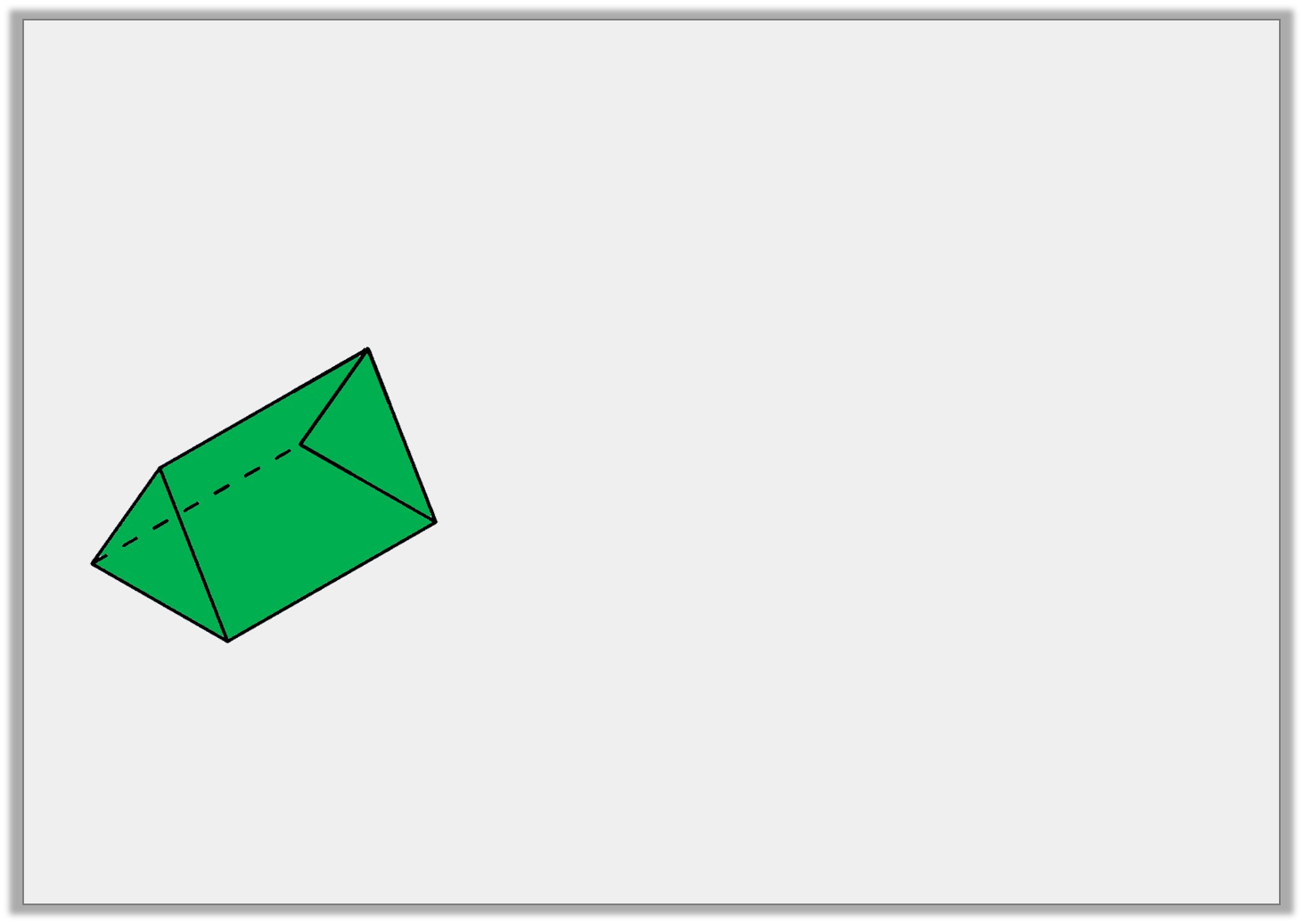
Varied Fluency 2
Tick the statements which relate to the shape.
2 triangular faces
6 vertices
It is a triangular based pyramid
© Classroom Secrets Limited 2018

Slide 7
Varied Fluency 2
Tick the statements which relate to the shape.
2 triangular faces | ✓
6 vertices | ✓
It is a triangular based pyramid
© Classroom Secrets Limited 2018

Slide 8
Varied Fluency 3
Circle the shapes that have more than 5 edges.
cone | square based pyramid | cuboid
© Classroom Secrets Limited 2018

Slide 9
Varied Fluency 3
Circle the shapes that have more than 5 edges.
cone | square based pyramid | cuboid
© Classroom Secrets Limited 2018

Slide 10
Varied Fluency 4
Use >, < or = to complete the statements below.
number of edges in a cuboid |  | number of faces in a triangular prism
number of vertices in a square based pyramid |  | number of faces in a cube
© Classroom Secrets Limited 2018

Slide 11
Varied Fluency 4
Use >, < or = to complete the statements below.
number of edges in a cuboid | > | number of faces in a triangular prism
(12)
(5)
number of vertices in a square based pyramid | < | number of faces in a cube
(5)
(6)
© Classroom Secrets Limited 2018

Slide 12
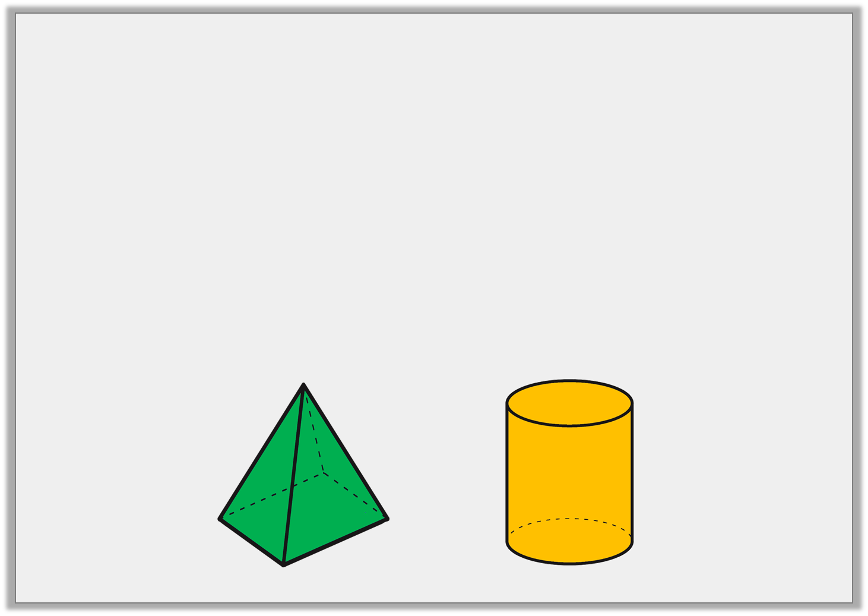
Problem Solving 1
Are the following statements always true, sometimes true or never true?
A) A square based pyramid has 4 vertices.
B) A cylinder has more curved edges than a cone.
© Classroom Secrets Limited 2018

Slide 13
Problem Solving 1
Are the following statements always true, sometimes true or never true?
A) A square based pyramid has 4 vertices.
Never true
B) A cylinder has more curved edges than a cone.
Always true
© Classroom Secrets Limited 2018

Slide 14
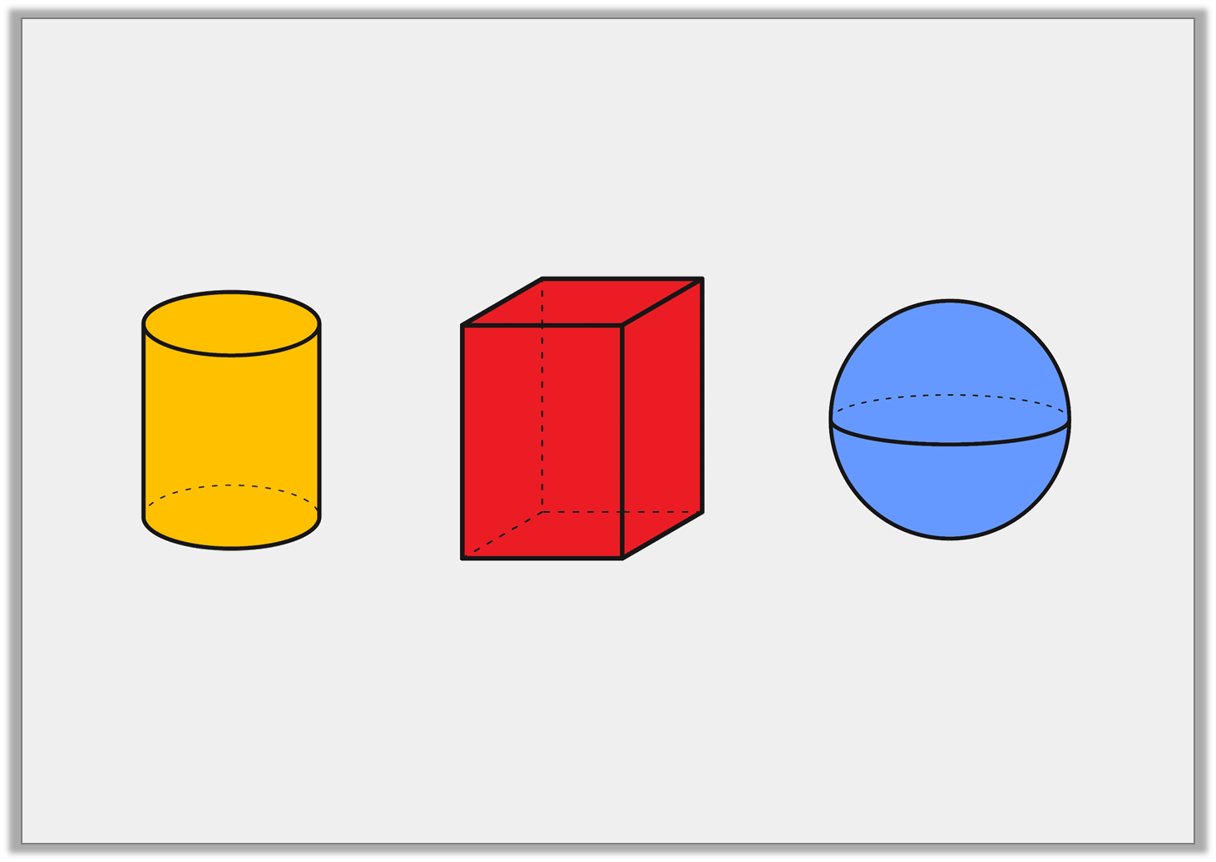
Reasoning 1
Which shape is the odd one out?
Explain your answer.
© Classroom Secrets Limited 2018

Slide 15
Reasoning 1
Which shape is the odd one out?
Explain your answer.
Various possible answers, for example: The cuboid is the odd one out because a cylinder and sphere have a curved surface whereas a cuboid has only flat faces.
© Classroom Secrets Limited 2018

Slide 16
Problem Solving 2
Use the cards below to make as many correct
statements as you can.
1. The number of edges in a cube.
2. The number of edges in a square based pyramid.
3. The number of vertices in a cube.
4. The number of edges in a cuboid.
=
© Classroom Secrets Limited 2018

Slide 17
Problem Solving 2
Use the cards below to make as many correct
statements as you can.
1. The number of edges in a cube.
2. The number of edges in a square based pyramid.
4 = 1
3 = 2
3. The number of vertices in a cube.
4. The number of edges in a cuboid.
=
© Classroom Secrets Limited 2018

