Slide 1
SS John and Monica’s Catholic Primary School
SEND School Information Report for Parents and Carers
Revised: February 2026
Next update: February 2027

Slide 2

At SS John and Monica’s School, we support children with a range of differing Special Educational Needs and Disabilities.
We pride ourselves on being a highly inclusive school with an ethos which encourages and celebrates diversity and difference.

Slide 3
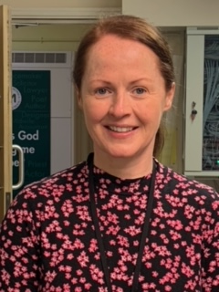
Meet our SENCO
Hello and welcome to SS John and Monica’s Catholic Primary School.
My name is Mrs. Nicholls and I am the Special Educational Needs Co-ordinator (SENCO). I am a qualified SENCO as I hold the National Award for SEND Coordination (NASENCO).
I work with children, parents/carers, teachers and outside agencies to make sure that all children with special educational needs have their needs met.

Slide 4


How can the SENCO help?
If you have a concern about your child, please speak to their class teacher in the first instance.
You may then want to contact Mrs Nicholls, our SENCO. She will be available to talk to you on Tuesdays, Wednesdays or Thursdays.
Sometimes she may be busy or teaching a class, so you can do the following:
*Speak to our staff in the office to find out when she may be available
*Make an appointment to see her or ask if she can telephone you
*Email the school office enquiry@stjonmon.bham.sch.uk and they will forward your email to Mrs. Nicholls
*Email senco@stjonmon.bham.sch.uk
Mrs. Nicholls will respond to messages from parents within 72 hours.

Slide 5
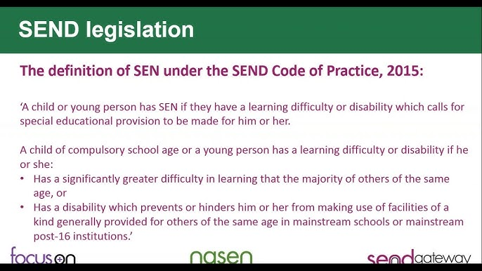
What are Special Educational Needs and Disabilities (SEND)?
We value all children equally and aim to offer an inclusive approach.
We know that at different times in their school life, a child may have a special educational need.
The SEND Code of Practice 2015 is the legislation that defines SEND as follows:
To read our school’s SEND Policy, please go to our website: https://stjonmon.bham.sch.uk/about-us/inclusion-and-send/send

Slide 6
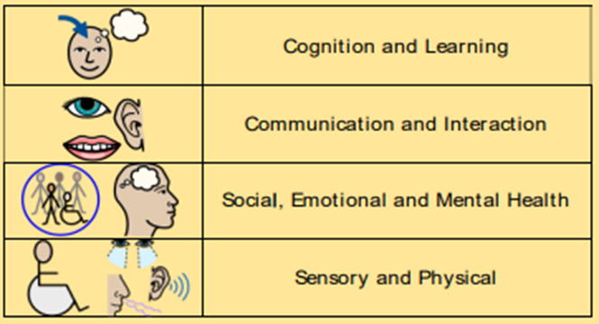
What are the different needs under SEND?
SEND is organised into 4 areas according to SEND law in the SEND Code of Practice (2014):
If your child is identified as having additional needs from the above categories, we will aim to provide provision that is ‘additional to or different from’ the normal curriculum. We will work to overcome the barrier/s to their learning.

Slide 7
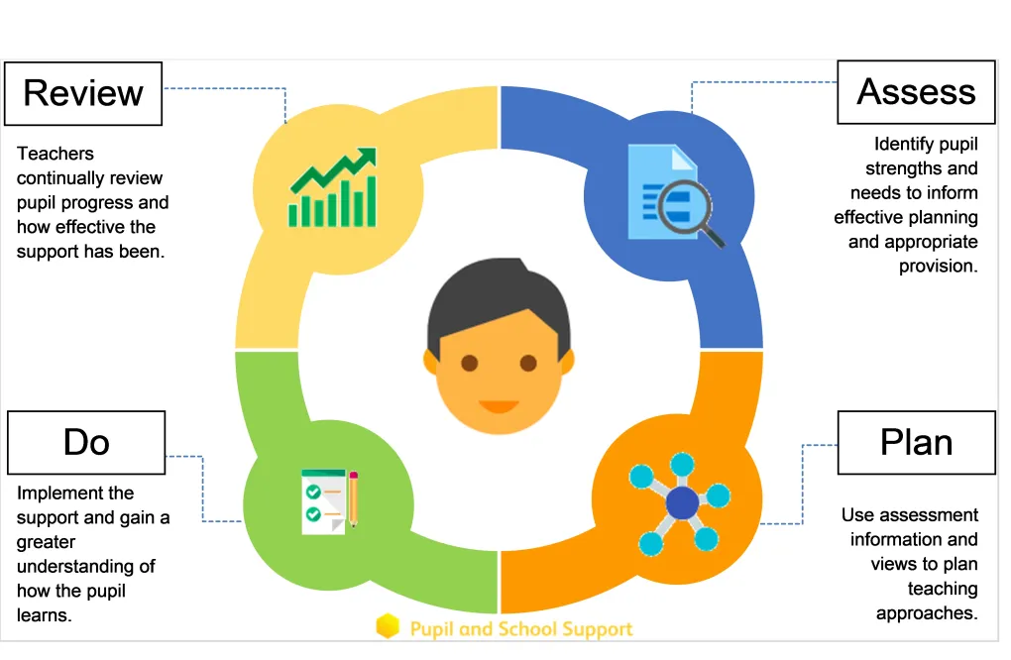
What is the Graduated Approach to SEND?
Staff at SS John and Monica’s work closely as a team. If a concern if raised by parents or staff, a child may be placed on our monitoring register and we then begin to follow the Graduated Approach which follows the model show below: ‘Assess, Plan, Do, Review.’
We will then plan some intervention for a period of around 6 weeks to try and address the concern. We identify needs through assessment, plan support, do the agreed intervention, and then review the impact of what we have done.
During this stage, the child will monitored by the SENCO.

Slide 8

How do we assess progress?
We may use the Birmingham Toolkits for Literacy, Language and Maths to assess current attainment and to plan the next steps needed to make progress.
These small steps of progress will be achieved through a blend of whole class teaching, small group or individual targeted work, with opportunities to be independent.
Some children may need support beyond what is ordinarily available and here we may ask external agencies to support us in planning provision.

Slide 9
What support is ordinarily available in class?
We use Birmingham’s Ordinarily Available Guidance to help support children’s learning within the classroom.
If your child has additional needs, the OAG is the first level of support a school should provide before considering more high needs, specialist support.
Ordinarily available guidance is designed so that most children’s needs can be met through normal teaching in class. Support is flexible and responsive. Schools take early action when concerns are noted.
You can access the Ordinarily Available Guidance (November 2023) to see what is normally offered in our classrooms through this link:
https://www.localofferbirmingham.co.uk/wp-content/uploads/2024/04/Ordinarily-Available-Guidance.pdf

Slide 10

Summary: What happens if there is a concern about my child’s progress?
A teacher of parent raises a concern about a child’s progress
We will meet to produce a plan of support in school
Provision is made to support the child’s learning with input from teacher, parents, SENCO and pupil (where appropriate)
After review of support provided, If there are still concerns, the SENCO will coordinate the next steps, which may include external agency support (with consent from parents)
As a parent, you will be informed at every stage of your child’s development and the circumstances in which they are being monitored.

Slide 11


Which outside agencies do we work with?
Here at SS John and Monica’s, we work with a range of external agencies to help identify and plan for additional needs.
Key agencies are:
Literacy, Language and Strategic Support Team (LLSS – previously PSS)
Communication and Autism Team (CAT)
Speech and Language Therapy (SALT)
Educational Psychologists (EP)
Occupational Therapy (OT)
Sensory Support Team
Forward Thinking Birmingham
Physical Difficulties Support Service (PDSS)
Compass Mental Health Support
If your child needs support from these services, we will always consult you and gain your written permission first.
Please note that there are currently long waiting lists for many NHS Services.

Slide 12
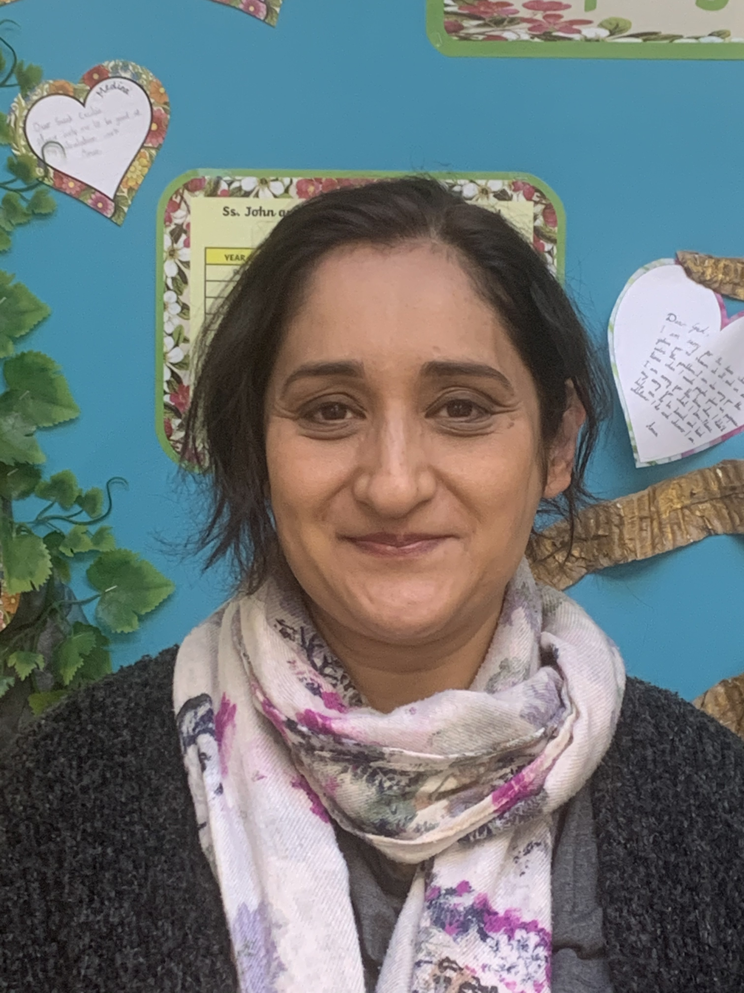

ELSA
At SS John and Monica’s, we are proud to be an ELSA school.
ELSA means Emotional Literacy Support Assistant.
Our ELSA is Mrs Ali and she works with children who need additional support with emotional issues. All ELSAs are supervised by Birmingham Educational Psychology Service.
To access support for your child, please speak to your child’s class teacher about your concern.

Slide 13
What happens if my child still has difficulties, even after intervention?
If, despite a period of intervention, concerns about your child continue, then they may be placed on the SEND register.
The SENCO maintains and monitors this list to make sure children on this register get the right support.

Slide 14
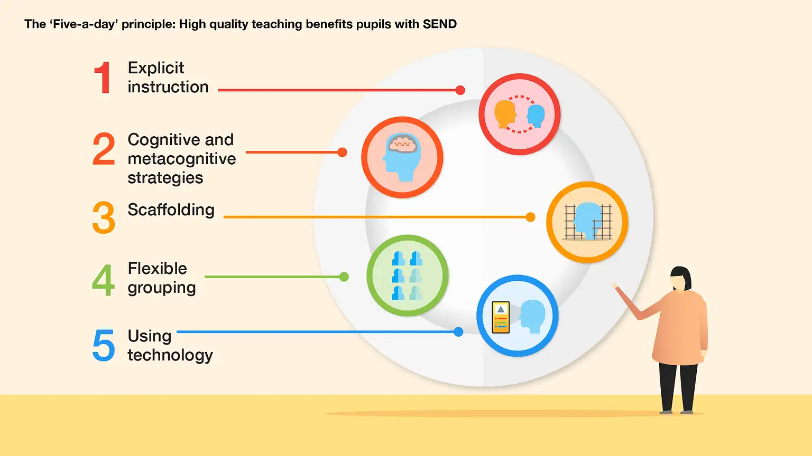
How do we teach children with SEND?
We are an inclusive school. Wherever possible, children are taught alongside their peers in their classroom in flexible teaching groups.
All work in class is pitched at an appropriate level so that all children are able to access according to their specific needs. This may mean adapting the task, extra resources, pre-teaching, extra modelling and scaffolding to support.
Teachers plan high-quality teaching to meet the needs of a diverse group of learners in class. Where necessary, this is complemented by additional interventions in small groups or one-to-one with an additional adult.
High quality teaching is monitored by the SENCO and Senior Leadership Team.
We use the EEF ‘Five-a-day’ guidance and the key principles are used to plan lessons for all pupils.
Some children may require more personalised curriculums which will be agreed with the SENCO, parents, teachers and outside agencies.

Slide 15

What interventions do we offer to provide targeted or specialist support?
Support is planned according to the needs of our children.
Some of our most commonly used interventions include:
Small group work in English and/or Maths lessons supported by a Learning Support Assistants (LSA)
Wellcomm Speech and Language programme
NESSY for KS2 pupils with dyslexia traits or diagnosis
Phonics booster sessions
1:1 daily reading support
Precision teaching of basic skills
ELSA (Emotional Literacy Support Assistant)
Gross and fine motor skills interventions
Attention Autism
Sensory circuits
Assistive technology

Slide 16
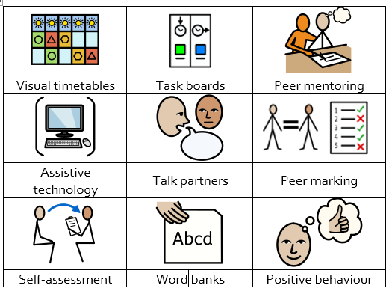
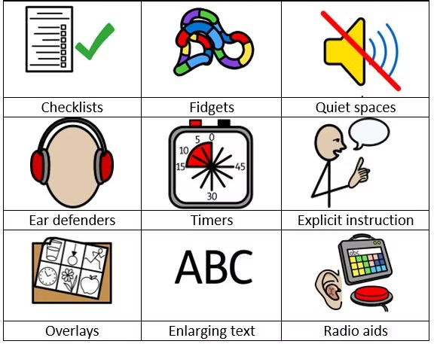
We use a range of strategies to ensure that we offer an inclusive approach to learning which allows all learners to access the curriculum.
Where external agencies are involved, we will seek their recommendations in this area.
Some of these adjustments may include:
How do we adapt the curriculum for children with SEND?

Slide 17
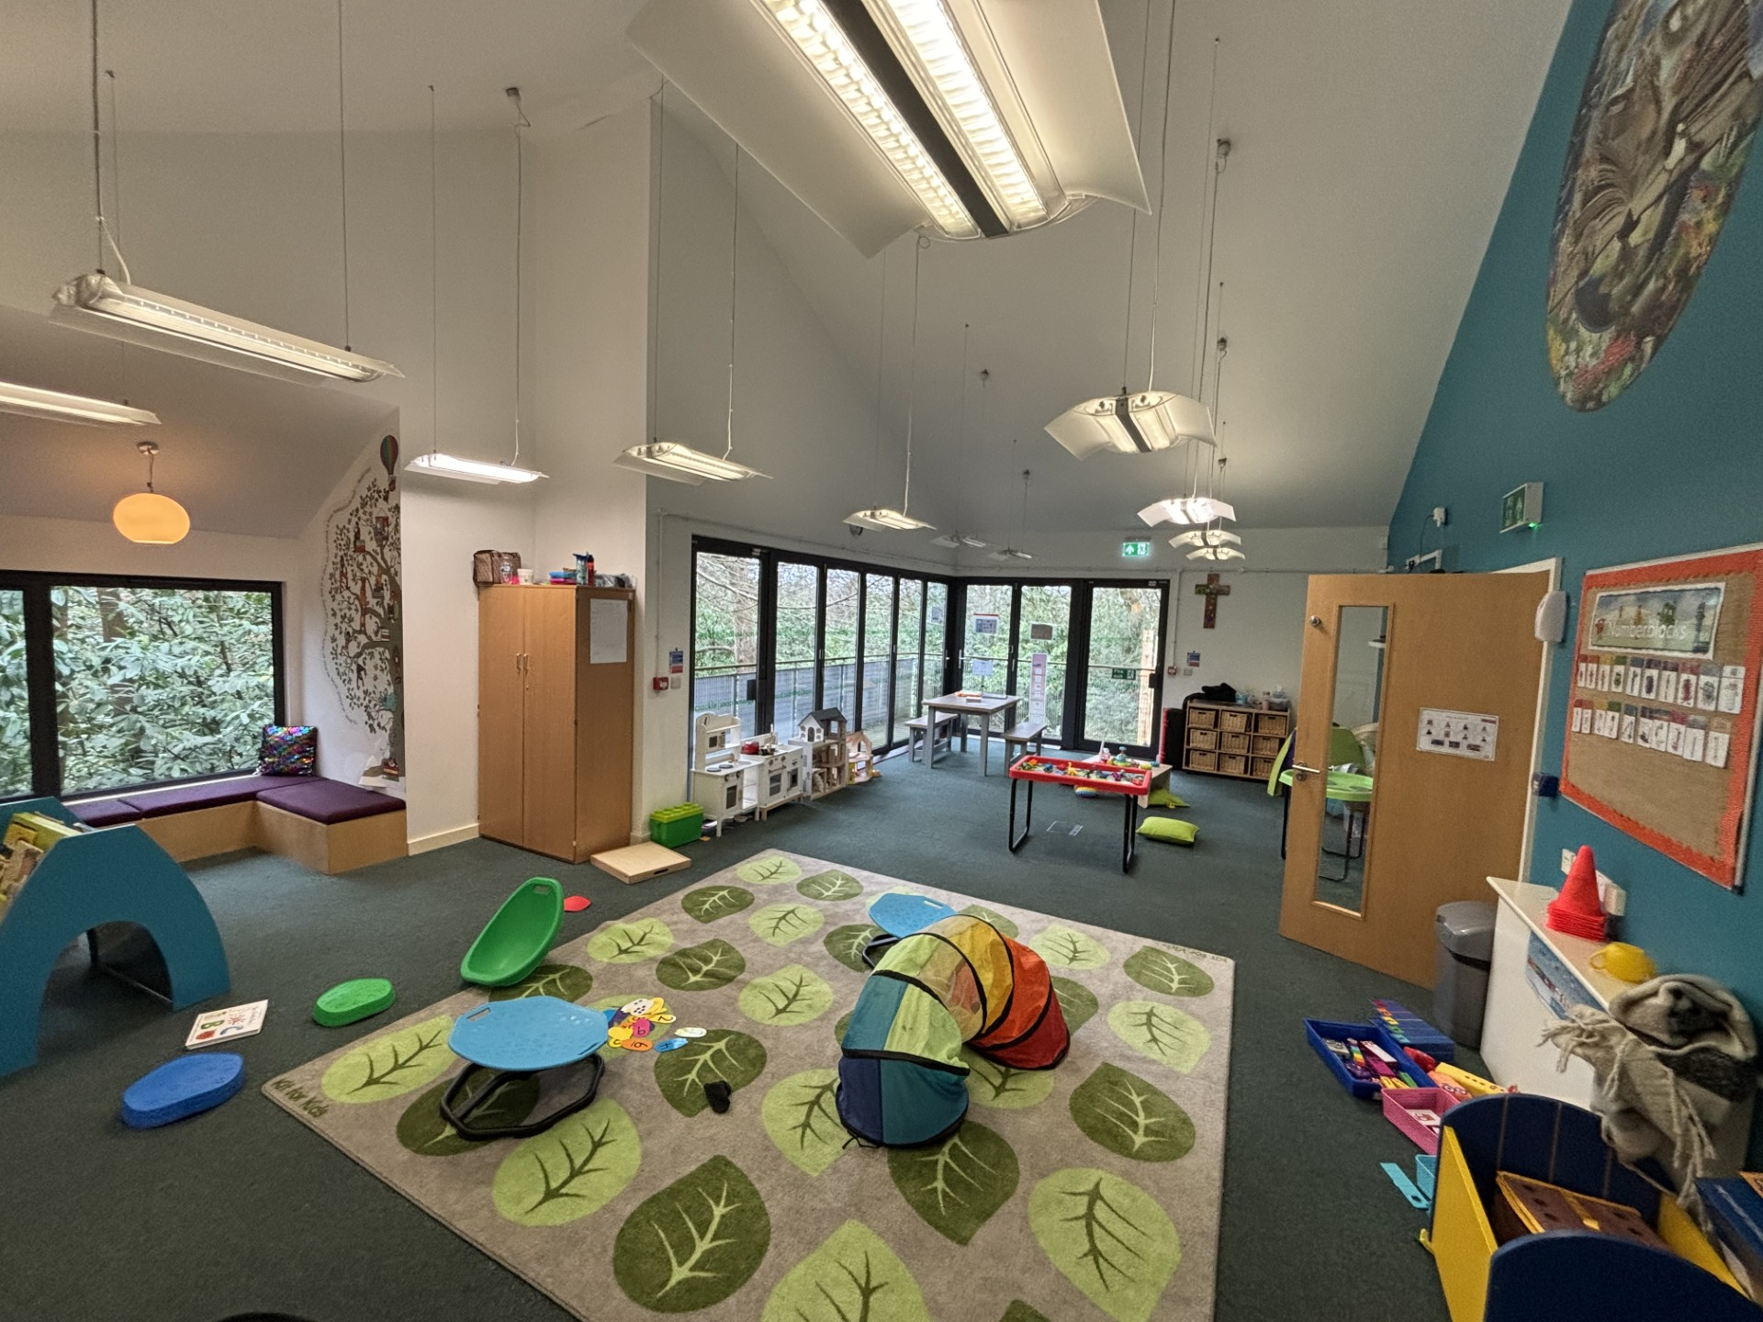
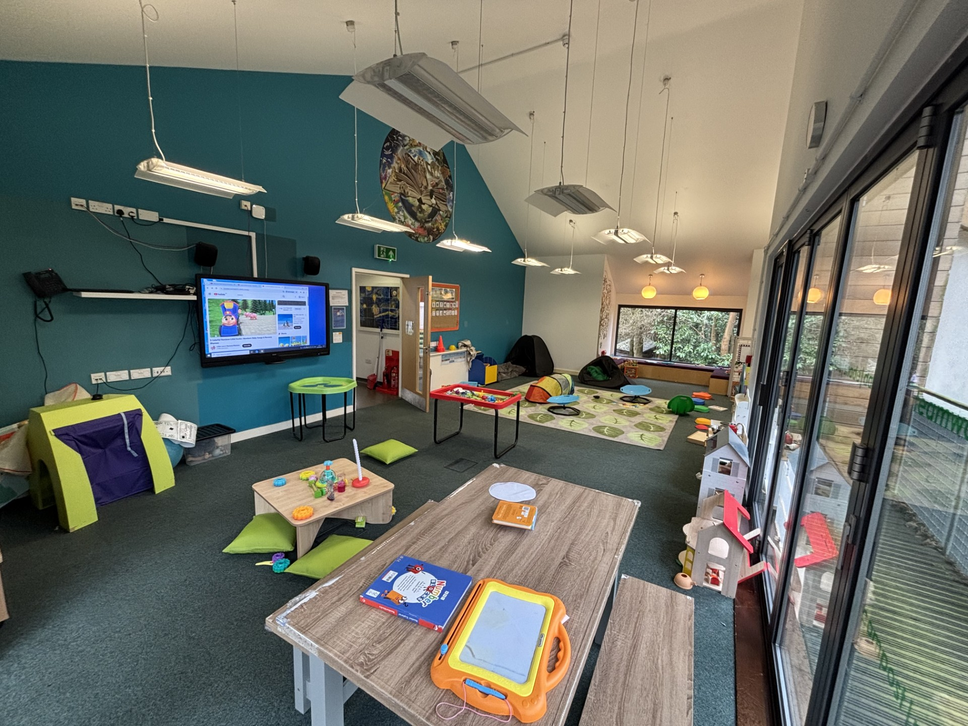
Beyond what is ordinarily available: Our SEND Hub
In the Autumn of 2025, we converted our school library into a SEND Hub.
This is an alternative classroom for children with higher levels of SEND who need access to a quieter, low-arousal space containing fewer children.
Access to this classroom is based on need and this is assessed by the SENCO. Most children who use our SEND Hub have a blended timetable where they also work in their main year group classroom alongside their peers for part of their day.

Slide 18

How do we evaluate provision to check what we are doing is working?
We continuously monitor our provision to check the impact of what we are doing.
We do this through:
Regular progress meetings involving all staff
Continuous Professional Development (CPD) for staff in meetings where we share good practice and receive training
Reviewing progress with parents at least three times per year
Seeking parent voice
Seeking pupil voice
Keeping and monitoring useful data to check the progress of learners with SEND
Talking to children to gain their voice about the support they are getting
Monitoring of staff by the SENCO
‘Book Scrutiny’ work by subject leaders to evaluate the children’s work
Online tracking of targets to measure progress
Annual reviews for children with an Education Health and Care Plan (EHCP)
Annual reviews for children with a SEND Support Provision Plan (SSPP)

Slide 19
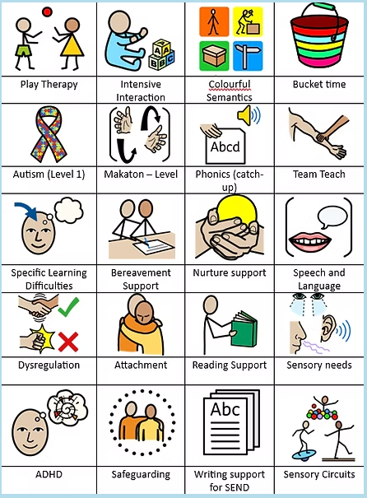
How are staff trained to meet SEND?
At SS John and Monica’s, we are committed to ongoing professional development for staff and aim to ensure all our staff have the understanding they need to enable them to support your child.
When a new member of staff joins the school, we ensure they understand the systems within the school and they are given information about the children they are working with.
The senior leadership team within the school are constantly moderating needs within the school and, where an area of concern is highlighted, whole school training can be organised to ensure all staff understand specific learning difficulties and appropriate teaching or support strategies that could be utilised.
Some of our staff have completed training in the following areas. When staff go on a course, they have an opportunity to give feedback to the rest of the staff during staff meeting sessions.

Slide 20

How will I know how my child is doing and how will you
help me to support my child’s learning?
We work closely with parents and carers and recognise they have much to contribute to our support for children with SEND. We will always arrange to meet with you and discuss how your child is getting on. We can also offer advice and practical ways you can help your child at home. We believe that your child’s education should be a partnership between home and school, therefore we aim to keep communication channels open and communicate regularly, especially if your child has complex needs.
You will be invited in to school on a termly basis for a review meeting where we will discuss the needs and progress of your child. These meetings ensure that everyone develops a good understanding of the pupil’s areas of strength and difficulty, parents concerns are taken into account and that everyone understands the agreed outcomes and next steps for the pupil.
Any reports from outside agencies will be sent home and you will be invited into school to discuss these reports.
For children who have an Education, Health and Care Plan (EHCP) or require specialist support (over and above what is ordinarily available), we will invite you in for further meetings in the year. These meetings celebrate your child’s learning, look at the progress they have made against the targets set, create new targets, and discuss the next steps.
During the year, a parental questionnaire is sent to gain views on the school and the SEND provision.

Slide 21

What about clubs and trips?
All of our extra-curricular clubs and school visits are available to all pupils, including Breakfast Club and after-school clubs.
All children are encouraged to go on trips outside of school.
All children are encouraged to take part in sports day, Masses, assemblies, performances, workshops, etc.
All children are encouraged to apply for roles of responsibility, e.g. school councillor or spiritual councillor.
No child is ever excluded from taking part in activities because of their SEN or disability.
For further information on how we make our school a place for everyone, please see our website for our Accessibility Plan.

Slide 22
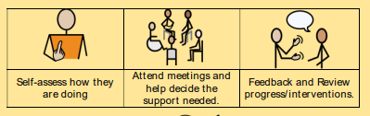
What is pupil voice?
We value and celebrate each child being able to express their views on all aspects of school life.
Pupil views are very important. All pupils have a right to be involved in decisions about their education and support.
Children’s views are gathered regularly and directly inform the support that is planned for them.
Children are encouraged to self -assess and share their views during lessons and interventions.
Pupils are given regular opportunities to:

Slide 23

What is the school’s approach to supporting children in periods of transition?
SS John and Monica’s Catholic Primary School recognises the importance of effective transition between classes, keys stages and schools, and has a number of strategies to support children. We can offer:
Regular and extra visits to new classrooms/ settings ahead of a change
1:1/small group transition session to discuss a coming change
Contact with staff/SENCO from previous/next settings
Transition meetings for staff to discuss needs of individual children
Transition sessions with parents to meet new members of staff
Transition booklets preparing the children for key issues they may face
Transition sessions in PSHE lessons about how to handle change
Personalised transition programmes when needed
Pupil profiles and essential information passed on to next teacher/setting

Slide 24

How do we work with parents?
We know that our parents and carers know their children best. We work closely with parents and carers as we know that you have much to contribute to our support for children with SEND.
We will always meet with you to discuss SEND needs or concerns
We will always inform you if we feel your child needs additional support
We will always ask for your permission when we think an outside agency could support your child’s needs
We will ensure that you receive feedback about your child from the professional who has been working with them
You will be invited to discuss your child’s progress regularly
You will be invited to Parent Consultations twice each year – in October and March – to discuss your child’s progress with their class teacher. You can also meet with the SENCO at Parent Consultations.

Slide 25

What is Birmingham Local Offer?
The Birmingham Local Authority Local Offer can be found at
https://www.localofferbirmingham.co.uk/home/parents-and-carers/
It includes information about the wide range of services available to support all areas of a child’s life (0-25 years), especially those with a Special Educational Need or Disability (SEND). This includes support with education, physical and mental health, social care, leisure activities and moving towards independence and adulthood.
Every local authority in England has a duty to provide children and young people (0-25 years) with support if they have Special Educational Needs and/or Disabilities - this is known as the Local Offer. Every local authority has to publish what support is available on a website: this is called the Local Offer Website.
This Local Offer website gives information about the support the local authority expects to be available across education, health and social care. The information on the website is clear and easy to find. It says who a particular service is for, how to apply, and how decisions are made about who gets that service.

Slide 26



I need further support Who can I contact? SENDIASS.
The Birmingham Special Educational Needs & Disability Information, Advice and Support Service (SENDIASS) offers impartial information, advice and support to children and young people with special educational needs or disabilities.
The service is impartial, confidential, and free.
www.birminghamsendiass.co.uk
Telephone: 0121 303 5004
Email: sendiass@birmingham.gov.uk
If you're a parent or young person being assessed, the service can:
Help you to understand the EHCP referral process
Act as a named contact throughout the process
Help you to communicate with everyone involved in the assessment process
Provide information about personal budgets
Put you in touch with other people who can help, if necessary

Slide 27

Useful telephone numbers

Slide 28

What if I have a complaint?
Complaints Procedure
If you are not happy about something, your first point of contact is your child’s class teacher or SENCO.
If you are not satisfied that your concern has been addressed, then you may make an appointment to speak to the Deputy Head Teacher, Mr. Ullah.
If he cannot solve your issue, then an appointment can be made to speak to the Head Teacher, Mrs. Elliott.
If you are not happy with the response, then you may contact the governors through the school office.
Mrs. B Rooney – Chair of Governors
Mr. S Cummins – SEND Governor

