Slide 1

Do you know what bullying is?
How do you know if you are being bullied?
What is bullying?
Do you know how to put up with it?
By Elizabeth, Lily and Anique

Slide 2

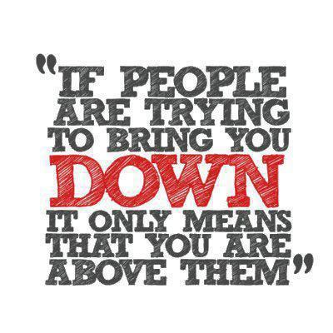
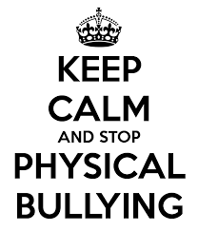


Different types of bullying
There are many different ways of bullying, but there are three ways you may of heard of.
You may have heard them being mentioned as Physical Bullying, Verbal Bullying and Cyber Bullying.

Slide 3



Cyber Bullying
Cyber Bullying is when you say rude things to people online.
This makes people very sad because they can read it again and again. If you say something rude and that person gets very upset, then those words could stay inside that person for the rest of their life.
Never believe anything any one says to you that is mean, because it is not true.
You must be careful what you put out on the internet, because once you put it out there, you have no control of it anymore.
Teasing is never a nice feeling but tell an adult if you receive something that makes you uncomfortable.

Slide 4

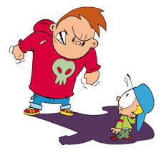
Physical Bullying
Physical Bullying is when you hurt someone with actions.
It could really injure that person and the bully would get into a lot of trouble.
It isn’t good to be afraid to come to school every day, because you are worried.
You shouldn’t be scared by the bully, because they are cowards.
You must always tell an adult if you get really hurt. Don’t bottle it up in you until you have heavy weights on your shoulders.

Slide 5


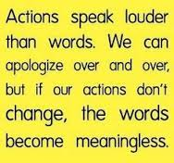
Verbal Bullying
Verbal Bullying is when you hurt people with words.
If you think about it actions can be louder than words.
It is mean and hurtful to say rude things behind people’s backs, and it is very hard for you to ignore them.
So what if you’re different? Who said being different is a bad thing?
Always tell an adult so this doesn’t continue.

Slide 6







You’re not alone….. Even some celebrities went through this!
Katy Perry
Demi Lovato
Victoria Justice
Selena Gomez
Taylor Swift
Lady Gaga

Slide 7



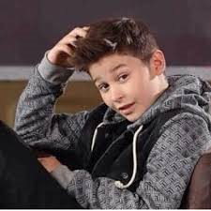
Celebrities being bullied continued…
Adele
Bradley Simpson
Leo from bars and melody

Slide 8



Sorting it out
Your teacher is not just there to give you a good education, but is also there to listen to you. You won’t get in trouble if you tell them.
Your parents will always listen to you and will always point you in the right direction. They will help you sort things out.

Slide 9

Almost 45,000 children talked to ChildLine about bullying in 2013. NSPCC figures suggest nearly half of children and young people (46%) have been bullied at school at some point in their lives.
The NSPCC stands for the National Society for the Prevention of Cruelty to Children. They help to make sure that young people’s lives (0-18 years), are safe, happy and bully-free.
The NSPCC talked to thousands of young people, and asked them how they were being bullied and how to put up with it. The NSPCC are just one of the many organisations standing up against bullying, and helping children go through the process.

Slide 10

How do you stop being a bully?
People who bully others often find it hard to ask for help. They may be worried they'll get into trouble with their teachers or they'll be bullied themselves.
It takes courage to stop being a bully. Just because you've started bullying doesn't mean you have to continue. Help with bullying isn't just available to people who've been bullied. Many anti-bullying support groups also help people who are involved in bullying themselves.
Talk to a parent, teacher or an older pupil who you get on well with.

Slide 11

The Disadvantages
If you are a bully, then your friends may find it difficult to play along with your mean actions.
Do not be angry if your friend stops playing with you, because they are sad about your actions.
Try to stop bullying others because then everyone will think you are mean, but remember it is never too late to change.

Slide 12

Think before you say!
Like a tube of toothpaste, when you squeeze it all out you can’t put it back in. This is like words. When you say them you cannot take them back

Slide 13







PUT AN END TO BULLYING NOW!!!

