Slide 1
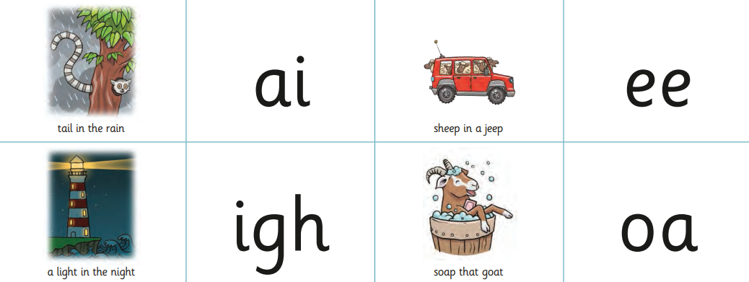
Little Wandle - Letters and Sounds Reception Phonics Home Learning
Phase 3 - Spring 1 Week 1 Focus - Phonemes ai / ee / igh / oa
Please support your child to practise and reinforce the phonemes and graphemes we are learning in school. More information and support can be found on the Little Wandle website -
https://www.littlewandlelettersandsounds.org.uk/resources/for-parents/
Phonemes we will be focusing on this week in school -
We will be reading and writing words. Can you spot segment and blend these words and spot this week’s phonemes?
pain | see | sight | coat
hail | jeep | high | road
We will be reading sentences. Can you spot any tricky words? Can you segment and blend the words and look out for this week’s phonemes?
The cat has a tail. |  | His feet go deep in the mud.
I can see a bat at night. |  | The goat had a red coat.
We will be practising tricky words. Can you spot the tricky part of the word?
is | as | the | I

Slide 2
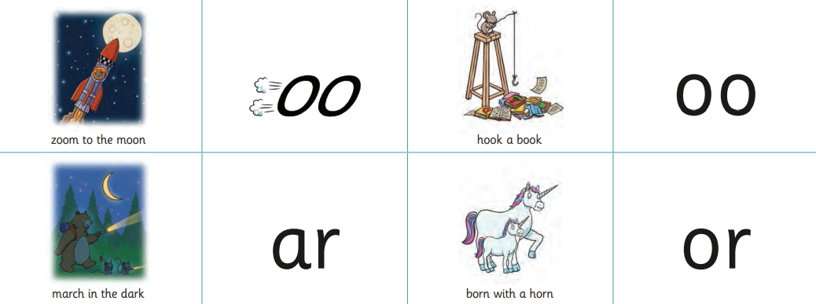
Little Wandle - Letters and Sounds Reception Phonics Home Learning
Phase 3 - Spring 1 Week 2 Focus - Phonemes oo / oo / ar / or
Please support your child to practise and reinforce the phonemes and graphemes we are learning in school. More information and support can be found on the Little Wandle website -
https://www.littlewandlelettersandsounds.org.uk/resources/for-parents/
Phonemes we will be focusing on this week in school -
We will be reading and writing words. Can you spot segment and blend these words and spot this week’s phonemes?
zoo | good | bark | pork
room | hook | yard | born
We will be reading sentences. Can you spot any tricky words? Can you segment and blend the words and look out for this week’s phonemes?
His food is not hot. |  | I look at the moon.
The car has lights on in the dark. |  | The goat has sharp horns.
We will be practising tricky words. Can you spot the tricky part of the word?
was | you | they

Slide 3
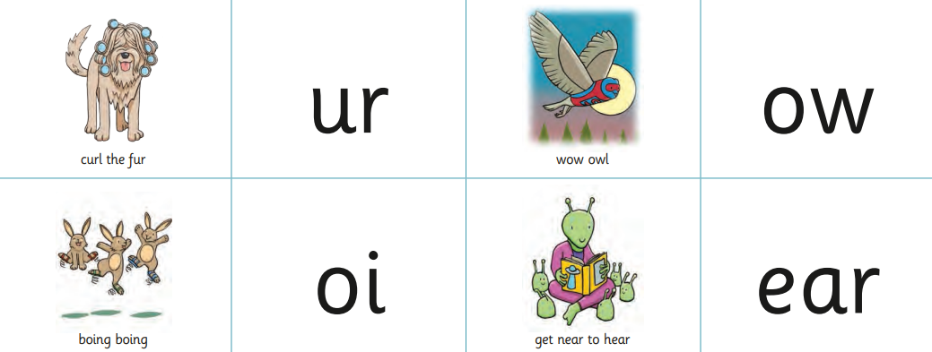
Little Wandle - Letters and Sounds Reception Phonics Home Learning
Phase 3 - Spring 1 Week 3 Focus - Phonemes ur / ow / oi / ear
Please support your child to practise and reinforce the phonemes and graphemes we are learning in school. More information and support can be found on the Little Wandle website -
https://www.littlewandlelettersandsounds.org.uk/resources/for-parents/
Phonemes we will be focusing on this week in school -
We will be reading and writing words. Can you spot segment and blend these words and spot this week’s phonemes?
surf | howl | oil | hear
turn | down | join | tear
We will be reading sentences. Can you spot any tricky words? Can you segment and blend the words and look out for this week’s phonemes?
The pig has a curl in his tail. |  | We go to the shop in town.
He boils the food in the pan. |  | I can hear the owl hoot.
We will be practising tricky words. Can you spot the tricky part of the word?
was | you | they | into
my | by | all

Slide 4
Little Wandle - Letters and Sounds Reception Phonics Home Learning
Phase 3 - Spring 1 Week 4 Focus - Phonemes air / er words with double letters e.g. dd / tt
Please support your child to practise and reinforce the phonemes and graphemes we are learning in school. More information and support can be found on the Little Wandle website -
https://www.littlewandlelettersandsounds.org.uk/resources/for-parents/
Phonemes we will be focusing on this week in school -
dd ladder | mm hammer | tt litter | bb rubbish | rr carrot | gg jogger | pp puppet | ff coffee
Double letters in words (e.g. rabbit) are also called ‘digraphs’ - two letters making one sound.
We will be reading and writing words. Can you spot segment and blend these words and spot this week’s phonemes?
hair | boxer | letter | rubber
chair | summer | rubbish | coffee
We will be reading sentences. Can you spot any tricky words? Can you segment and blend the words and look out for this week’s phonemes?
The man has no hair. |  | He hits the nail with a hammer.
The rabbit needs a bigger carrot. |  | We get a letter from the queen.
We will be practising tricky words. Can you spot the tricky part of the word?
my | by | all | no
go | are | sure | pure

Slide 5
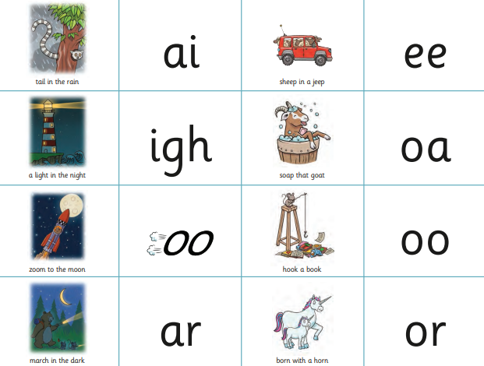
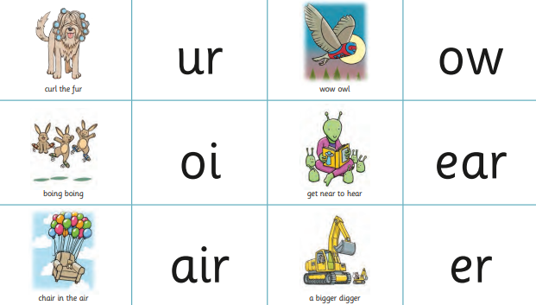
Little Wandle - Letters and Sounds Reception Phonics Home Learning
Phase 3 - Spring 1 Week 5 Focus - longer words
Please support your child to practise and reinforce the phonemes and graphemes we are learning in school. More information and support can be found on the Little Wandle website -
https://www.littlewandlelettersandsounds.org.uk/resources/for-parents/
Phonemes we will be focusing on this week in school -
We will be reading and writing words. Can you spot segment and blend these words and spot this week’s phonemes?
laptop | popcorn | market | raincoat
sunset | starfish | ticket | melon
Words such as laptop and sunset are ‘compound words’. Help your to see the two root words that make up each compound word e.g. lap - top. Talk about how these root words help to create the meaning of the new word.
We will be reading sentences. Can you spot any tricky words? Can you segment and blend the words and look out for this week’s phonemes?
We had a picnic at sunset. |  | He has a chicken in his pocket.
The goat was in the farmyard. |  | I can see a starfish.
We will be practising tricky words. Can you spot the tricky part of the word?
are | sure | pure | into
she | he | we | me
be | of

