Slide 1
Little Wandle - Letters and Sounds Reception Phonics Home Learning
Phase 3 - Spring 2 Week 1 Focus - Phase 3 phonemes
Please support your child to practise and reinforce the phonemes and graphemes we are learning in school. More information and support can be found on the Little Wandle website -
https://www.littlewandlelettersandsounds.org.uk/resources/for-parents/
Phonemes we will be focusing on this week in school -
ai | ee | igh | oa
oo | ar | or | ur
oo | ow | oi | ear
We will be reading and writing words. Can you spot segment and blend these words and spot this week’s phonemes?
tail | deep | fight | load
food | hard | born | surf
foot | town | boil | hear
We will be reading sentences. Can you spot any tricky words? Can you segment and blend the words and look out for this week’s phonemes?
The man has a long boat. |  | He has buckets of carrots.
The night is dark. |  | The cat has a curl in his tail.
We put the rabbit down on the carpet.
We will be practising tricky words. Can you spot the tricky part of the word?
is | as | his | has | the | I

Slide 2
Little Wandle - Letters and Sounds Reception Phonics Home Learning
Phase 3 - Spring 2 Week 2 Focus - Phase 3 phonemes / Double letters / Longer words
Please support your child to practise and reinforce the phonemes and graphemes we are learning in school. More information and support can be found on the Little Wandle website -
https://www.littlewandlelettersandsounds.org.uk/resources/for-parents/
Phonemes we will be focusing on this week in school -
dd ladder | mm hammer | tt litter | bb rubbish | rr carrot | gg jogger | pp puppet | ff coffee
Longer Words - We will be reading longer words and using chunking method to help us read them e.g. hel/met helmet, hab/it habit
We will be reading and writing words. Can you spot segment and blend these words and spot this week’s phonemes?
bigger | chair | fair | rubber
shimmer | butter | supper | chatter
muffin | mutter | buzzer | cannot
laptop | seven | fantastic | comic
We will be reading sentences. Can you spot any tricky words? Can you segment and blend the words and look out for this week’s phonemes?
This pink chair is bigger than the red chair.
We feed the chicken and rabbit supper.
We will be practising tricky words. Can you spot the tricky part of the word?
and | go | no | of

Slide 3
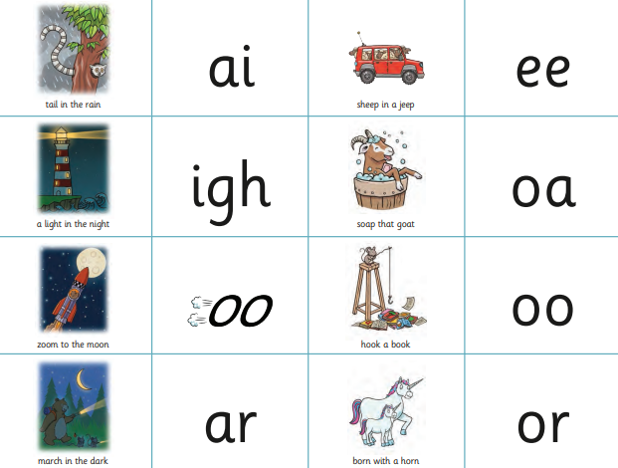
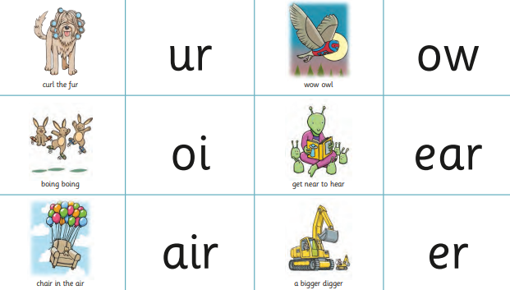
Little Wandle - Letters and Sounds Reception Phonics Home Learning
Phase 3 - Spring 2 Week 3 Focus - Words with two or more digraphs
Please support your child to practise and reinforce the phonemes and graphemes we are learning in school. More information and support can be found on the Little Wandle website -
https://www.littlewandlelettersandsounds.org.uk/resources/for-parents/
Phonemes we will be focusing on this week in school -
We will be reading and writing words. Can you spot segment and blend these words and spot this week’s phonemes?
sharp | shark | sheep | cheep
queen | tooth | short | thinker
powder | church | corner | farmer
torch | chain | shower | march
We will be reading sentences. Can you spot any tricky words? Can you segment and blend the words and look out for this week’s phonemes?
The sheep march up the hill and into the sunset.
We tell the farmer that his goat has got into the shower.
We will be practising tricky words. Can you spot the tricky part of the word?
no | of | to | into | she | he | we

Slide 4
Little Wandle - Letters and Sounds Reception Phonics Home Learning
Phase 3 - Spring 2 Week 5 Focus - Longer words / Words ending in -s (s/z) -es
Please support your child to practise and reinforce the phonemes and graphemes we are learning in school. More information and support can be found on the Little Wandle website -
https://www.littlewandlelettersandsounds.org.uk/resources/for-parents/
Phonemes we will be focusing on this week in school -
We will be reading and writing words. Can you spot segment and blend these words and spot this week’s phonemes?
lightning | mammoth | earring | poison
queens | chains | chairs | cars
boots | surfs | cooks | cheeps
torches | boxes | fizzes | fishes
We will be reading sentences. Can you spot any tricky words? Can you segment and blend the words and look out for this week’s phonemes?
You need to put on coats and boots to go into the garden.
The cooks pop the popcorn and pop it into the boxes!
We will be practising tricky words. Can you spot the tricky part of the word?
they | all | by | my | are | sure | pure

