Slide 1
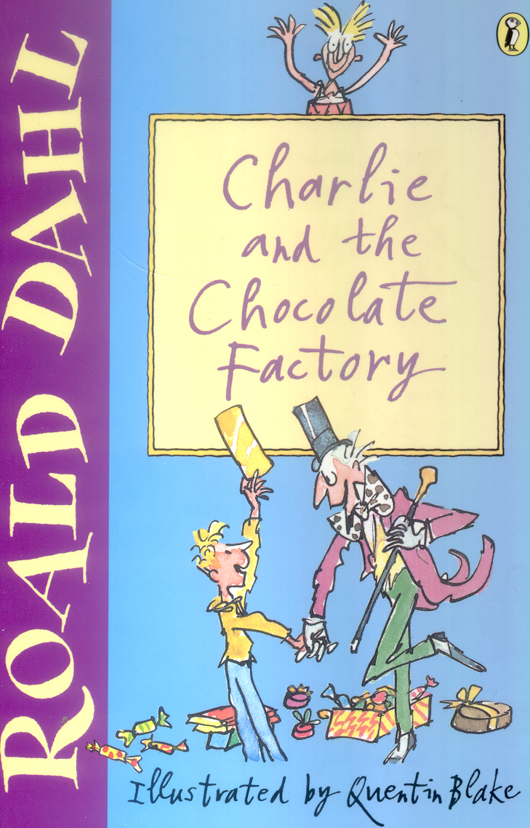

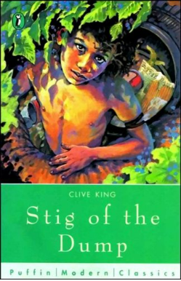



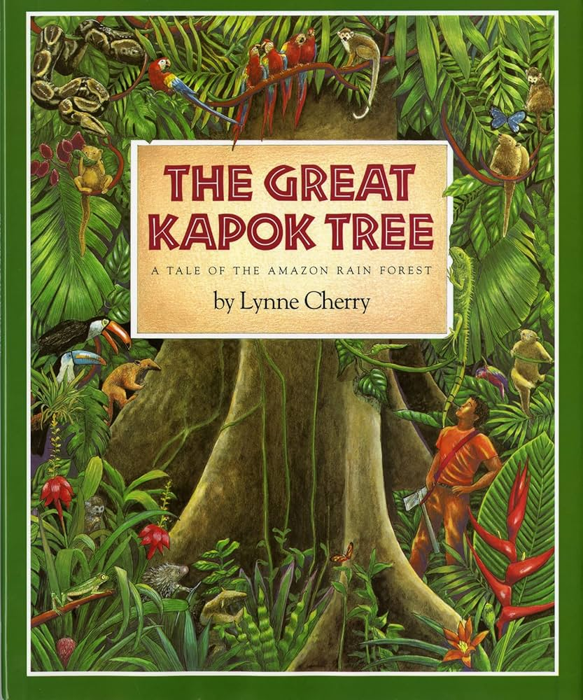
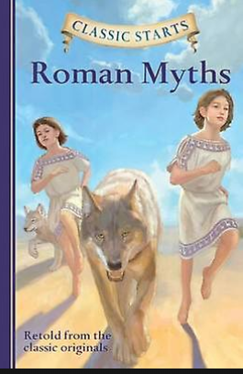
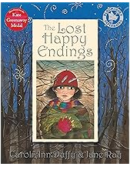

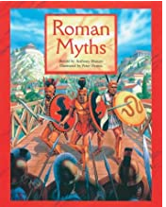


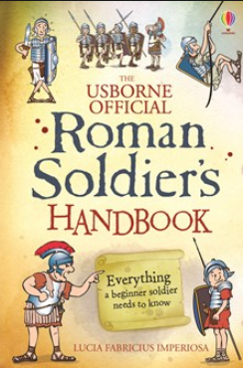

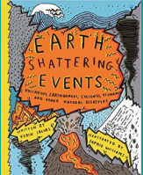

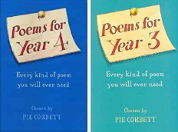


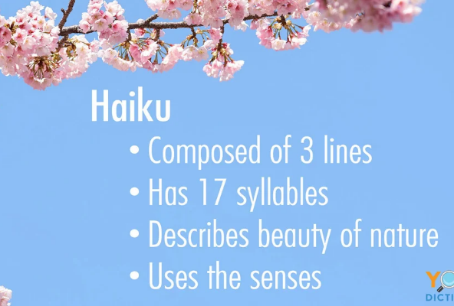

Year 2,3&4 Cycle A History Geography Science | Autumn 1 How children’s lives have changed Materials, rocks and soils | Autumn 2 Why are Rainforests important to us? Materials, states of matter | Spring 1 Romans Digestion and Food | Spring 2 Plants Settlements | Summer 1 Light and shadow 4 weeks | Summer 2 Volcanoes Making connections
Reading Spine Reading for Pleasure 15-20 mins a day
Narrative Core Text Informs Narrative writing outcomes & may be linked to curriculum area & WCR
Non-narrative Linked to topic & used for WCR
Poetry Whole Class Reading/guided Reading Performance/written

