Slide 1
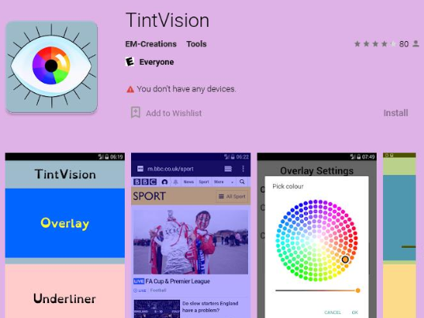
Dyslexia & Visual Stress
How to change the tint on your devices to support visual stress.
Android Phones – Download the free app Tint Vision – Apply the colour you need

Slide 2
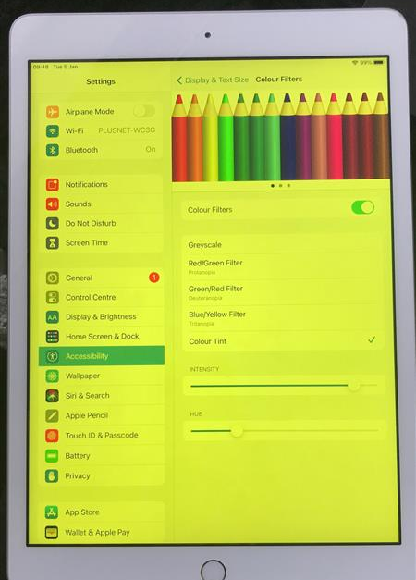

iPad and iPhones –
Settings
Accessibility
Display Text & Size
Colour Filters
Slide to ON and pick the colour you need by sliding the intensity and hue.
Intensity
Hue

Slide 3



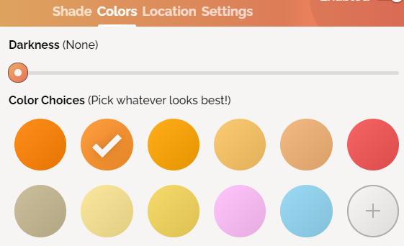

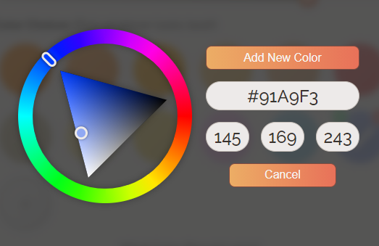
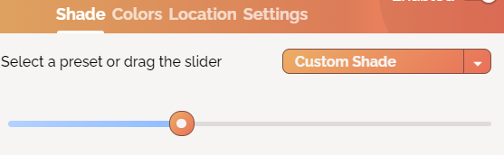

Laptops -
Open Google Chrome
type screen shader
click the first link and add to chrome
click add extension
press the jigsaw piece on the toolbar for extensions (image 1)
select screen shader
select colours and pick the colour you need (image 2)
If you need a colour not available click the + button and select the right colour on the wheel and press add colour (image 3)
Finally to adjust the shade of your colour select shade and drag the slider (image 4).

