Slide 1
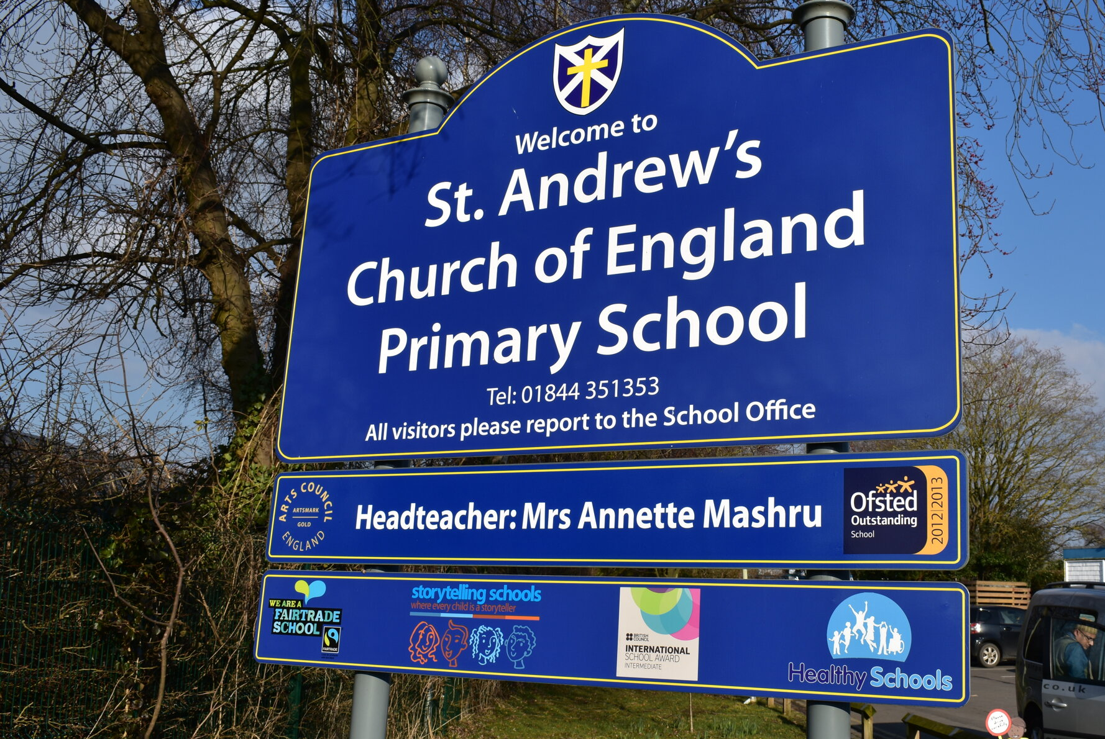

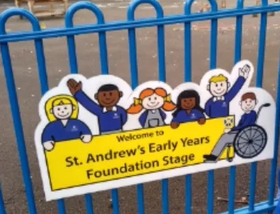
EYFS
Admissions meeting for parents
L
O
M
W
E
C
E
Wednesday 13th May 2026 (5.00pm)

Slide 2

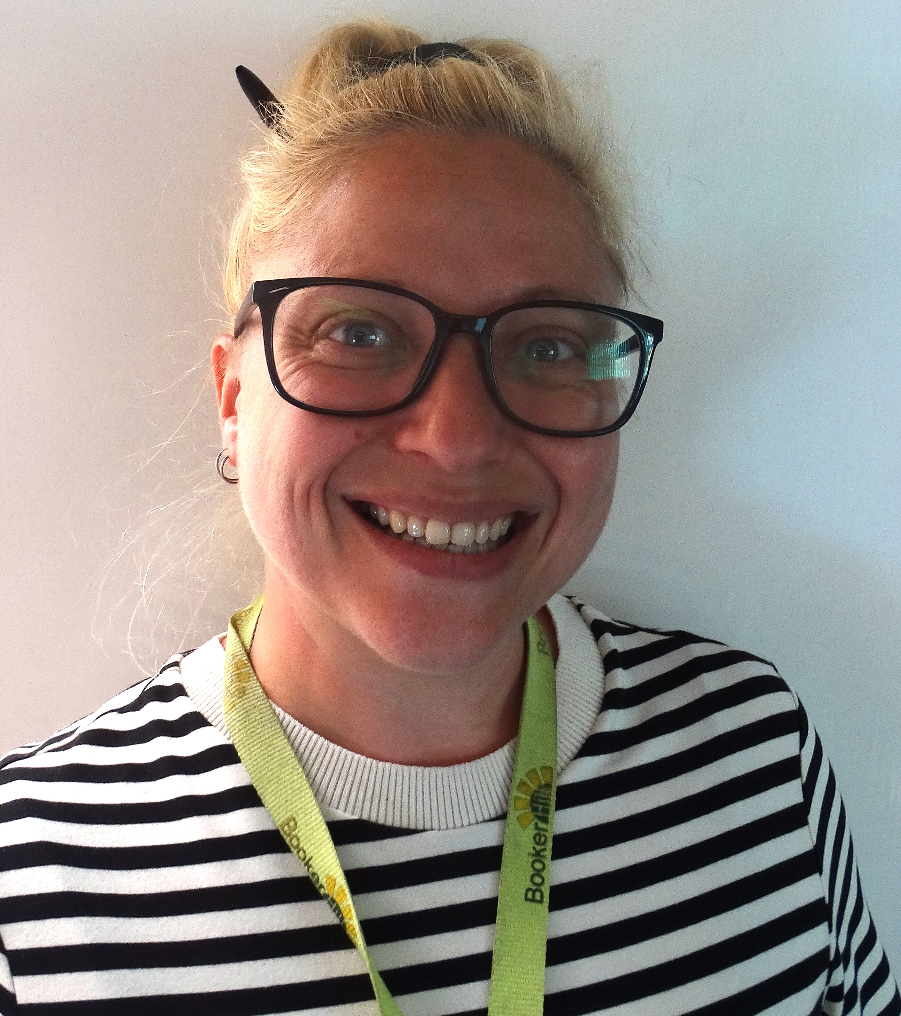
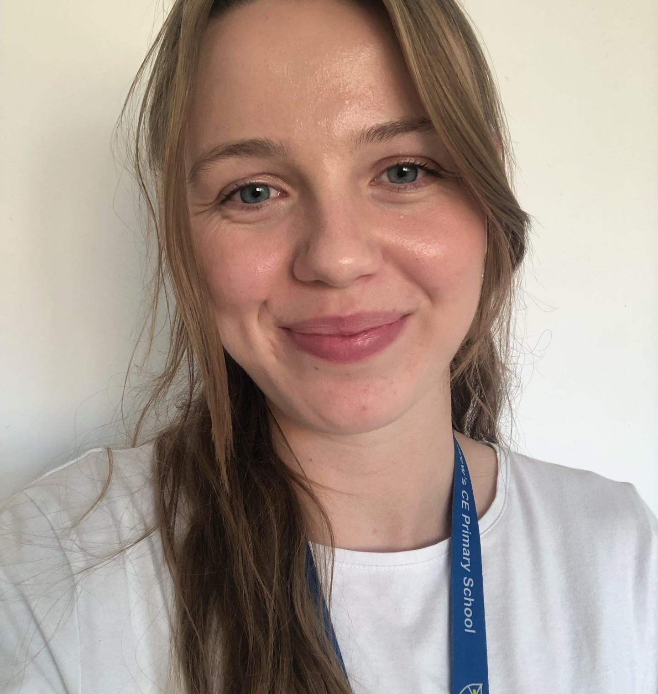
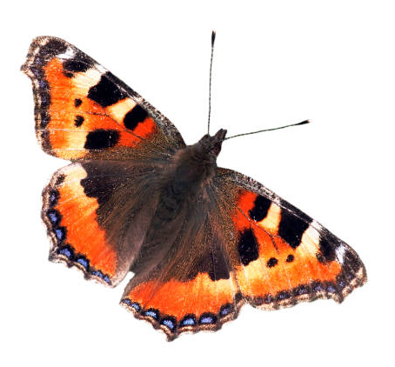
Meet the EYFS teachers
Miss Zakaszewski
Miss Surman
Red Admiral Class
Tortoiseshell Class
Teaching Assistants in EYFS are yet to be confirmed

Slide 3
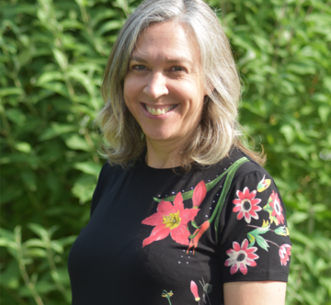
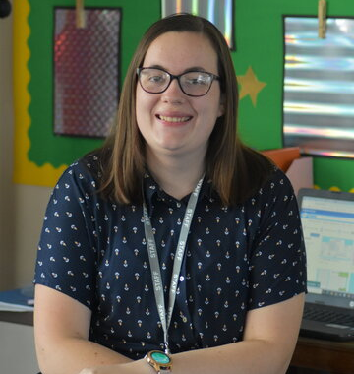
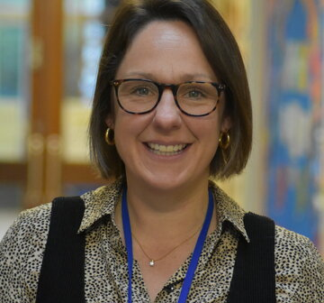
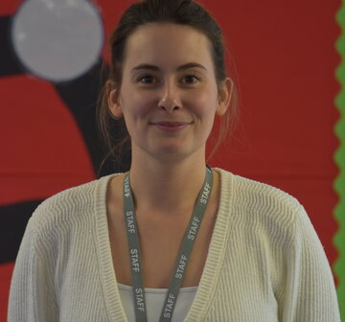
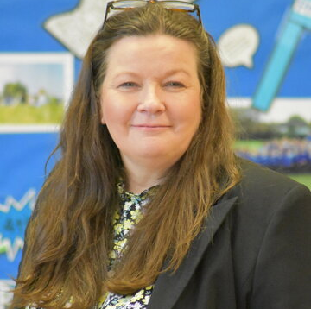
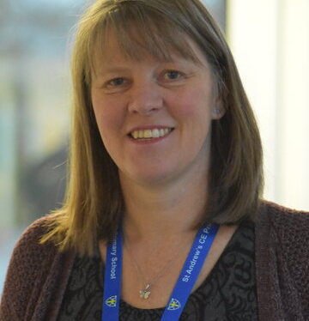


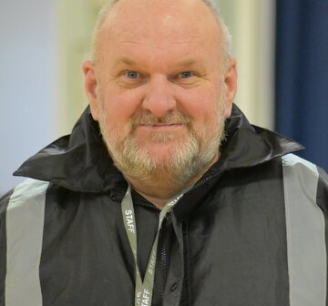
Other key staff to know…
Mrs Mashru
Mrs Gerrish
Miss Churchman
Mrs Garlick & Mrs Collier
Headteacher
Assistant Headteacher (KS2)
Assistant Headteacher (KS1)
SENDCo
Mrs Wootton
Mrs Mann
Mr Clarke
Mr Cummins
School Business Manager
Office Administrator
PE Teacher
Caretaker

Slide 4
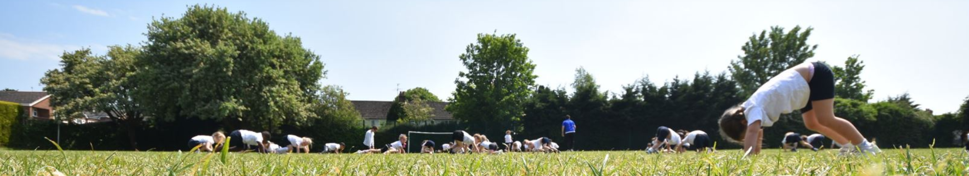
EYFS - 7 areas of Learning
3 Prime Areas
4 Specific Areas
Communication and Language
Physical Development
Personal, Social and Emotional Development
Literacy
Mathematics
Understanding the World
Expressive Art and Design
To get a Good Level of Development at the end of the year, your child has to have met the Early Learning Goals in the 3 Prime Areas, plus Literacy and Maths
Notes:
Different curriculum from the rest of the school / Learn through play / Very similar to how many children will have been learning in Nurseries

Slide 5
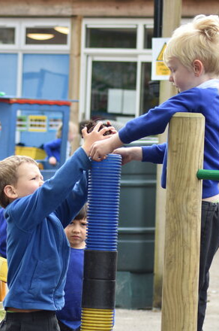
Our Day in EYFS
Welcome activities & Register
Phonics & Drawing Club input – with focus groups
Child Initiated Learning
Maths input – with focus groups
Collective Worship
Lunch
Curriculum Input
Child Initiated Learning/adult focus groups
Story time
Home time
Notes:
Child initiated is indoor and outdoor

Slide 6


Two letter-sounds are taught a week, steadily and continuously.
Each letter-sound is taught over two days, with the first day focusing on blending for reading and the second day focusing on segmenting for spelling.
The program incorporates storytelling to make learning engaging and memorable. Carefully levelled, fully decodable books are sent home to support learning.
You will be invited to a Phonics workshop to help support your child’s learning

Slide 7
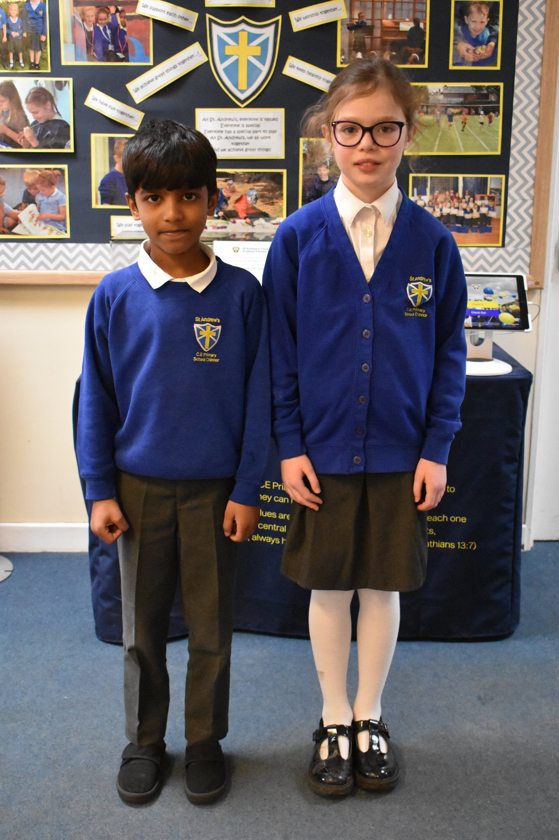
School Uniform
  White/blue polo shirt
  Blue school sweatshirt, cardigan or fleece with St. Andrew’s logo
  Mid grey – trousers, skirt or pinafore dress
  White/grey socks or tights
  Indoor shoes - black plimsolls (not slippers)
  Black school shoes (preferably Velcro)
PE Uniform:
  Dark navy shorts (Not cycling shorts)
  White T-shirt
  Dark navy tracksuit
  Trainers for outdoor PE
Swimming:
  One piece swimming costume or swimming shorts
  Swimming hat (material – can be bought from school office)
Notes:
This list is available on the school website
PTA sell second hand uniform
Please name everything!!!!!!!

Slide 8
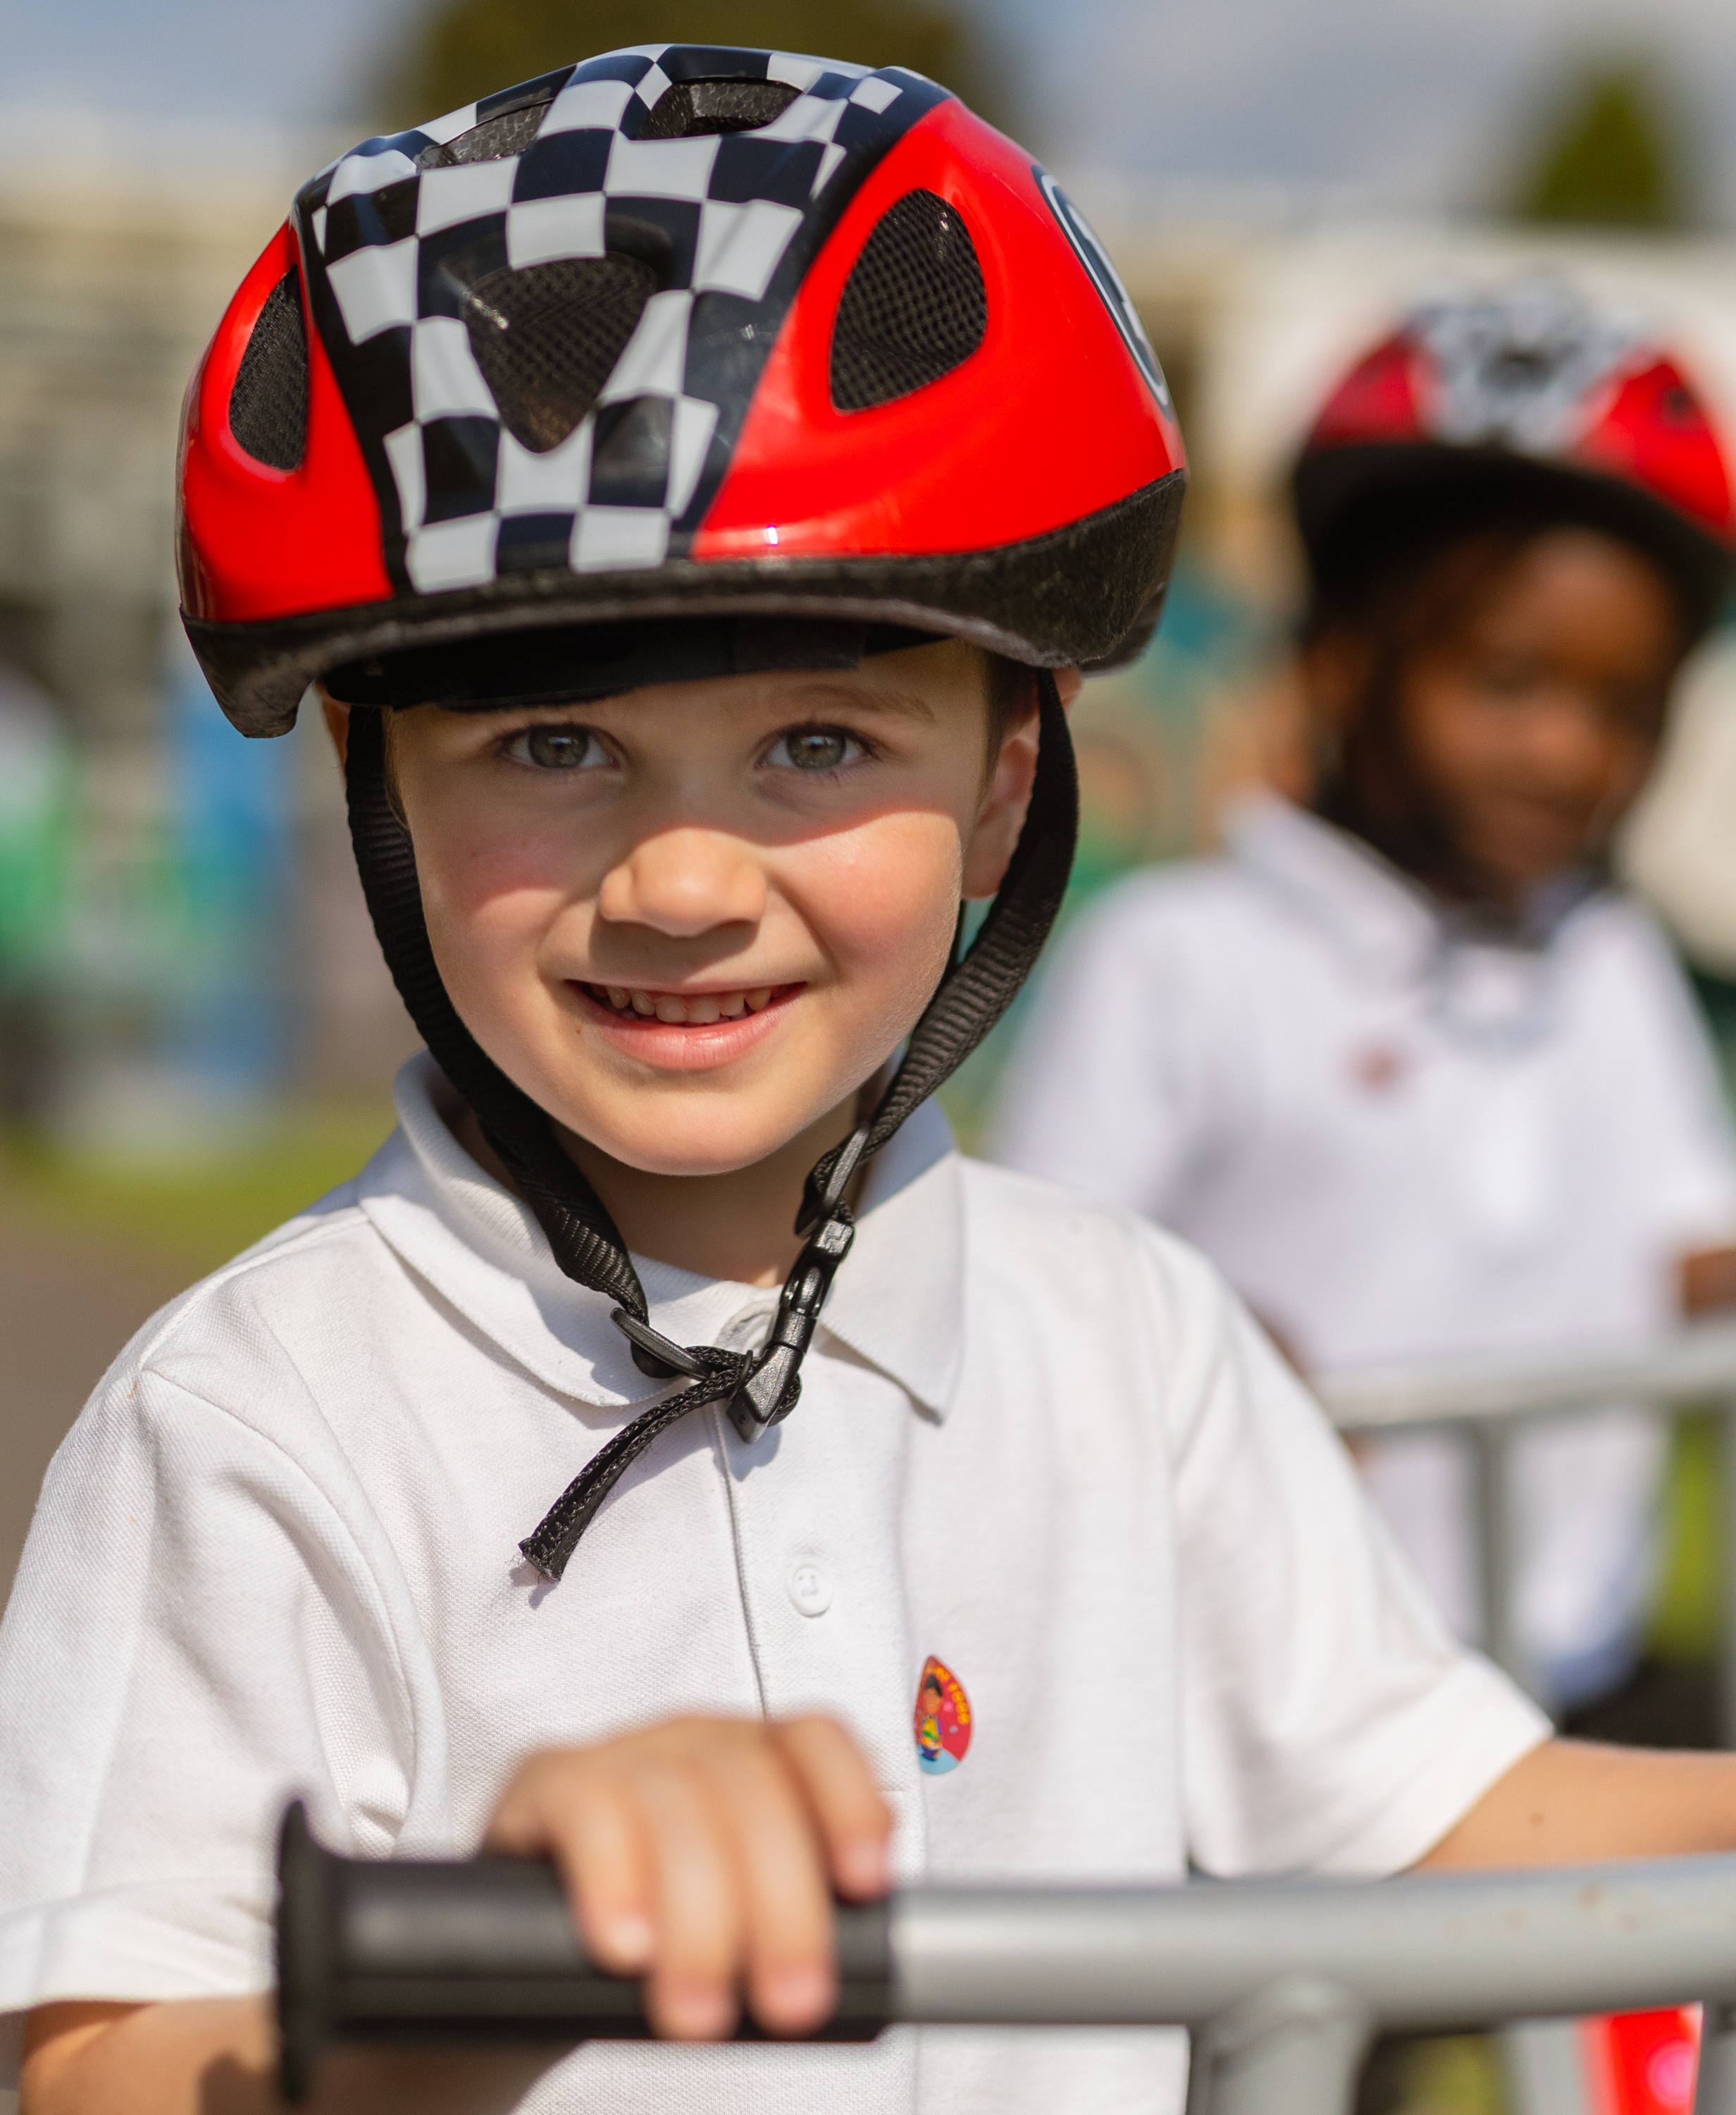

Being prepared for school
Be on time – school starts at 8.45 and finishes at 3.10pm (3.15pm for KS2 building)
Notify school office if absent
Named water bottle and book bag in daily
Plimsolls to live in school (also named!)
EYFS also learn outdoors all year round - Make sure children are dressed appropriately for the weather
Order school lunch (if using) on time
Check Arbor app and emails

Slide 9

Important Dates
We will visit or at least speak to pre school staff
School visit - All children (no adults) on Tuesday 30th June 9.45 to 10.45am
School Term dates are available on the school website
Children attend full time from the beginning of the school year (amendments to this are on an individual basis)

Slide 10
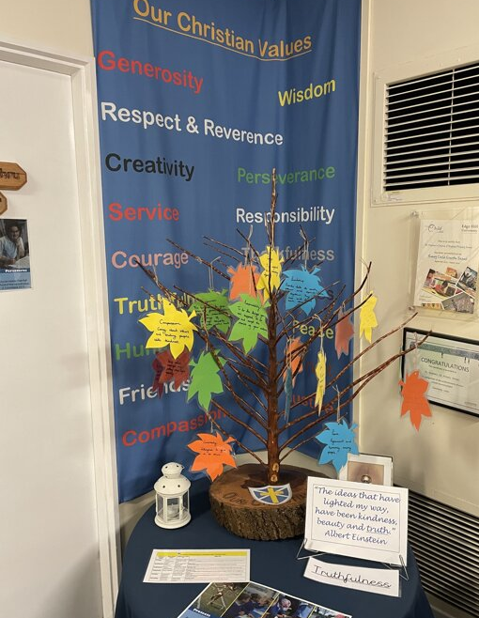
The first day!
Thursday 3rd September
Please bring children to the blue gates outside the classes. Say goodbye and send them through the gate independently.
Go home, have a cup of tea and try to relax! Rest assured if there are any problem, we will call you.
Please collect your child at the gate at 3.10pm
Notes:
They are here today – please enquire for more information.

Slide 11



Slide 12

Thank you!
Any questions?

