Slide 1
WELCOME

Slide 2
Staffing
Class Teachers:
Tortoiseshell- Miss Surman
Red Admiral- Mrs Thompson/ Mrs Wade (Fridays)
Teaching Assistants:
Mrs Collins/ Ms Osmond
Mrs Cummins
Ms Wright
Mrs McClement (Tuesday and Thursday morning)

Slide 3
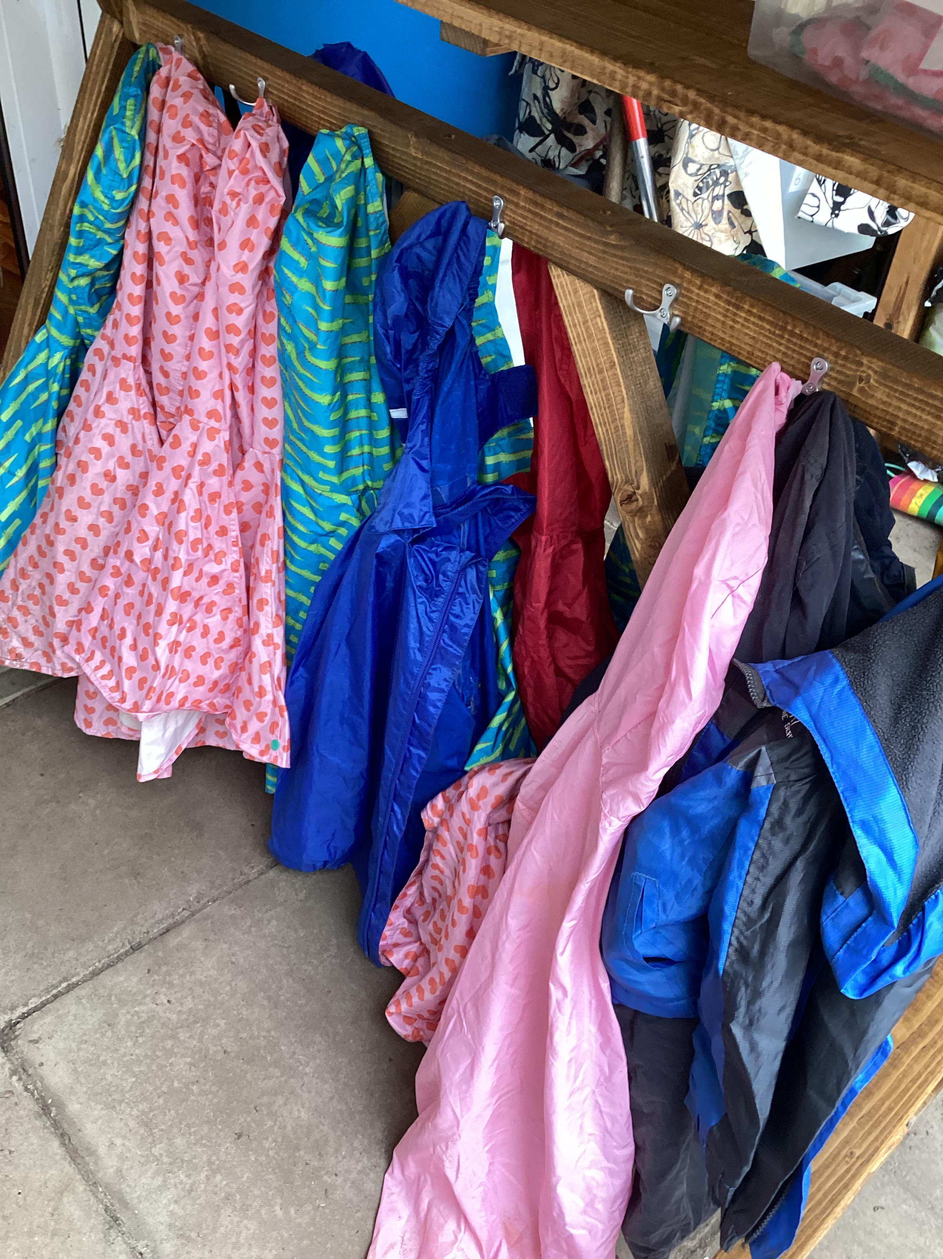
Useful information
School uniform including PE and swimming kit
https://st-andrews.oxon.sch.uk/school-information/school-uniform
http://www.standrewsce.bigcartel.com/ - to order uniform
Please remember to label all items of clothing and footwear BEFORE YOUR CHILD STARTS SCHOOL.
Footwear- THINK- Can my child fasten their shoes independently?
Ooooops moments!- Spare clothes please in a named plastic bag.
Learning environment- both indoors and outdoors so do make sure your child has practical clothing, suitable for the seasonal changes.

Slide 4
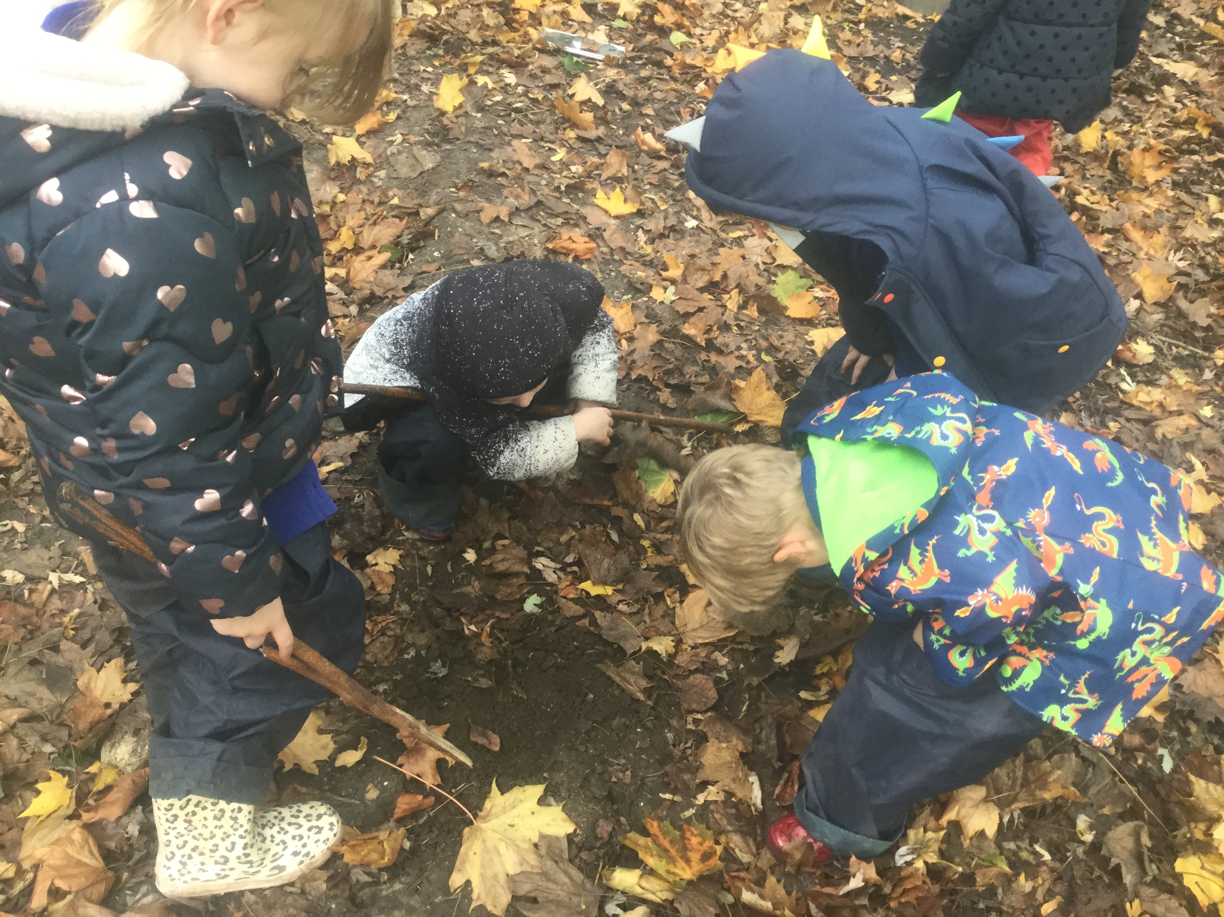
Things to bring to school-LABELLED PLEASE!
Suitable coats—nothing too special!
Hats, scarves, gloves and sun hats (where applicable)
Water bottles – plastic or metal
Book bags, reading records and reading books—these are checked and changed regularly.
A pair of wellies-which can be left at school
PE bag every Monday

Slide 5
Important dates
Transition visits:
Children who attend Ladybird pre-school can visit on Thursday 8th and Wednesday 28th June from 3.45 to 4.30pm. (Parents and children)
Children from all other EYFS settings will visit on Thursday 22nd June and Wednesday 5th July from 3.45 to 4.30pm (Parents and Children)
AND Both groups (children only): Tuesday 11th July 9.40 to 11.00am
School Term dates: https://st-andrews.oxon.sch.uk/termdates
*From Monday 18th September, our intention is for all children to attend full time (8.45am- 3.15) – before this date you may choose for your child to attend part time.
Any amendments to this will be on an individual basis.

Slide 6
The first day! Tuesday 5th September.
*Please bring children to the blue gates at the EYFS entrance. Say goodbye and send them through the gate independently.
Go home and have a cup of tea!
Please collect your child at the gate at 3.10/3.15. *Remember to wave to us!- This will help us and your child to find you amongst the crowd.

Slide 7
The School Day
8:45 Fidgety fingers
9:05 Register
9:10 Maths-whole class
9.20 Maths groups/ continuous provision
10.00 Daily phonics – whole class
10.15 Phonics groups/ continuous provision
11:15 Tidy up
11.30 Collective Worship
11.45 Lunch
1.00 Register
1:10 Book time
1:20 Curriculum input/whole class teaching
1:30 Child Initiated Learning/adult focus groups
2.20 Tidy up time
2.30 Snack
2.50 Story
3.00 Home time prep.
3.10/3.15 Home time

