Slide 1
Welcome to Year 2
Peacock class and Chiltern Blue class

Slide 2
Teachers: Miss Churchman
Thursday: Mrs Chapman
Teachers: Mrs Whitworth
1 Student teacher Miss Harman
Teaching assistants:
Mrs Rolfe Mrs Wilkinson Mrs Osbourne Mrs Gray Mrs Robinson

Slide 3
Year 2 Timetable

Slide 4
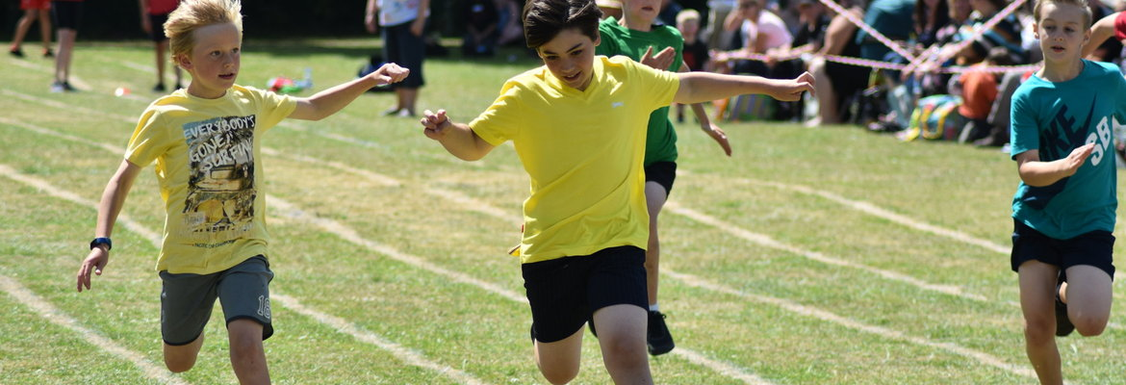
PE
PE is on a Wednesday for both classes and swimming is on Friday.
Please ensure children have a PE kit with them on PE days (including trainers)
Please send children with correct PE kit and ensure they are appropriately dressed for the weather (eg: jogging bottoms and a sweater if cold, rain coat if wet)
Everything must be labelled.

Slide 5
Homework
Spellings
Please practise spellings daily
Spellings based on phonics learning during the week
New spellings will go home on Friday
Spelling folders are due in on Thursday for the spelling test
Reading
Please read daily
Reading books should come with the children every day so an adult can hear them read.
Books will be changed when they have finished.
Please note in the reading diary when you have read with your child so their book can be changed.
We should see reading at home at least twice a week
Homework will go home on Friday and be collected in on Thursday or when completed.
Times Tables Rockstars
This will be set up shortly so look out for a letter!
These are set in advance for each week
Please encourage your child to have a go
You will receive a login in September

Slide 6
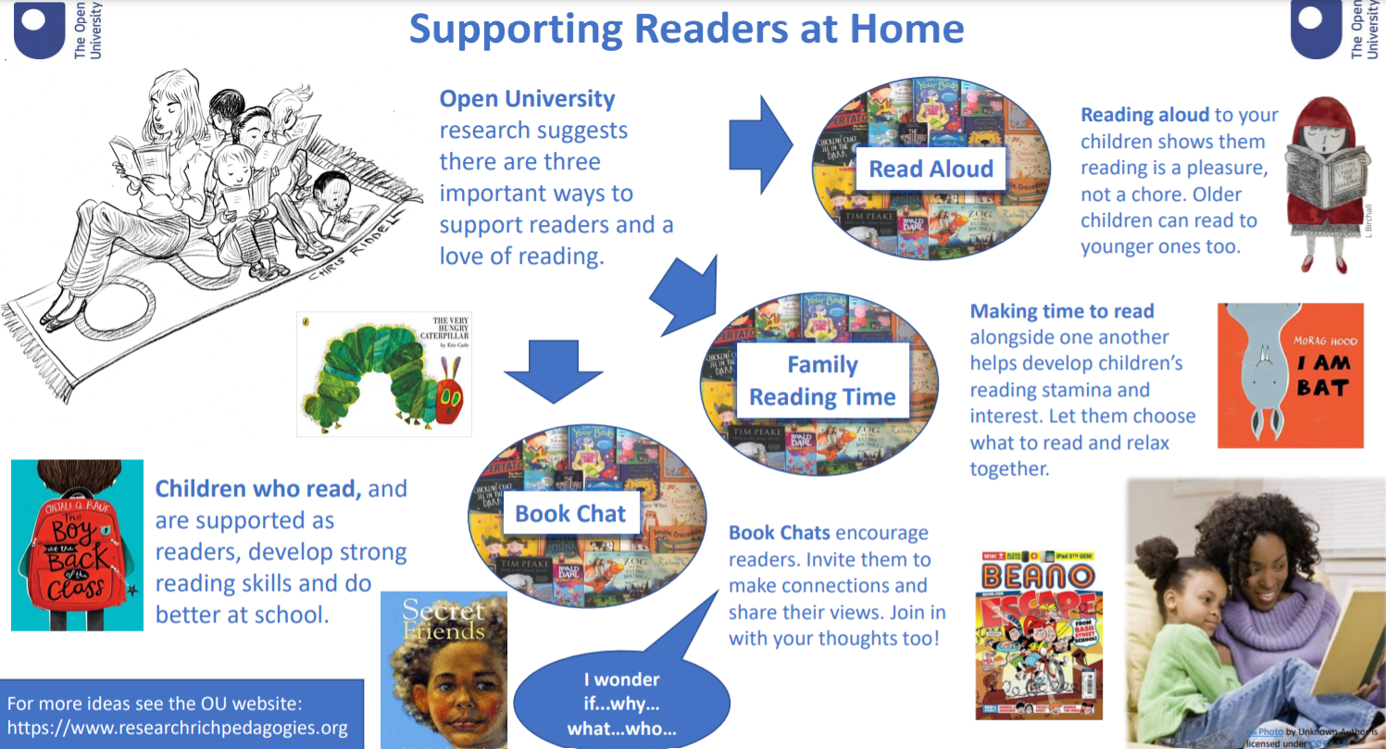

Slide 7
Rapid recall
We aim to practise these rapid recall skills through the year.

Slide 8
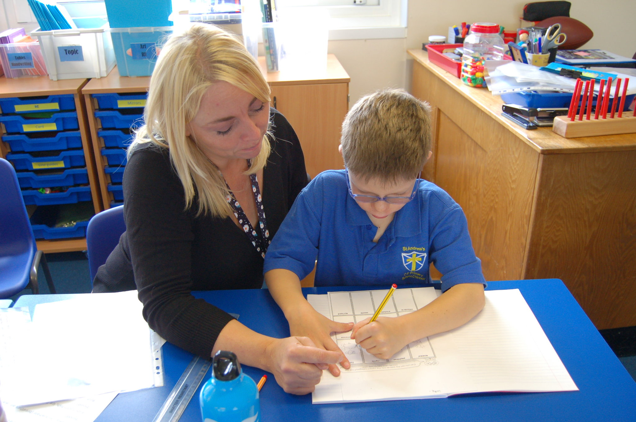
Early Morning Interventions (EMIs)
EMIs start daily at 8:30 am
Invitations are sent termly
Used to plug gaps in learning, to extend learning or for a specific need
We will encourage children to attend as much as possible

Slide 9
Assessment
At present, the government still has KS1 SATs scheduled for the month of May.
Our priority in Year 2 will be to prepare the children for KS2
We will continue to teach a broad and engaging curriculum
We will continue to prepare for SATs
A meeting will likely be scheduled in around March to provide details about what these assessments involve.

Slide 10
Maths

Slide 11
Maths

Slide 12
Writing

Slide 13
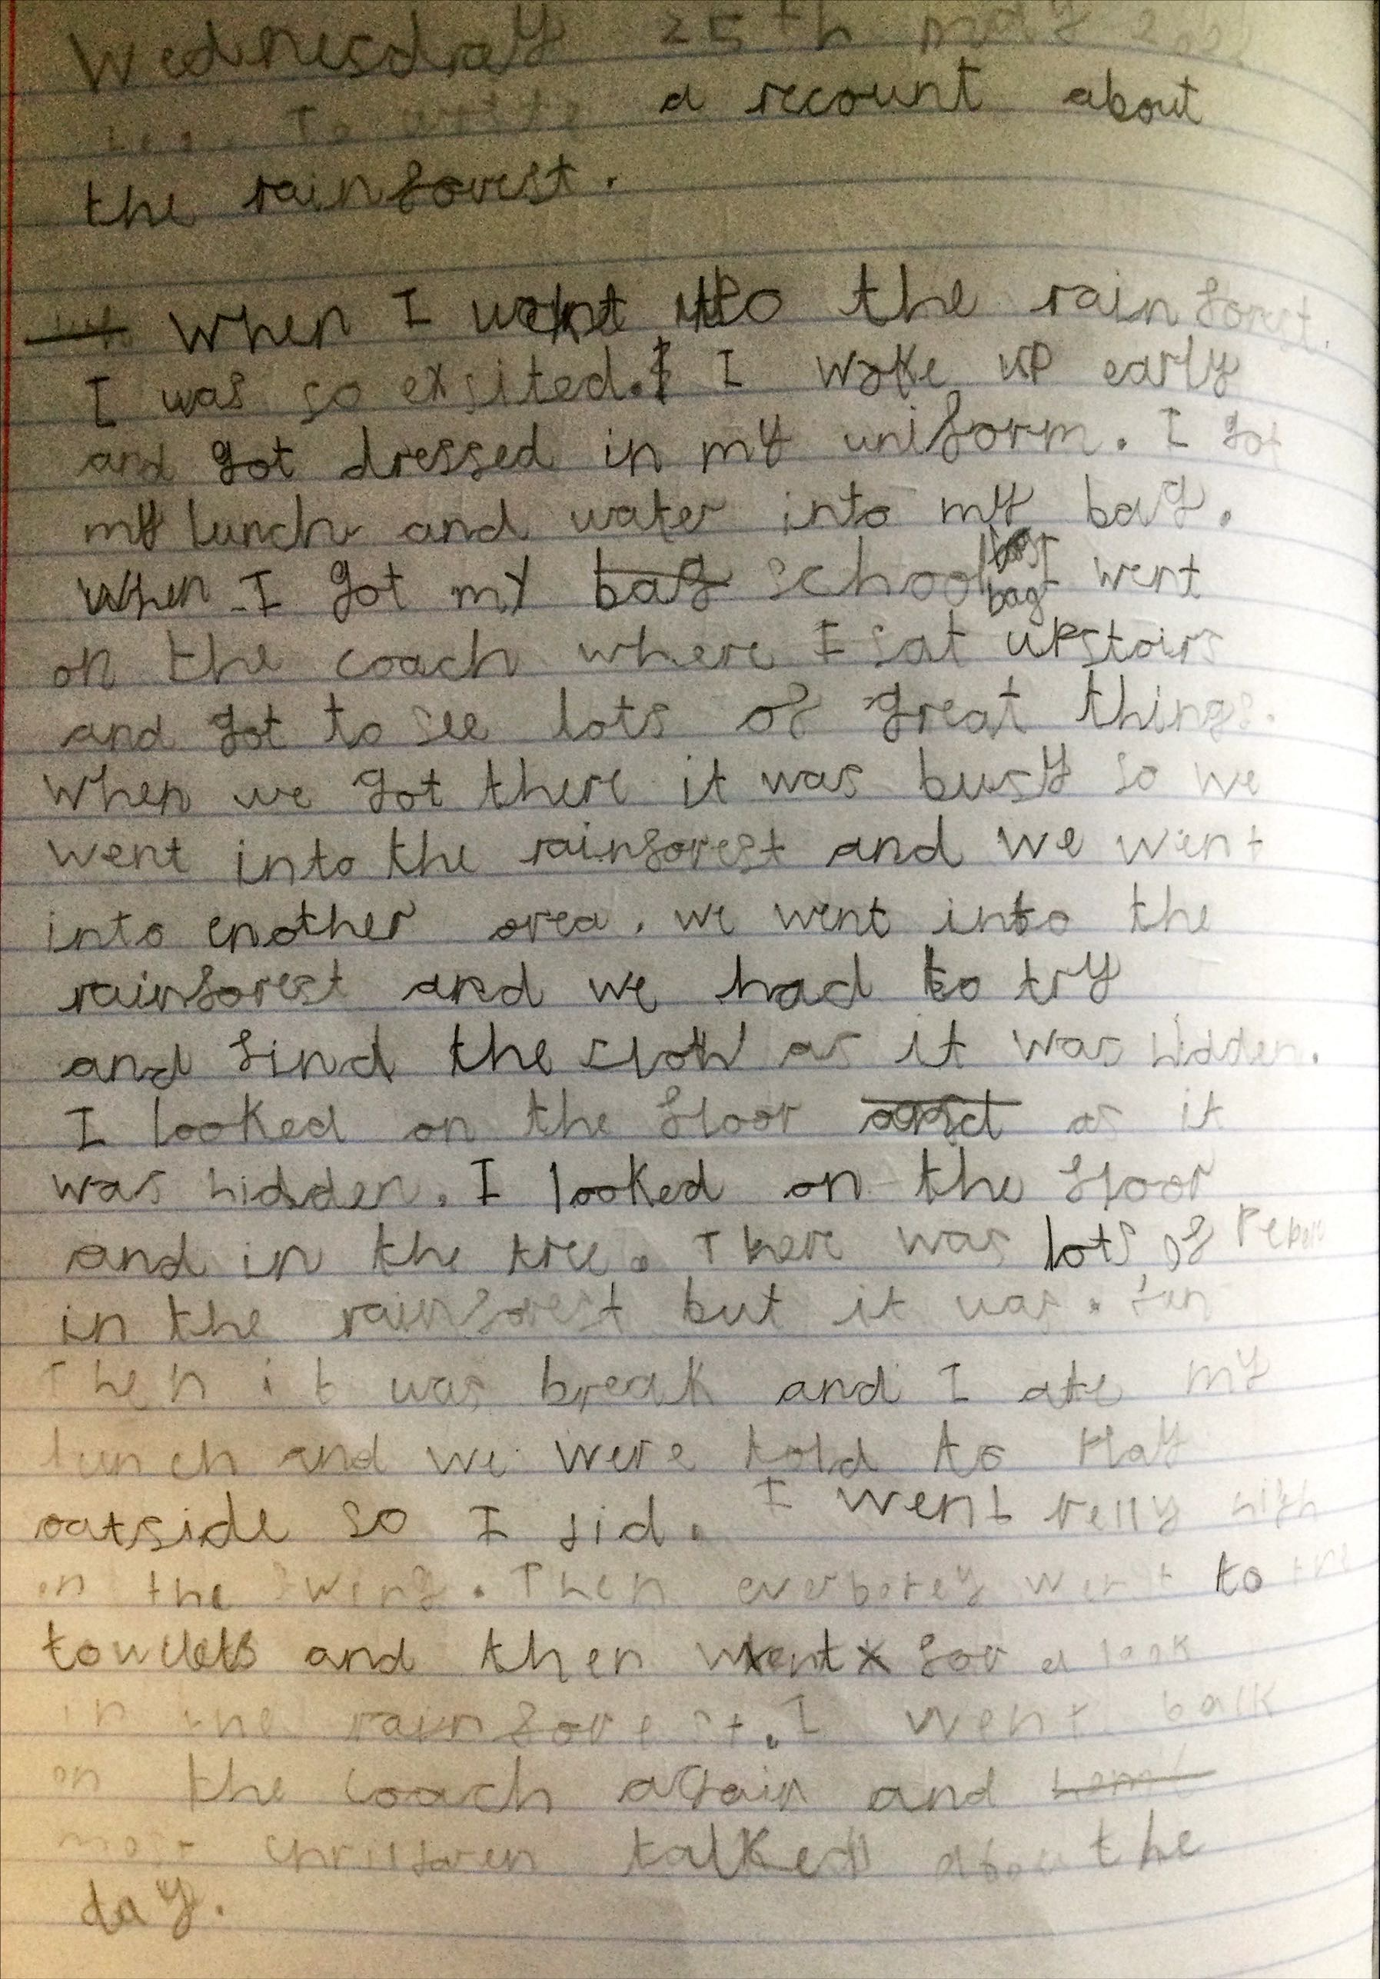
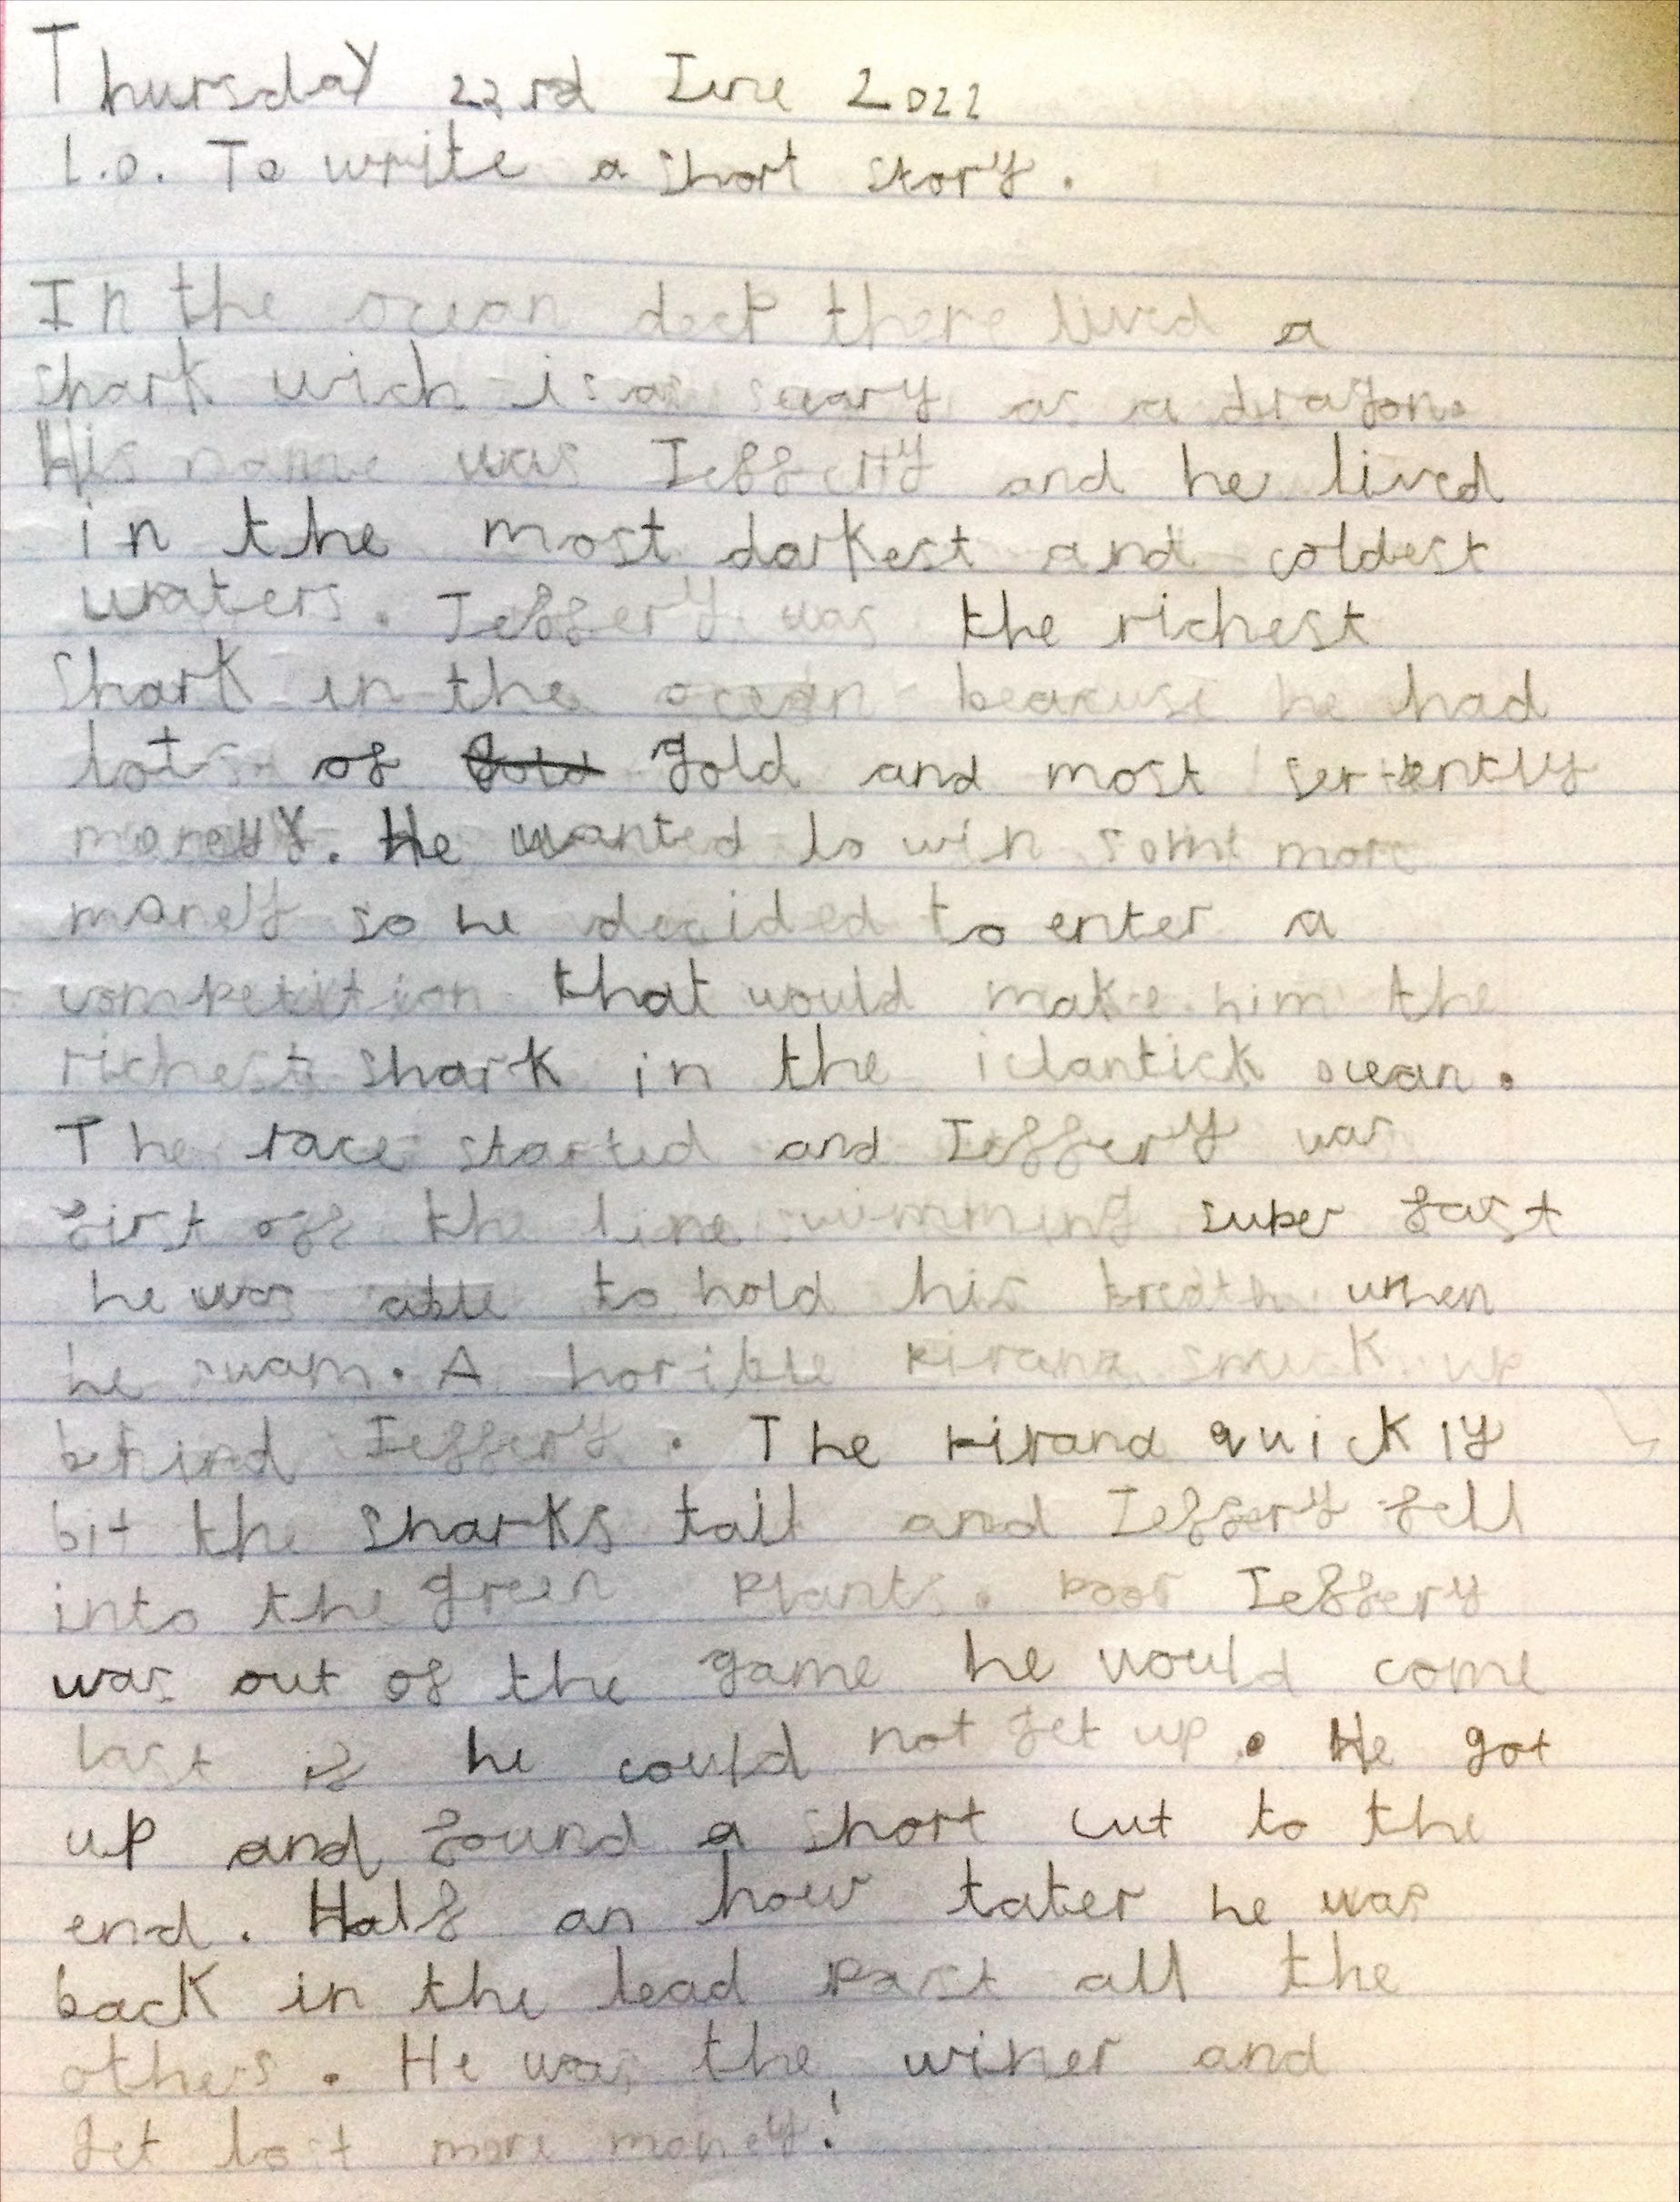
Expected Standard

Slide 14
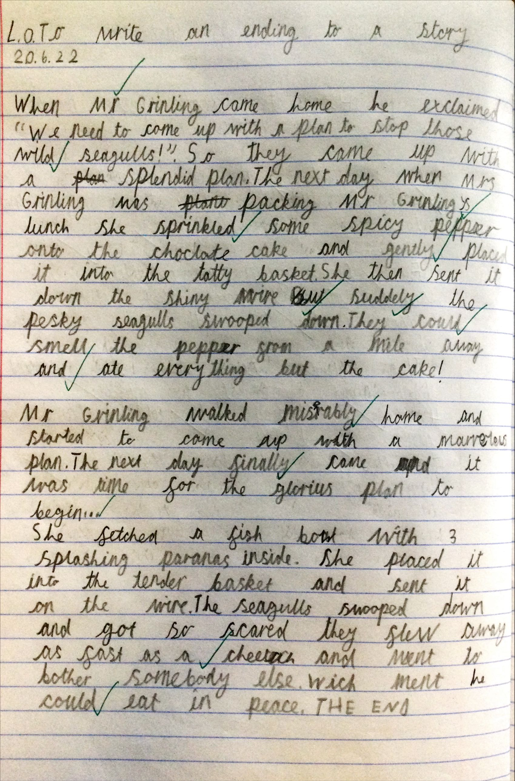
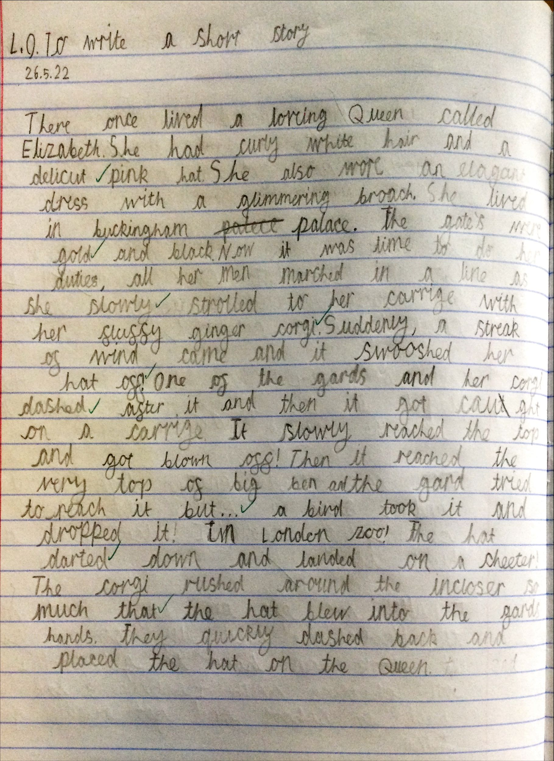
Greater Depth

Slide 15
Reading

Slide 16
Reading

Slide 17
How can you help?
Encourage and support homework being done each week
Read daily even if it is a few pages or you read to your child. Bring in reading books daily.
Changes at home – please make teachers aware via the school office or on the door.
Encourage EMI attendance
Ensure correct uniform- this includes indoor shoes.
Social media usage – please make sure children are following safe internet usage guidance to avoid issues coming in to school
Parent Partnership

