Slide 2
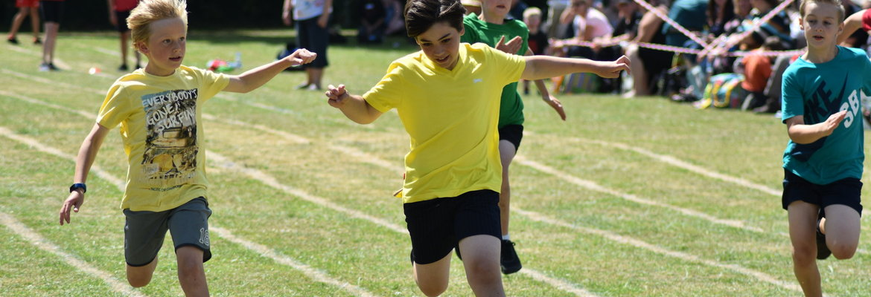
PE
There is currently no swimming
PE is on Wednesday and Friday (Antarctica); Thursday and Friday (Americas)
Please send children into school wearing PE kit on PE days (including trainers)
PE is currently outside – please send children in appropriately dressed for the weather (eg: jogging bottoms and a sweater if cold, rain coat if wet)

Slide 3
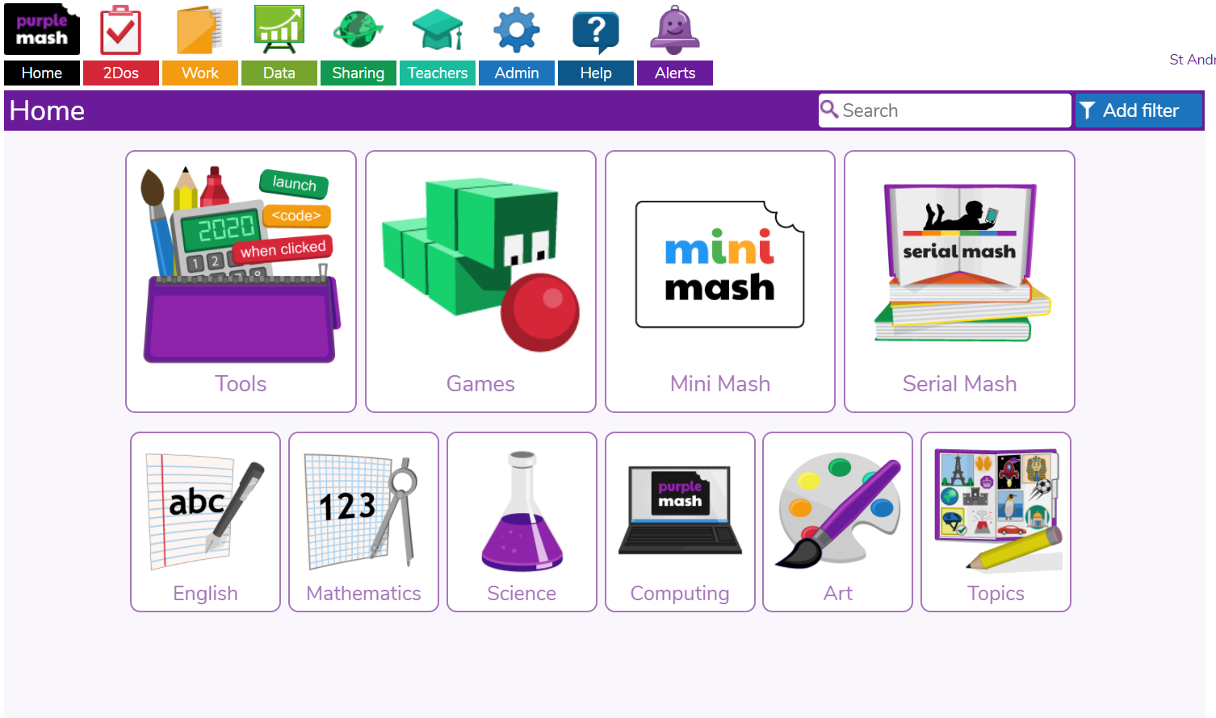
Homework
Spelling and Maths homework is set each week.
Spelling test is on Thursday.
Maths homework is set on Friday to be
handed in on Wednesday.
In addition to this children should:
Read for 10 minutes a day
Check Purple Mash for further activities

Slide 4
Home Learning
If your child/family needs to self-isolate, work will be provided on the school website.
This will be updated termly to match topics covered in class.
BBC Bitesize continues to support daily literacy and maths which will be highlighted on the home learning grids.
Purple Mash 2Dos will continue to be set.

Slide 5
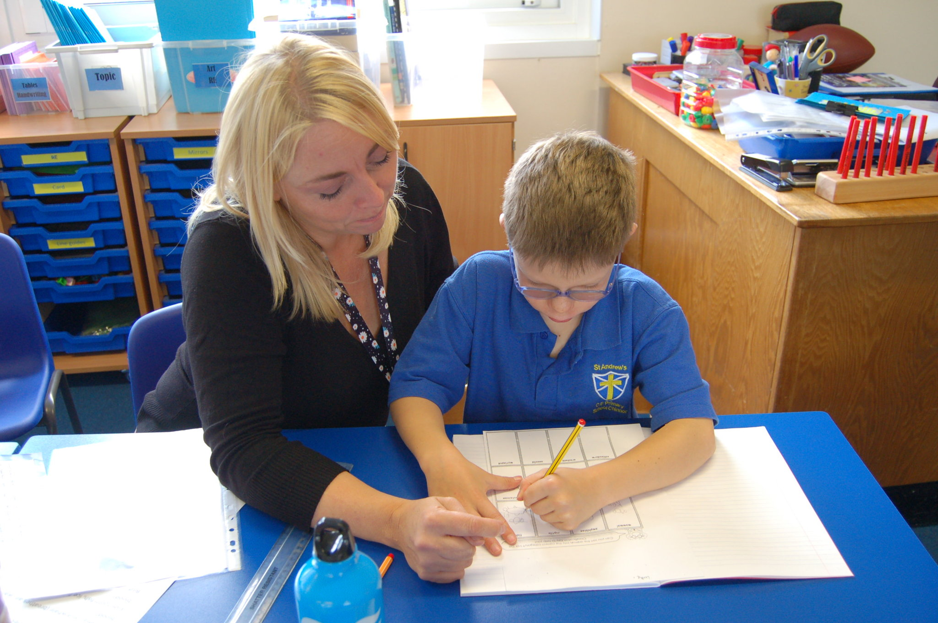
Early Morning Interventions (EMIs)
EMIs start daily at 8:30 am
Invitations are sent termly
Used to plug gaps in learning, to pre-teach to aid understanding in a new topic, to extend learning or for a specific need
PSHE – building confidence
Please encourage children to attend as much as possible

Slide 6
Trips and Residential
Youlbury
Christchurch, Oxford
Olympic Park
Our hope is that the Youlbury residential will be able to go ahead in the Summer Term.
Our aim will be to make these trips happen where possible, or cover the topics creatively in class where a visit is not possible.

Slide 7
Parent Partnership
How can you help?
Encourage homework to be done each week
Changes at home – please make teachers aware via the school office
Encourage EMI attendance
Ensure correct uniform
Social media usage – please make sure children are following safe internet usage guidance to avoid issues coming in to school

