Slide 1

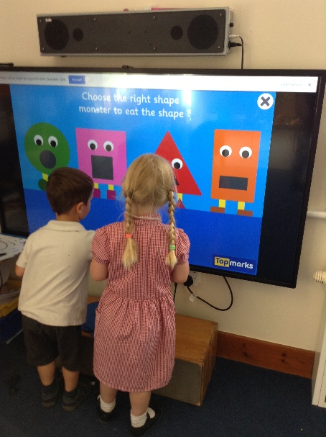


Nursery
Curriculum Information for Parents

Slide 2
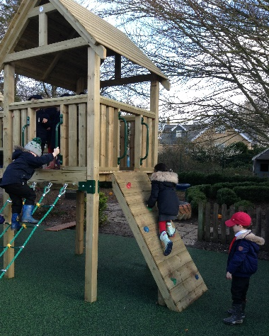
Areas of learning
All of the learning in the Early Years come under the following seven headings:
Prime Areas of Learning
Communication and language (speaking, listening, understanding and attention)
Personal, social and emotional development (relationships, health and behaviour)
Physical development (big and small movements with your body and with your fingers for writing)
Specific Areas of Learning
Literacy (comprehension, reading and writing)
Mathematics (number, number patterns and shape and measures)
Understanding the world (History, Geography, RE, Science)
Expressive arts and design (Dance, Art, Music and Design and Technology)

Slide 3
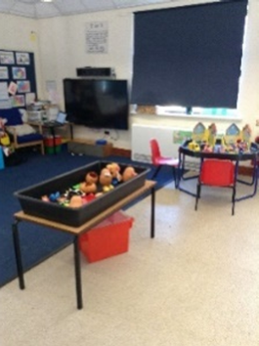
Characteristics of effective learning
What will this learning look like?
Playing and exploring (our inside and outside environment)
Active learning (children are challenged and challenge themselves)
Creating and thinking critically (children explore their individual ideas independently)

Slide 4
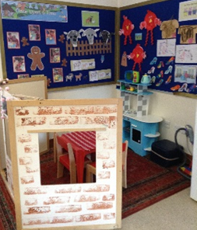
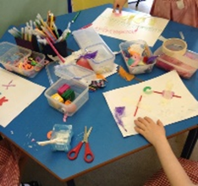
The shape of the day
8.55-9.00 Children arrive and registration
9.00-9.15 Story and teaching input
9.15-10.30 Learning through play in the Nursery indoor and outdoor areas
10.30-11.00 Snack and story, singing and phonics activity
11.00-11.45 Learning through play in the Early Years garden
11.55 End of morning session
12.00-12.45 Lunch time in class
12.45-1.00 Story and teaching input
1.00-1.45 Learning through play in the Early Years garden
1.45-2.40 Learning through play in the Nursery indoor and outdoor areas
2.40-2.55 Class time together, stories and songs.
2.55 End of the day.

Slide 5

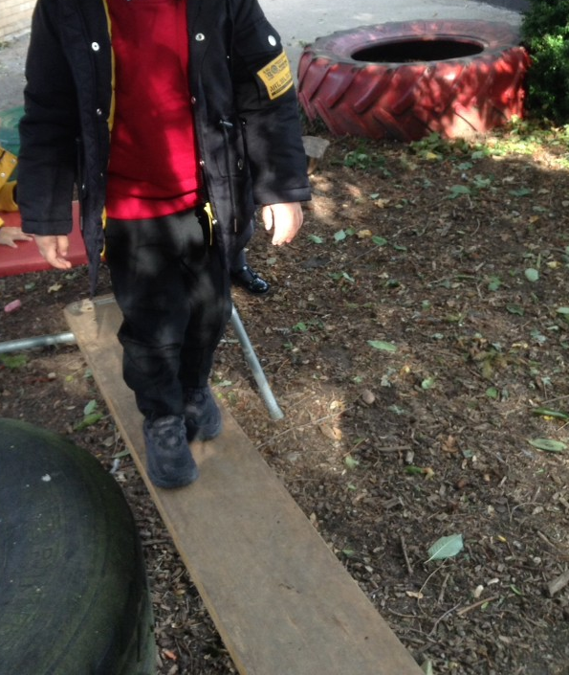
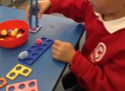
Prime Areas of Learning
Communication and language (speaking, listening, understanding and attention)
Personal, social and emotional development (relationships, health and behaviour)
Physical development (big and small movements with your body and with your fingers for writing)
We spend a lot of our day in Nursery developing these areas of learning, through play. We help the children to negotiate, take turns and play with their peers.
We start with short sessions together on the carpet, building across the year to develop the children listening and attention.
For physical development we start with the big movements; running, jumping, skipping, waving our arms around, and move to the small movements such as drawing, threading, play dough.
We use Squiggle while you wiggle to go from the large scale movements to the small as well as Funky Finger activities to develop our hand and finger muscles to get us ready to write.

Slide 6
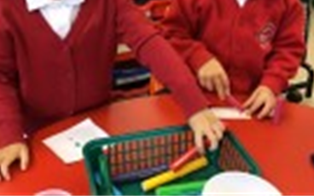
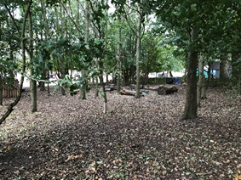
Specific Areas of Learning
Literacy (comprehension, reading and writing)
Mathematics (number, number patterns and shape and measures)
Understanding the world (History, Geography, RE, Science)
Expressive arts and design (Dance, Art, Music and Design and Technology)
Throughout the week the children are given opportunities to develop their knowledge and understanding of the specific areas of learning. We base much of our learning and teacher inputs around stories, and use these to develop the children language and communication skills .
We enhance the provision within our classroom with opportunities to practise mark making, the beginnings of writing, maths skills, opportunities to be creative as well as understanding the world.
In Nursery we aim to go to our Forest area at least once a week, wind is pretty much the only thing which stops us. This gives the children the opportunity to explore the outdoors and nature as well as the seasons and weather in a different way.

Slide 7

Assessment
During the Nursery year, the adults working with your child will continually assess them, making an end of year judgement against their age. We use the non-statutory document ‘Development Matters’ to help inform our judgements, as well as our knowledge of your child.
During the Reception year, the adults working with your child will continually assess them, making an end of year judgement against the end of year statutory Early Learning Goal statements:
https://assets.publishing.service.gov.uk/government/uploads/system/uploads/attachment_data/file/896810/EYFS_Early_Adopter_Framework.pdf
Follow this link to page 11 (we are an early adopter school) to read the statements.

Slide 8


Helping your child at home
Your child will have a very busy day at Nursery so you will probably find they are very tired initially. However, once they are settled and in the routine, you can support their learning at home by:
Reading ‘Thoughts for the Weekend’ (published Fridays each week) and talking to them about what they are learning at school.
Reading books to them and talking about the story and any new words to build their vocabulary.
Play games which develop their turn taking and communication skills.
Talk to your child about their day, it’s sometimes easier to ask them one thing that they really enjoyed as this is less daunting than trying to remember everything! We are always really busy learning in Nursery.

Slide 9

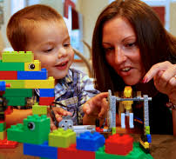
Helping your child at home continued
Practise counting at home, making sure your child counts one number for each object.
Practise ‘how many?’ by encouraging your child to either look at a small set of objects and know how many there are by looking (up to 5 objects) or by encouraging them to count the set and know that the last number in the count is the total of the set of objects.
Sing number songs to help them develop the skill of saying numbers in order.
Play with toys which help to develop your child’s small movements such as Lego, playdough, modelling clay, threading.
Help them to become more independent in going to the toilet and putting on coats and shoes.

