Slide 1
ASDAN - Award Scheme Development and Accreditation Network
ASDAN lessons are taught in Key Stage 4. ASDAN is a charity which provides courses and qualifications.
Students complete Lifeskills Challenge modules and receive a certificate at the end of Year 11, listing the modules they have achieved.
The level and topic of the modules vary according to the needs and interest of the students. We currently offer Lifeskills Challenge modules from pre- entry up to Level 1
Each module provides the opportunity for students to develop their research skills as well as a range of other skills, such as speaking and listening, teamwork, IT, maths and practical skills such as sewing and cooking.
There are a variety of ASDAN modules, covering a wide range of interests and skills, which can be chosen.
Examples of Lifeskills Challenge modules include:
  Caring for a pet
  Using Minecraft, construct a build of a famous building
  Introduction to sport
  Cooking on a budget
  Making a textile toy
  Creating a healthy smoothie

Slide 2
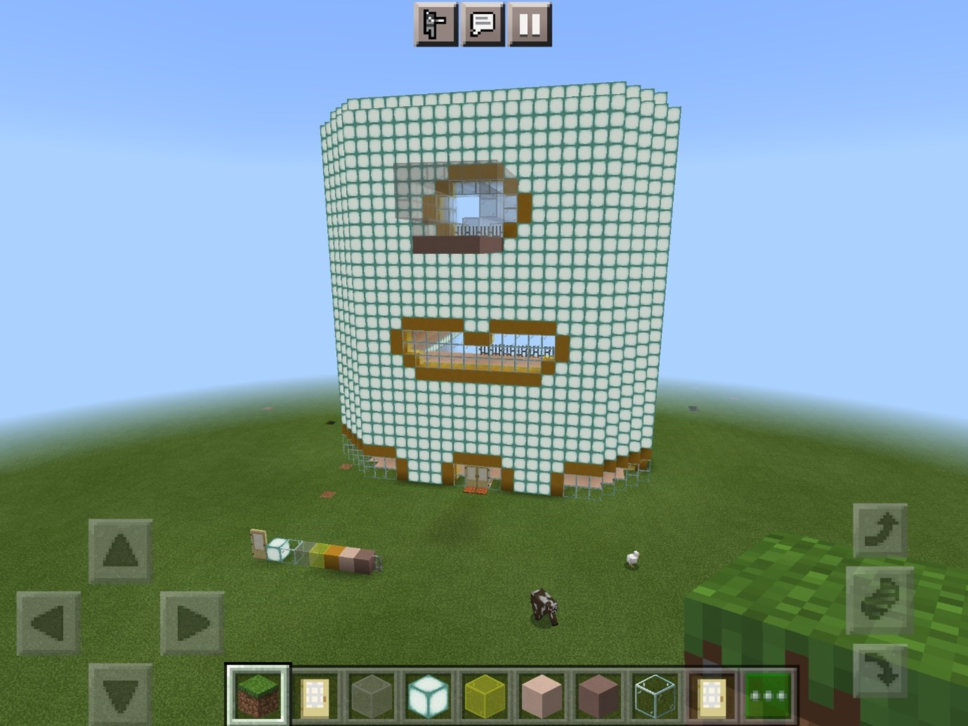
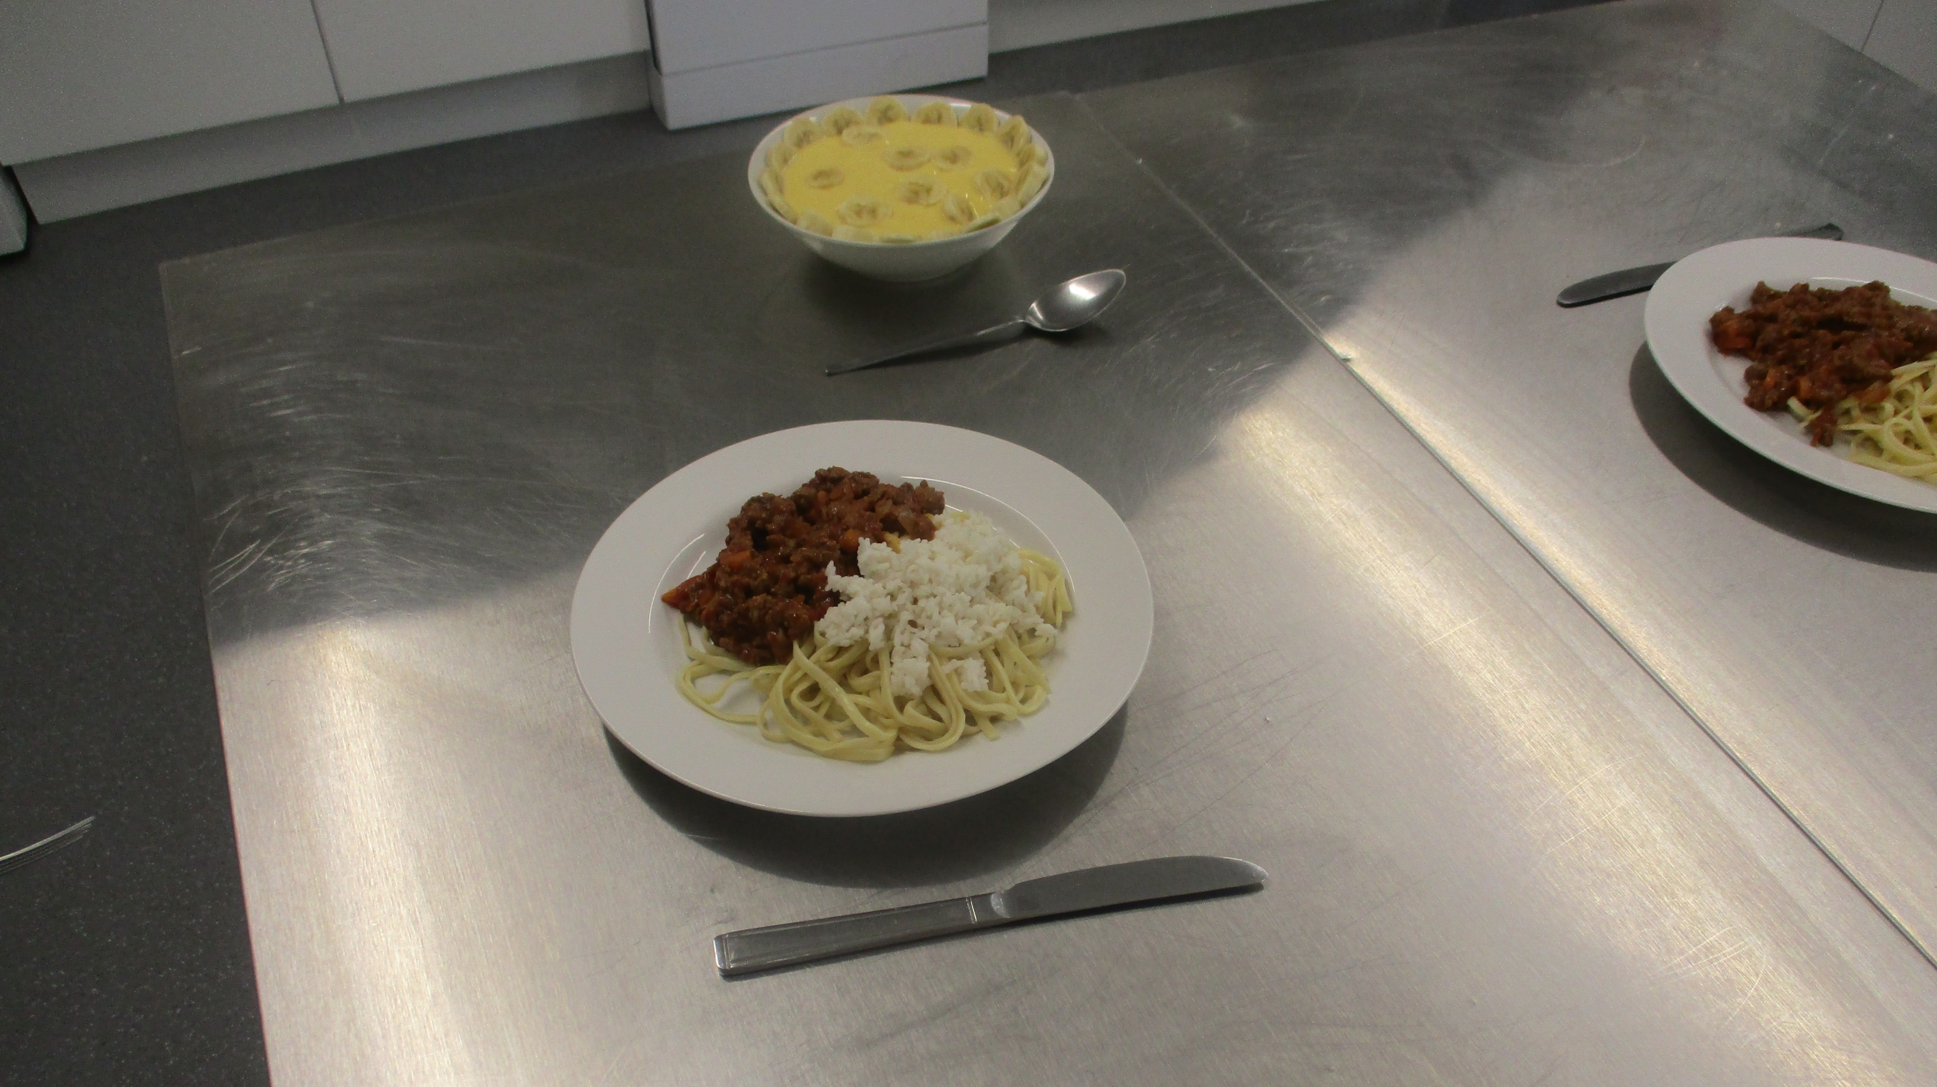
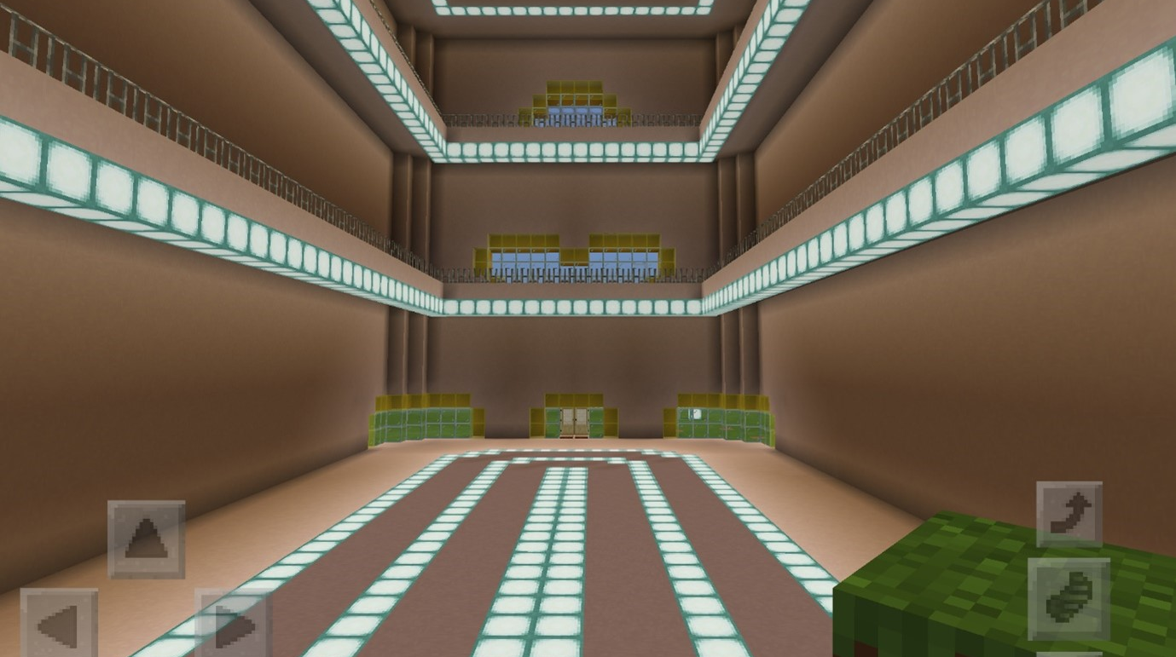
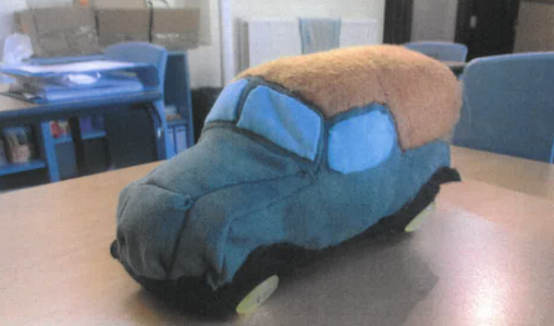
  Using Minecraft, construct a famous building. This is the outside of the Bullring, Birmingham.
Assessment
Cooking on a budget
There are three methods for assessing students throughout each module. Each Lifeskills Challenge module stipulates the assessment method for each assessment point within the module.
Observation Checklist- students are observed completing the task.
Record of Oral Questioning- students explain the information required for the assessment point.
Labelled product or photographic evidence- the completed work is used as evidence withing students ASDAN folders.
  Making a textile toy.
This is the inside of the Bullring, Birmingham.

Slide 3
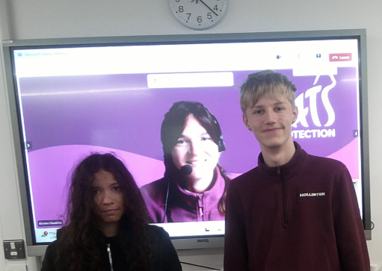

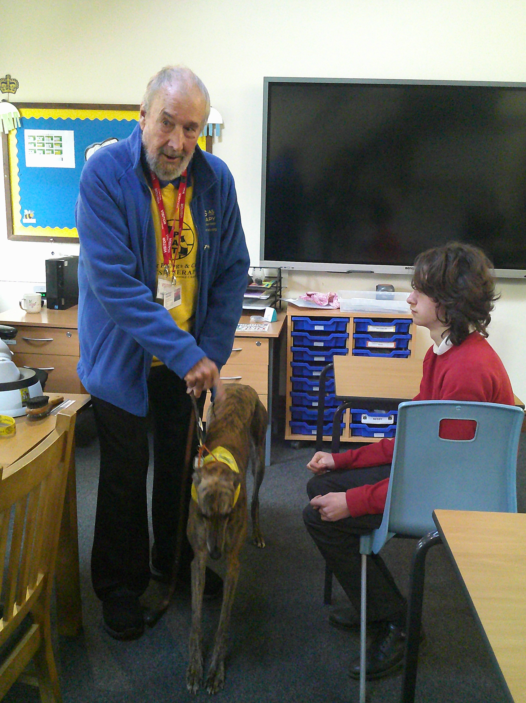
Outside providers also support the learning
These volunteers supported the Pet Care Module.
www.cats.org.uk/education
The students participated in live interactive video lessons with the Cats Protection. The first session focused on cat welfare and the second lesson explored the range of careers offered at the charity.
Patsy and her handler David, kindly visited to help students fulfil the practical element of the module, which includes walking and preparing water for a pet.

