Slide 1
Careers
At St Andrew’s School we aim to support the aspirations of all our learners and to ensure they gain the understanding, skills and experience needed to make progress and succeed in learning and work. As a Special Education Needs (SEND) school, we have a particular focus of developing the personal characteristics such as social skills, communication, independence, and resilience of our students.
Careers is taught throughout the primary and secondary years, within the PSHE (Personal Social Health and Education) curriculum.
Careers learning is also linked throughout the curriculum, as part of specific subjects throughout Key Stage 3 and Key Stage 4. Threading careers within the curriculum subjects helps students to understand the relevance of the subjects within the world of work and the possible career pathways available to them.
Our school’s careers provision is measured against the Gatsby’s Benchmarks.

Slide 2








The 8 Gatsby Benchmarks are:
A STABLE CAREERS PROGRAMME ​
LEARNING FROM CAREERS AND LABOUR MARKET INFORMATION. ​
ADDRESSING THE NEEDS OF EACH STUDENT.
LINKING CURRICULUM LEARNING TO CAREERS.
ENCOUNTERS WITH EMPLOYERS AND EMPLOYEES
EXPERIENCES OF WORKPLACES.
ENCOUNTERS WITH FURTHER AND HIGHER EDUCATION.
PERSONAL GUIDANCE

Slide 3
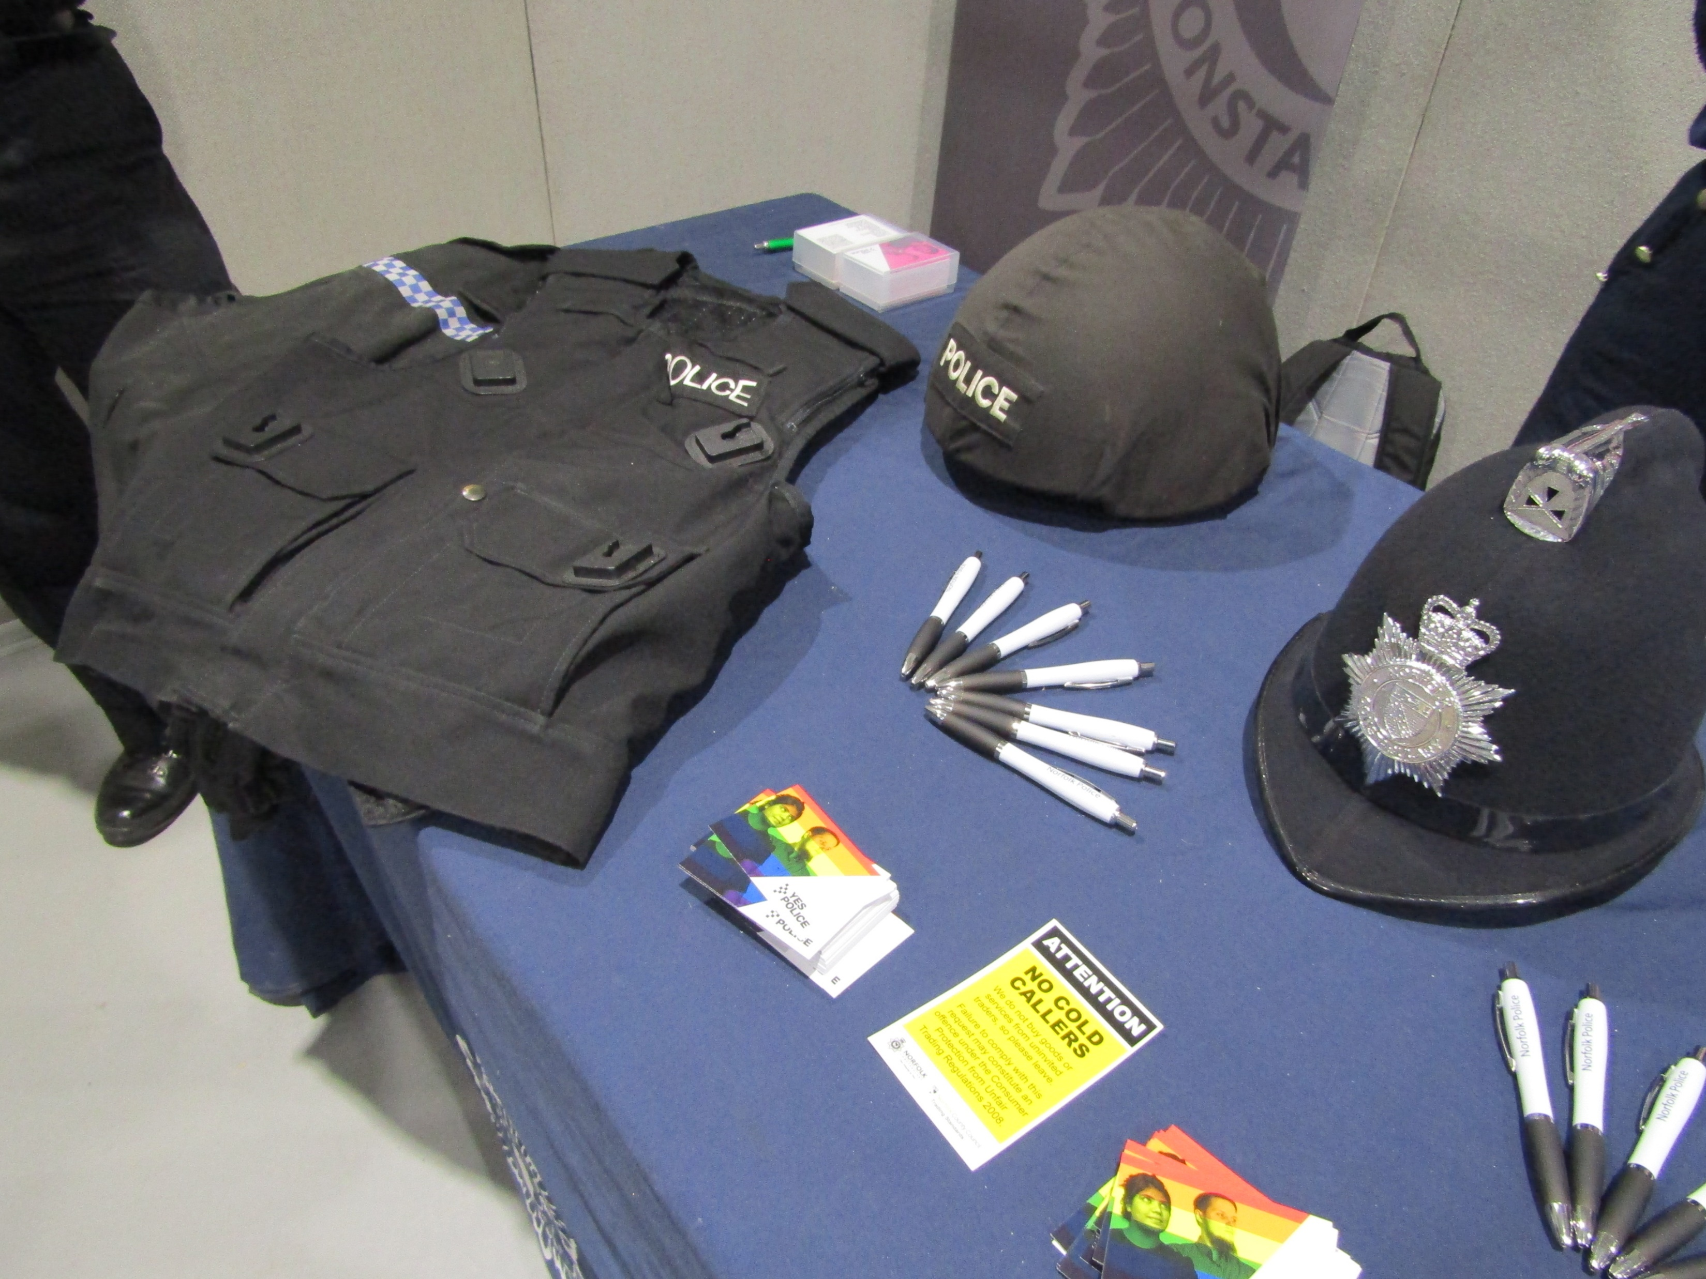
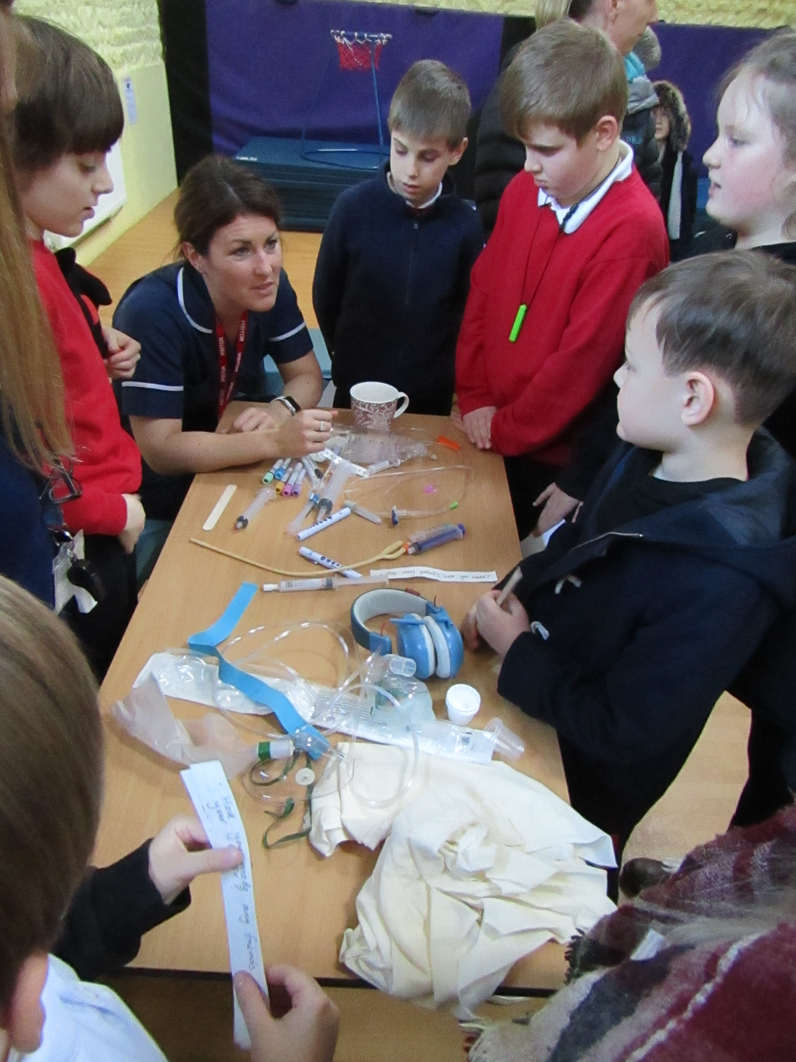
Enrichment Activities
Students learn about different careers and the world of work through a range of enrichment activities throughout their school journey. This includes employers providing talks and interactive sessions in school, apprenticeships and internship lessons from Norfolk County Council and off-site visits to employers to broaden students’ experience and knowledge of different areas of work. Students also visit careers fairs, where they are encouraged to engage with a range of employers as well as gathering information to inform their specific career choices.
Past students are encouraged to stay in touch and visit the school. The Year 11 enjoy welcoming past students back to the school, sharing their experience of college and any work experience or employment, followed by their next steps and aspirations for the future.
Careers Fair - The Year 10 students attend the Festival of Norwich at the Norfolk Showground each year.
Differentiated careers lessons for each class - Rebecca, an NHS Nurse, recently visited the school.

Slide 4


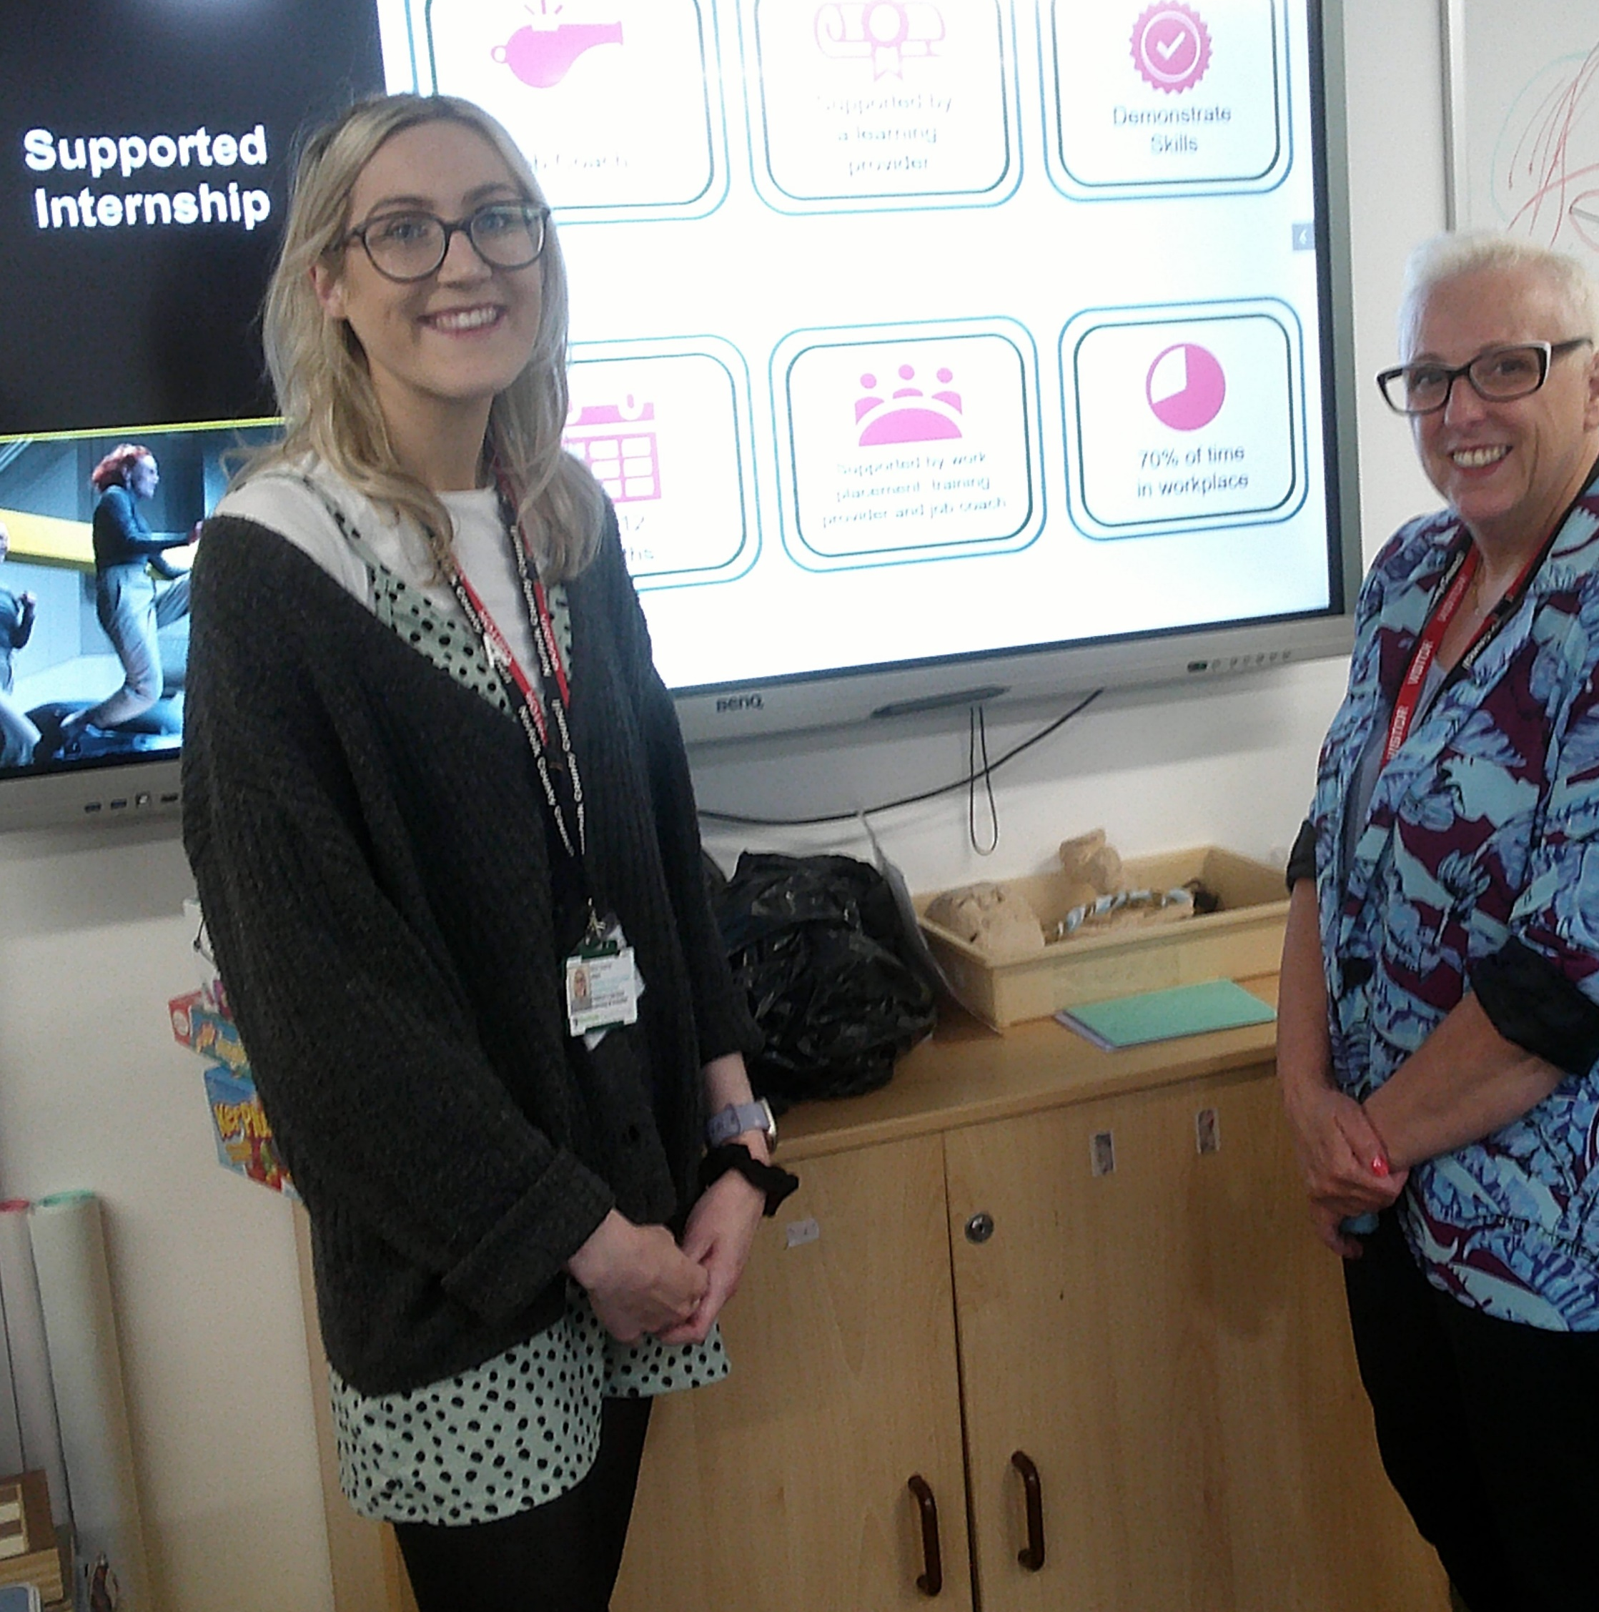
An Apprenticeship and Supported Internship lesson was recently delivered by Sophie and Pam from The Ask Programme.

Slide 5




Vocational Learning
Students have the option of furthering their learning within KS4 through the academic route of option subjects or the vocational route, consisting of a placement at a local provider.
Our current vocational route providers are ACE and St Eds offering courses in mechanics, construction and hair and beauty.

Slide 6

Careers Advisor Sessions
St Andrew’s School provides every student the opportunity to participate in a one-to-one discussion with a qualified careers advisor from The Shaw Trust. All of the advisors are experienced in advising to neurodivergent students. This is a vital stepping stone for our students to express where they are now and explore possible career paths for the future.
Parents receive a copy of the careers advisor’s planning, enabling them to also discuss and explore options at home. Additionally, students have the opportunity to reflect on the advice and feedback with the school’s Careers Lead.

Slide 7






Work Experience
All students are encouraged to undertake work experience within Year 10. Most students complete a placement within the local community, supported by a member of staff. Having a pre-visit, an outline of the tasks and individualised targets helps students to gain the most from their time with their organisation. We strive to secure individualised placements which meet each student’s preferences and needs. Placements range from customer service, catering, animal care, accountancy and more. Some students choose to gain experience of work internally within the school environment, for example supporting younger students within our primary classes or gaining administration experience by undertaking various computer and paper-based tasks. Parent feedback following the placement is sought and our students and parents benefit from employers’ feedback.
WEX Norfolk, part of Norfolk County Council's Children’s Services, provide expert advice and support to schools on work-related activities, including work experience, and support St Andrew’s School with this work.

Slide 8




Post 16 Transitions and Education
We provide the opportunity to visit colleges and alternative provisions in KS4 where appropriate. This could be whole class, small groups or individual visits, depending on the needs of individual students. The programme of transition for each student to their post 16 provider is tailored to the needs of the individual to ensure that our students feel as comfortable and equipped for the next stage of their education as they can be.

Slide 9

Contact Details
For more information on our careers programme, please contact:
Juanita Burrows - Head of Careers Office@standrewsschool.co.uk
or by calling the school office:
01263 837927
Review date: September 2025

Slide 10







Student Websites
General Careers Information
Labour Market Information
A range of SEND courses and technical providers from Norfolk providers.

Slide 11




Supported Internships A stepping stone to employment. Work base learning placements with the aim of securing a job.
Apprenticeships Paid employment whilst training for a qualification.

Slide 12
Parent Website Links
In addition to the websites on our student website page, the following websites are also useful:
Norfolk’s Local Offer
Further education, higher education and training - Norfolk County Council
Local Labour Market Information
https://www.nomisweb.co.uk/reports/lmp/la/1941962835/report.aspx

Slide 13


Teacher Website Links
My Learning My Future is a range of information and resources for teachers to support the delivery of careers within their subjects.
My Learning My Future | CEC Resource Directory

Slide 14



External Providers
Whether you are self- employed or work for an organisation, we encourage people from all types of job sectors to support educating students with this work.
We make lasting relationships with local external providers who support our students by visiting our school, offering work experience placements and by providing tours and talks of their business premises.
Our full Provider Access Statement is within our Careers Policy.
If you would like to be involved in our careers programme, or would like to leave a prospectus, please contact the school via email on: office@standrewsschool.co.uk or phone the school office to discuss this further.

