Slide 1

Careers Education
St Andrew’s School

Slide 2

Careers Intent
The careers programme has been created to ensure that all students are given a growing knowledge and awareness of the world of work and what they, as young people, can aim for as they prepare for adulthood and post 16 transitions. This includes delivering a breadth of opportunities and experiences that our students can start to build their own future pathways on.
As an independent special school, we have a particular focus on developing personal characteristics such as social skills, communication, independence and resilience of our students and how this prepares students for the future. This in line with the school vision of:
‘Encouraging every student through learning, creativity and adventure, to become a kind, respectful and independent young adult prepared for the future’.

Slide 3
Careers Intent (Aims)
High-quality careers guidance is important for our students’ futures:
We want our students to be prepared for the world of work, by building self-development and career management skills.
We want to provide work experience and a clear understanding of the working world.
We want to help students to understand the variety of education, training and careers opportunities available to them.
We want students to know the routes to careers that they’re interested in, and to make informed choices about their next step in education or training.
We want to take into account the individual needs of all students to tailor the programme accordingly and provide the right level of support.
We want our students to learn and make progress so they can thrive and experience success in their future pathways.
We want to promote a culture of high aspirations, equality and diversity of opportunity, including challenging stereotypes.
We want students to be well-informed and engaged in relevant courses to avoid the risk of students becoming NEET (not in education, employment or training).

Slide 4
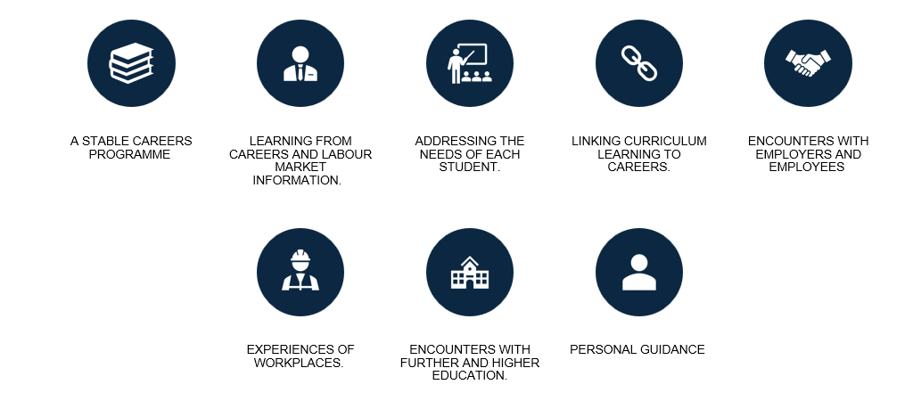
Careers Implementation
The careers programme provided by St Andrew’s School is tailored for the needs of each student, to ensure it is appropriate and realistic. All our students need a carefully planned programme of activities to help them choose appropriate pathways and to enable them to manage their careers, career progression and sustain employability throughout their lives. We provide statutory independent careers guidance to students from Year 7 onwards. We also provide some opportunities for our KS2 students to gain an insight into careers education.
Our programme has been developed to meet the expectations outlined in the ‘Gatsby Benchmarks’:
A stable careers programme
Learning from career and labour market information
Addressing the needs of each young person
Linking curriculum learning to careers
Encounters with employers and employees
Experience of workplaces
Encounters with Further and Higher Education
Personal guidance
It is structured in a way that builds upon previous years, and the overarching aim is divided between the key stages so that students are encouraged to think appropriately about their future. We provide aims, objectives and activities for each year group.

Slide 5

Careers Implementation
Our careers programme is taught through the PSHE scheme of work by EC Publishing. Students are taught explicitly about education, employability, and work-related learning through the unit ’Living in the Wider World’. Topics covered are: apprenticeships and vocational route; career pathways and options; CV writing and interview skills; workplace rights and responsibilities; challenging stereotypes in employment and decision-making and goal setting. Careers education is also interwoven into all areas of the curriculum. Subject teachers will share relevant subject-related careers information and plan for meaningful encounters with the world of work.
Students will access the following:
Experiences of different workplaces and environments.
A careers curriculum that is regularly monitored and evaluated.
Opportunities to talk with previous students and find out about their experiences and aspirations.
Displays promoting an awareness of careers.
Events such as Careers Fairs.
Guest speakers to share their experience or work and careers.
Personalised Work experience to meet their individual needs.
The delivery of careers is bespoke and personalised, taking into account the needs of our students. For many students, the thought of ‘life beyond St Andrew’s School’ can be an overwhelming thought. In Year 10, careers becomes much more bespoke to a student’s individual learning journey and their intended pathway and aspirations. This includes trips to career fairs, work experience, visits to colleges etc.

Slide 6
Careers Impact
Intended Outcomes:
Students will have a successful transition on from Year 11 into Post 16 and beyond.
Students will have had an experience of a wide range of opportunities, interests and options so they are best placed to make informed decisions about their future choices.
Students will have a bespoke and individualised careers programme, which provides an appropriate level of support, to enable them to have meaningful encounters and access work experience.
Students will develop the skills needed for them to be employable, whether that is voluntary or paid employment. Students will know the value of having work and commitments in their lives.
Students will make use of the range of support and advice that is available to them to support their choices and decision making.
Students will be well-informed and engage in relevant courses that will prevent students from becoming NEET (not in education, employment or training).
At St Andrew’s we measure the school’s progress against the ‘Gatsby Benchmarks’ and this is reviewed at least twice a year. Visits to other institutions are evaluated, to ensure that their future pathways are the most suitable for them. Destination data is then evaluated when analysing the impact of the careers programme.

Slide 7

Compass
Compass is a tool used by schools and colleges that helps to evaluate careers activity against the eight benchmarks of best practice – known as the ‘Gatsby Benchmarks’.
The tool was built in partnership with the Gatsby Charitable Foundation, to help discover strengths and find areas for improvement.

Slide 8
A Summary of the Careers Programme
These are the key themes that are taught explicitly through our PSHE curriculum. For further information about our curriculum, please contact our Careers Lead.
Year 7 | Year 8 | Year 9 | Year 10 | Year 11
Personal development and target setting Importance of respect Wants, needs and priorities Self-esteem through life Media literacy Stereotyping Protected characteristics Careers skills and qualities Budgeting our money | Attendance and punctuality Ambitious, aspirational, realistic careers Employability skills Entrepreneurs Saving and investing money Teamwork Sexism in society Ableism visibility and invisible disabilities Communication skills | The importance of volunteering Workplace skills Importance of community E reputation Financial exploitation The economy Responsible finances and avoiding debt Getting ready for KS4 and options. | Equality and Equity Work Experience Future careers and rise of AI Social media validation Employment rights and responsibilities Personal development and Careers | CV, cover letters and job applications Cost of living crisis Personal safety and independent travel Different types of employment Job interviews Revision and study skills

Slide 9
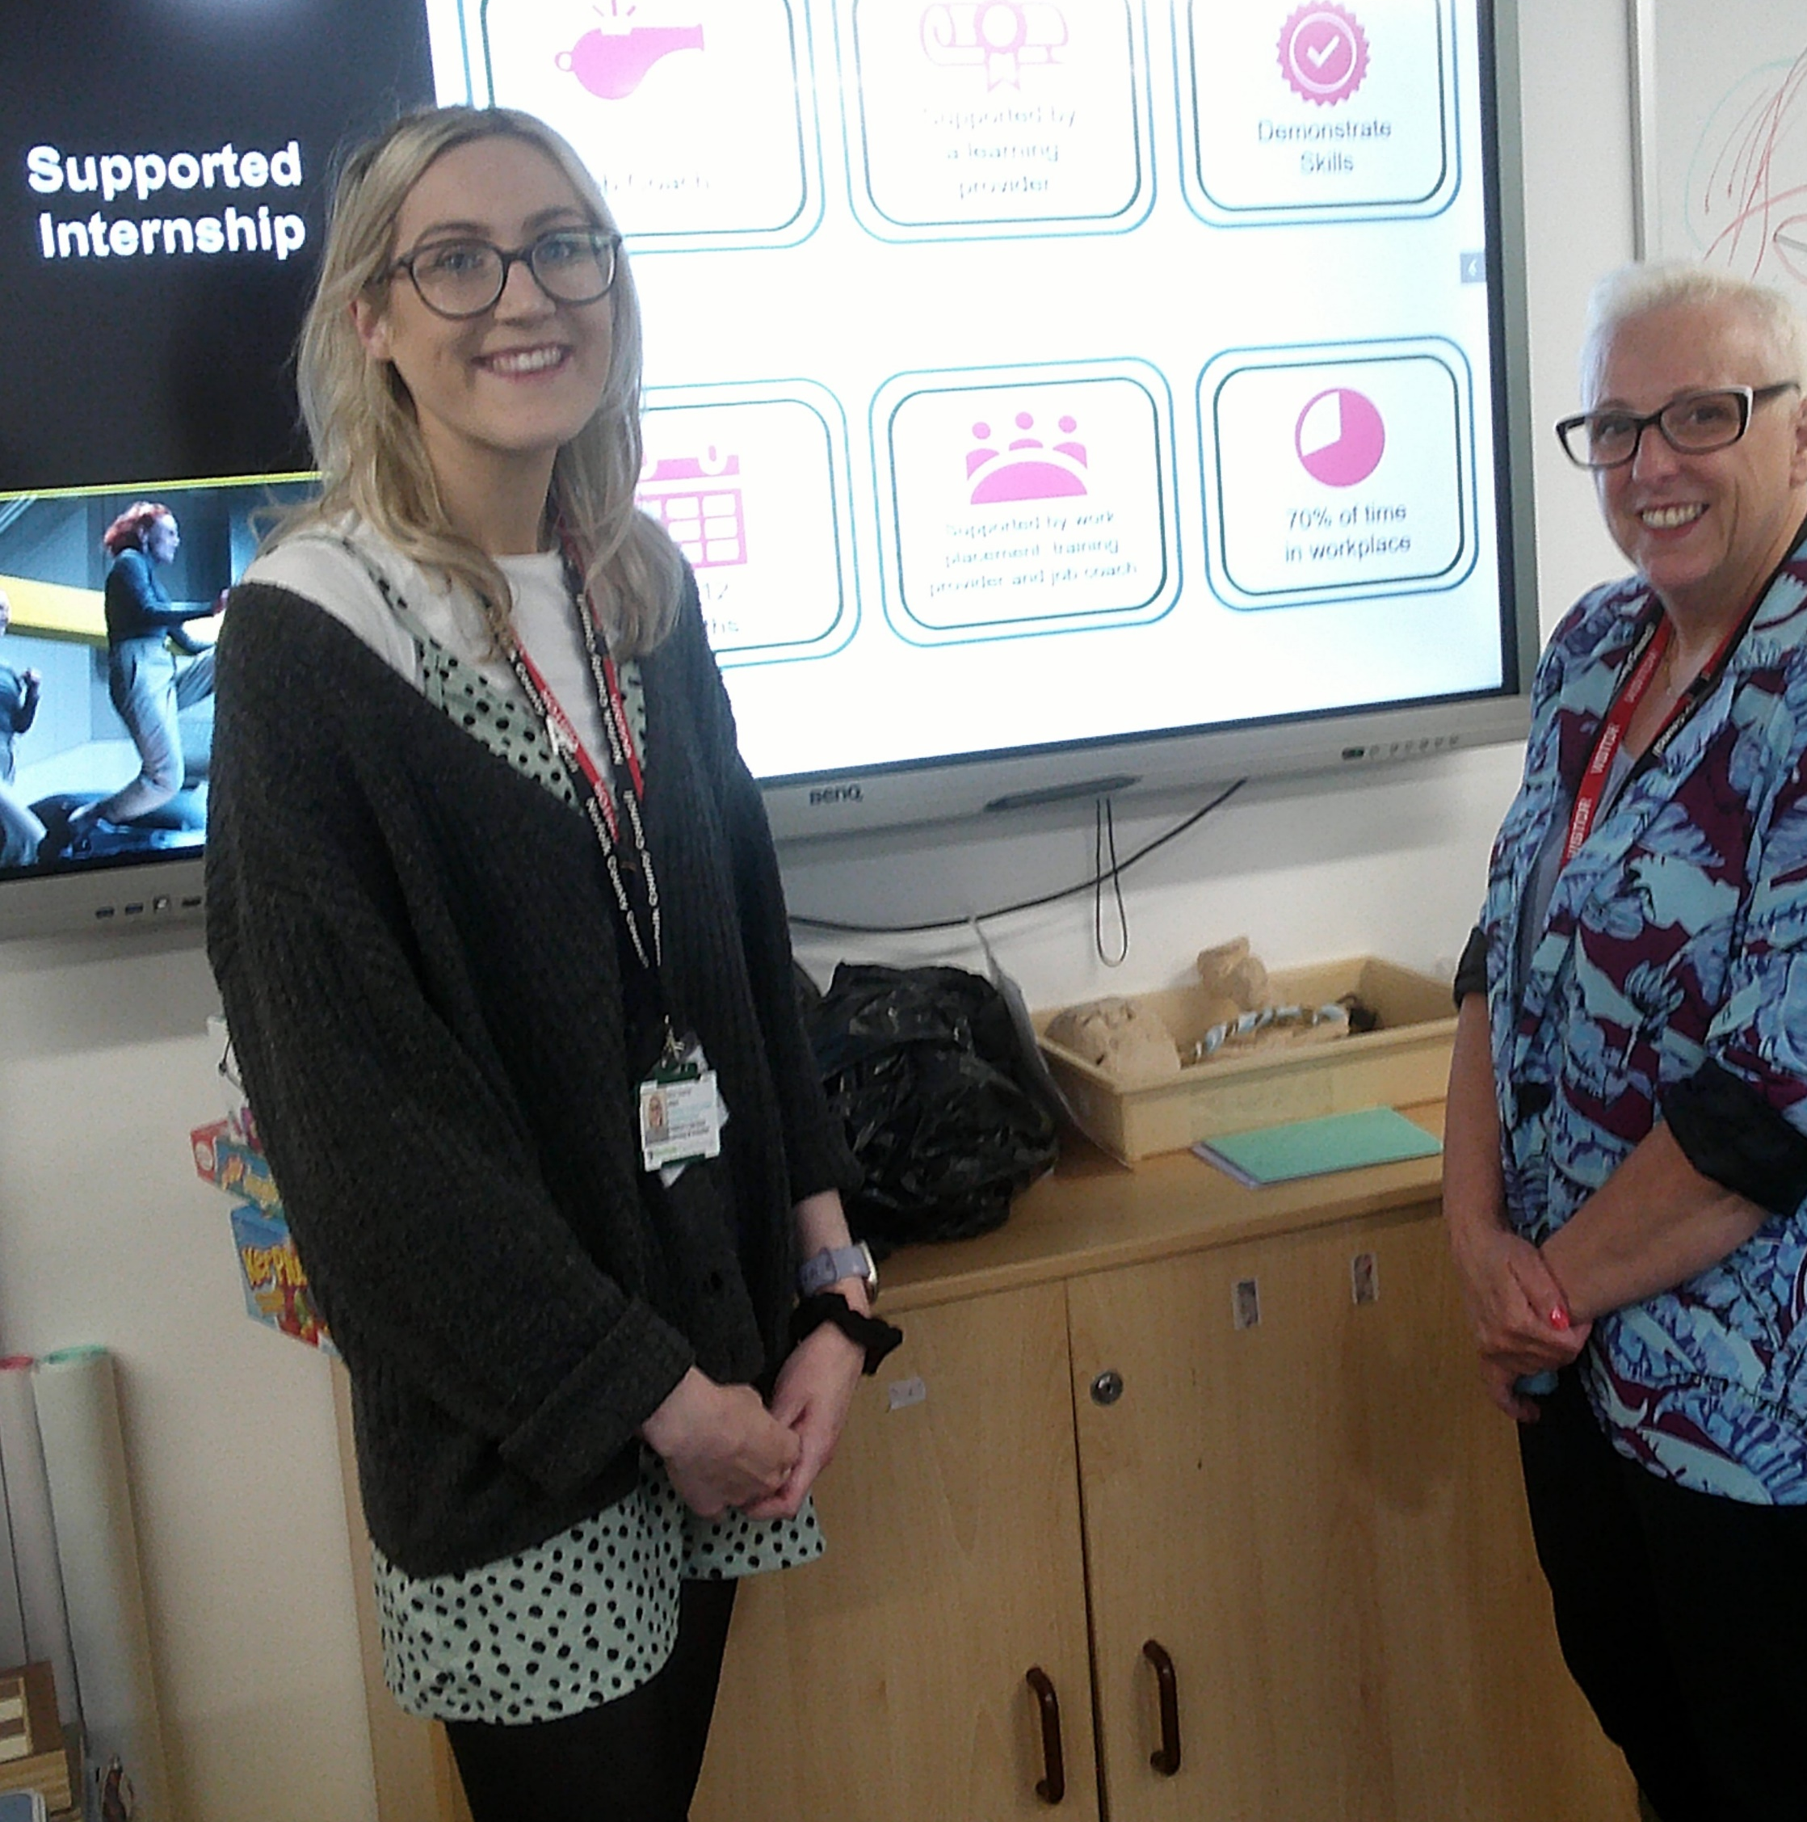
Planned Enrichment Opportunities
Students will access the following:
Experiences of different workplaces and environments.
A careers curriculum that is regularly monitored and evaluated.
Displays promoting an awareness of careers.
Guest speakers to share their experience or work and careers.
Visits to businesses and organisations.
Subject-related careers information.
Lessons about apprenticeships and vocational routes.
Sessions on supported Internships with a SEND employment officer.

Slide 10



Y9-Y11 Opportunities
Year 9 | A visit to a technical provider, such as ACE vocational provider Key Stage 4 ‘Options Event’ for parents and individual meetings with students
Year 10 | Visit from a student who previously attended the school Video call with an Employment Engagement Officer from Norfolk County Council ahead of work experience applications. Festival of Knowledge Session from Norfolk County Council on apprenticeships and supported internships CV writing workshop from an external provider subject to availability Sheringham Woodfield’s School ‘Moving on’ event Work experience preparation lessons. Work experience preparation visits. Work experience placements College visits 1:1 meeting with a Careers Adviser.
Year 11 | Visit from a student who previously attended the school Post-16 application support Post-16 interview support Sessions from Norfolk County Council on apprenticeships and supported internships.

Slide 11






Partners we work closely with

Slide 12
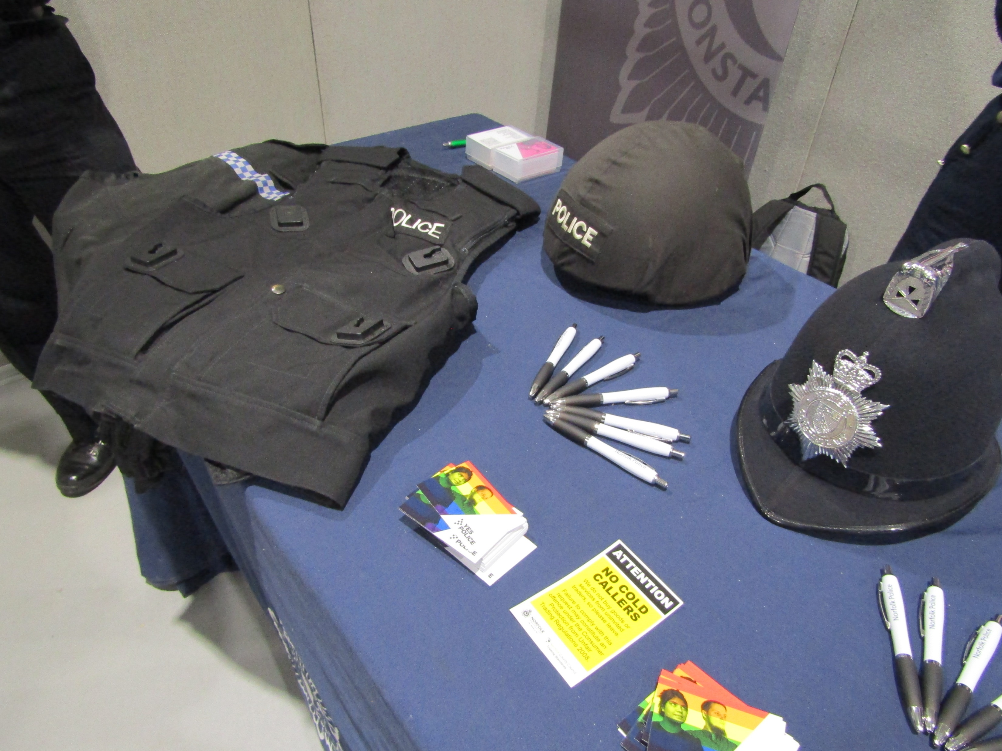
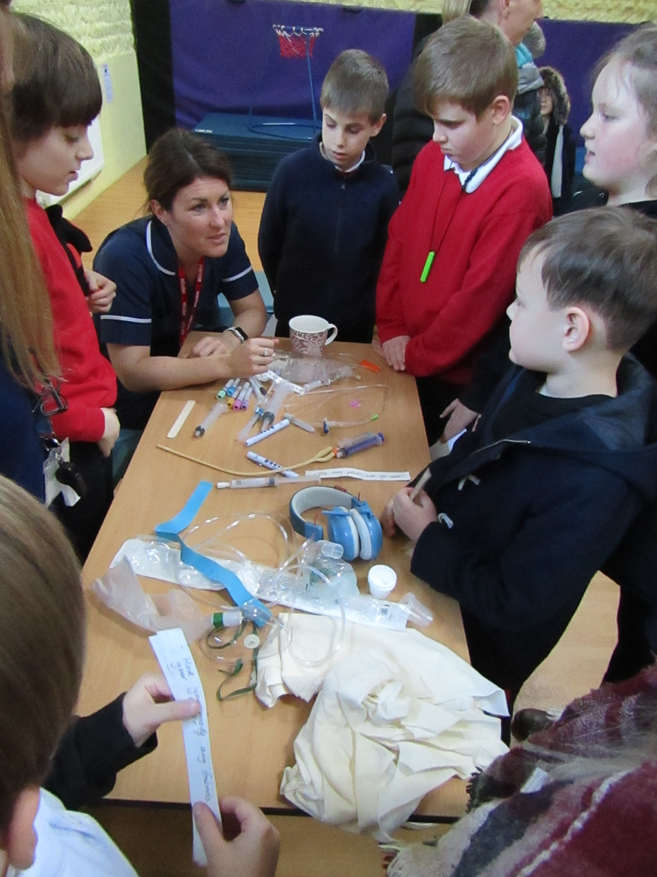
Enrichment Activities
Students learn about different careers and the world of work through a range of enrichment activities throughout their school journey. This includes employers providing talks and interactive sessions in school, apprenticeships and internship lessons from Norfolk County Council and off-site visits to employers to broaden students’ experience and knowledge of different areas of work. Students also visit careers fairs, where they are encouraged to engage with a range of employers as well as gathering information to inform their specific career choices.
Former students are encouraged to stay in touch and visit the school. The Year 10 and Year 11 students enjoy welcoming these students back to the school, sharing their experience of college and any work experience or employment, followed by their next steps and aspirations for the future.
Careers Fair - The Year 10 students attend the Festival of Norwich at the Norfolk Showground each year.
Differentiated careers lessons for each class - Rebecca, an NHS Nurse, recently visited the school.

Slide 13




Vocational Learning
Students have the option of furthering their learning within KS4 (or KS3 if appropriate) through the academic route of option subjects or the vocational route, consisting of a placement at a local provider.
Our most recent vocational route providers are Lab Media, ACE and St Eds, offering courses in mechanics, construction and hair and beauty.

Slide 14

Vocational Learning
St Andrew’s School provides every student the opportunity to participate in a one-to-one discussion with a qualified careers advisor from The Shaw Trust. All the advisors are experienced in advising neurodivergent students. This is a vital stepping stone for our students to express where they are now and explore possible career paths for the future.
Parents receive a copy of the careers advisor’s planning, enabling them to also discuss and explore options at home. Additionally, students have an opportunity to reflect on the advice and feedback with the school’s Careers Lead.

Slide 15

Work Experience
All students are encouraged to undertake work experience within Year 10. Most students complete a placement within the local community, supported by a member of staff. Having a pre-visit, an outline of the tasks and individualised targets helps students to gain the most from their time with their organisation. We strive to secure individualised placements which meet each student’s preferences and needs. Placements range from customer service, catering, animal care, accountancy and more. Some students choose to gain experience of work internally within the school environment, for example supporting younger students within our primary classes, organising their own enterprise project or gaining administration experience by undertaking various computer and paper-based tasks. Parent feedback following the placement is sought and our students and parents benefit from employers’ feedback.
WEX Norfolk, part of Norfolk County Council's Children’s Services, provide expert advice and support to schools on work-related activities, including work experience, and support St Andrew’s School with this work.

Slide 16
Work Experience Experiences
“It was like saying goodbye to my childhood and hello to adulthood. It has made me feel proud and independent.”
Student
“We were delighted that he was able to participate in the ‘work experience’ experience and very grateful for all the accommodations made to enable him to do so. Thank you.” Parent
“I am very thankful to the support staff for taking such good care of him and making sure this was a positive experience. I never imagined ‘work experience’ could be possible.” Parent
“The experience made her feel more confident about her choices for post-16 education.”
Parent

Slide 17

Post-16 Transitions and Education
We provide the opportunity to visit colleges and alternative provisions in KS4 where appropriate. This could be whole class, small groups or individual visits, depending on the needs of individual students. The programme of transition for each student to their post-16 provider is tailored to the needs of the individual to ensure that our students feel as comfortable and equipped for the next stage of their education as they can be.

Slide 18
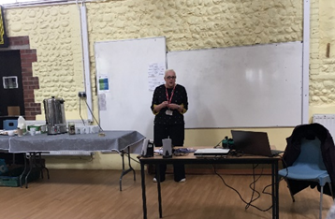
Parental Engagement
Throughout their time at St Andrew’s School, there are regular opportunities for parents to feel more informed about the school’s careers offer. We aim to involve parents and carers in our careers programme and welcome their attendance at encounters with providers in school. We will inform parents and carers about upcoming encounters by letter and email.
This includes:
Regular updates on the school newsletter.
Coffee mornings with the SEND Employment Officer.
Parents’ ‘options’ coffee mornings.
Focussed EHCP meetings with Careers Lead for
Y11 students.
Letters and updates about LMI and links to
career information.
Invites to career adviser sessions, where appropriate.
Liaison with Careers Lead for Y10 work experience.

Slide 19

Contact Details
Students, parents and carers, teachers and employers can access information on our careers programme, please contact:
Juanita Burrows - Careers Lead office@standrewsschool.co.uk
or by calling the school office:
01263 837927
Review date: Spring Term 2027

Slide 20







Student Websites
General Careers Information
Labour Market Information
A range of SEND courses and technical providers from Norfolk providers.

Slide 21




Supported Internships A stepping stone to employment. Work base learning placements with the aim of securing a job.
Apprenticeships Paid employment whilst training for a qualification.

Slide 22
Parent Website Links
In addition to the websites on our student website page, the following websites are also useful:
Norfolk’s Local Offer
Further education, higher education and training - Norfolk County Council
Local Labour Market Information
https://www.nomisweb.co.uk/reports/lmp/la/1941962835/report.aspx

Slide 23


Teacher Website Links
My Learning My Future is a range of information and resources for teachers to support the delivery of careers within their subjects.
My Learning My Future | CEC Resource Directory

Slide 24


External Providers
Whether you are self- employed or work for an organisation, we encourage people from all types of job sectors to support educating students with this work.
We make lasting relationships with local external providers who support our students by visiting our school, offering work experience placements and by providing tours and talks of their business premises.
Our full Provider Access Policy is available on the school website.
If you would like to be involved in our careers programme, or would like to leave a prospectus, please contact the school via email on: office@standrewsschool.co.uk or phone the school office to discuss this further.

