Slide 1
IT Home Page
Ks2a
Ks2b
Year 7
Year 8
Year 9
Careers
School Home Page
Computing Curriculum at St. Andrews
Computers are incredibly fast, accurate and stupid.
Human beings are incredibly slow, inaccurate, and brilliant.
Together they are powerful beyond imagination.
-Albert Einstein

Slide 2
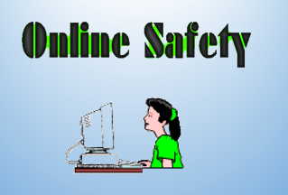
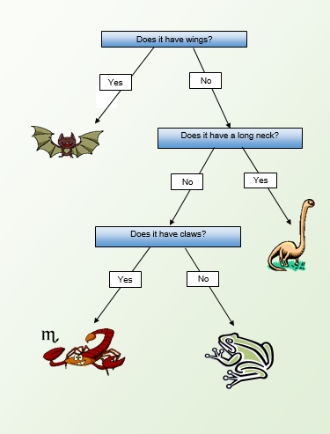
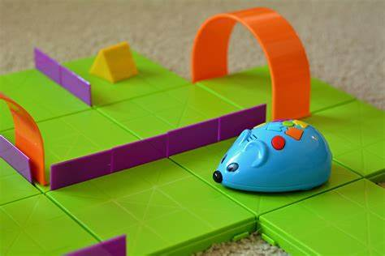
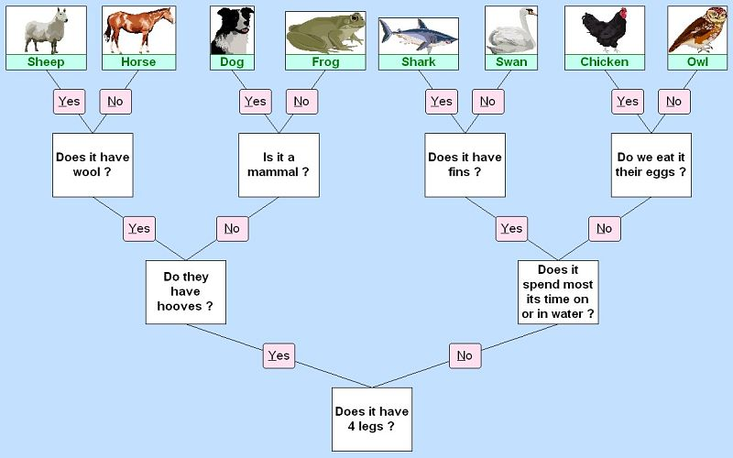
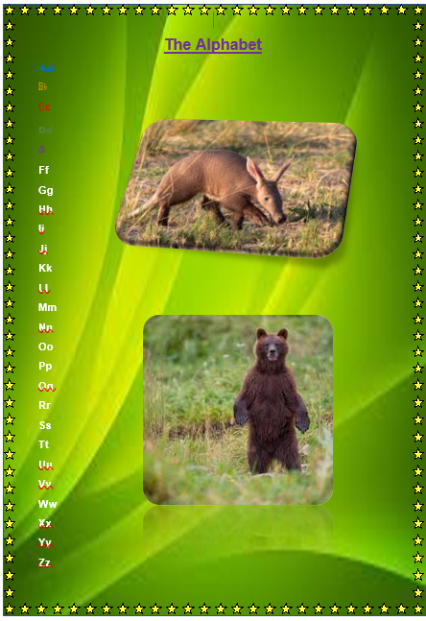
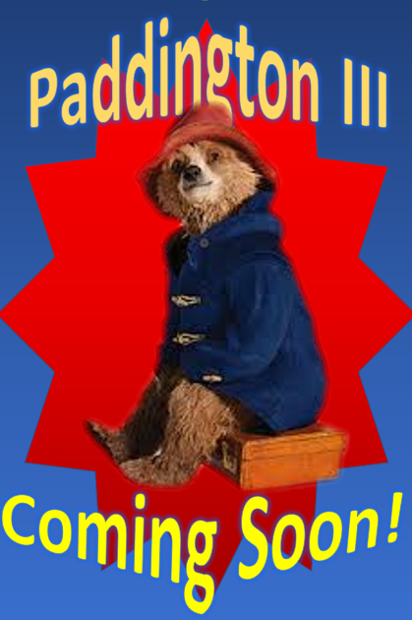
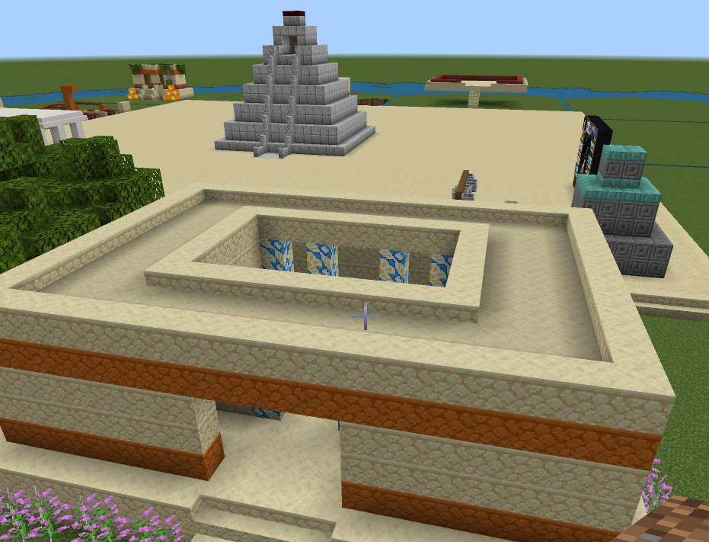
IT Home Page
Ks2a
Ks2b
Year 7
Year 8
Year 9
Careers
School Home Page
Autumn 1 – Online Safety & Multimedia
Objectives: To be able to develop the skills required to use multimedia software, and use these skills to develop a presentation about staying safe online.
Spring 1 – Branching Databases
Objective: To be able to demonstrate an understanding of the purpose of a database and create a working branching database.
Summer 1 – STEM Robotics
Objectives: To be able to programme a robot to move around different mazes.
Autumn 2 – Word Processing, Graphics
and Email
Objectives: To be able to use a keyboard, format and edit text.
Spring 2 – 2D graphic Design
Objectives: To be able to create a poster for a film/book/game using graphics and text for an audience of the same age.
Summer 2 – The Aztecs and Minecraft
Objectives: To be able to use simulation software to create an historically recognisable and researched environment.

Slide 3
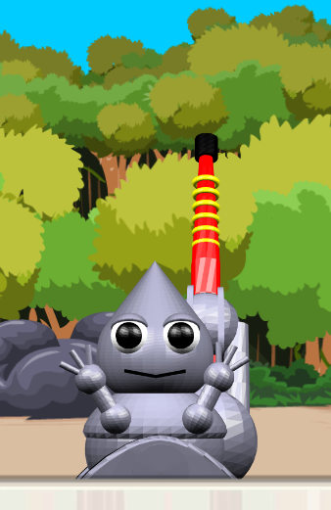
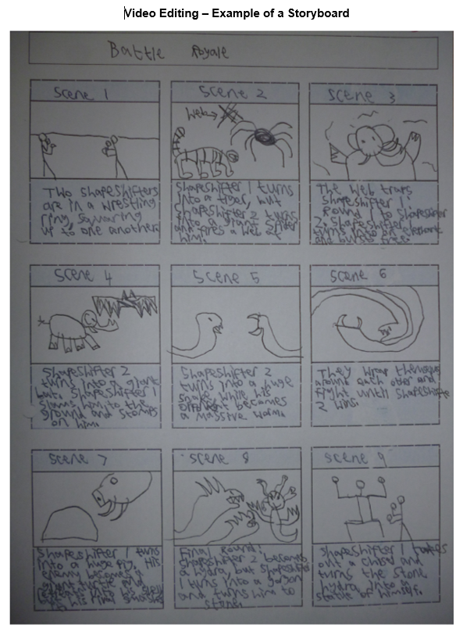
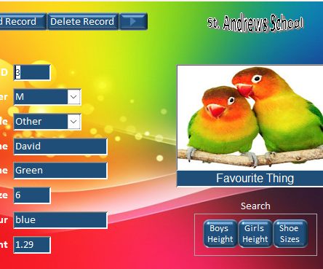
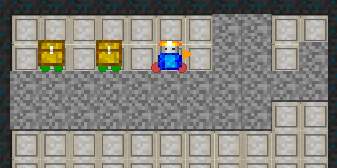
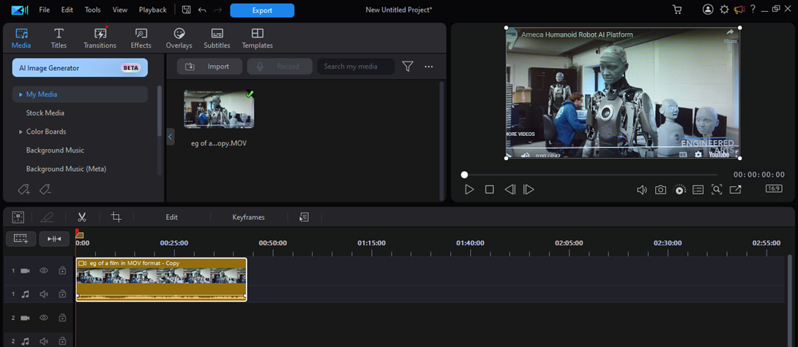
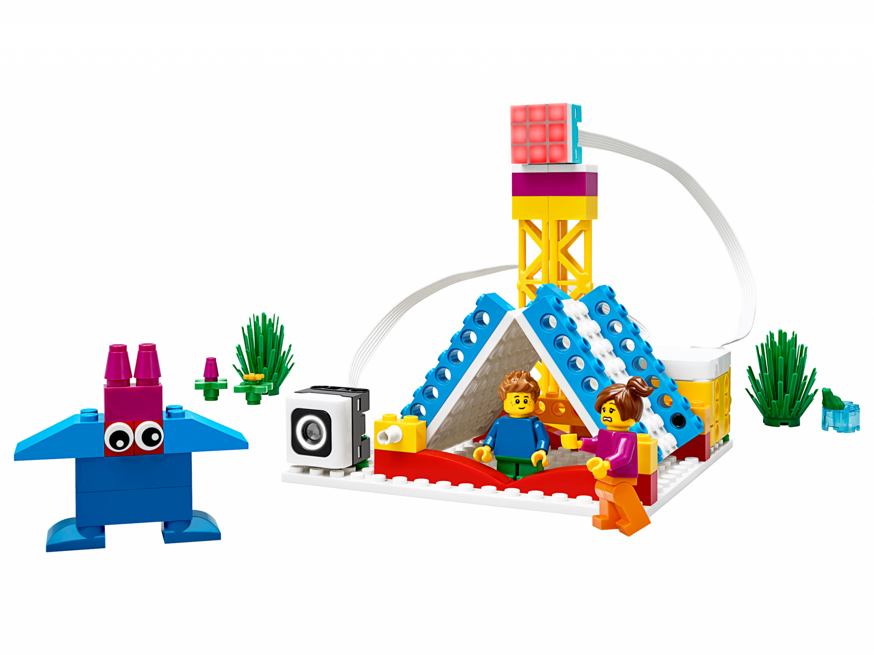
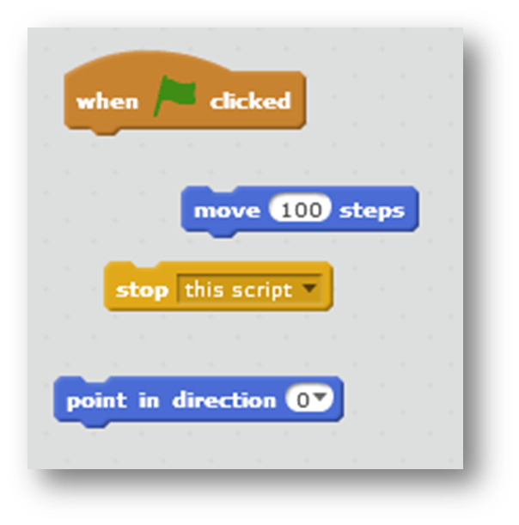
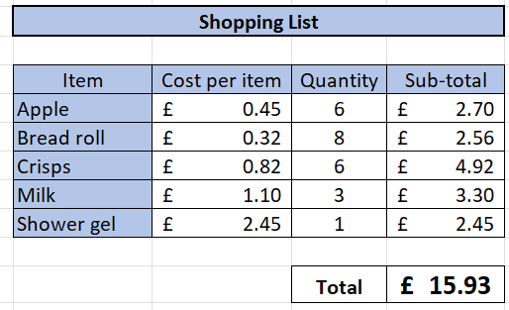
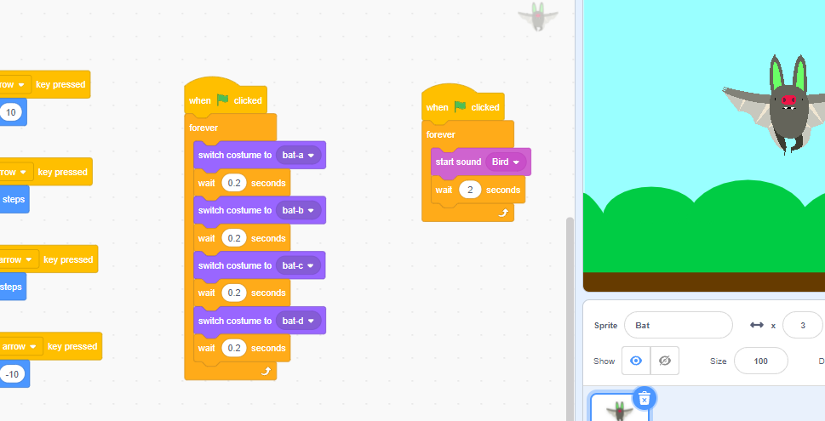

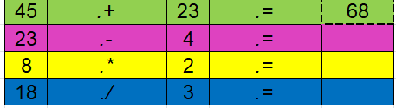
IT Home Page
Ks2a
Ks2b
Year 7
Year 8
Year 9
Careers
School Home Page
Autumn 1 Rainforest coding
Objectives: To be able to solve an online game developing and using coding skills.
Spring 1 – Video Editing
Objective: To be able to plan a video sequence and create a coherent video sequence that fulfils a brief.
Summer 1 – Databases
Objective: To be able to search a database to answer questions, and collect data to be used in a database.
Autumn 2 – Spreadsheets
Objectives: To be able to recognise and navigate elements of spreadsheet software, and use knowledge of spreadsheets to solve problems.
Spring 2 – Programming
Objective: to be able to code simple and more complex programs, and develop ideas in a new context.
Summer 2 – STEM: Lego Robotics
Objectives: To be able to follow a set of instructions to build and code a robot and sensor.

Slide 4
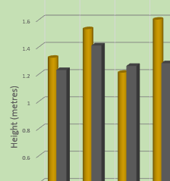
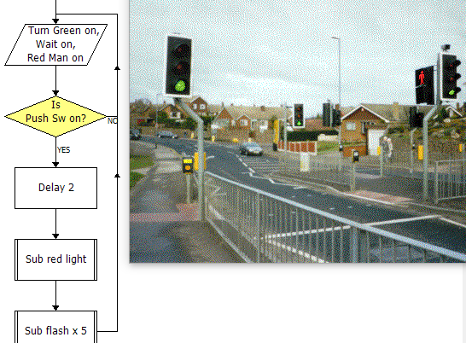

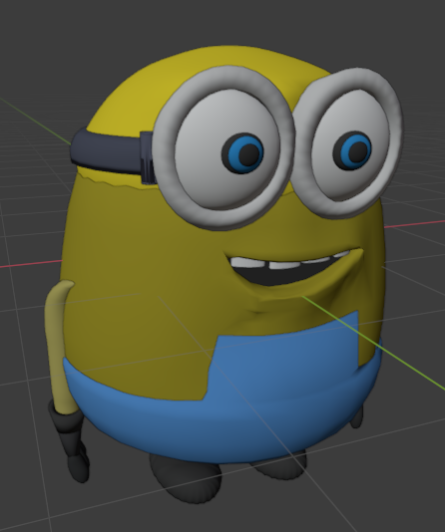
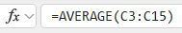
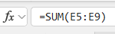
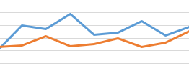
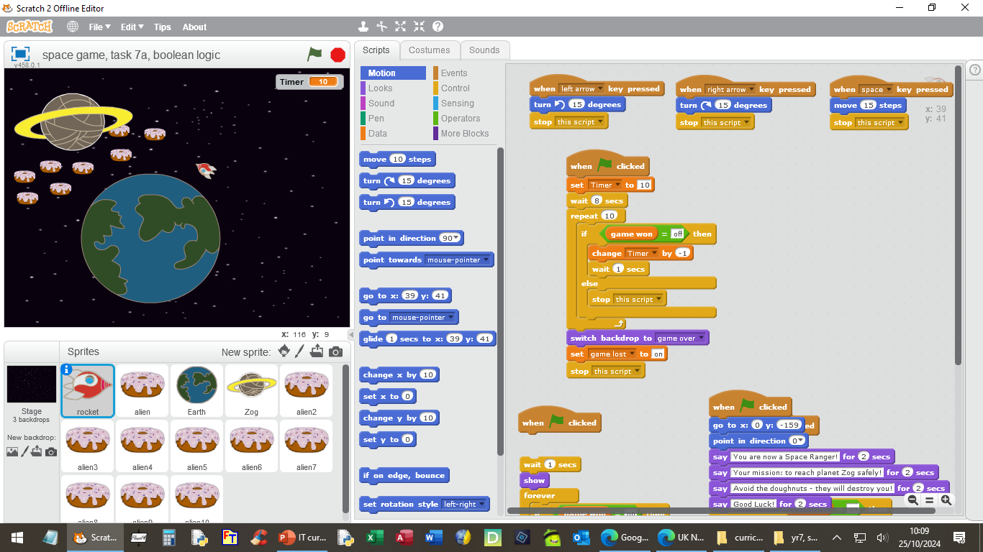
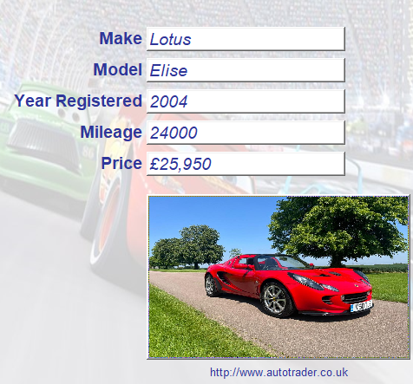
IT Home Page
Ks2a
Ks2b
Year 7
Year 8
Year 9
Careers
School Home Page
Autumn 1+2 – 3D Graphic Design
Objective: To be able to independently create
a 3D object using a variety of editing
techniques.
Spring 1 – Spreadsheets
Objectives: To be able to use knowledge of spreadsheets to solve a problem, and represent data in a variety of forms.
Summer 1 – Control and Monitoring
Objective: To be able to implement and manually run a system to carry out a control task, and use a sensor as a switch in a control model to automate a more complex task.
Spring 2 – Programming
Objectives: To be able to create, refine and adapt a program to certain criteria.
Summer 2 – Databases
Objectives: To understand terminology specific to databases, and create a simple database and edit elements of a database.

Slide 5
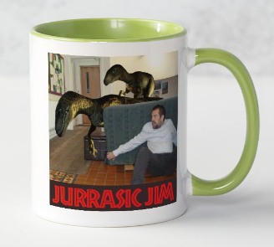
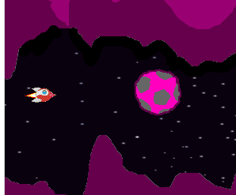
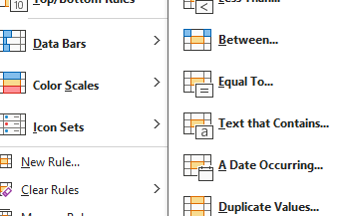
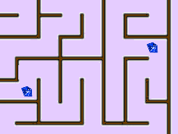
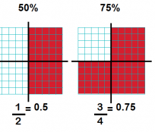
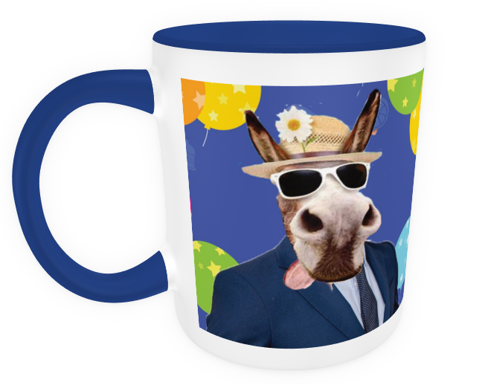
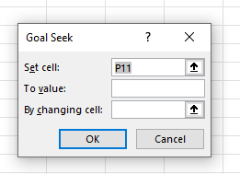
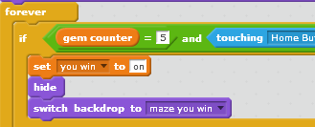
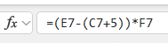
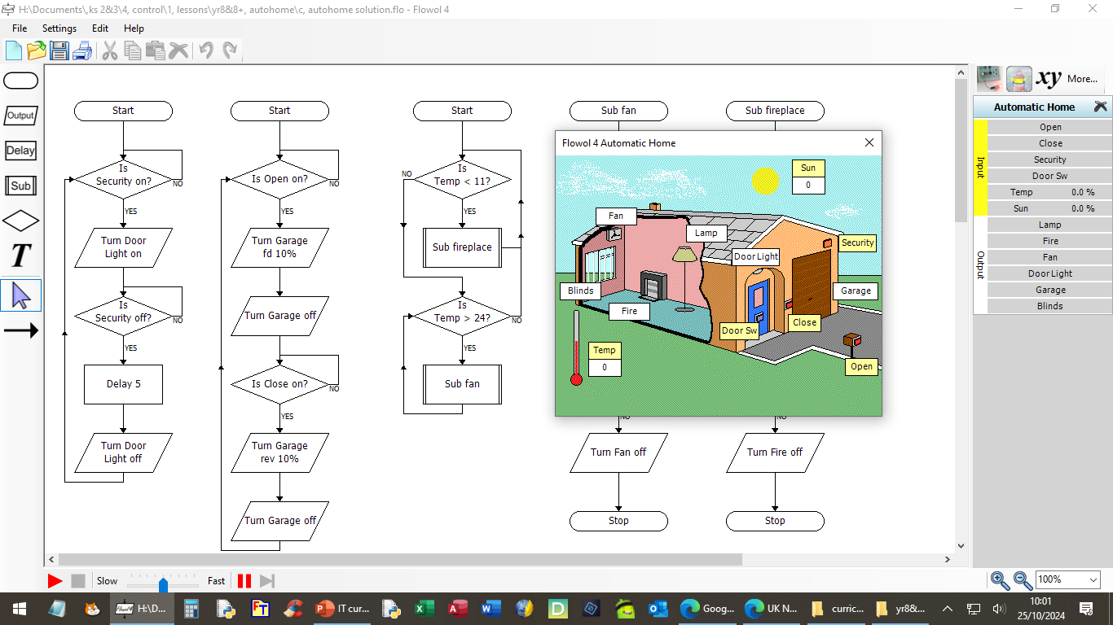
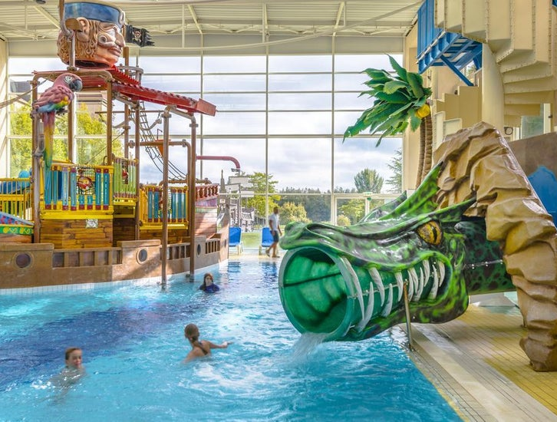
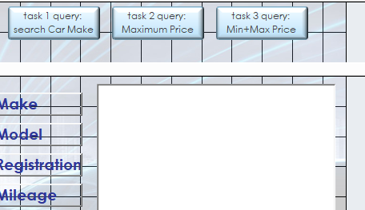
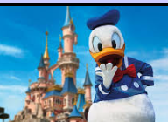
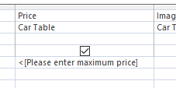
IT Home Page
Ks2a
Ks2b
Year 7
Year 8
Year 9
Careers
School Home Page
Autumn 1 – Photoshop
Objective: To be able to independently create an image with Photoshop, using a range of features and tools.
Spring 1 – Programming
Objectives: To be able to apply programming skills in a new context, create efficient code, test for and eliminate bugs, and design and develop own project.
Summer 1 – Spreadsheets
Objectives: To be able to create a model and explore the effects of changing variables, and develop a model to solve a problem to meet a particular need.
Autumn 2 – Control and Monitoring
Objectives: To be able to independently create a control and monitoring system, and to be able to refine and develop a system.
Spring 2 – Web Design Editor
Objectives: To be able to use an editor to produce a website using a variety of techniques, and independently produce a website with researched content and a specific audience in mind.
Summer 2 – Databases
Objectives: To be able to edit a database to improve its functionality, search a database using more than one condition, and use software features to improve database integrity.

Slide 6
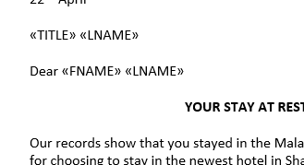
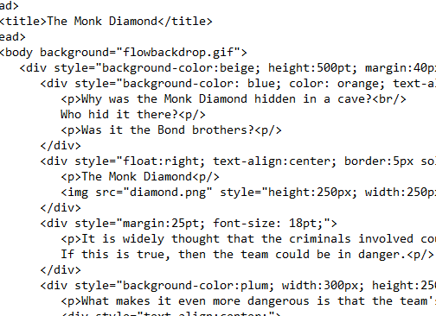
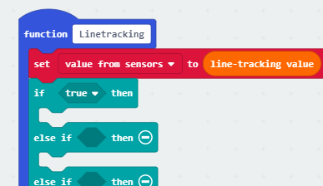
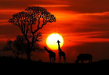
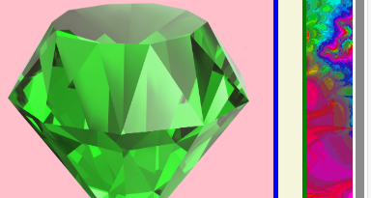
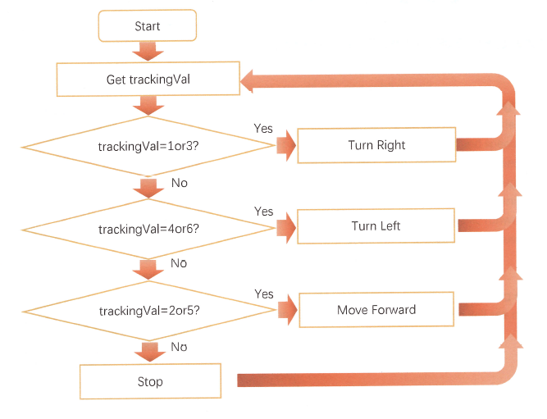
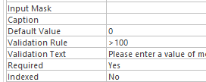
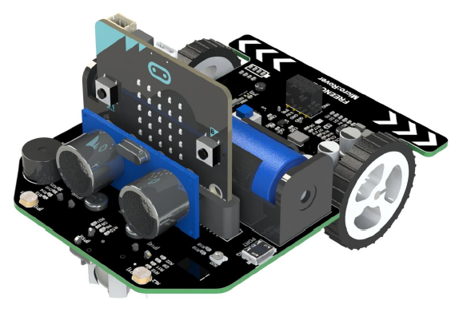
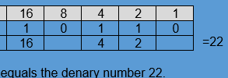
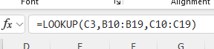
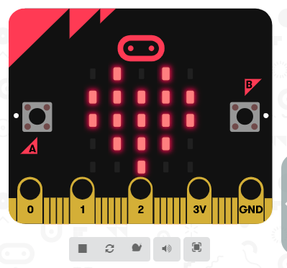




IT Home Page
Ks2a
Ks2b
Year 7
Year 8
Year 9
Careers
School Home Page
Autumn 1 – Web Design: HTML
Objective: To be able to create a website using text-based coding and a variety of techniques.
Spring 1 – S.T.E.M.: Robotics
Objectives: To be able to program a robot to navigate in the real world using ultrasonic and infrared sensors, and incorporate related work undertaken in other subjects.
Summer 1 – Databases
Objectives: To be able to use a database in a mail merge operation, extend knowledge of datatypes, and independently create a database.
Autumn 2 – S.T.E.M.: Robotics
Objectives: To be able to program a robot to navigate in the real world using ultrasonic and infrared sensors, and incorporate related work undertaken in other subjects.
Spring 2 – Networks and How Computers Work
Objectives: To develop an understanding of computers in terms of their hardware, software and logic, and develop an understanding of how networks work.
Summer 2 – Spreadsheets
Objectives: To be able to use a wider range of software features to assist in the creation of a model, create a more complex model using functions and apply those functions in a new context.

Slide 7
IT Home Page
Ks2a
Ks2b
Year 7
Year 8
Year 9
Careers
School Home Page
Cyber-security Analyst
Database Administrator
Games Developer
IT Support Executive
Software Engineer
Systems Analyst
Web Designer
Network Engineer
Careers in IT
Many jobs in the 21st century involve using a computer.
There are also lots of careers that are mainly all about computing.
To read a brief overview of some of the more common careers in computing, use the links above.
There is also a very useful government website containing more detail on the careers mentioned here, as well as a wider range of available careers. Click HERE to visit the site.

Slide 8
IT Home Page
Ks2a
Ks2b
Year 7
Year 8
Year 9
Careers
School Home Page
Cyber-security Analyst
Database Administrator
Games Developer
IT Support Executive
Software Engineer
Systems Analyst
Web Designer
Network Engineer
Cyber-Security Analyst
This involves protecting computers and networks against cyber-attacks, for example computer viruses.
As an analyst you would identify and fix weaknesses in the computer code and hardware of an organization.
Related school topics include programming, control, databases and networks.

Slide 9
IT Home Page
Ks2a
Ks2b
Year 7
Year 8
Year 9
Careers
School Home Page
Cyber-security Analyst
Database Administrator
Games Developer
IT Support Executive
Software Engineer
Systems Analyst
Web Designer
Network Engineer
Database Administrator
This involves the storing and organisation of important company data in databases.
As an administrator you would need to recognise patterns in data, and ensure that the companies databases run efficiently.
Related school topics include databases and networks.

Slide 10
IT Home Page
Ks2a
Ks2b
Year 7
Year 8
Year 9
Careers
School Home Page
Cyber-security Analyst
Database Administrator
Games Developer
IT Support Executive
Software Engineer
Systems Analyst
Web Designer
Network Engineer
Games Developer
This involves producing games for different platforms, including desktop computers, game consoles, mobile phones and tablets.
As a games developer, you could be involved in developing game ideas, writing code, creating audio and video files, and instructing animators.
Related school topics include 3D graphic design, programming, Photoshop and robotics.

Slide 11
IT Home Page
Ks2a
Ks2b
Year 7
Year 8
Year 9
Careers
School Home Page
Cyber-security Analyst
Database Administrator
Games Developer
IT Support Executive
Software Engineer
Systems Analyst
Web Designer
Network Engineer
IT Support Executive
This involves providing technical help to computer users in an organisation.
As an IT Support Executive, you would solve common problems such as forgotten passwords or lost data. You would also help to maintain the computer hardware and network infrastructure.
Related school topics include programming, networks, spreadsheets and web design.

Slide 12
IT Home Page
Ks2a
Ks2b
Year 7
Year 8
Year 9
Careers
School Home Page
Cyber-security Analyst
Database Administrator
Games Developer
IT Support Executive
Software Engineer
Systems Analyst
Web Designer
Network Engineer
Network Engineer
This involves the set up and maintenance of computer networks.
You would also diagnose and fix problems with network software, which may often involve travel around the country.
Related school topics include control, networks and robotics.

Slide 13
IT Home Page
Ks2a
Ks2b
Year 7
Year 8
Year 9
Careers
School Home Page
Cyber-security Analyst
Database Administrator
Games Developer
IT Support Executive
Software Engineer
Systems Analyst
Web Designer
Network Engineer
Software Engineer
As a software engineer you would plan, analyse, design, develop and test a wide variety of computer software.
You would also be involved in the maintenance of this software, from custom applications to computer operating systems.
Related school topics include control, databases, spreadsheets, programming and web design.

Slide 14
IT Home Page
Ks2a
Ks2b
Year 7
Year 8
Year 9
Careers
School Home Page
Cyber-security Analyst
Database Administrator
Games Developer
IT Support Executive
Software Engineer
Systems Analyst
Web Designer
Network Engineer
Systems Analyst
This involves identifying potential problems in a computer network and solving these problems.
You would work closely with network users and programmers to help plan and design any necessary improvements to a network system. You may also teach staff how to use any new hardware or software.
Related school topics include control, programming and networks.

Slide 15
IT Home Page
Ks2a
Ks2b
Year 7
Year 8
Year 9
Careers
School Home Page
Cyber-security Analyst
Database Administrator
Games Developer
IT Support Executive
Software e
Engineer
Systems Analyst
Web Designer
Network Engineer
Web Designer
This involves building and maintaining websites and apps for organisations.
You would need to be able to write coding and create attractive and useable web pages. This requires a blend of technical and creative skills.
Related school topics include web design, Photoshop, networks and programming.

