Slide 1
English Enrichment
Extra-curricular Activities

Slide 2
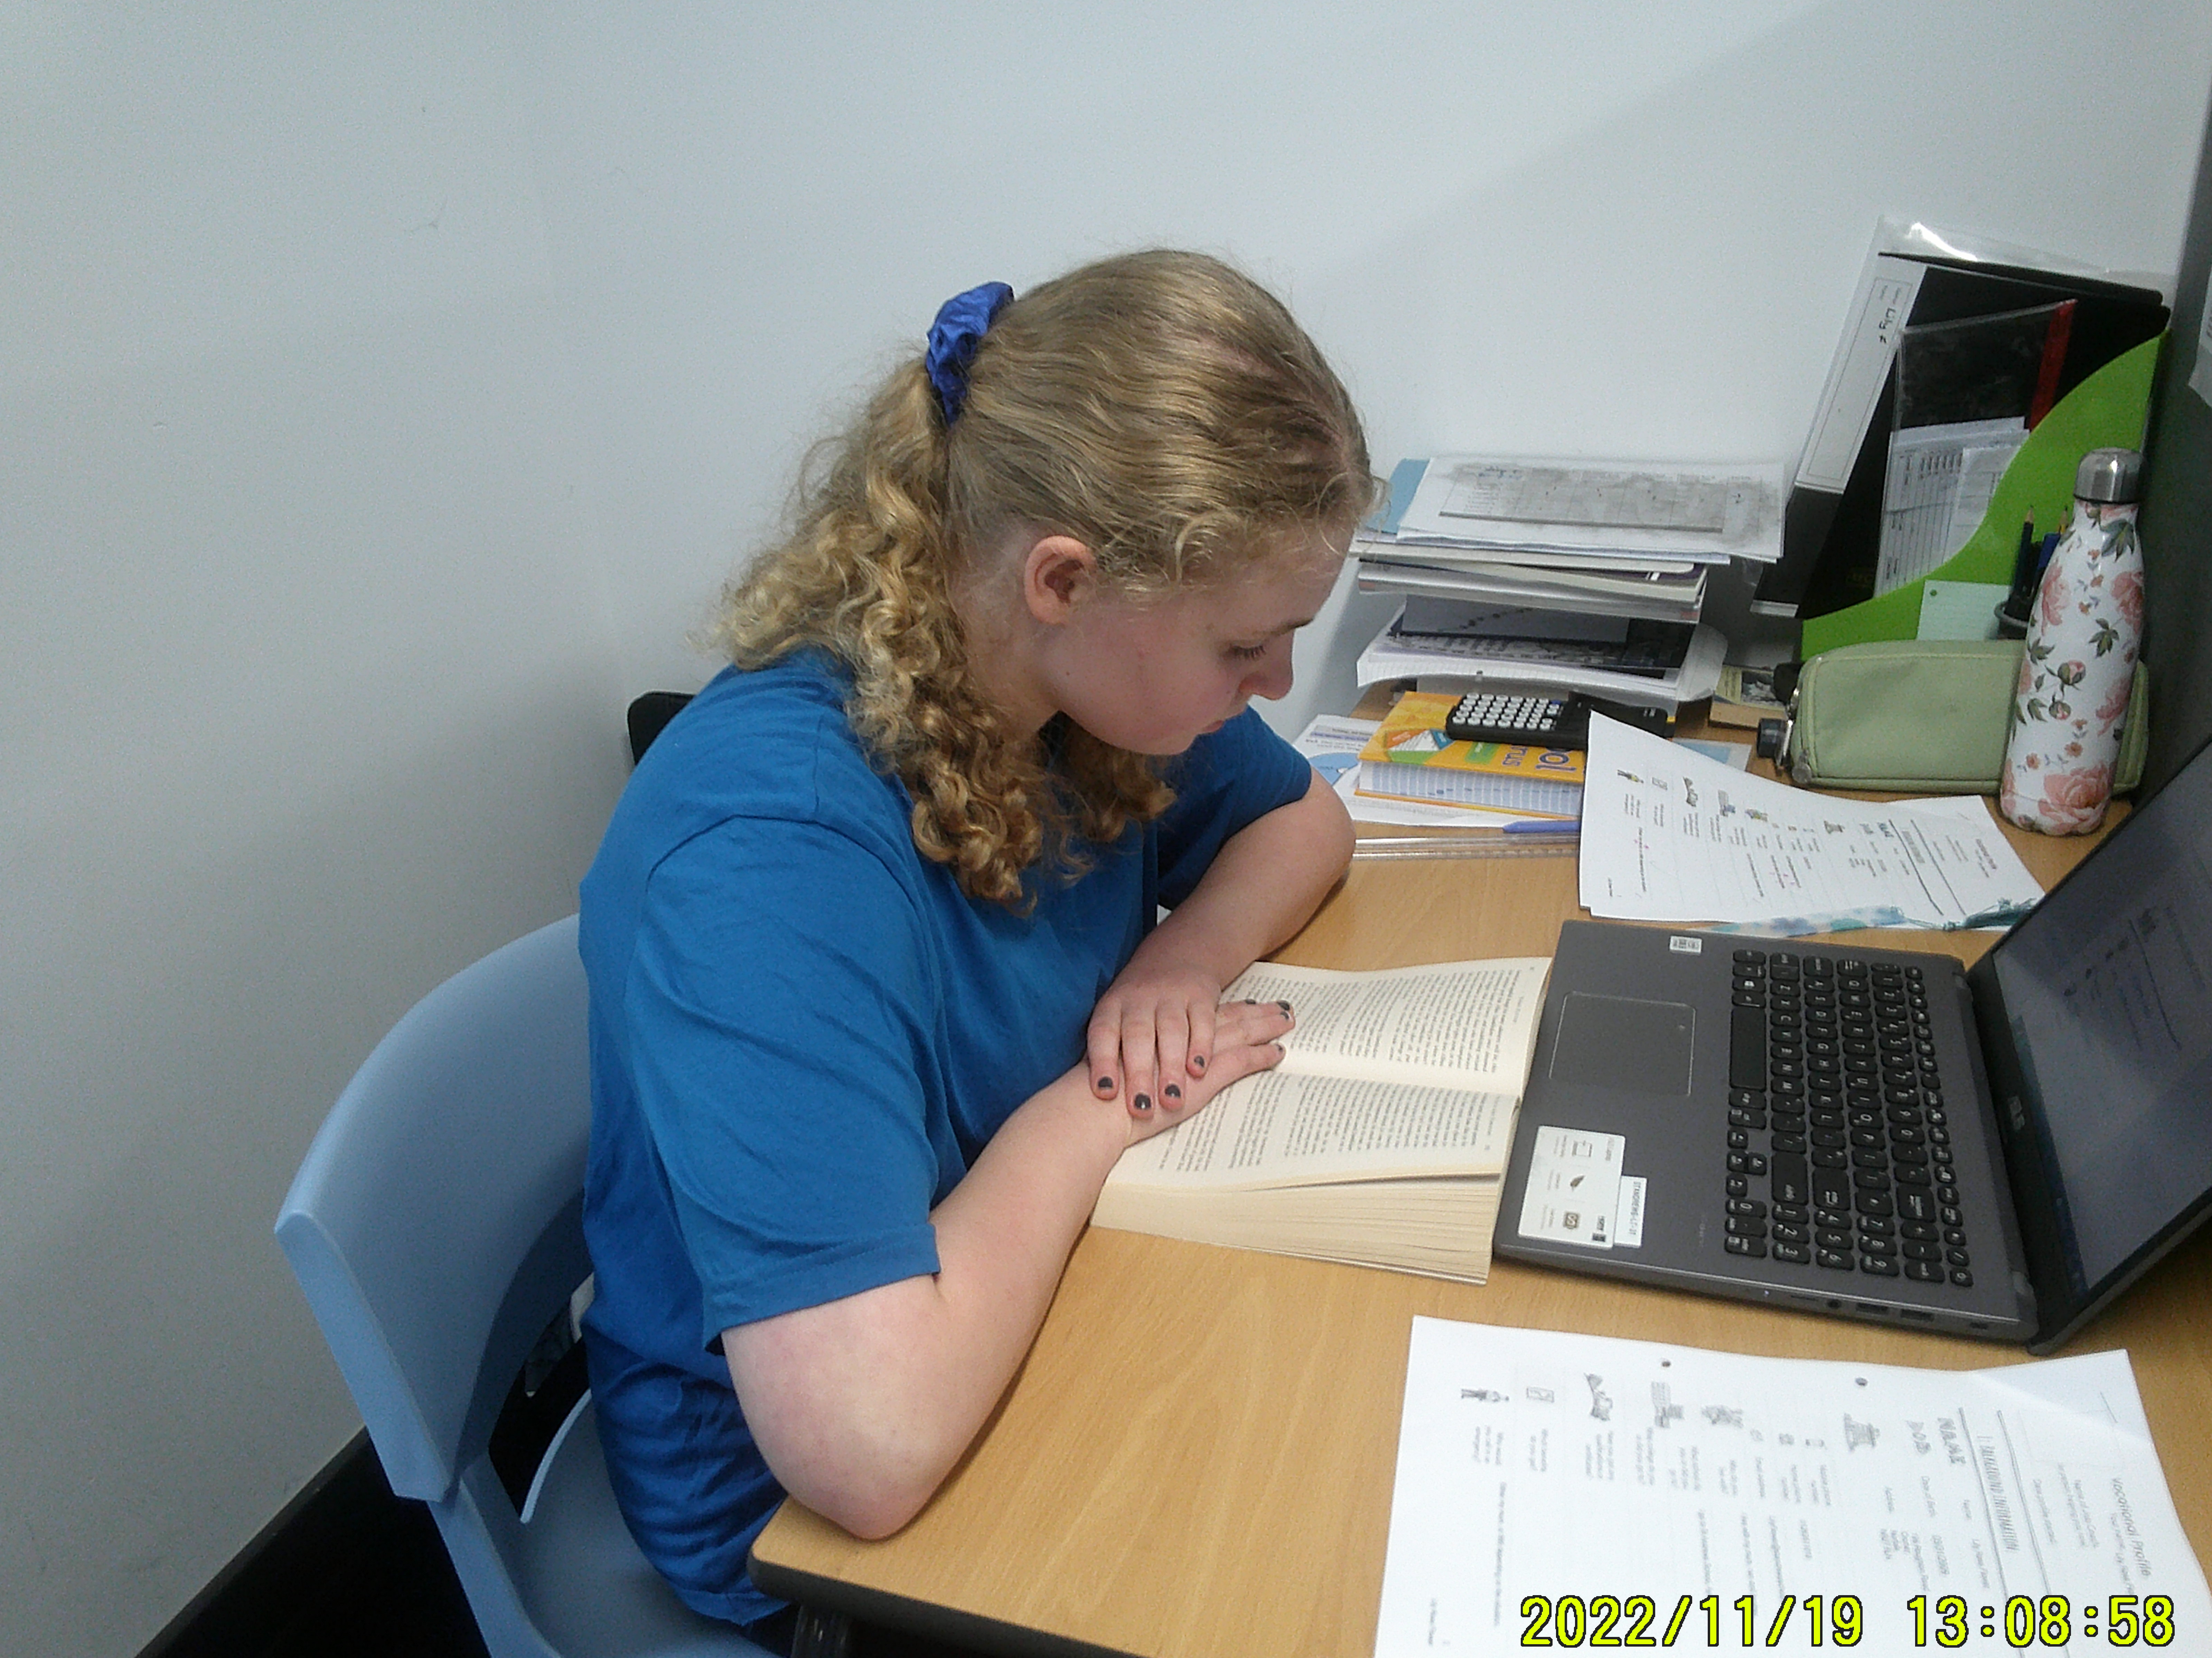
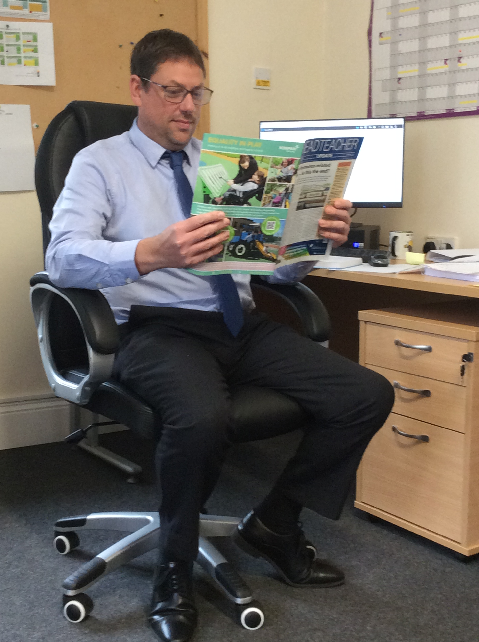
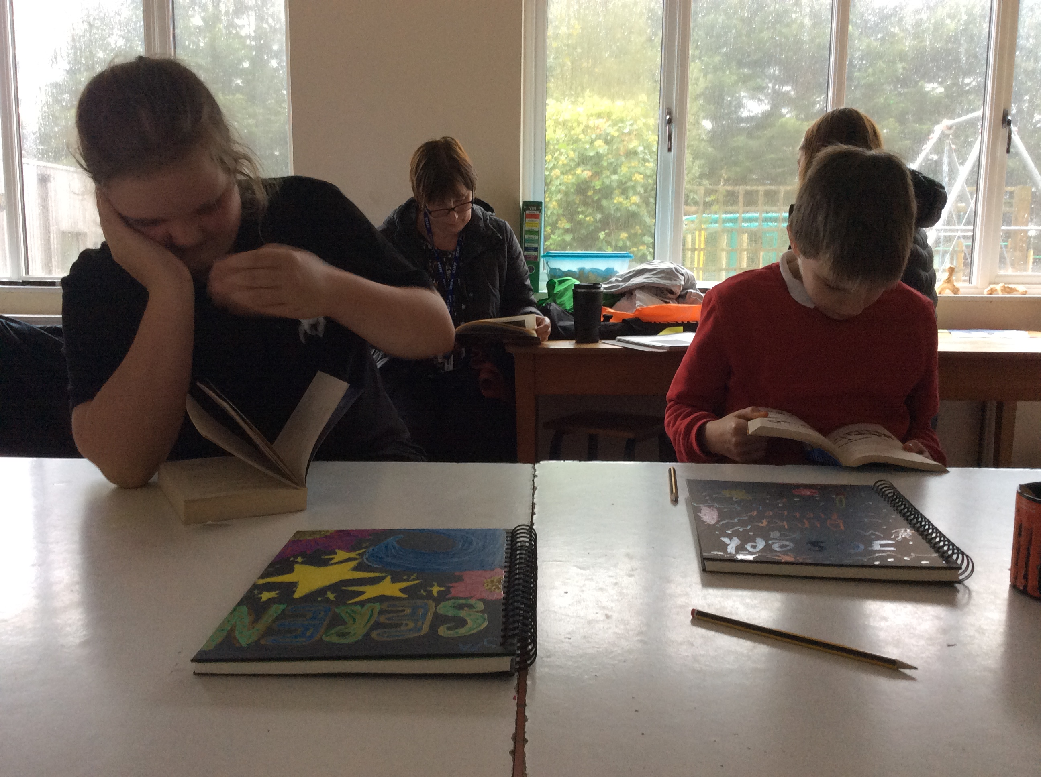
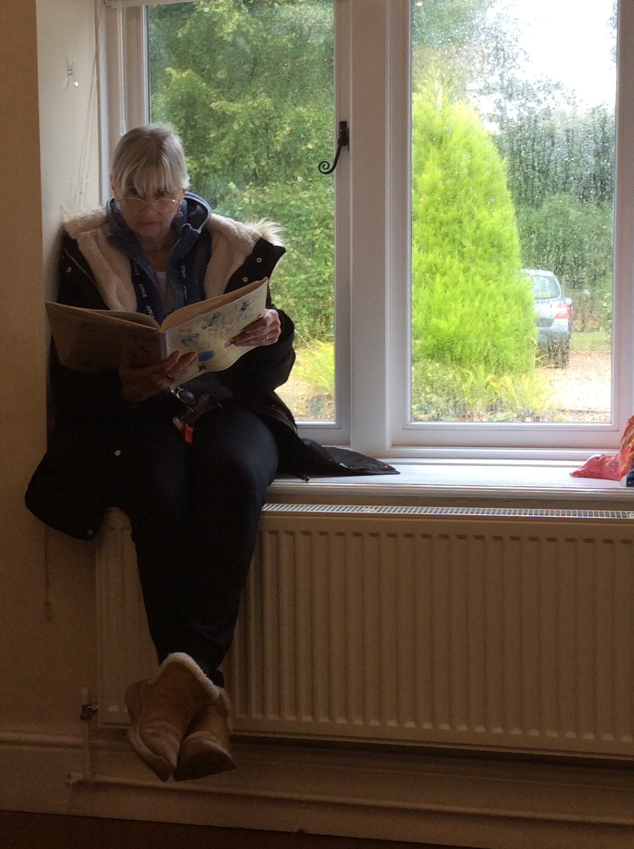
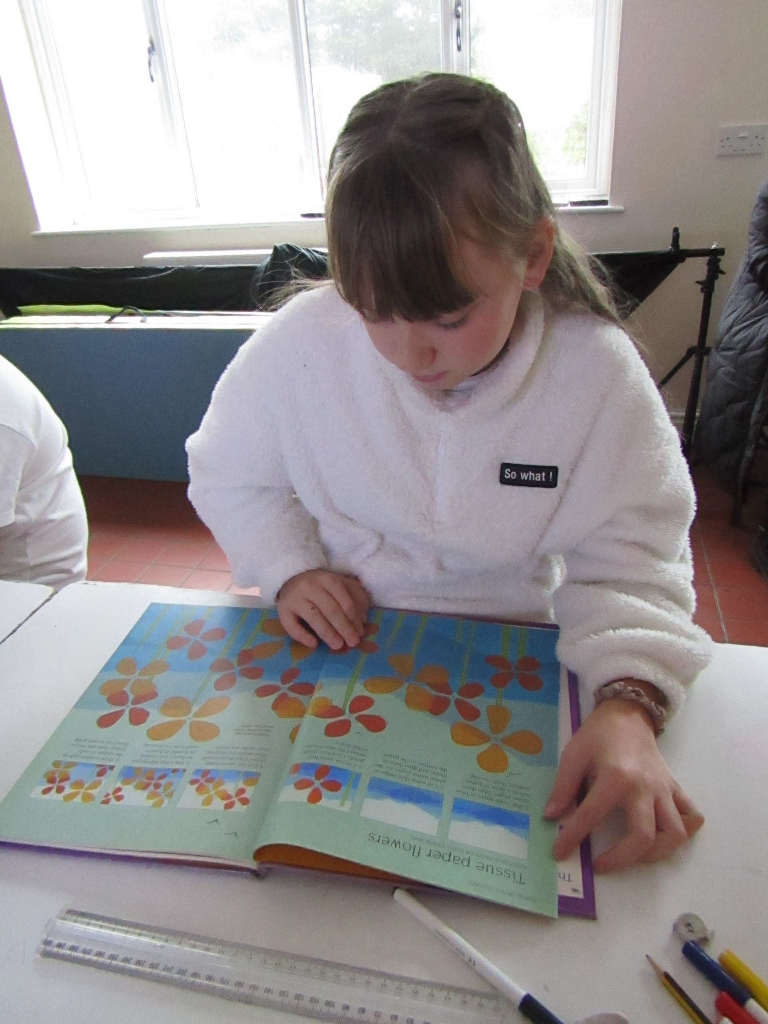
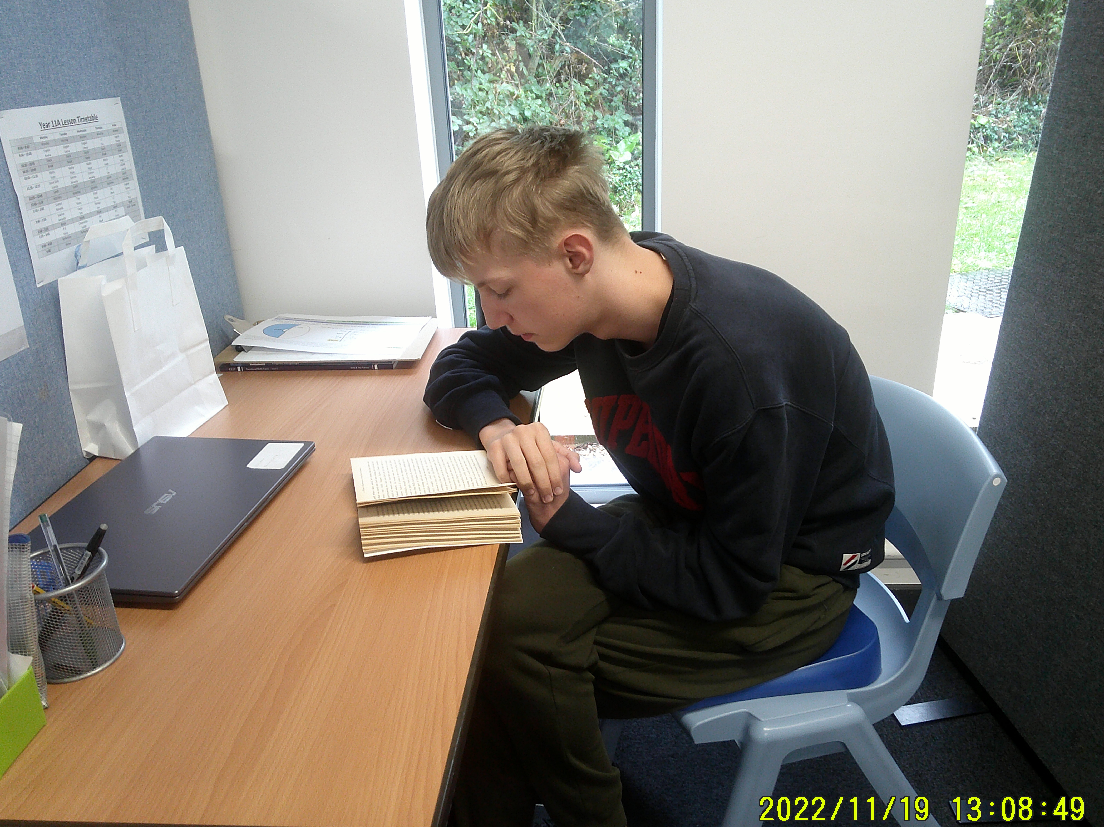
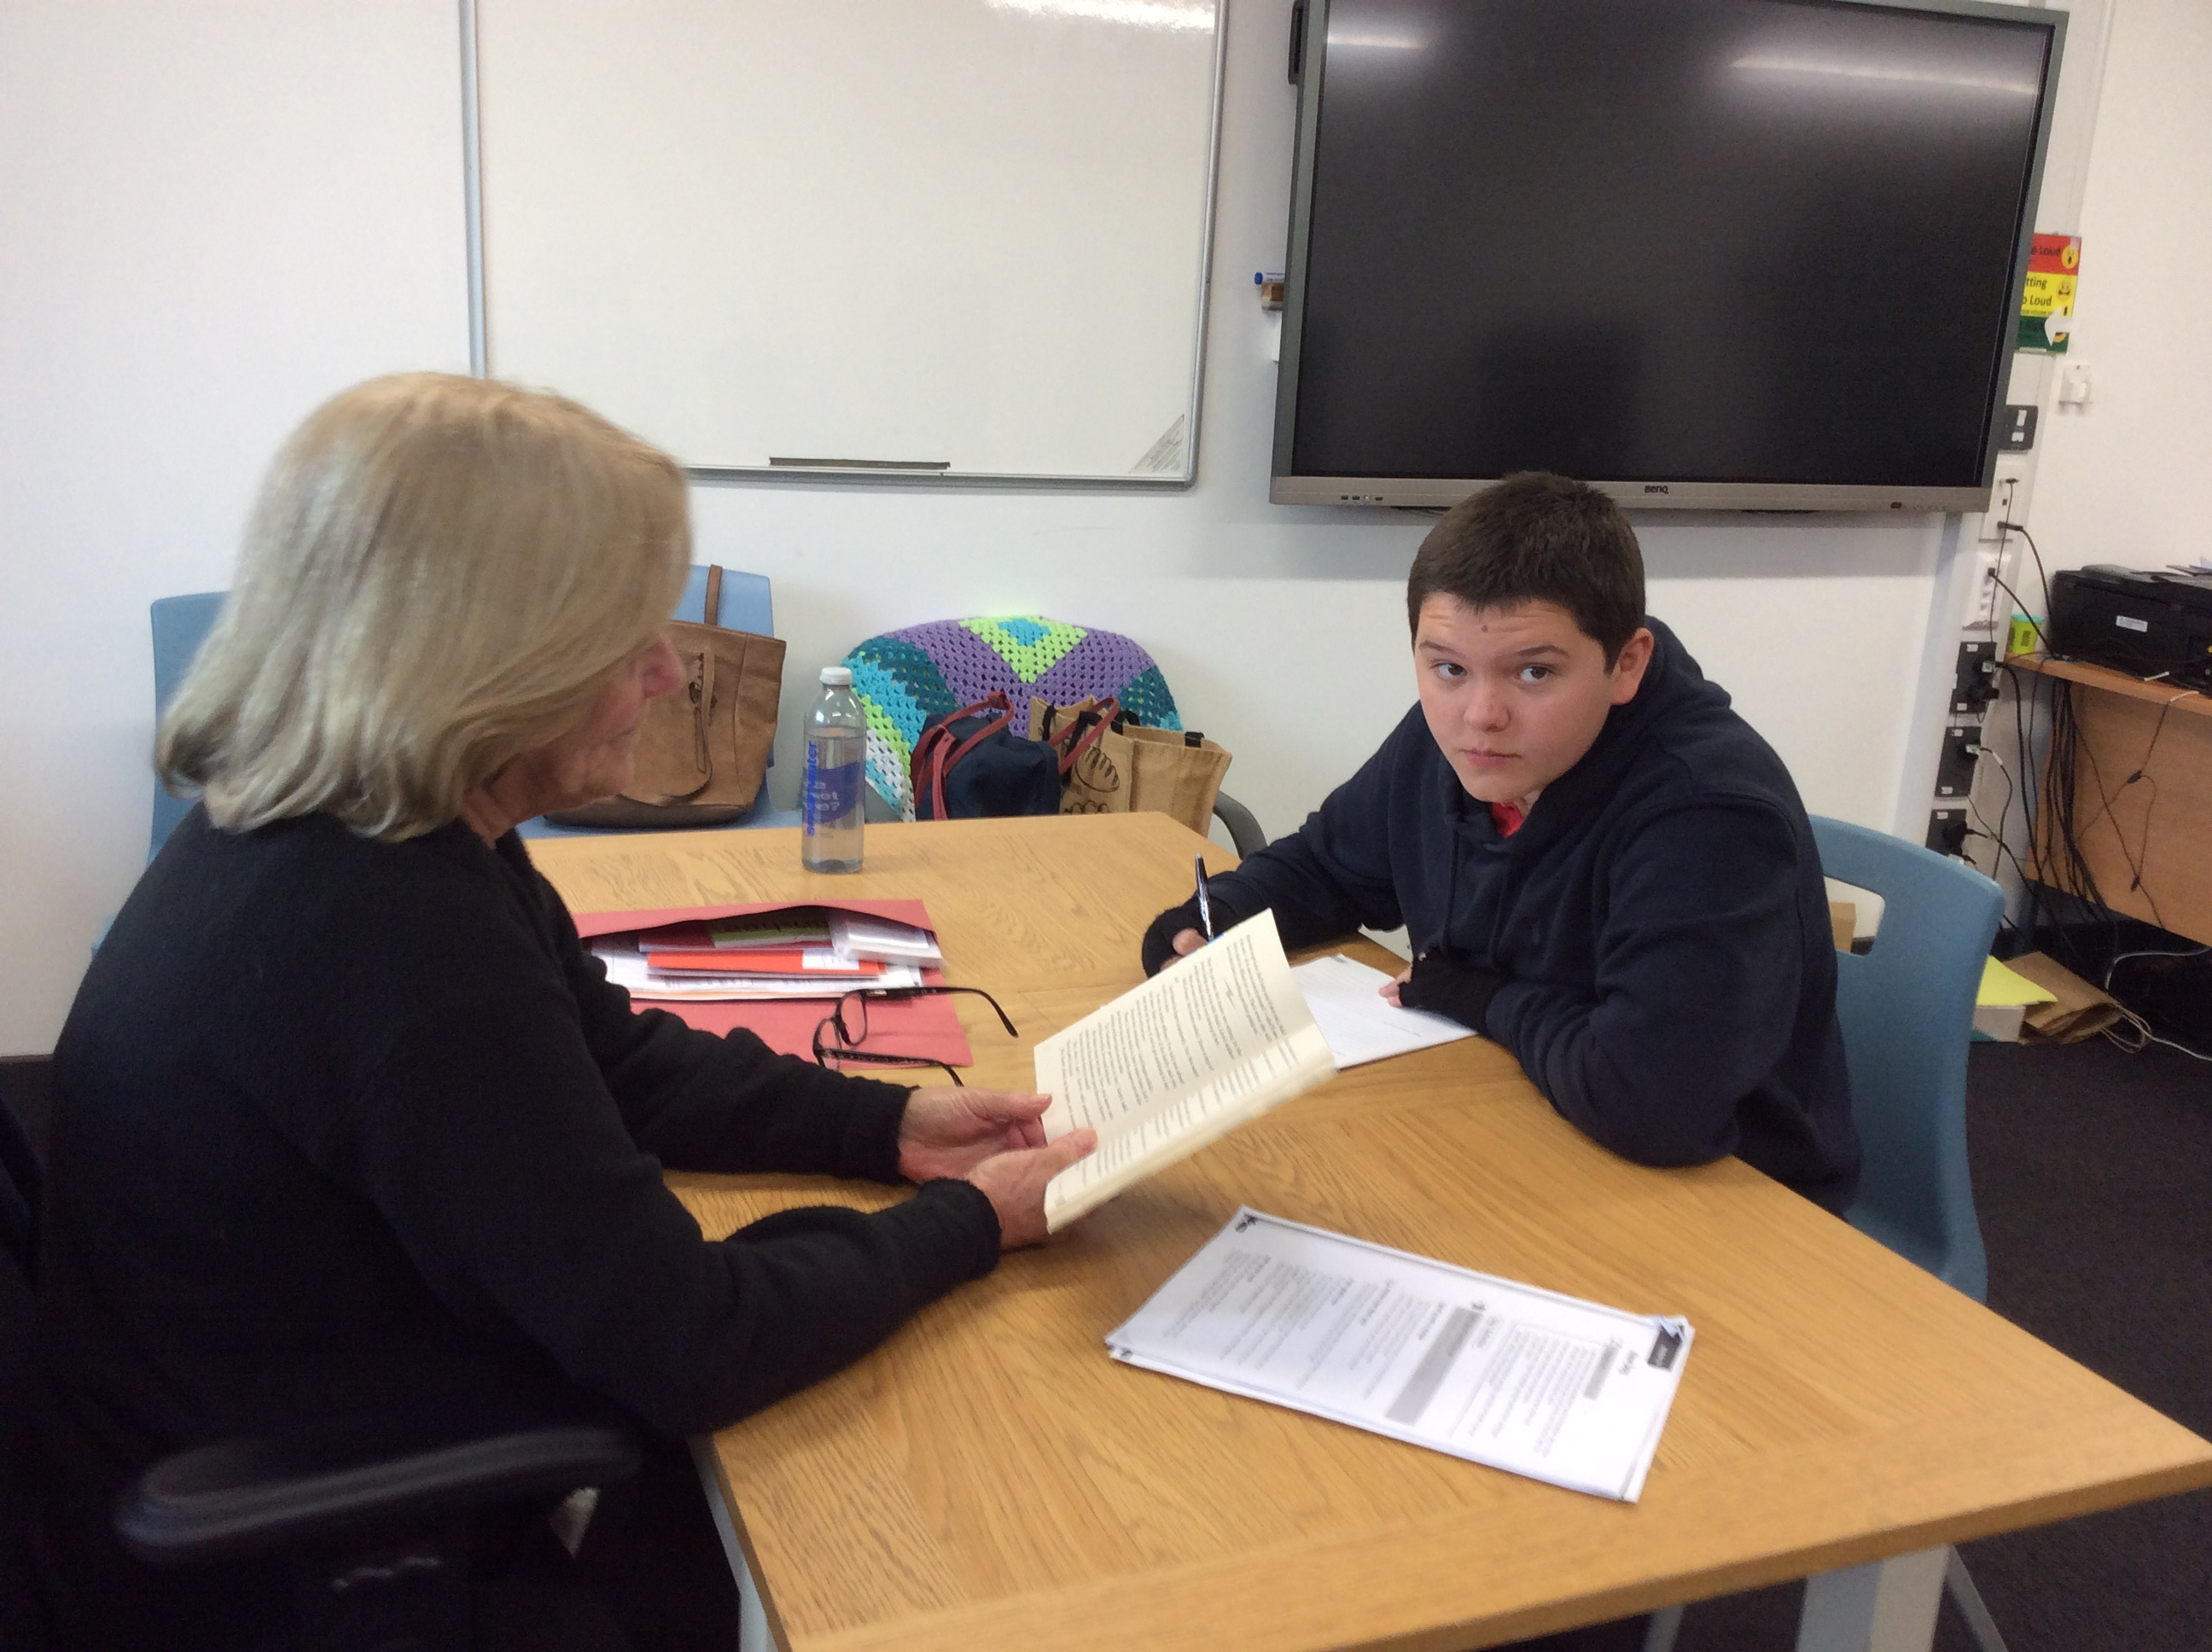
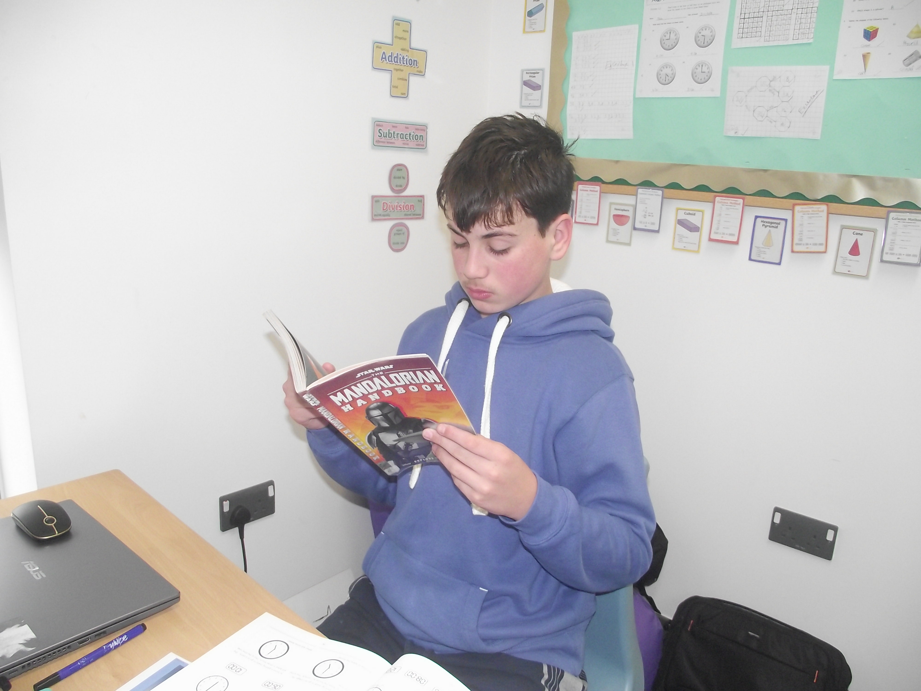
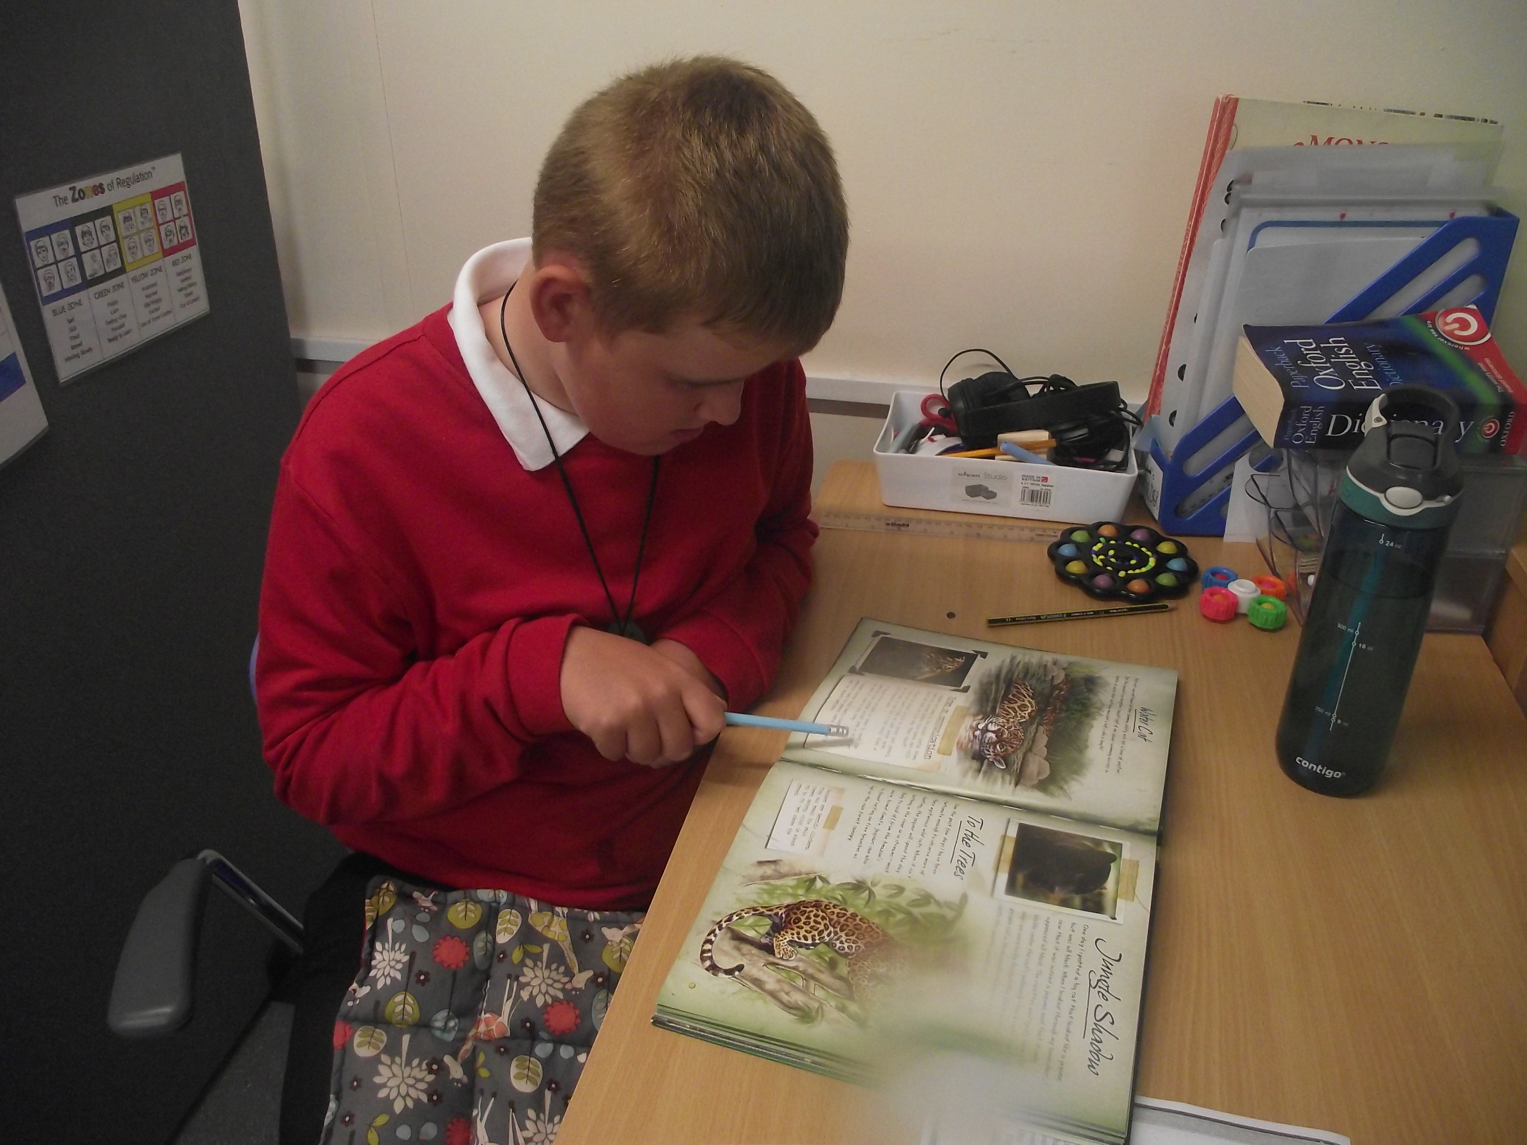
Drop Everything and Read!

Slide 3
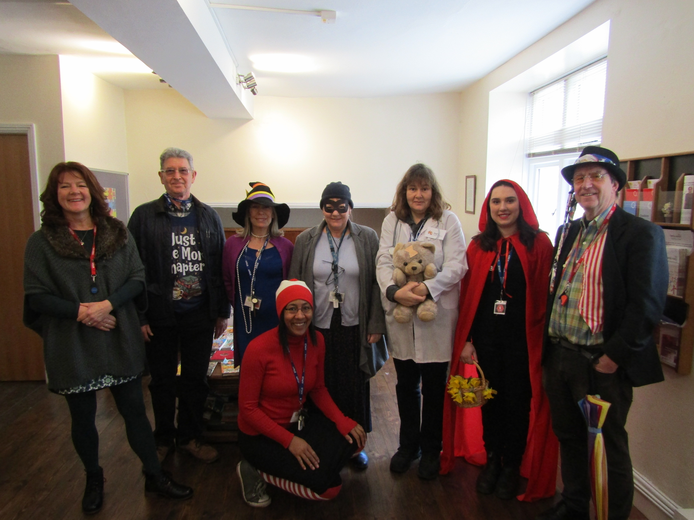
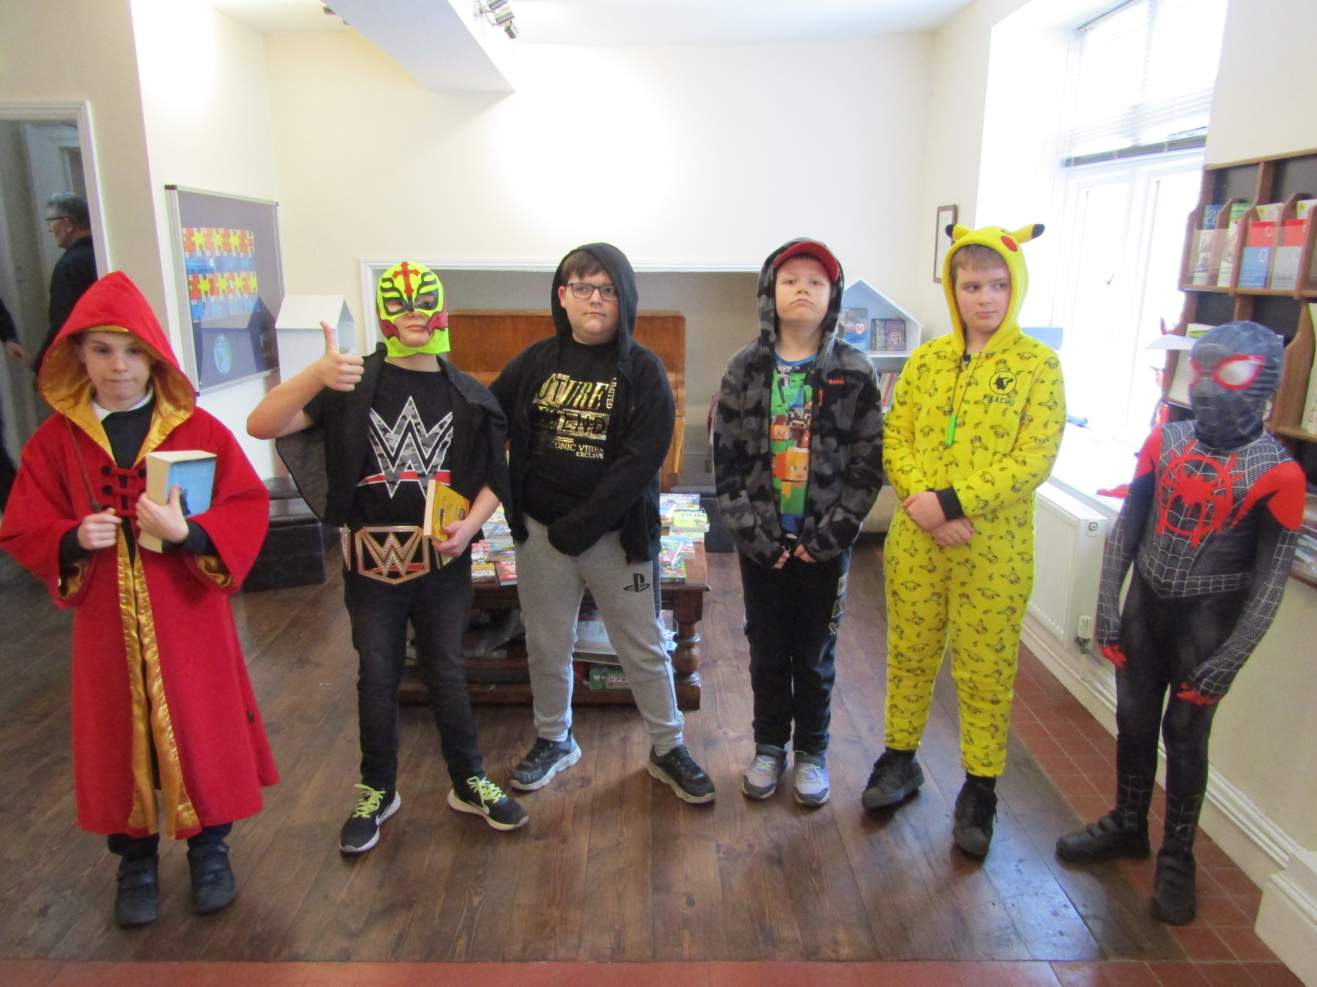
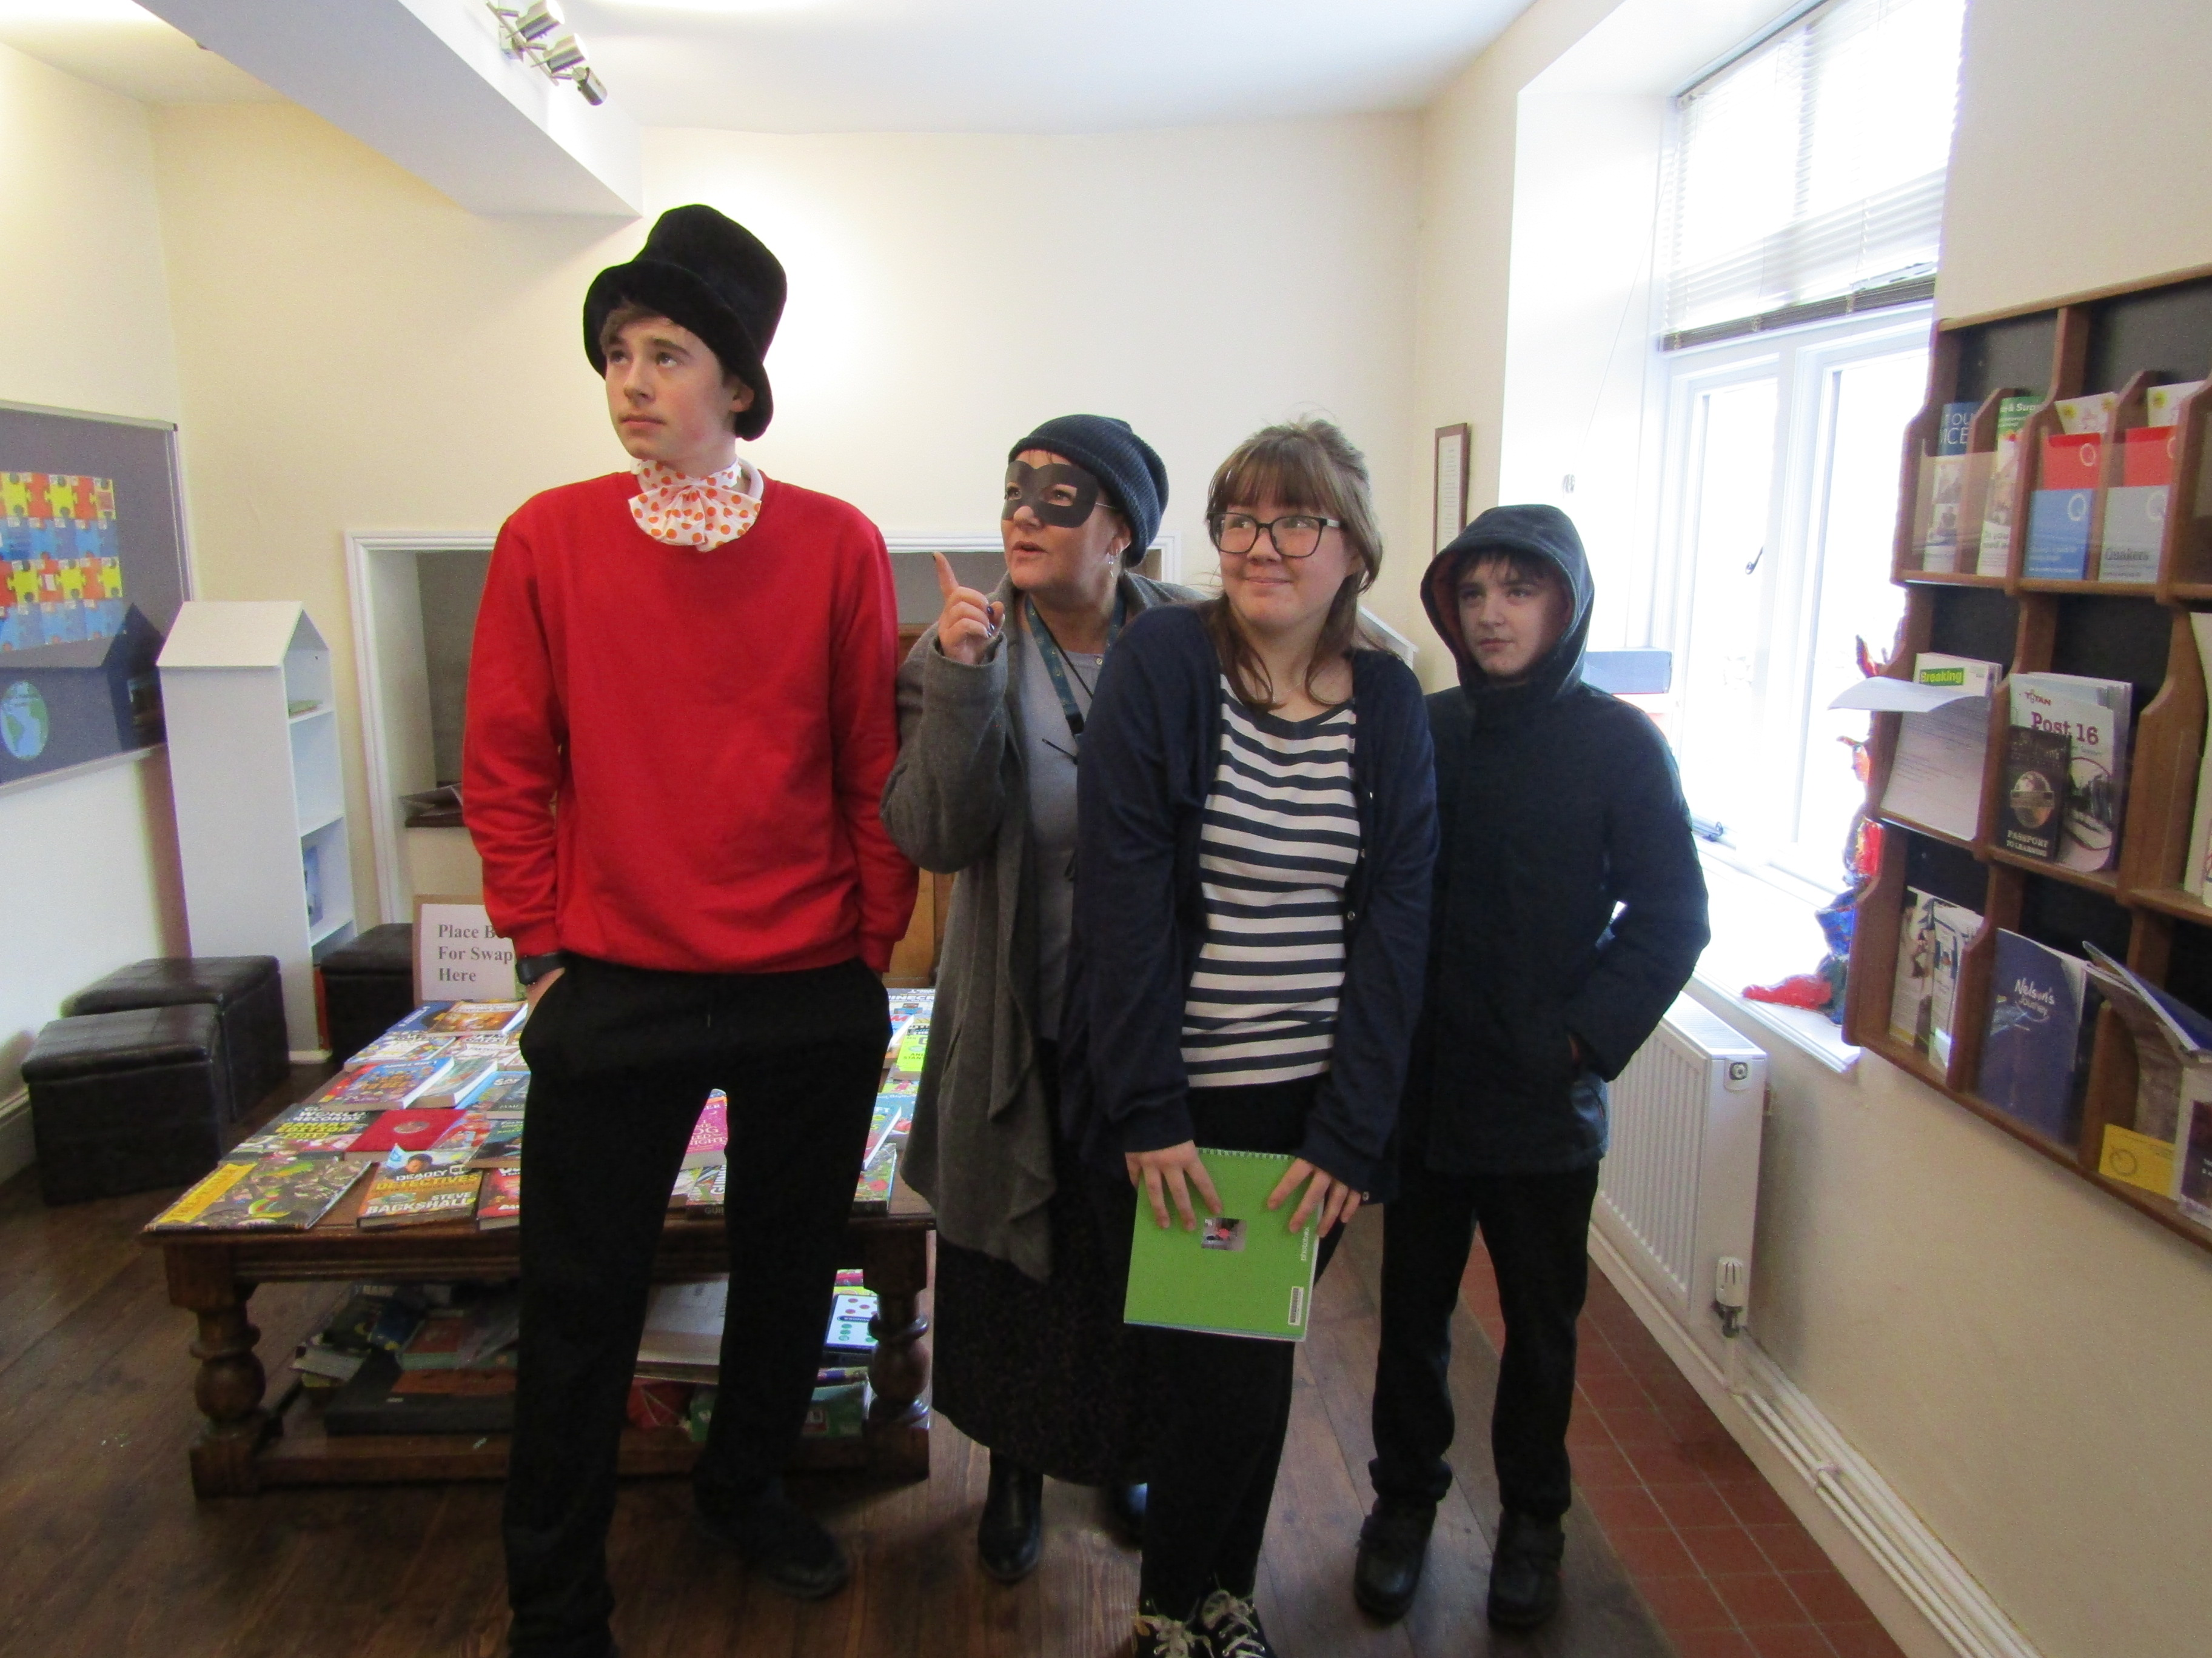
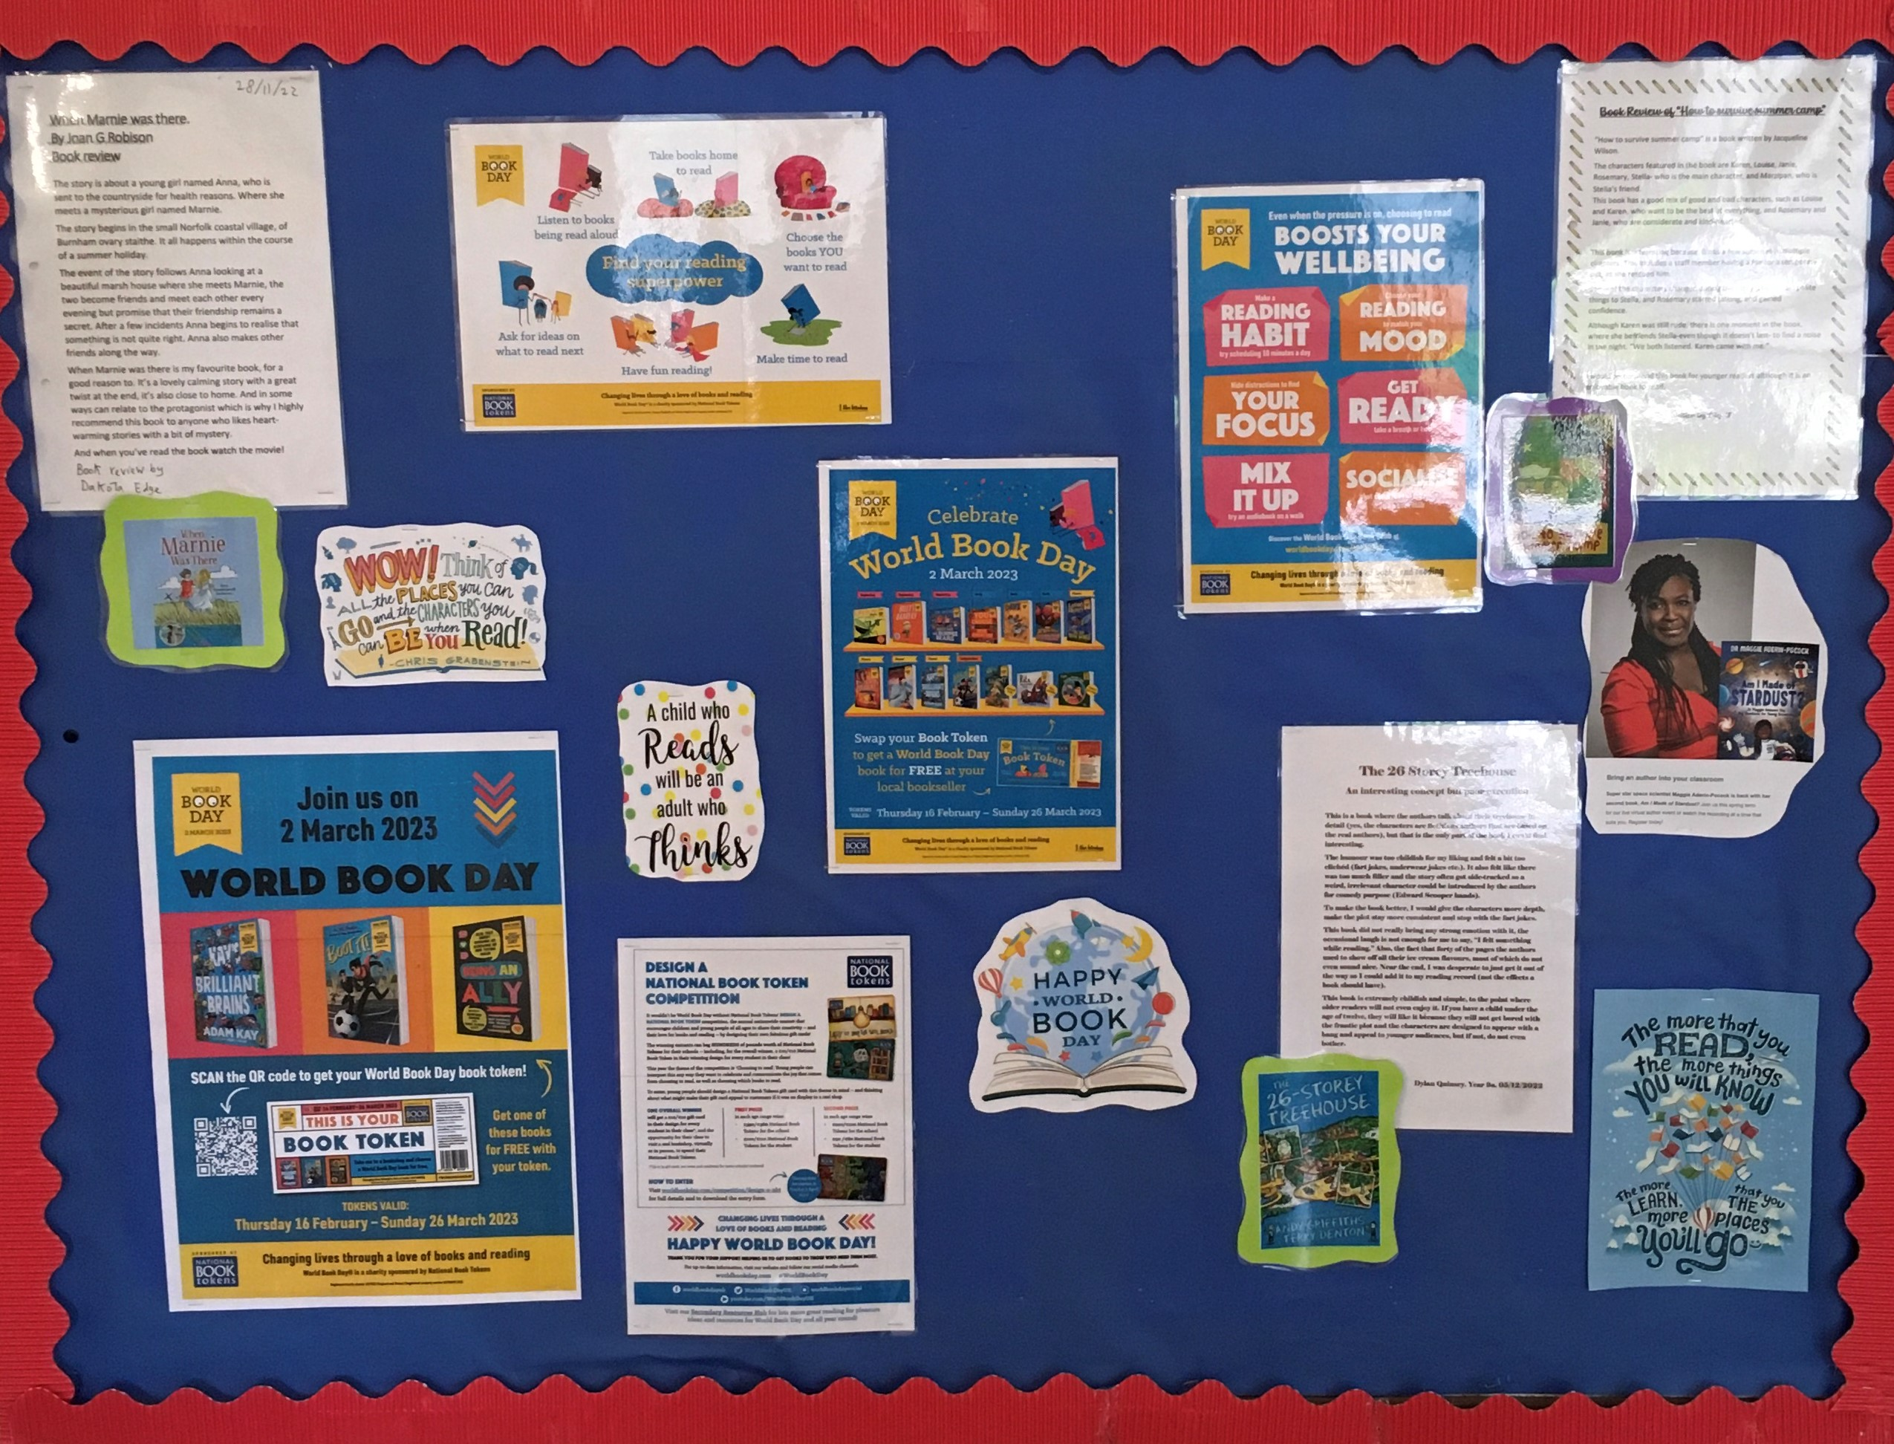
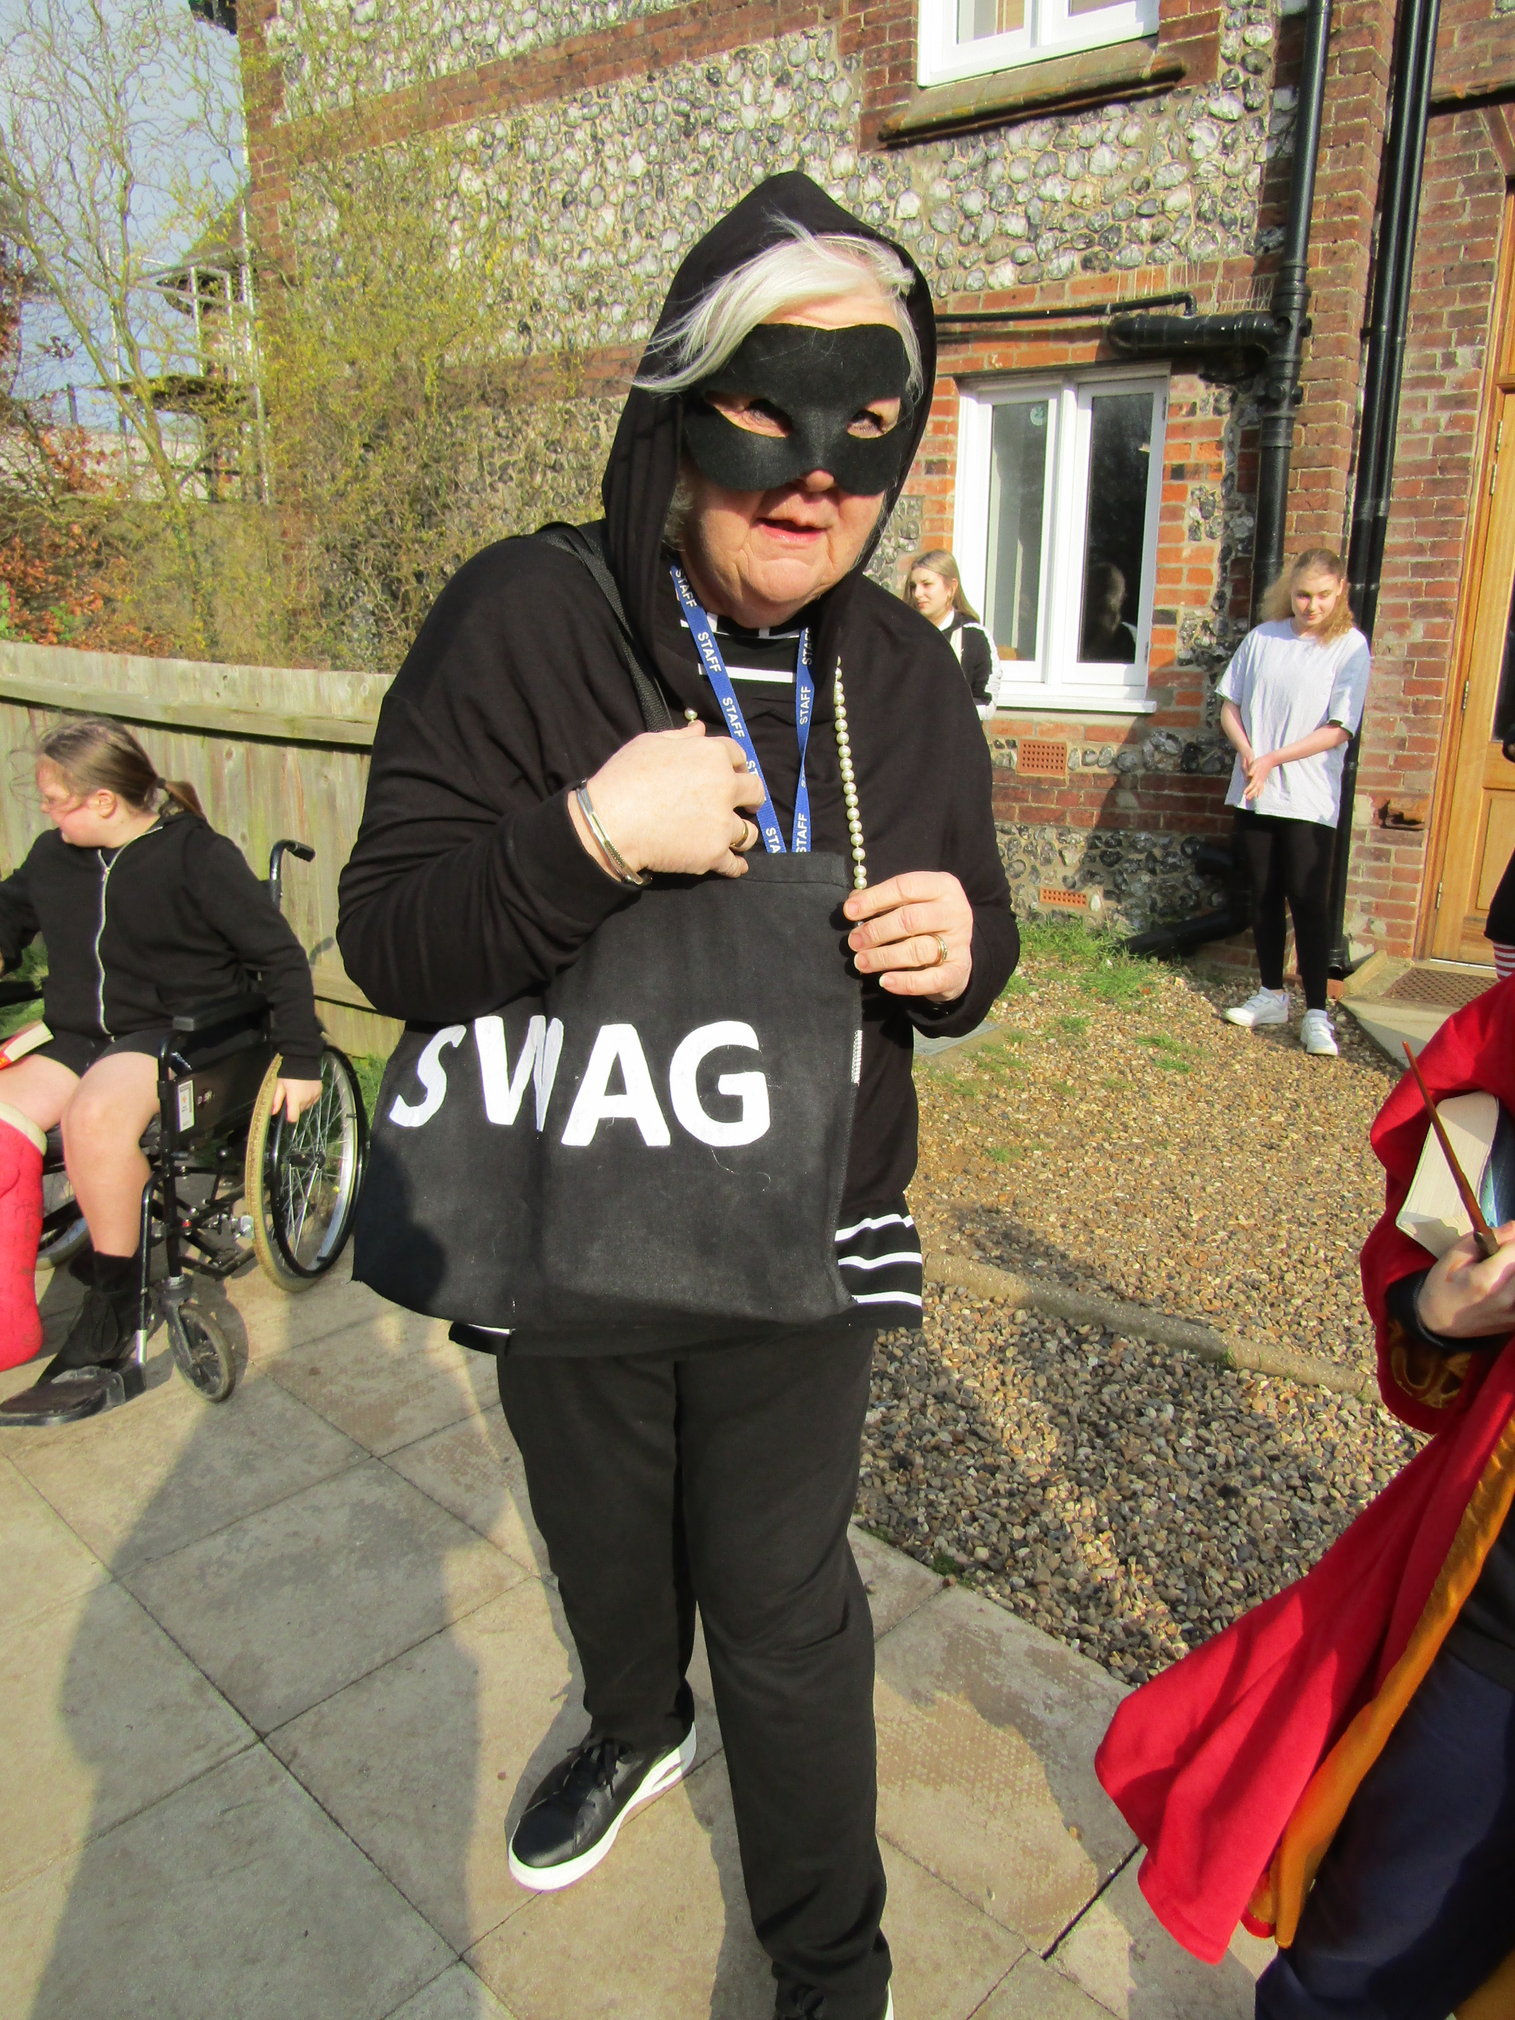
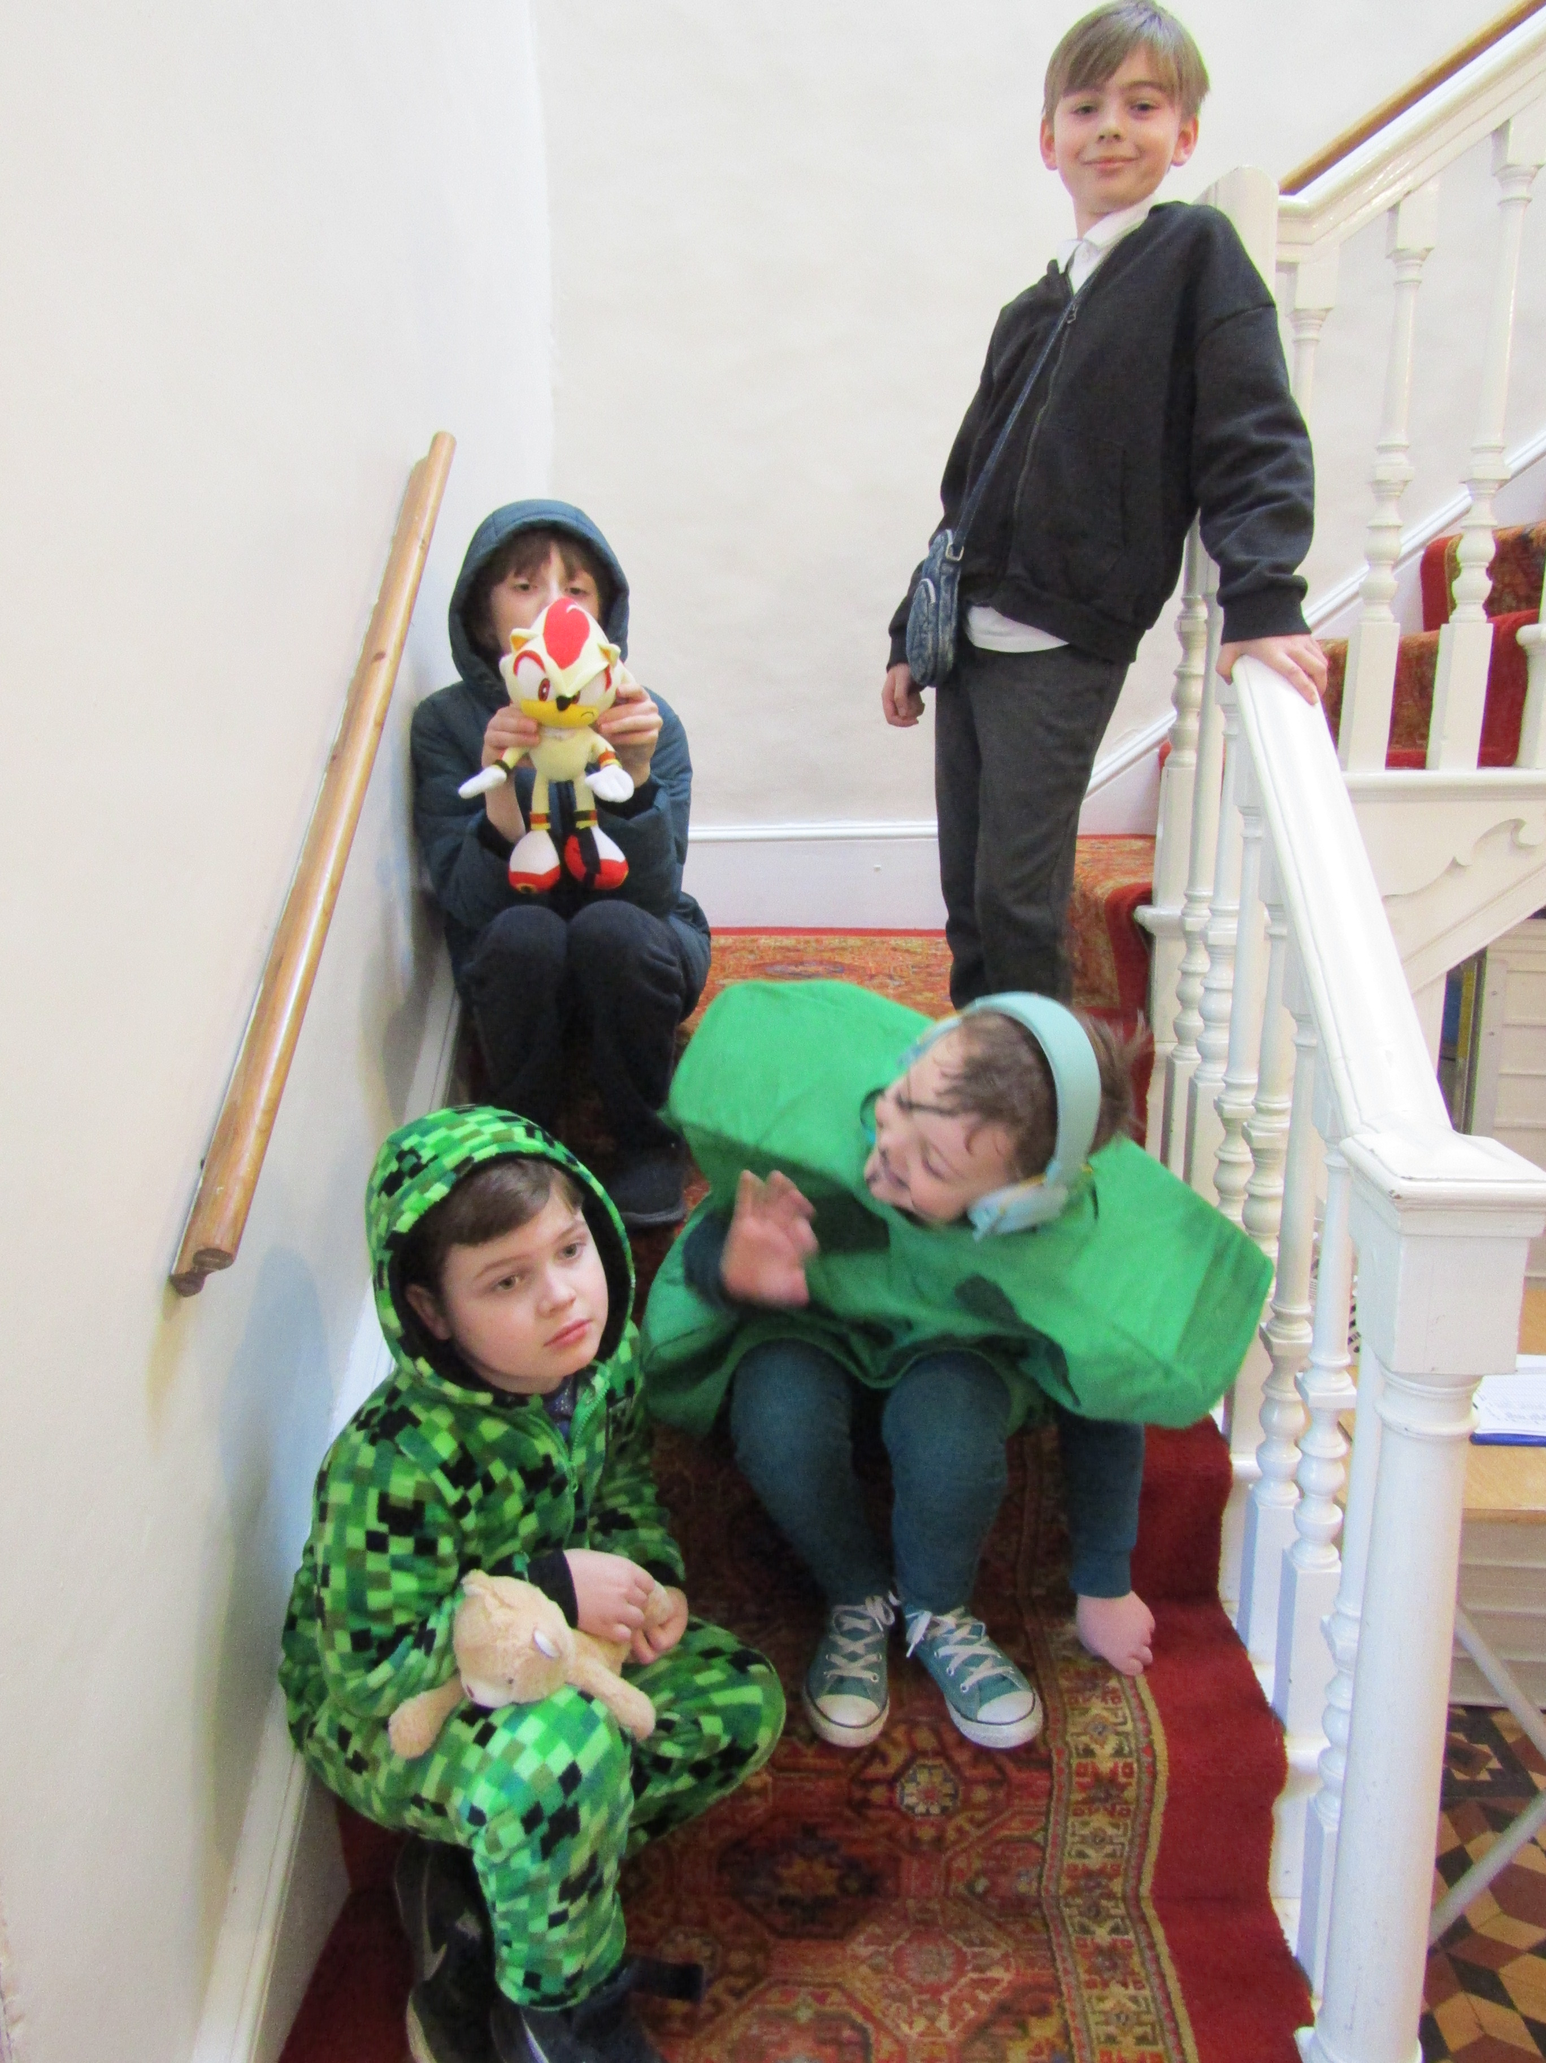
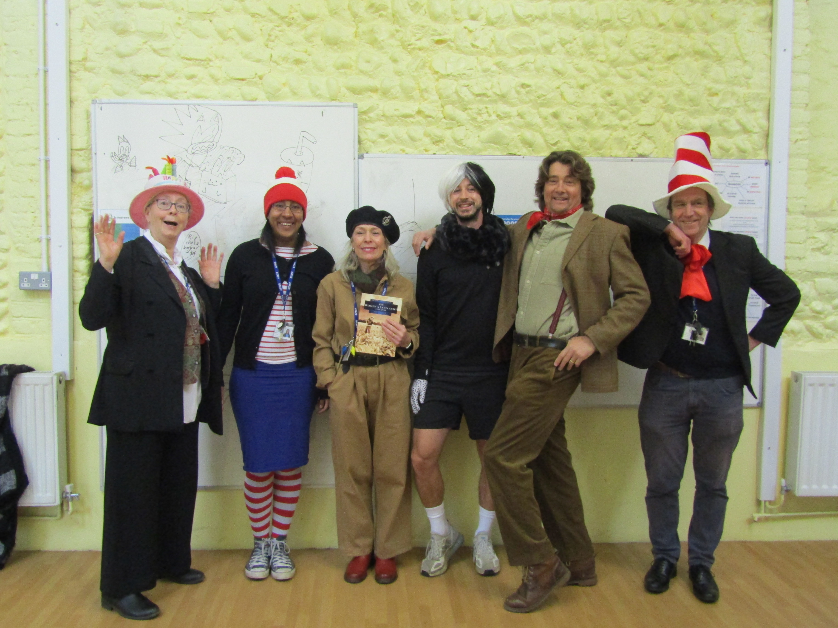
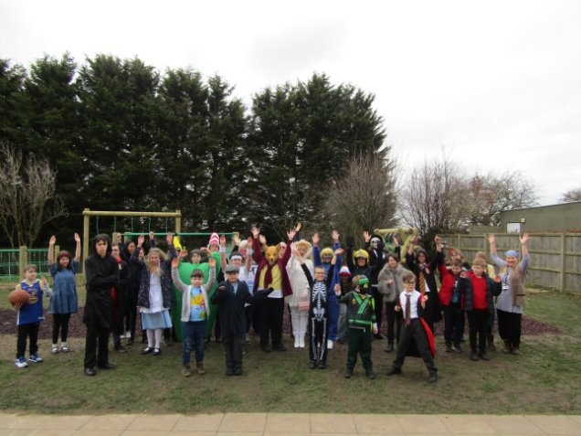
World Book Day

Slide 4
A Different Reality
I wouldn’t change autism
I would change the world instead.
Autism isn’t a shame
It’s just a beautiful name
It’s the way we process
It’s the way we see
See the better, the brighter,
The magic and power.
Through the storm and the sun
We feel through our nerves
We tiptoe we skim we laugh
We fall. We are amazing.
Be who you are, not what you’re told
don’t be defined, trust in your mind.
If the lights are too bright
If the music’s too loud
When you’re lost in a crowd,
Hold on. You are beautiful
Never change autism
Change the world instead.
Year 10 took part in a poetry workshop with esteemed poet Peter Pegnall and here is an example of a student's poem inspired by the experience.

Slide 5

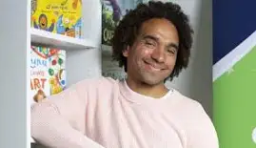
‘Write a story you would love to read.’ This year our students have
been given the opportunity to enter the BBC's 500 Words,
the UK's largest children's writing competition for children aged
5-11. We have also opened it up across the school for children
to choose their favourite tales and discuss the power of a good yarn.
https://www.bbc.co.uk/teach/500-words
Joseph Coelho: "Observe the world around you"

Slide 6
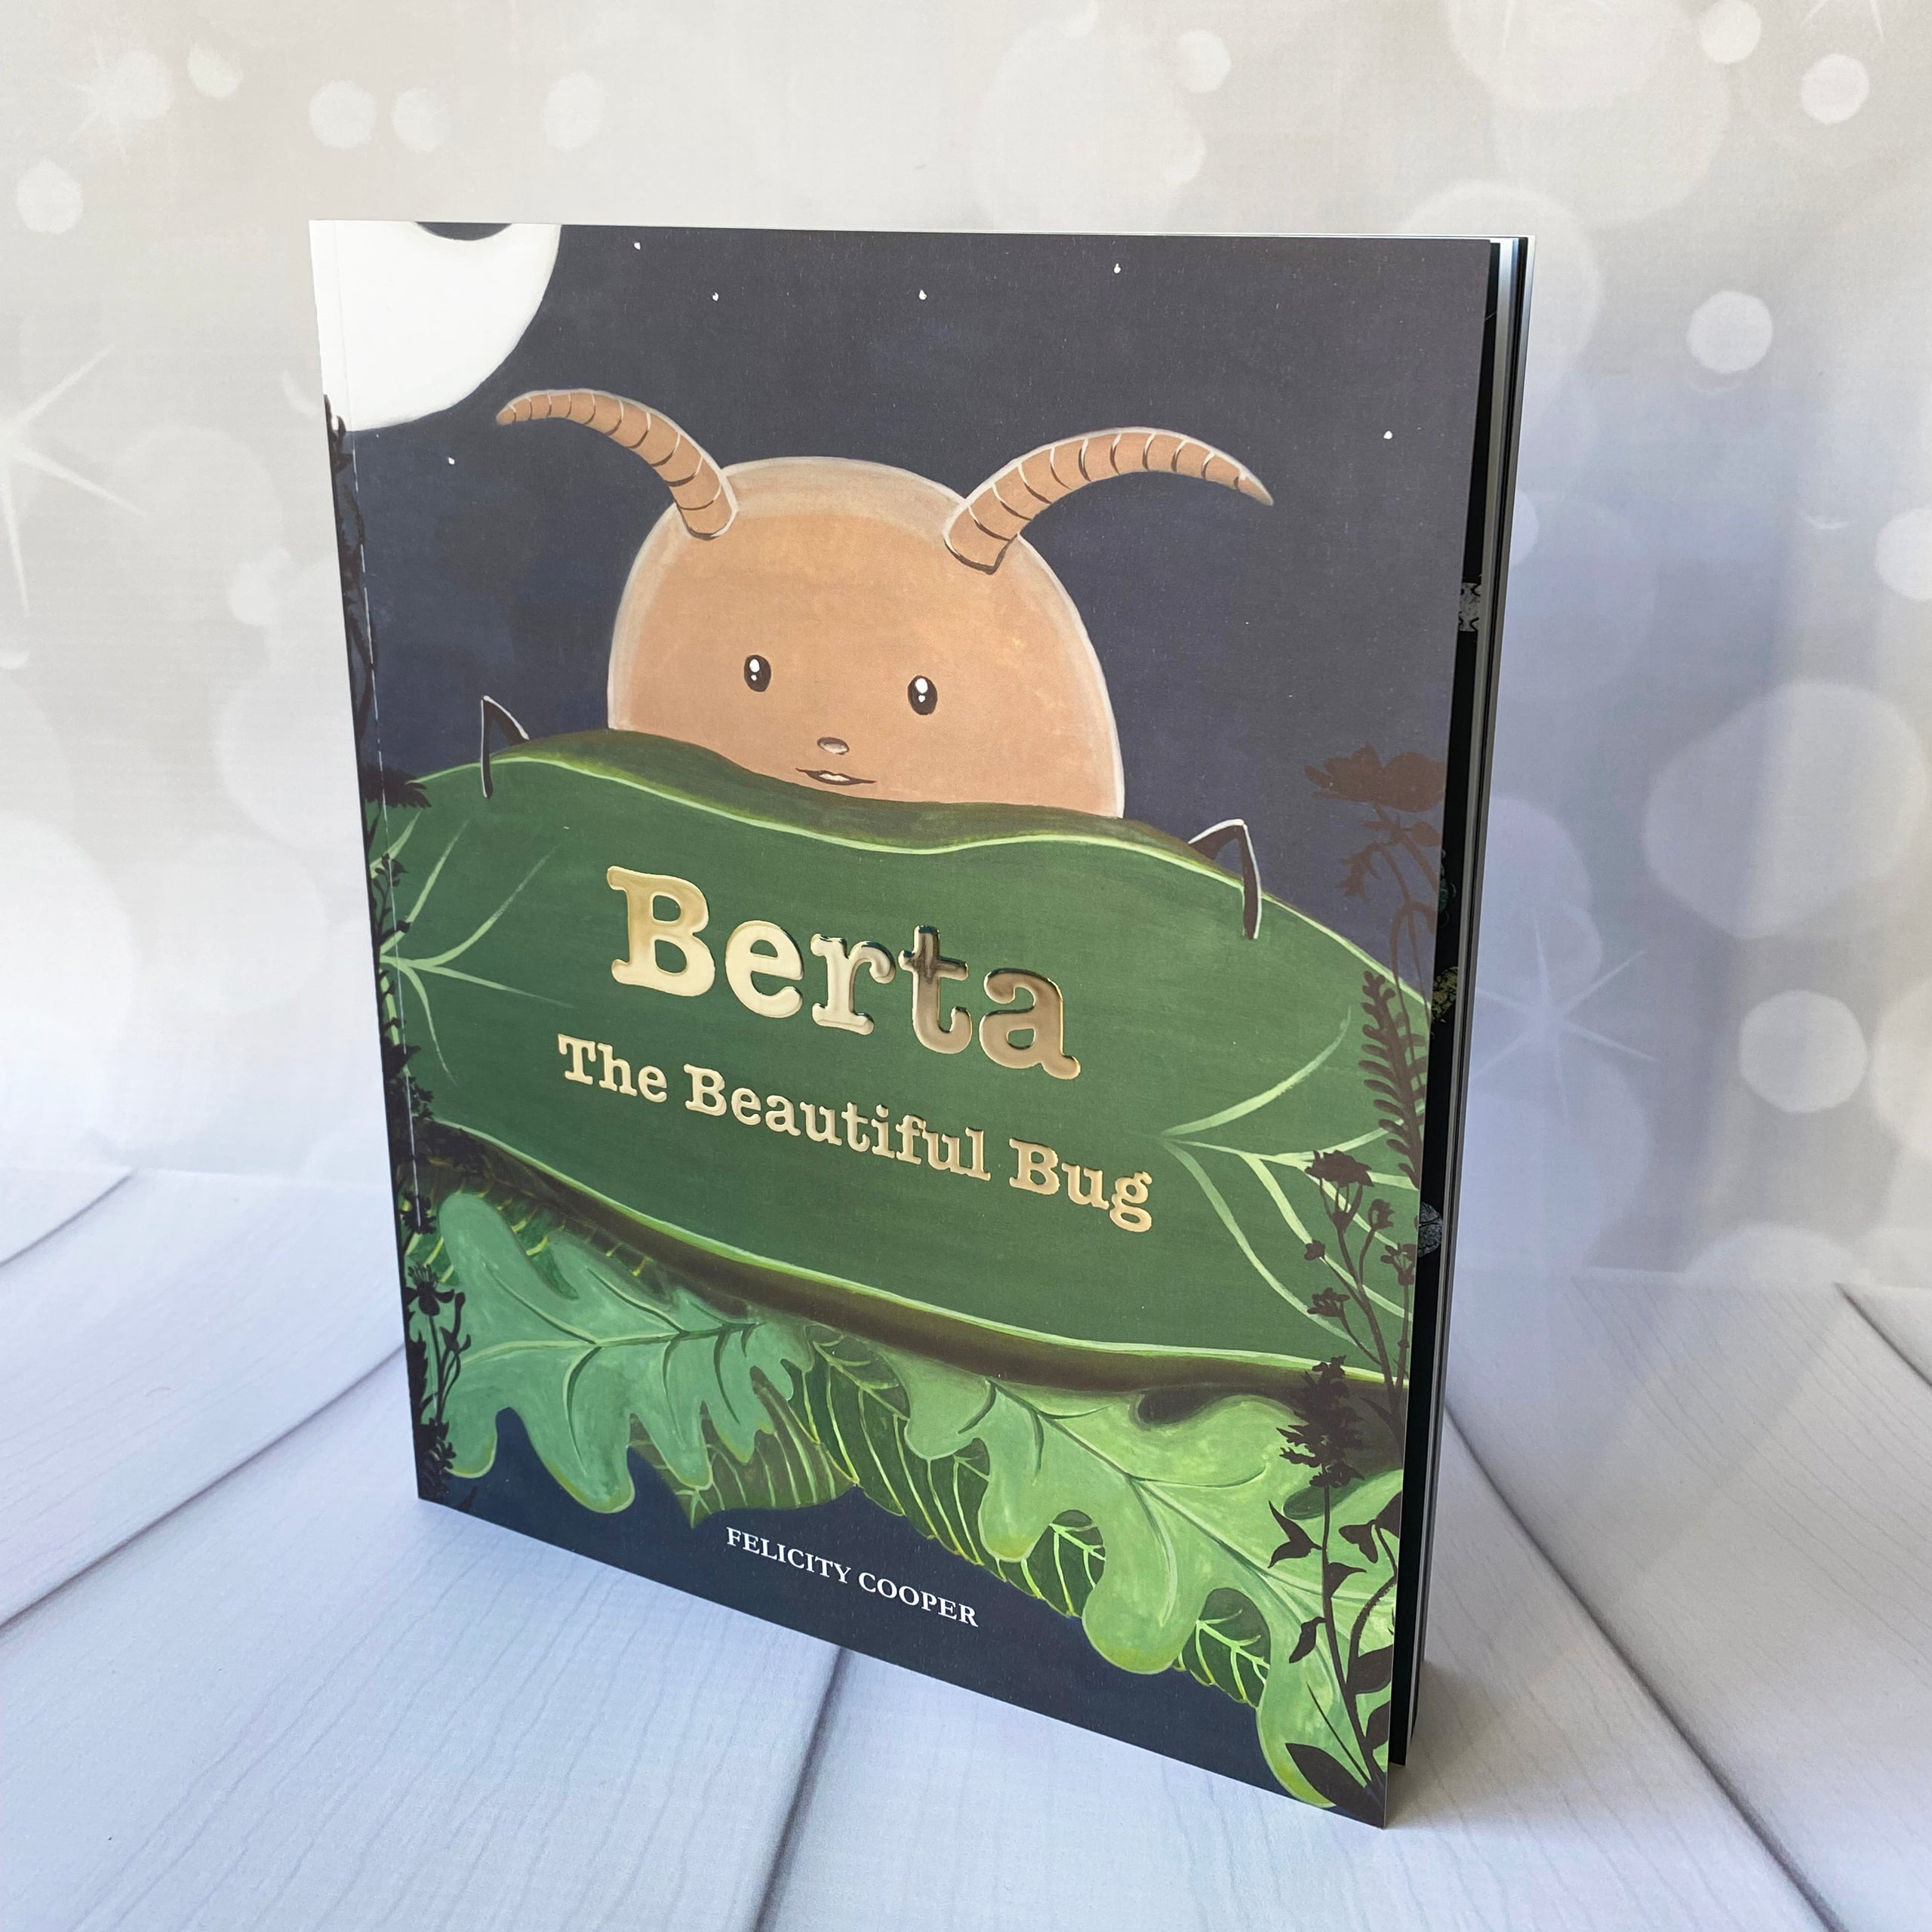
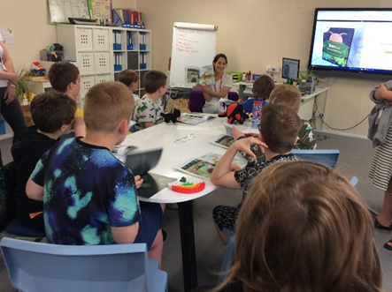
Visits from Felicity Cooper, our Local Children’s Author
Talented artist and writer, Felicity Cooper, regularly visits our Key Stage 2 students to share the joys of her creative process when writing books.
In the past, she has come to read her first book, ‘Berta’, on Pyjamarama Day, and the children shared ideas about themes of belonging and individuality. Thanks to Felicity's generosity, they were lucky enough to take a copy of the book home. Students enjoyed their experience, commenting, “I thought it was cool seeing an author with their book.” and “I liked her book, but I would like it to include more bugs.”
As a part of our latest Pyjamarama celebrations, we were delighted to welcome Felicity Cooper back to St Andrew’s to share the work she has been doing on her next book, ‘Happypopotamus'. As yet unpublished, she read it out to students and showed us the fascinating process involved in creating a picture book. First, she showed the hand drawn proofs, and then she revealed the digital copy with her stunning illustrations created with the help of software on her Apple Macintosh.
Students then used visual writing prompts to create their own stories and experimented with ‘Mad Libs’. The children had a very creative morning and were heard to say, "Her book is amazing!" and "I think that you should never give up with your story writing…"
Thanks to Felicity for continuing to share her creative process with the school. We look forward to seeing you again soon.
https://www.littlepossumbooks.com

Slide 7

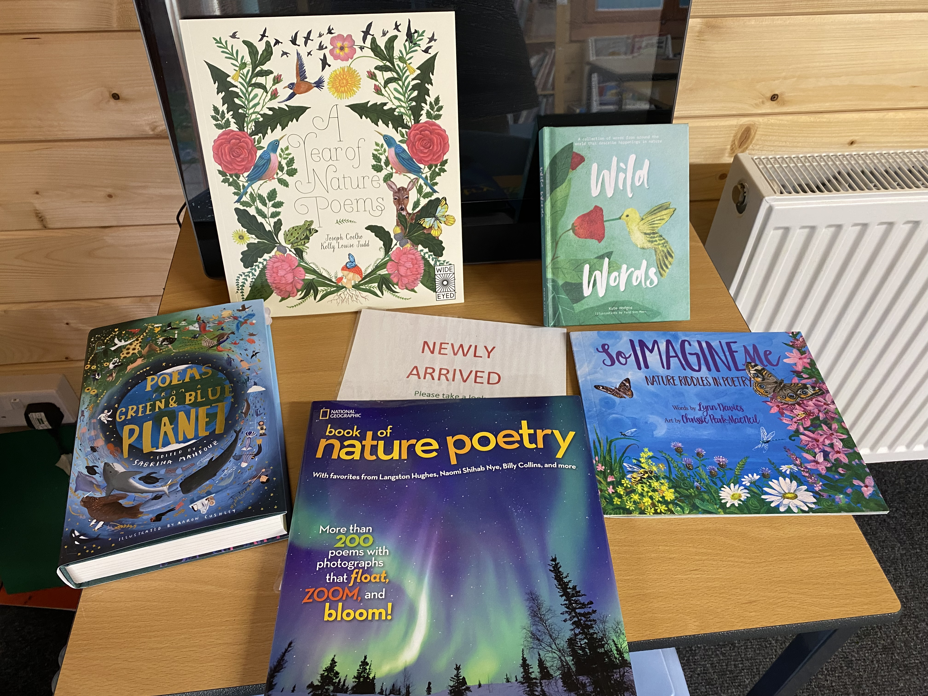

Readathon at St Andrew's https://readforgood.org/
Read for Good’s Readathon has been running in schools since 1984, motivating millions of children to read for pleasure. The money raised here at St Andrew's is used to help deliver brand new books and storyteller visits to all of the UK’s major children’s hospitals, as well as supporting school libraries.
Adrian Crossland says: “Readathon is a fantastic way to encourage reading for pleasure. Pupils can choose to read whatever they love which creates a brilliant buzz around books throughout the school. We are also incredibly proud to play a part in bringing stories to children in hospital.”
Justine Daniels, Chief Executive of Read for Good, said: “There’s a wealth of evidence that children who read for fun are more likely to thrive, socially and emotionally as well as academically. For some pupils, a Readathon is the spark that inspires a lifelong love of reading and for many others, it serves as a timely reminder, in a busy school day, of the joy to be had when you pick up a book.”

Slide 8

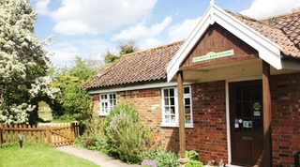
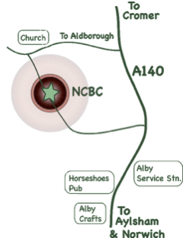
Our school nurtures strong links with Norfolk Children's Book Centre, who support us on World Book Days, ensuring £1 books are put straight into the hands of our students.
The team there also supply specially curated selections of books tailored to the specific interests and needs of our students, ensuring their often esoteric needs are met.
Over the years, the insight and expertise they offer has been instrumental in helping build our Garden Library – a burgeoning resource.
Norfolk Children’s Book Centre (NCBC) in Alby welcomes visitors to their well-stocked shop between 9am - 5pm Monday to Friday, and 10am - 5pm on Saturday. The friendly staff are always keen to give personal recommendations tailored to individual needs, and even better, free tea and coffee with them!
To find out more about NCBC, head to their website. Here, you can sign up to their newsletter to keep up to date with the latest news and events.
Norfolk Children’s Book Centre, Alby, Norwich NR11 7HB

Slide 9
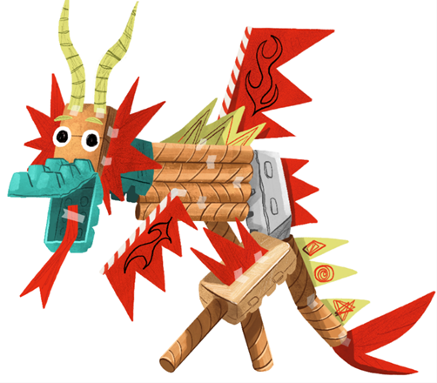
Every summer, St Andrew's School gets creative with the Summer Reading Challenge
Developed by the Reading Agency, the Summer Reading Challenge is a free holiday activity for children aged 4-11. It's all about reading for fun, aiming to improve children's reading skills and confidence.
Children can read anything they like (really - anything!) and collect free rewards for their reading. For under 5s there is a mini challenge, so they don't miss out.
Every year’s Challenge is about creativity. From dance to drawing, junk modelling to music, there’s something for everyone! Children will be able to find new reads linked to their favorite creative arts and join in with free activities at their local library.
The Summer Reading Challenge is developed by The Reading Agency and delivered in partnership with public libraries. This year’s theme has been developed in partnership with Create, a leading charity bringing creative arts to those who need it most.
Find out more at www.norfolk.gov.uk/summerreadingchallenge
Every summer we enjoy reading books and taking part in the creative activities at our local libraries.

Slide 10

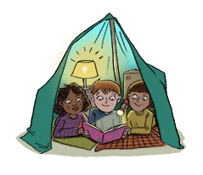
Every year, students choose to enjoy Pyjamarama in
collaboration with The Book Trust, sharing the magic
of stories. Funds raised go towards supplying children in
hospital in the UK with stories to read, helping them
celebrate and escape through a good book too. Students
wear their pyjamas and share their favourite bedtime
stories.
https://www.booktrust.org.uk/support-us/pyjamarama/
In return, St Andrew’s School enjoys virtual author workshops and can take part in national events with celebrated writers such as Mark Grist.
https://www.markgrist.com/

