Slide 1
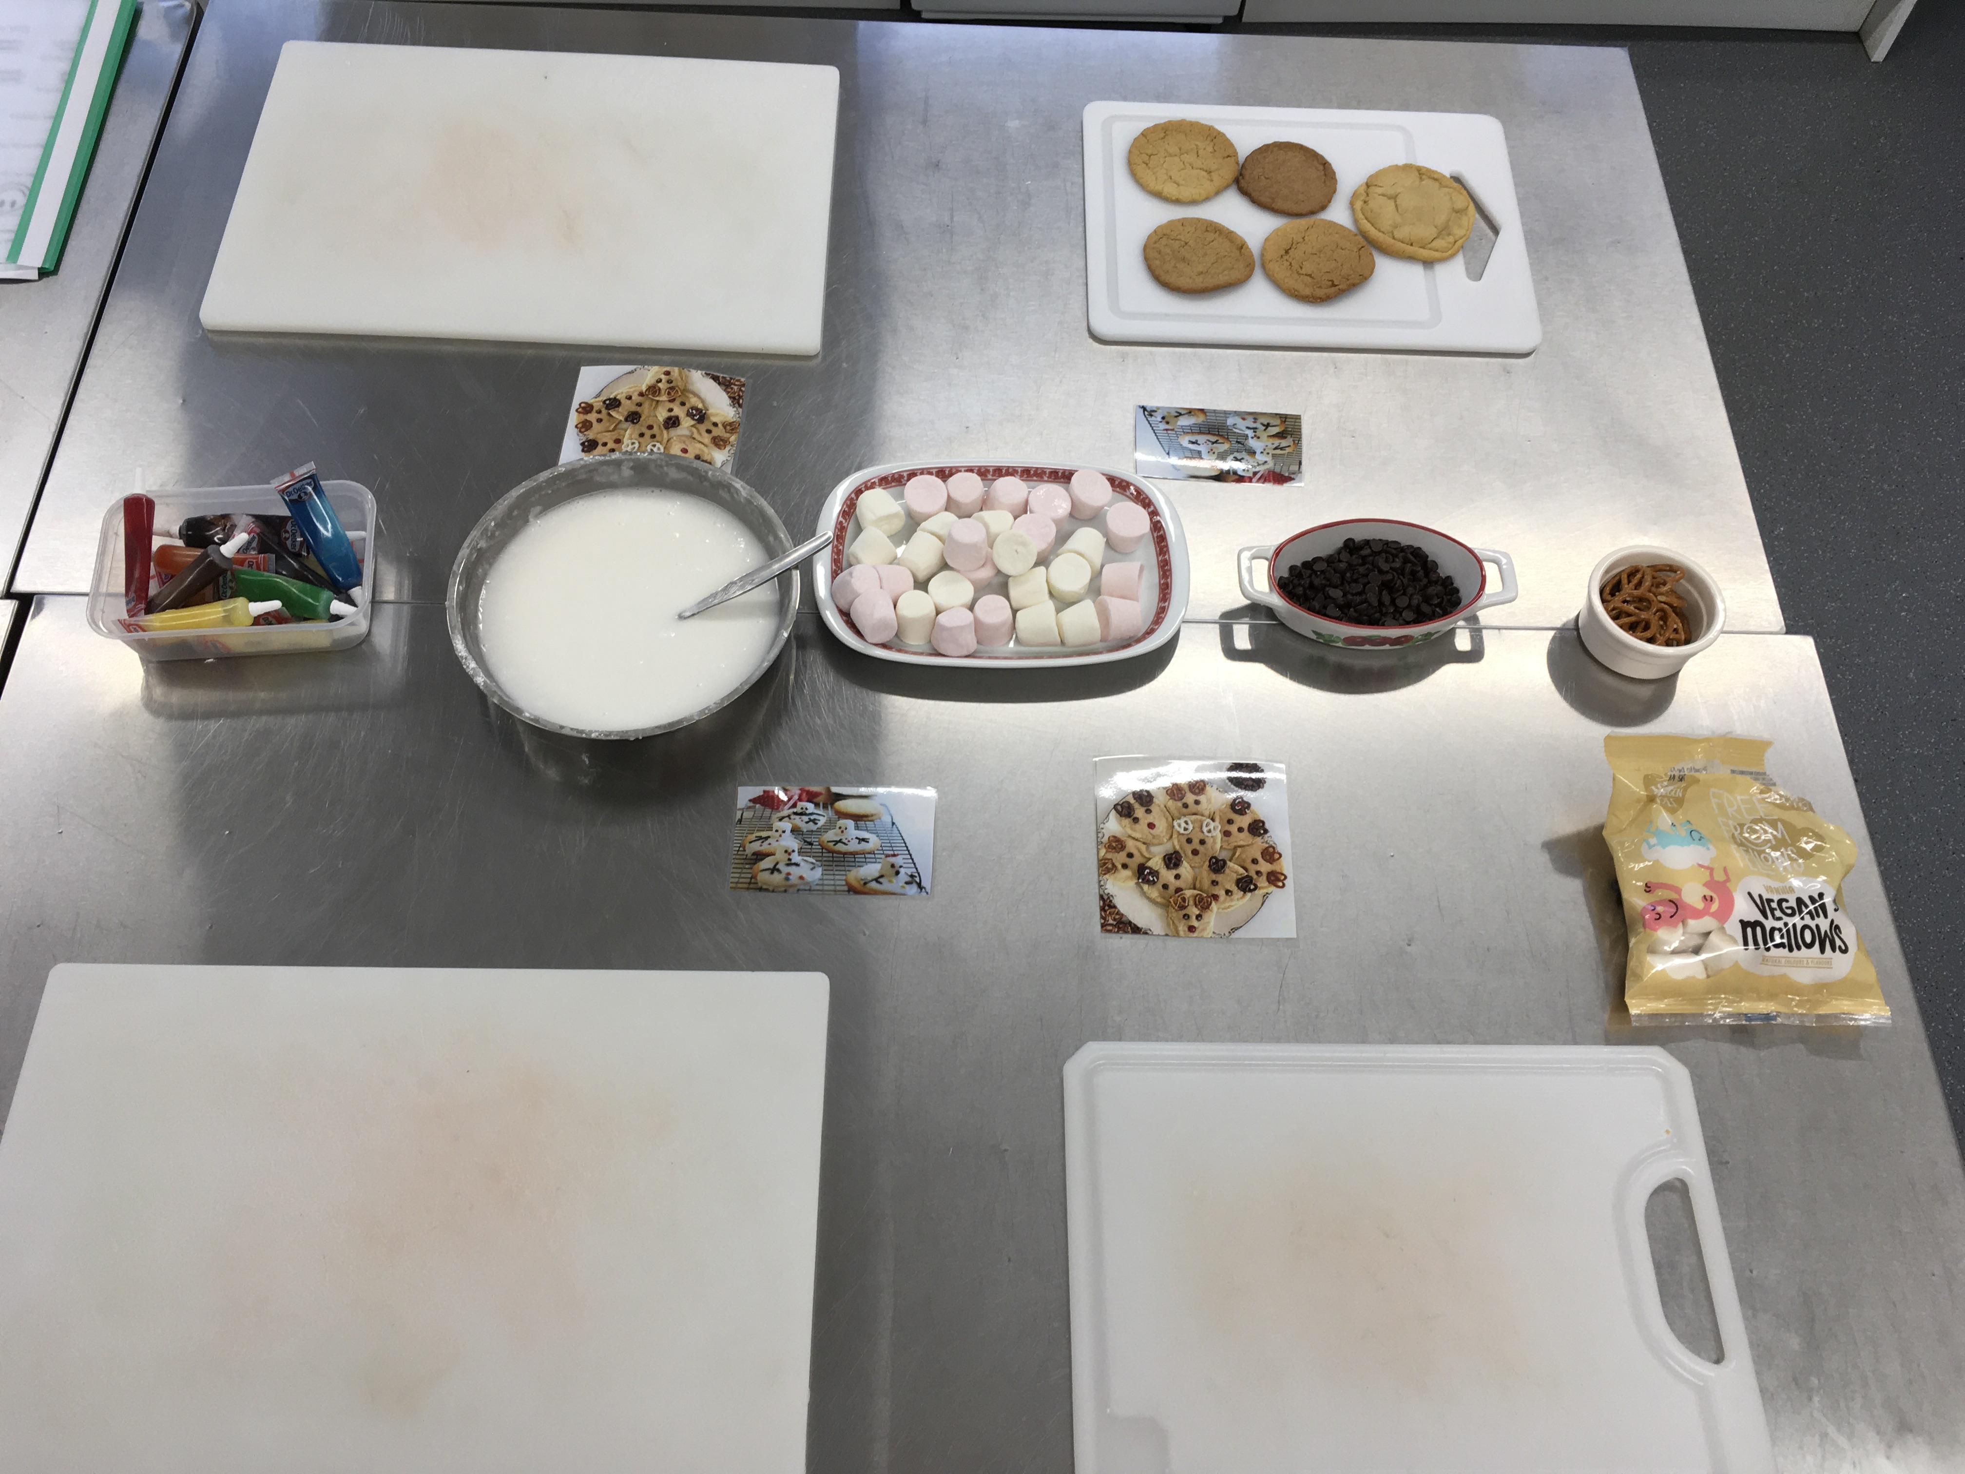
Curriculum map
Food Technology
Pupils will learn life skills that are needed on a daily basis.
As a school we follow the National Curriculum, which we adapt to suit the needs of every pupil, tailoring each lesson on an individual basis.
The kitchen is all labelled and has pictures on every cupboard door for familiarity and to support our learners.
Pupils are each given a responsibility for cleaning down to promote independence.
We have a range of kitchen equipment, including cookers, microwaves, toaster, kettle, blender, slow cooker and electric whisk, which the pupils will learn to operate.
The pupils will apply their knowledge from a theory lesson to a practical lesson.

Slide 2
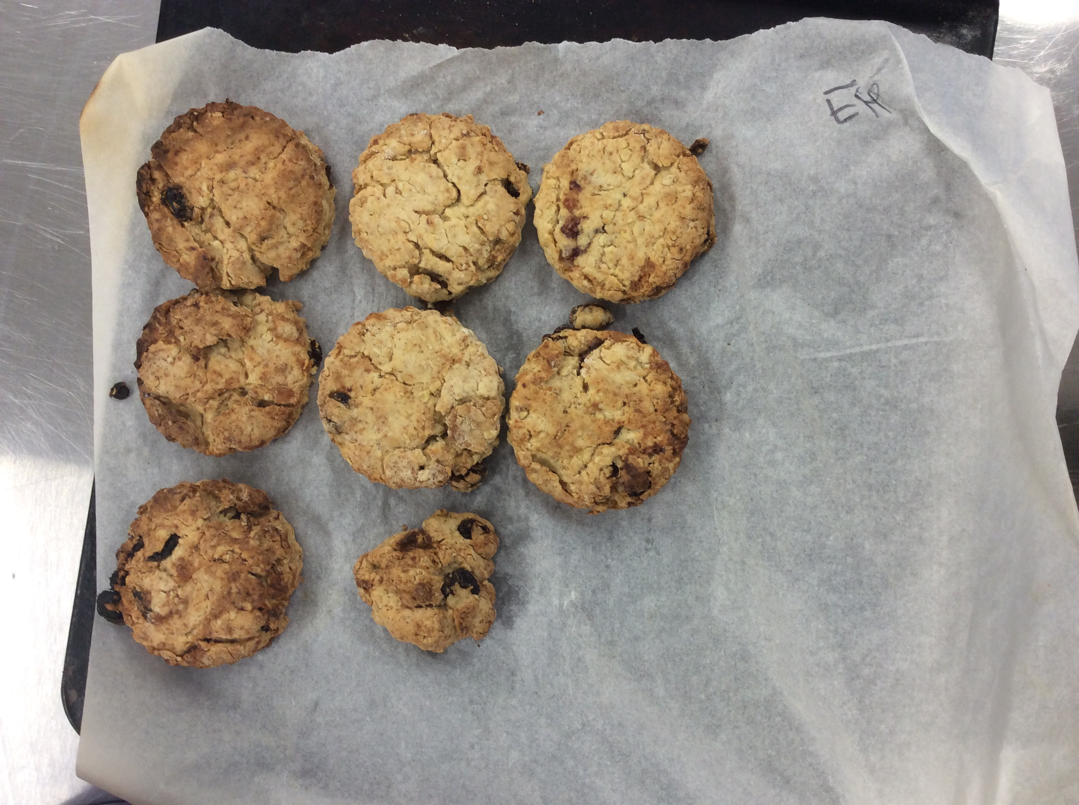
KS2 – Over the year the pupils will learn about food hygiene and safety, weighing, measuring, sharing equally, bridge and claw method, fork secure method, peeling, grating, cutting with scissors, kneading, combining, sieving, rubbing-in, grating, rolling out, waste management, baking, using an oven, using a hob and using a kettle under adult supervision.
Autumn Term
Be healthy – energy
Health and safety
Kitchen expectations
Eat well guide
Harvest
Halloween
It’s all about you!
Personal hygiene
Equipment – purpose and overview.
Food choices for health
Christmas Fayre
Remembrance Day
Christmas
Spring Term
International cuisine
British favourites
World foods
Traditions around the world
Pancake Day
Religion and cultural choices
Food produced around the world
Food miles
Be active
Mother’s Day
Summer Term
It’s all about you!
Grown, reared or caught?
How is food produced and processed?
Seasonal fruit and vegetables
Where does food come from?
Father’s Day
Fakeaway!
Food provenance
Food sustainability
Food labels
Summer Fayre

Slide 3
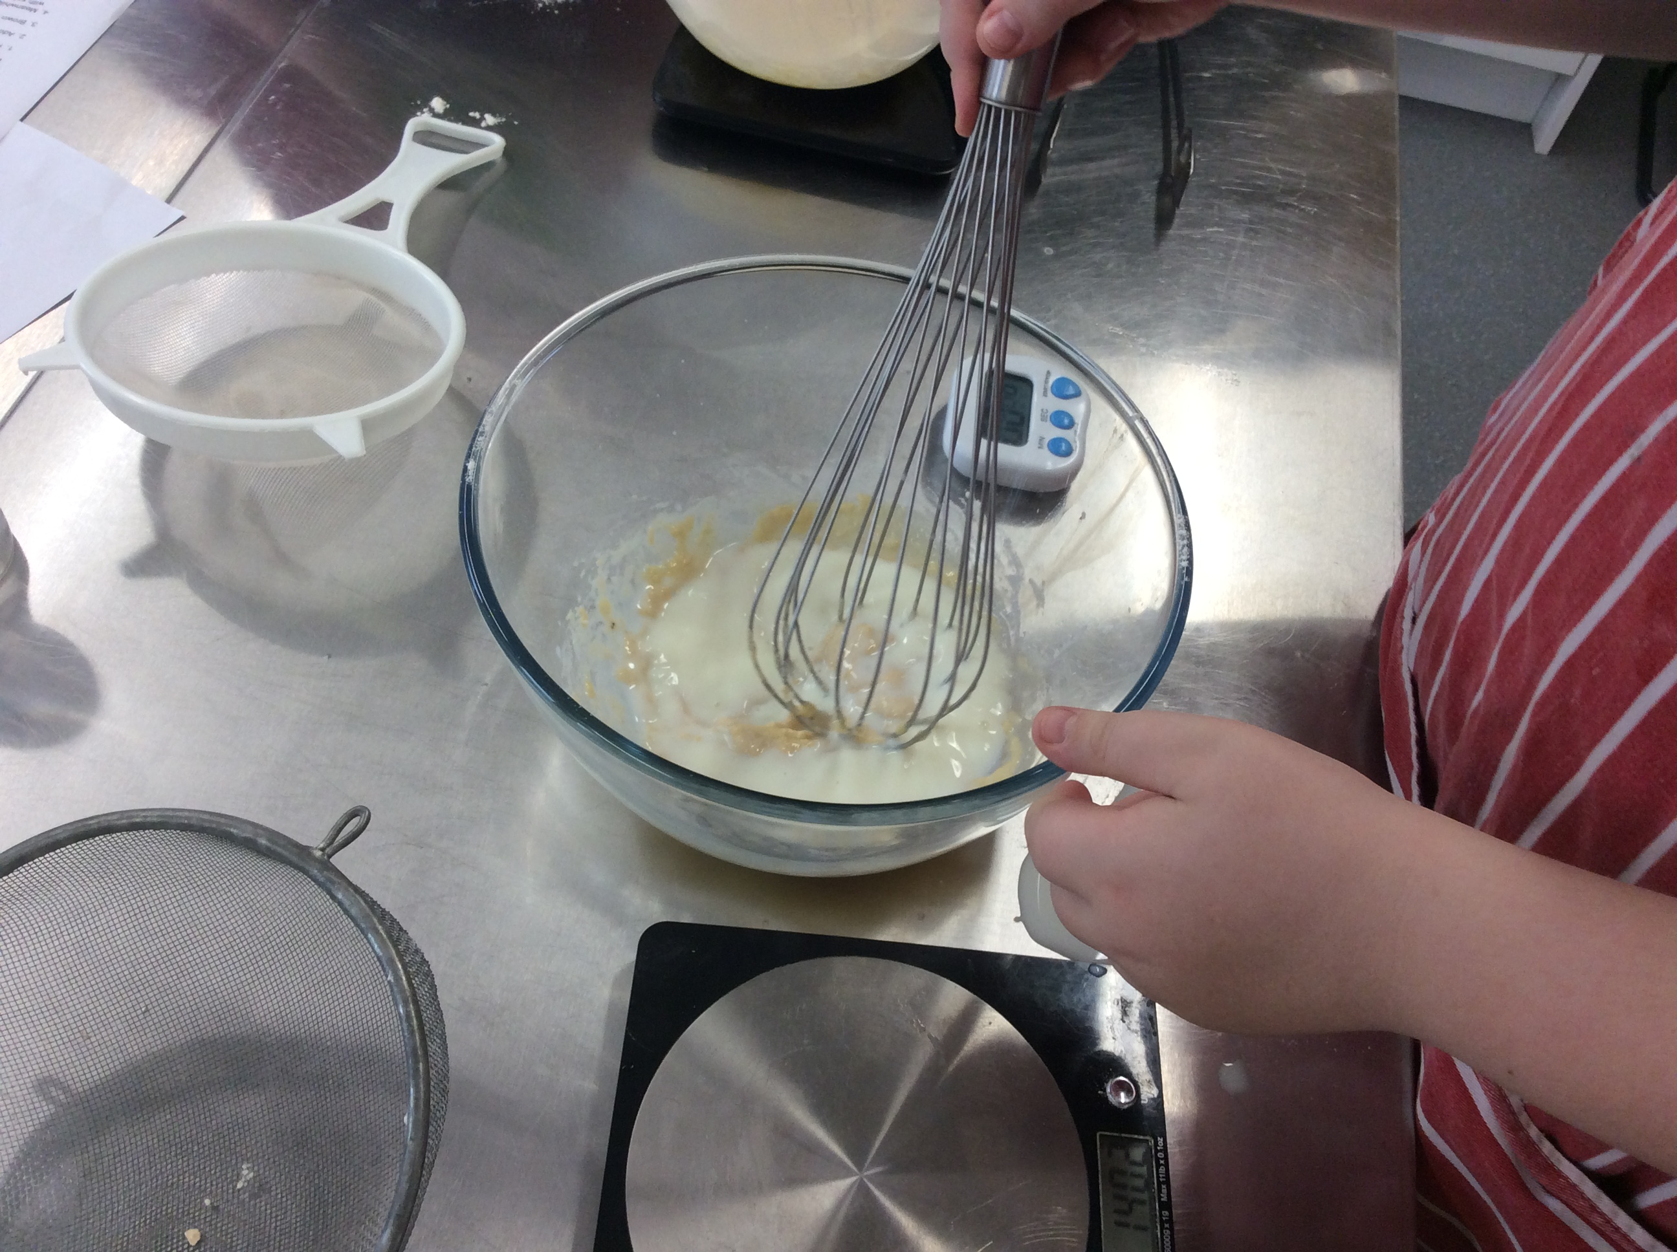
Year 7 – Over the year the pupils will learn about enzymic browning, heat sources - bridge and claw safe knife skills, oiling, simmering, steaming, blanching, baking, toasting and grilling, moulding, shaping and binding.
Autumn Term
Be healthy – energy
Health and safety
Eat well guide
Healthy eating – reflect on own diet
Black History Month
Harvest
Halloween
It’s all about you!
Energy needs and how they change through life
Nutrients – sources and functions
Anti-bullying month
Remembrance Day
Christmas
Spring Term
International cuisine
What skills are need to make a dish?
How lifestyle and culture can influence food choices
Chinese New Year
Pancake Day
International cuisine
Food provenance and sustainability
Food preparation and safety including food labelling
Making informed choices
Mother's Day
Summer Term
It’s all about you!
Food sustainability
Food miles
Father's Day
Fakeaway!
Budgeting
Adapt and follow recipes
Pupils will have an opportunity to evaluate and test their work of others
Summer Fayre

Slide 4
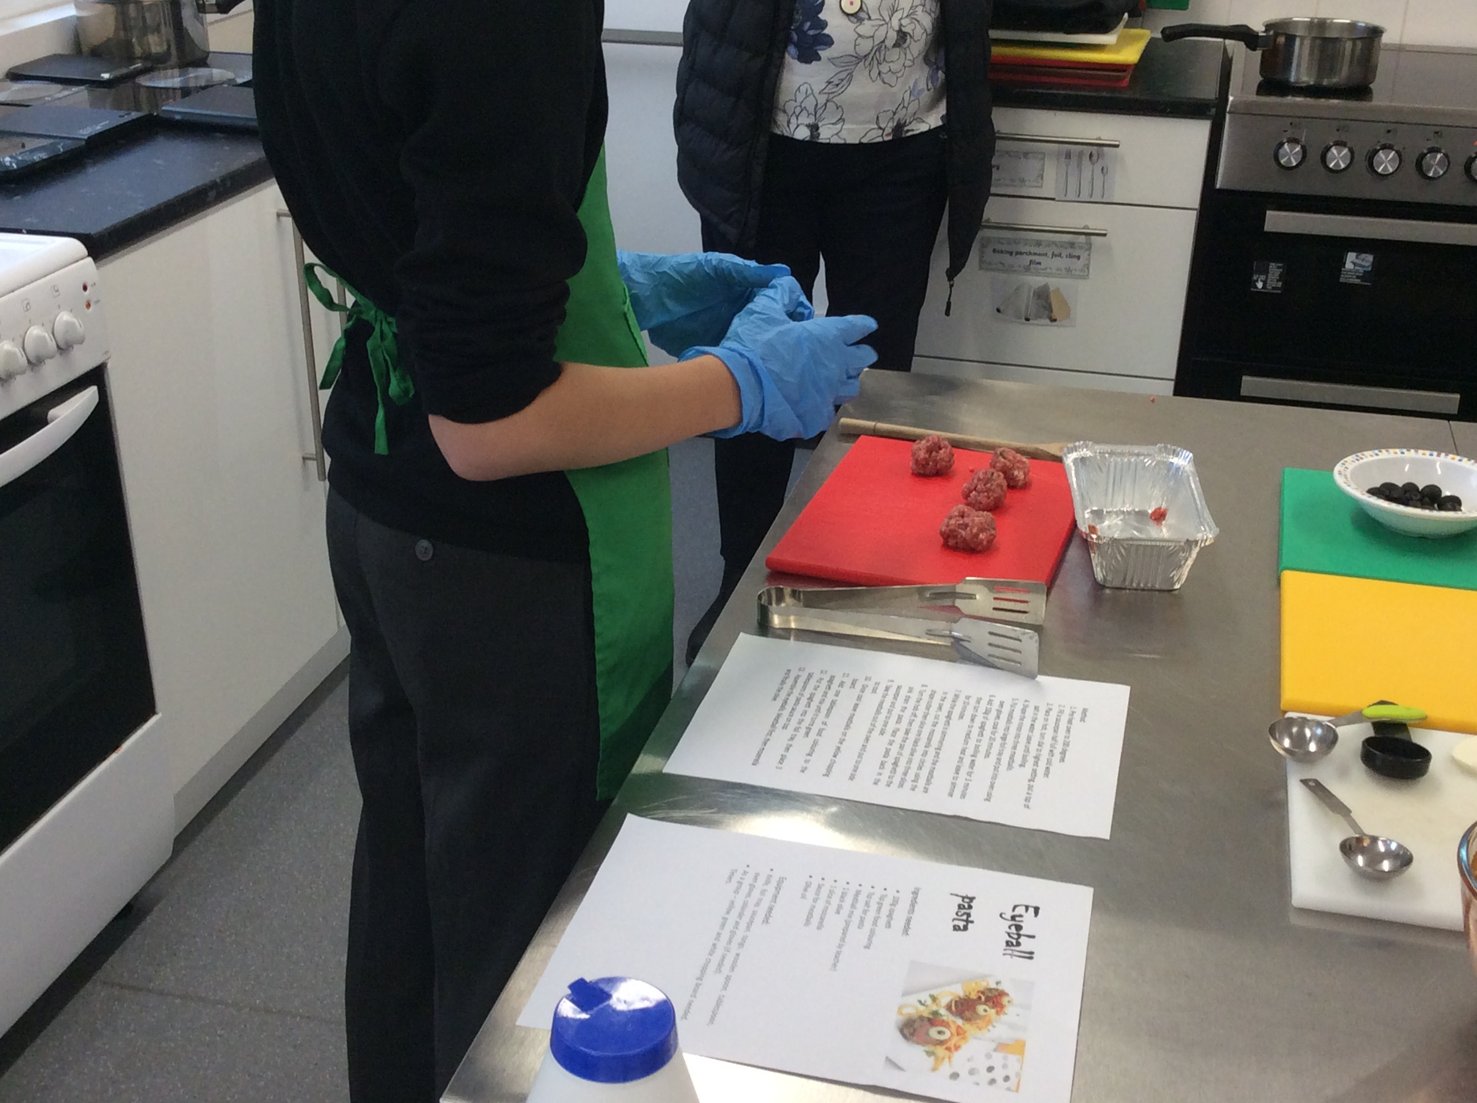
Year 8 – Over the year the pupils will learn about caramelisation and the Maillard reaction, raising agents, baking, grilling, toasting, shallow frying, stir-frying, boiling, simmering, poaching, stewing, steaming and blanching, melting, whisking, shaping, measuring and blind baking, cooking methods and heat transfer.
Autumn Term
Be healthy – energy
Health and safety
Eat well guide
8 top tips for healthy eating
Black History Month
Harvest
Halloween
It’s all about you!
Key nutrients, sources and their functions
Cross contamination
Reducing food spoilage
Anti-bullying
Remembrance Day
Christmas
Spring Term
International cuisine
Menu planning
Raising agents
Food science
Chinese New Year
Pancake Day
International cuisine
Diets for specific groups
Consumers food and drink choice
Cooking more complex dishes
Mother’s Day
Summer Term
It’s all about you!
Source and seasonality of a range of ingredients
Food sustainability
Food miles
Father’s Day
Fakeaway!
Adapt and follow recipes
Pupils will have an opportunity to evaluate and test their work and of others
Be active

Slide 5
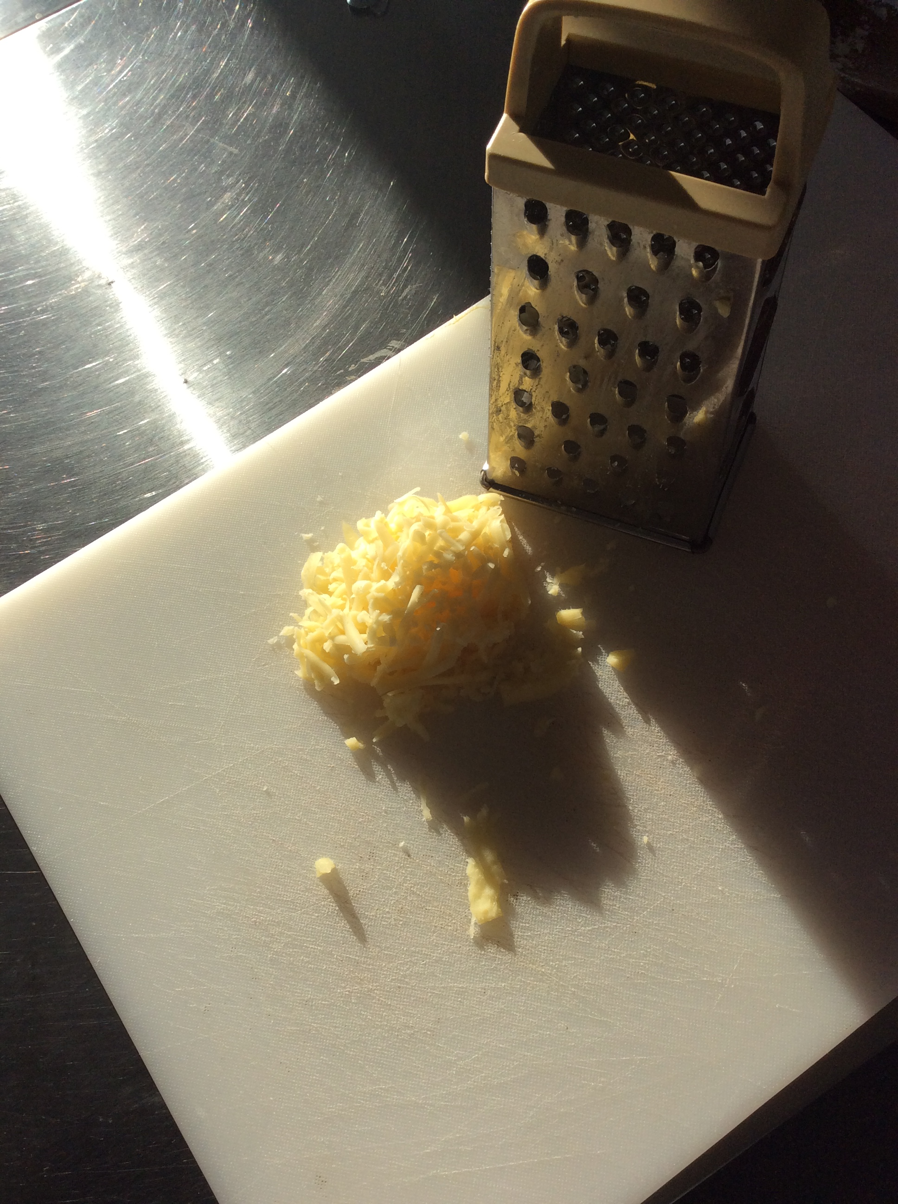
Year 9 - Over the year the pupils will learn about denaturation of proteins, coagulation (liquid protein transforms to a solid), emulsification (combining two liquids that would usually separate), the role of gluten (to add protein , texture and flavour) - Baking, grilling, toasting, shallow frying, stir-frying, shaping, proving and hydrating techniques and moist, dry and oil-based methods of cooking .
Autumn Term
Be healthy - energy
Health and safety
Eat well guide
Diet and health
Black History Month
Harvest
Halloween
It’s all about you!
Macronutrients and micronutrients
Food provenance and consumer information
Consumer food and drink choice
Anti-bullying
Remembrance Day
Christmas
Sping Term
International cuisine
International cuisine
How characteristics of ingredients contribute towards cooking
Food safety
Chinese New Year
Pancake Day
International cuisine
Digestion
Pupils will get to create a dish which will suit another dietary need
Health implications
Physical, social and mental wellbeing
Summer Term
It’s all about you!
Nutrition and allergy information
Food labelling, food certification, assurance schemes and animal welfare
Food sustainability
Fakeaway!
Pupils will have an opportunity to test each other's work, evaluate it and offer recommendations
Be active
Summer Fayre

Slide 6
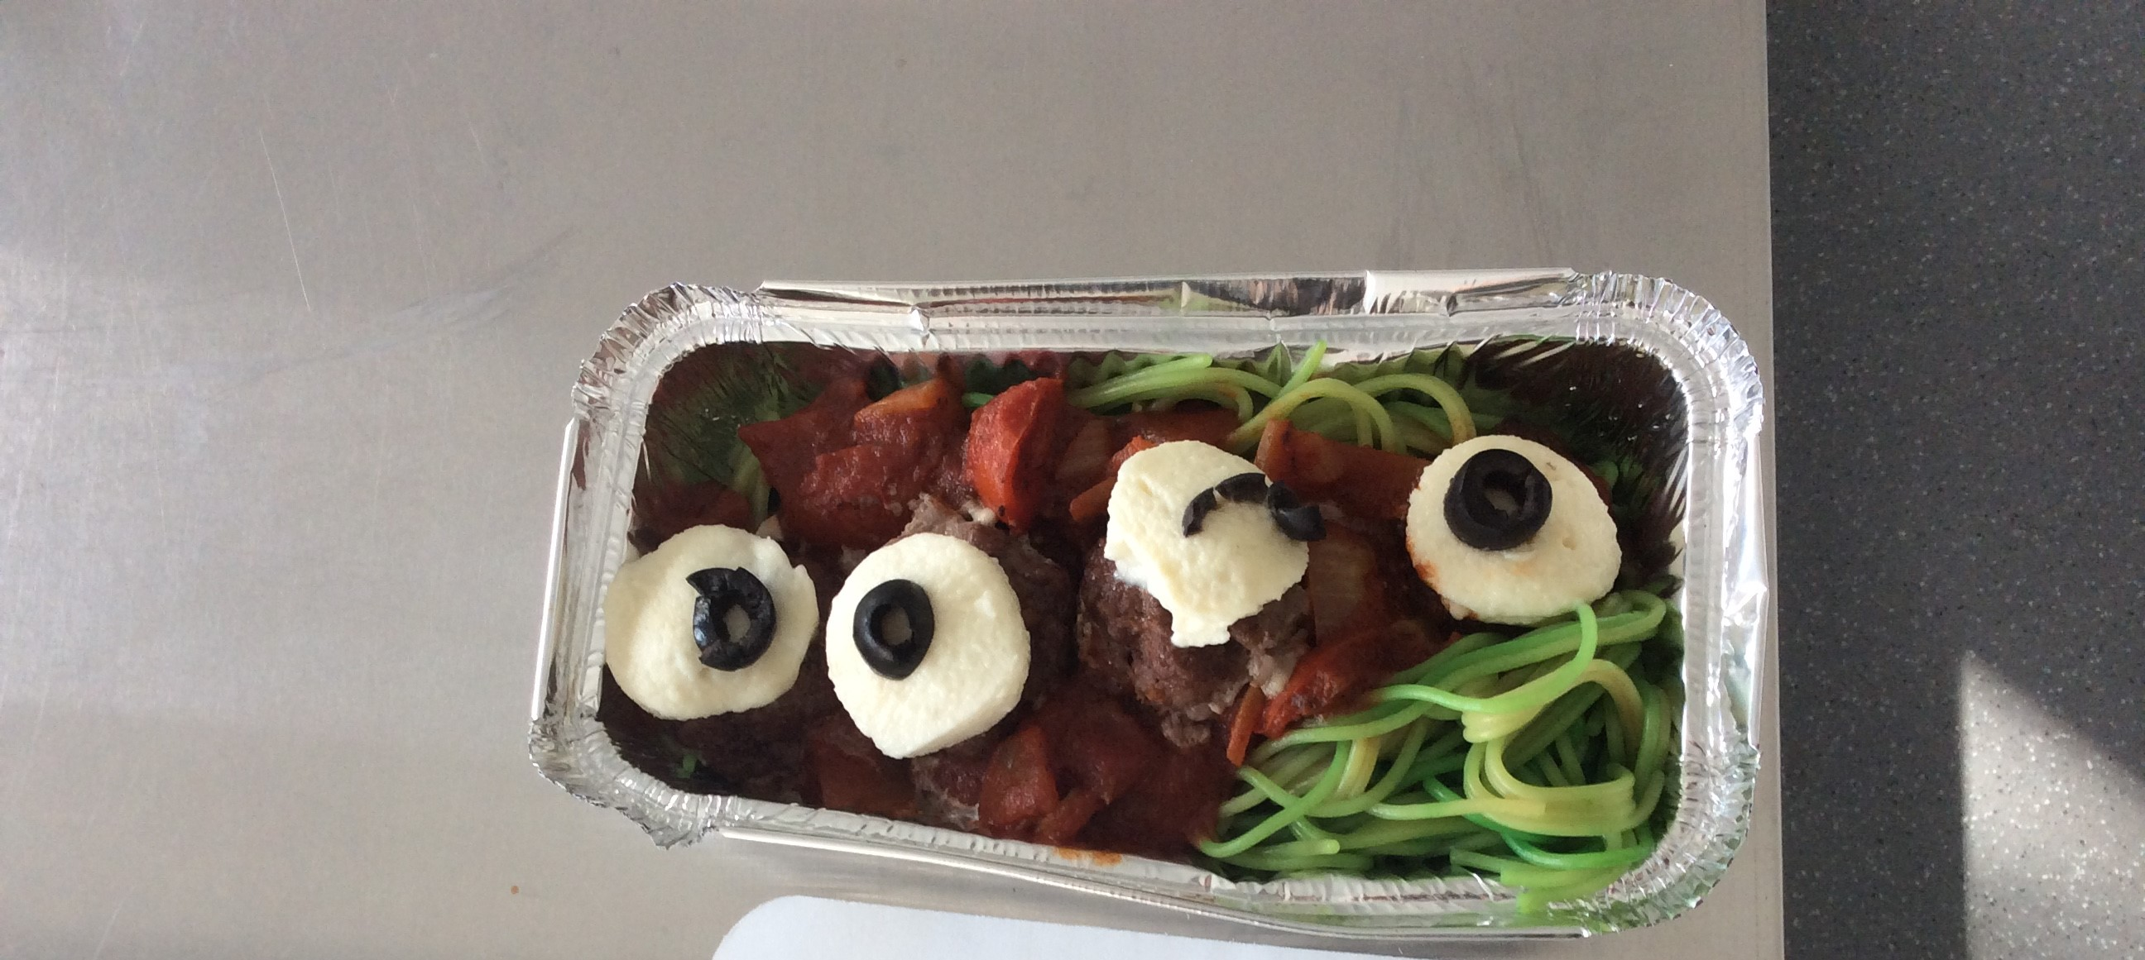
Year 10 students have the option of studying food preparation and nutrition. This can lead to a qualification, such as GCSE. During Year 10 the students will combine practical lessons and theory lessons.
Autumn Term
Carbohydrates
Starch (polysaccharides)
Sugars
(monosaccharides / disaccharides)
Dietary fibre
Protein
Low and high biological value proteins
Protein complementation
Protein alternatives e.g. textured Vegetable protein (TVP), soya, Mycoprotein and tofu
Fats
Saturated fats
Unsaturated fats (monounsaturated and polyunsaturated)
Spring Term
Fat soluble vitamins
Vitamin A, Vitamin D, Vitamin E, Vitamin K
Water soluble vitamins
B group – B1 (thiamine), B2 (riboflavin), B3 (niacin), folic acid, B12
Vitamin C (ascorbic acid)
Loss of water-soluble vitamins when Cooking (B group and Vitamin C)
Antioxidant functions of vitamins
Vitamin A, Vitamin C, Vitamin E
Minerals
Calcium, Iron, Sodium (salt), Fluoride, Iodine
Summer Term
Making informed choices
The current guidelines for a healthy diet
Portion size and costing when meal planning
How peoples’ nutritional needs change and how to plan a balanced diet for different life stages
How to plan a balanced meal for specific dietary groups.
How to maintain a healthy body weight throughout life.
Microorganisms and enzymes
The growth conditions for microorganisms and enzymes and the control of food spoilage
Bacteria, yeasts and moulds are microorganisms
High risk foods
Enzymes are biological catalysts usually made from protein.
Factors which influence food choice
To know and understand factors which may influence food choice

Slide 7
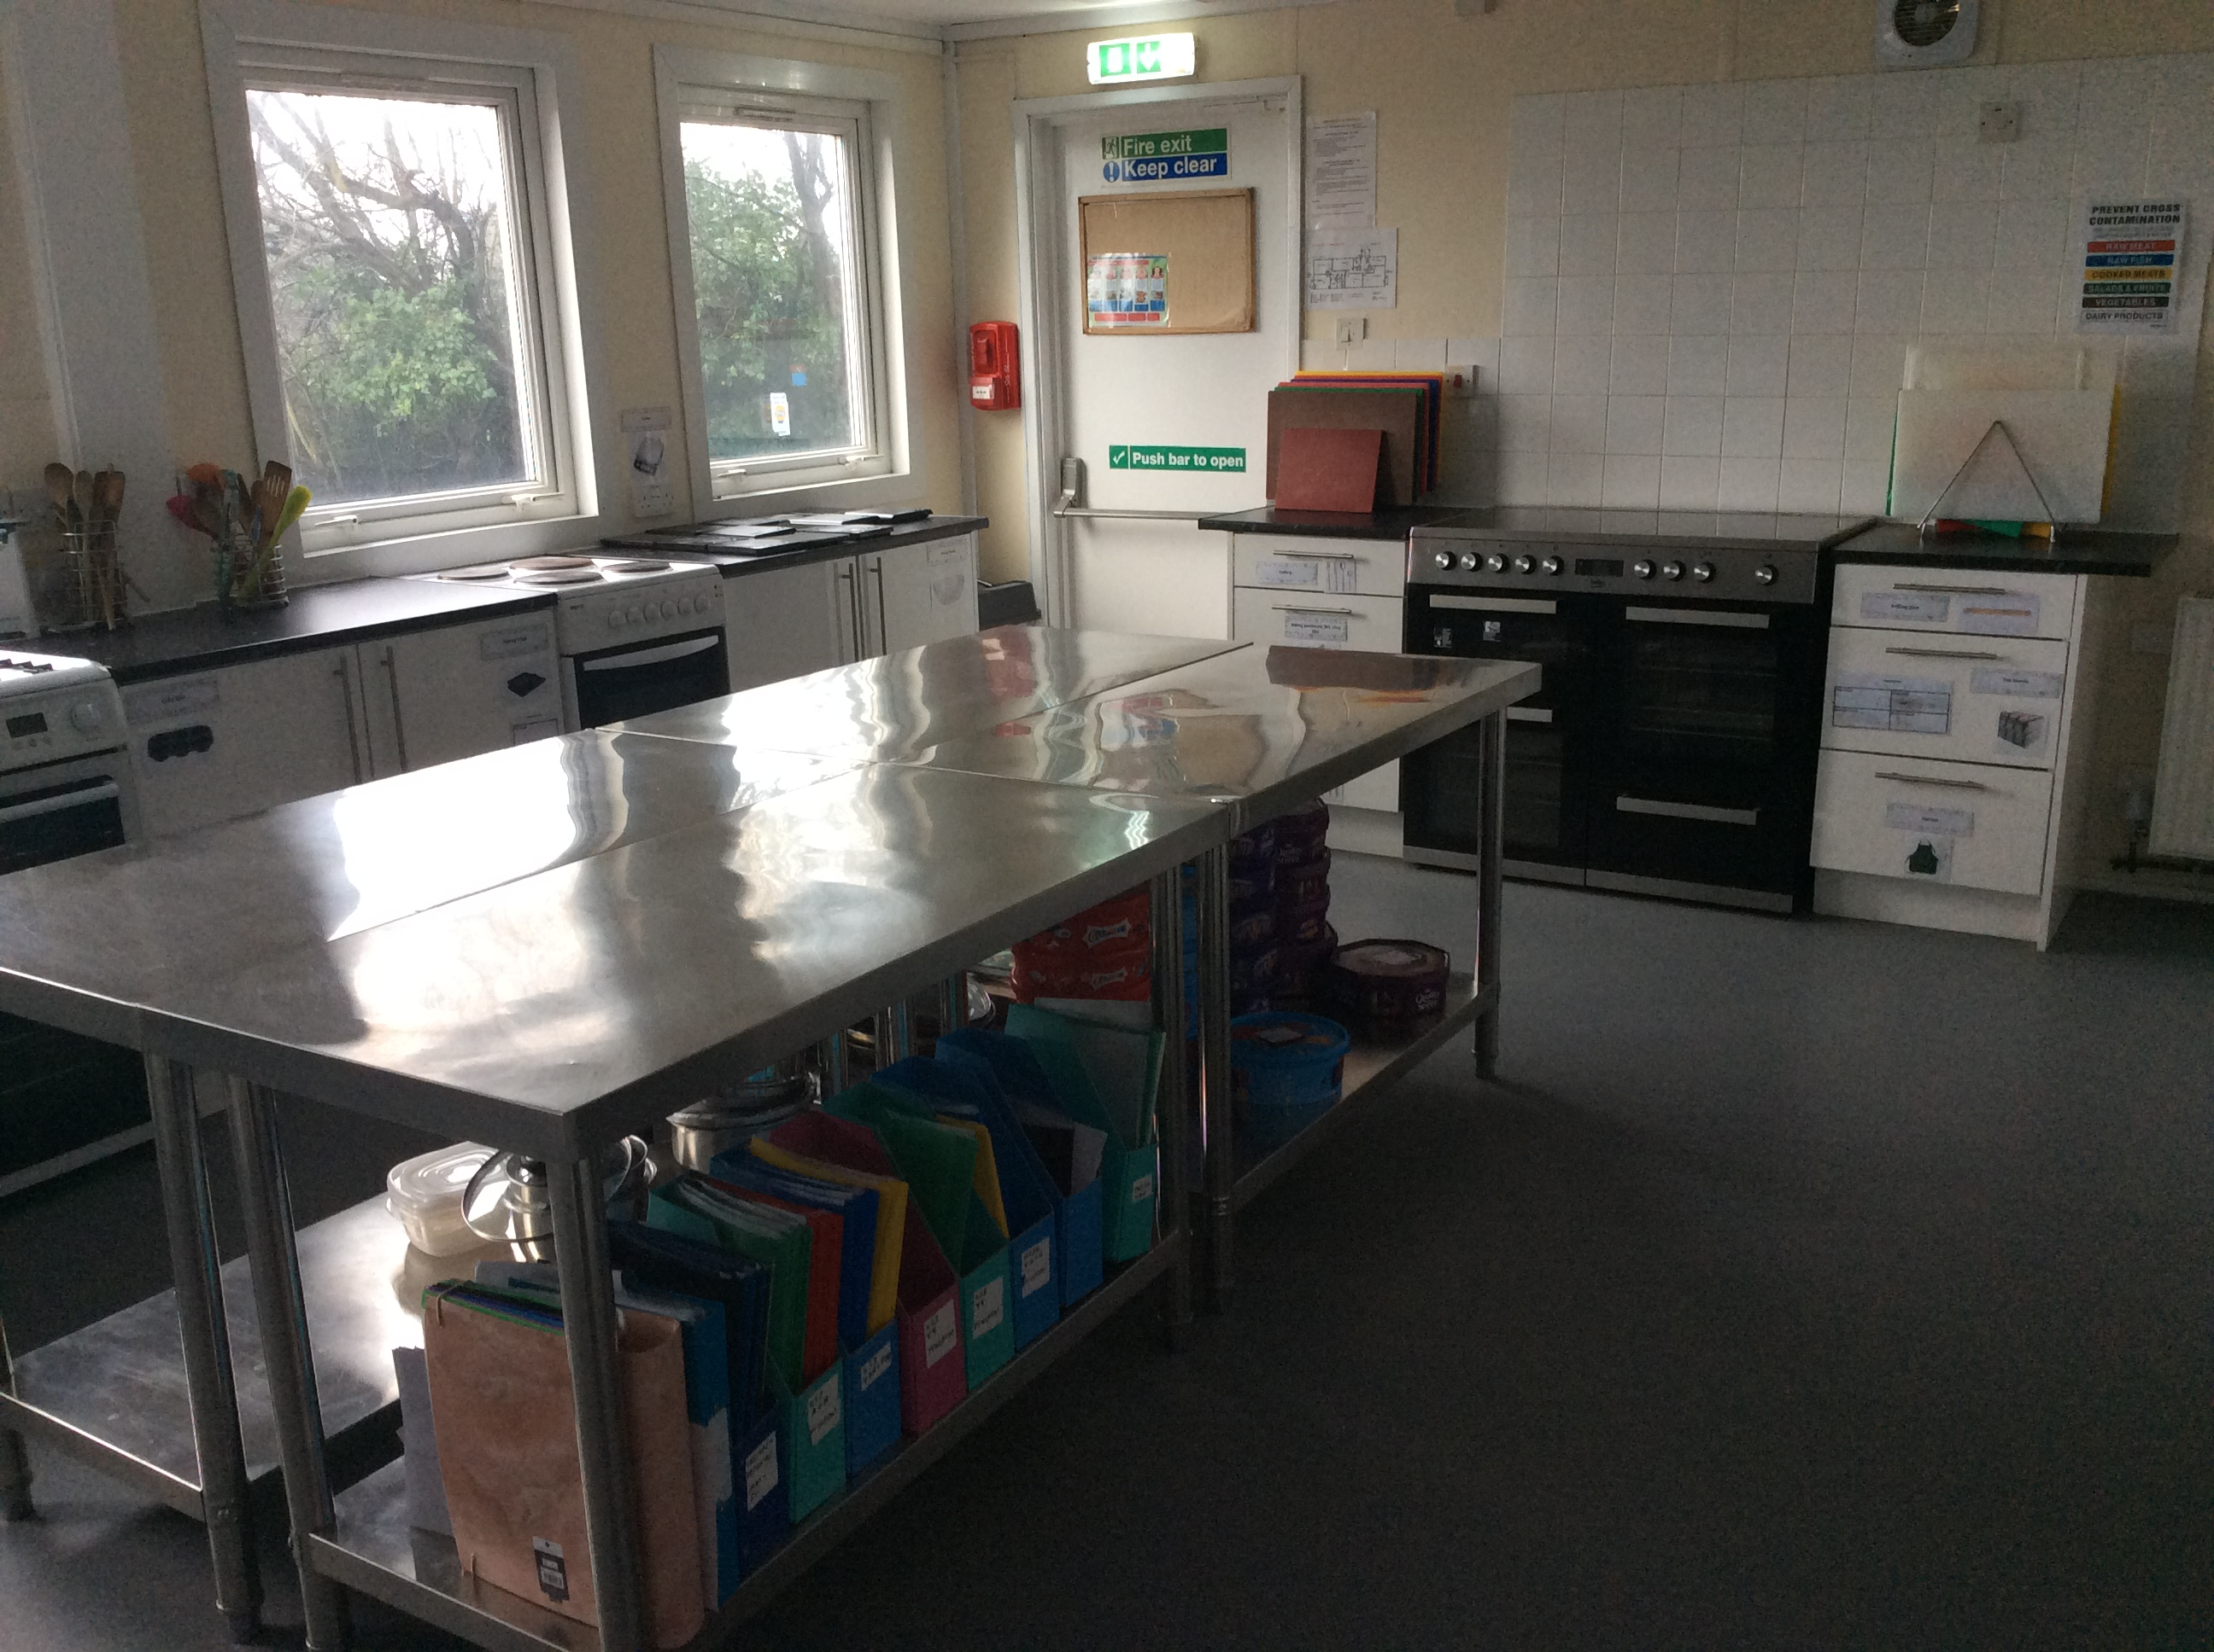
Year 11 students will be working on their non-exam assessments and revision.
Autumn Term
Completing non-exam assessments.
Spring Term
Completing non-exam assessments.
Revision and exam preparation.
Summer Term
Revision and exam preparation.

