Slide 1
Geography
Geography is all about the world in which we live and on which we depend. Landscapes, peoples, places and the fragile environment are all interwoven. Its unique combination of knowledge gives rise to a clear and incisive understanding of the interconnections of our world, including the human impact on our landscape and environment.
Geography explores the relationship between the earth and its peoples. It studies the location of the physical, human and environmental features of the earth and the processes, systems and inter-relationships, from local to global, that create and influence them. The character of places, the subject’s central focus, derives from the interaction of people and environments.

Slide 2
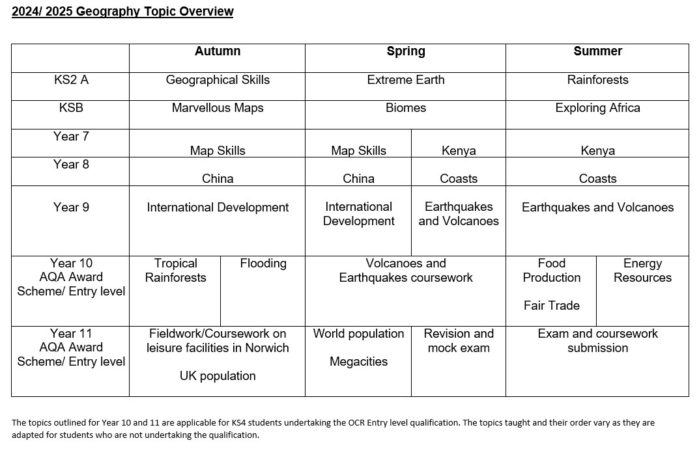

Slide 3
 | KS2A Curriculum
Autumn Term | Spring Term | Summer Term
Geographical Skills | Extreme Earth | Rainforests
Use maps to locate countries Identify OS map symbols Understand how to use four-figure grid references Identify human and physical geographical features Locate our county on a map of the UK | Name the layers that make up the Earth Show how tectonic plates move Explain how volcanoes are formed Identify where earthquakes happen Explain what causes a Tsunami Explain how scientists collect data about storms | Identify areas of the world containing rainforests Explain the key aspects of a rainforest climate Describe the layers and features of a rainforest Know animals and plants living in the rainforest Compare the Amazon rainforest to Sherwood Forest

Slide 4
 | KS2B Curriculum
Autumn Term | Spring Term | Summer Term
MARVELLOUS MAPS | BIOMES | EXPLORING AFRICA
Using Atlases To locate the world’s countries, using maps to focus on Europe (including the location of Russia) and North and South America by using an atlas. Map Symbols To use symbols and a key (including the use of Ordnance Survey maps) to build knowledge of the United Kingdom and the wider world by identifying landmarks shown on an Ordnance Survey map. Compass Points To use the eight points of a compass to build knowledge of the United Kingdom and the wider world by describing routes on a map. Grid References To use four and six-figure grid references to build their knowledge of the United Kingdom and the wider world by finding features on a map. Planning a Route To use the eight points of a compass, four and six-figure grid references, symbols and key (including the use of Ordnance Survey maps) to build their knowledge of the United Kingdom and the wider world by planning a journey. | What are the Earth's biomes? Explore the world's many different biomes. Understand that biomes are large ecosystems. Explore how biomes have distinct climatic conditions, flora and fauna. Where are the Earth's biomes? Where are the Earth's six major biomes located and how their position on the Earth impacts their climates. What affects an ecosystem? Learning about the climatic factors and human activities that impact biomes and the ecosystems within them. What is the taiga? Learning about climatic factors and location of the taiga. We will also learn about the flora and fauna that are present there. What are the grasslands? Exploring the climatic factors and location of the grasslands. We will also learn about the flora and fauna that are present there. How are biomes being damaged? Learning about global warming and climate change. We will learn about how climate change, predominantly caused by human activity, is putting the world's biomes at risk. How are biomes being protected and preserved? Learning about conservation, both in relation to plants (flora) and animals (fauna). | To identify African countries and locate them on a map Use compass direction clues to identify and locate each of the 54 countries. Nigeria and West Africa To learn that Africa can be split into five different regions. Identify countries in each region. Physical and human features of Nigeria. Northern Africa and Morocco To identify the seven countries of N. Africa and some general features. Physical and human features of Morocco. Central Africa and the Central African Republic Identify the nine countries of Central Africa and features including the equatorial climate. Western Africa and Tanzania Identify the countries (eighteen) and explore the country using photographs Physical and human features of Tanzania. Southern Africa and South Africa Identify the five countries of Southern Africa. Physical and human features of South Africa. Explore the nine different biomes and their biodiversity. Consolidation and independent research

Slide 5
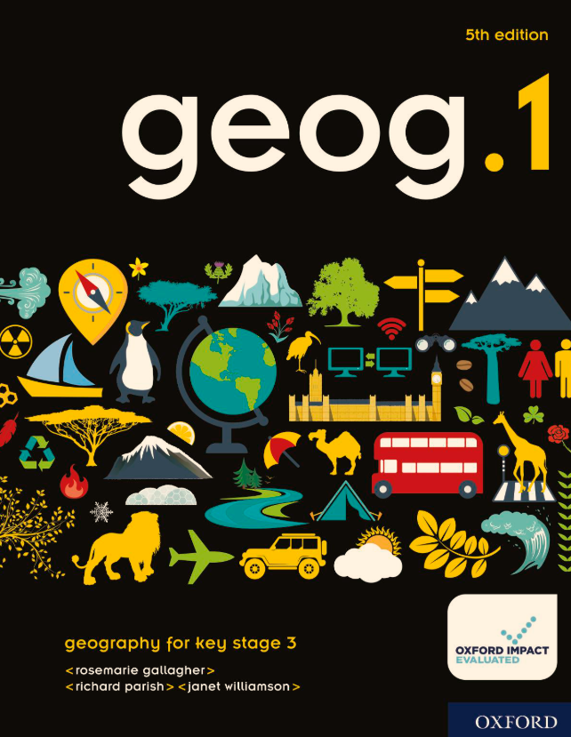
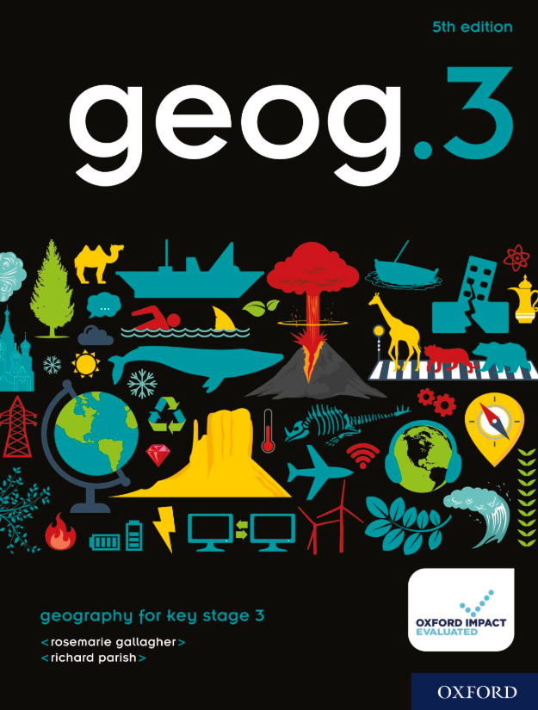
Our Key Stage 3 Provider is
Year 7
Year 8
Year 9
There is flexibility in the learning outcomes and topics taught throughout the Key Stage 3 curriculum, to meet the needs and capabilities of the students.

Slide 6
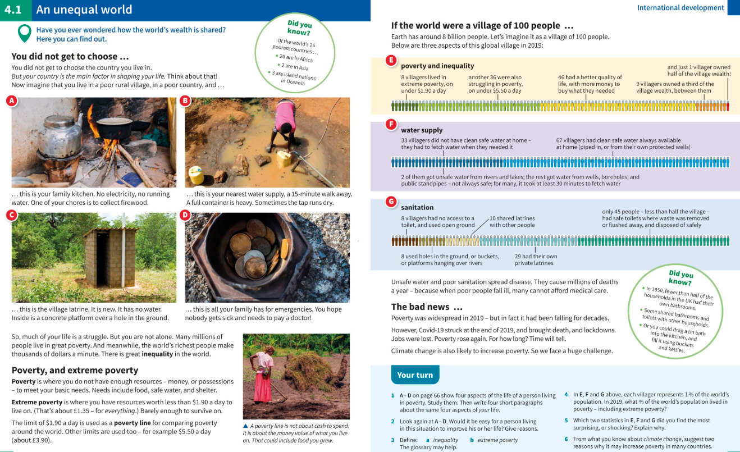
Key Stage 3 lesson examples

Slide 7
 | Year 7 Curriculum
Autumn Term 1 | Autumn Term 2 | Spring Term 1
Introduction to Geography: Maps and Mapping | Maps and Mapping | Maps and Mapping
Introduction to Geography: the differences between human, physical and environmental geography. Locate and name the continents and oceans of the world. Maps and Mapping How mapping has become more accurate. Careers relating to map skills | Work out scales on a map. Draw a mental map and suggest improvements. Draw a sketch map from a photo. Use four and six-figure grid references, to locate places on maps. | Measure distances on a map and use the scale to work out actual distances. Interpret contour lines and their patterns, and spot heights. Locate key lines of longitude and latitude on a globe. Undertake a map skills fieldwork project.

Slide 8
 | Year 7 Curriculum
Spring Term 2 | Summer Term 1 | Summer Term 2
Kenya | Kenya | Kenya
Mark and label Kenya on a map of Africa; name the countries which share Kenya’s border. Name its main physical features and draw a labelled sketch to show how the Great Rift Valley formed. Describe the pattern of temperature and rainfall across Kenya and understand Kenya’s climate zones. | Outline Kenya’s history. Compare patterns of rainfall and population density in Kenya. Describe the growth in Kenya’s population and suggest problems that Kenya’s young population might cause. Select photos that show a well-off city and three that show poverty; draw a graph to show Nairobi’s population growth. | Interpret a pie chart showing employment in Kenya; explain why Kenya’s government wants more factories. Describe the positive and negative aspects of tourism in Kenya, and outline how tourism could be made more sustainable. Understand and discuss the careers relating to conservation. Give examples of poverty and inequality in Kenya, reasons why Kenya is still poor and examples of how Kenya is changing.

Slide 9
 | Year 8 Curriculum
Autumn Term 1 | Autumn Term 2 | Spring Term 1
China | China | China
Name the continent that China belongs to and give at least three facts about China’s population. Outline China’s history from its first emperor to the rise of the Communist party and explain why it is no longer a truly communist country. Describe the pattern of relief in China; describe China’s climates in broad terms and explain why there are temperature differences between coastal and inland areas. | Describe and explain China’s population distribution and give a reason why China’s population growth slowed after 1979. Explain how setting up a special economic zone in Shenzhen created growth and wealth. Describe life in rural China, and how the government plans to improve things. | Identify evidence that China suffers from air pollution and desertification and describe how pollution and desertification are being tackled. Understand and discuss jobs in relating to environmental sustainably. Explain what the Belt and Road Initiative is, how it will benefit China, and why it might alter world trade.

Slide 10
 | Year 8 Curriculum
Spring Term 2 | Summer Term 1 | Summer Term 2
Coasts | Coasts | Coasts
Describe and label the water cycle. Explain how rainwater reaches a river. Explain that waves are caused by the wind and factors which affect waves. Explain how tides are caused. Describe the processes of erosion, transport and deposition by the waves. Name, describe and identify coastal landforms and how they are formed. | Give examples of ways we use the coast; and explain why there might be conflict between different types of coastal land use. Outline the cause of storm surges. The main stretches of coast where erosion is a problem; describe the problems at Happisburgh. Give ways to protect coastal places from erosion. Explain why some places won’t be protected in future. Understand and discuss the careers relating to rivers and coasts. | Undertake an enquiry project to explain why there are different sea defences at Overstrand and Weybourne.

Slide 11
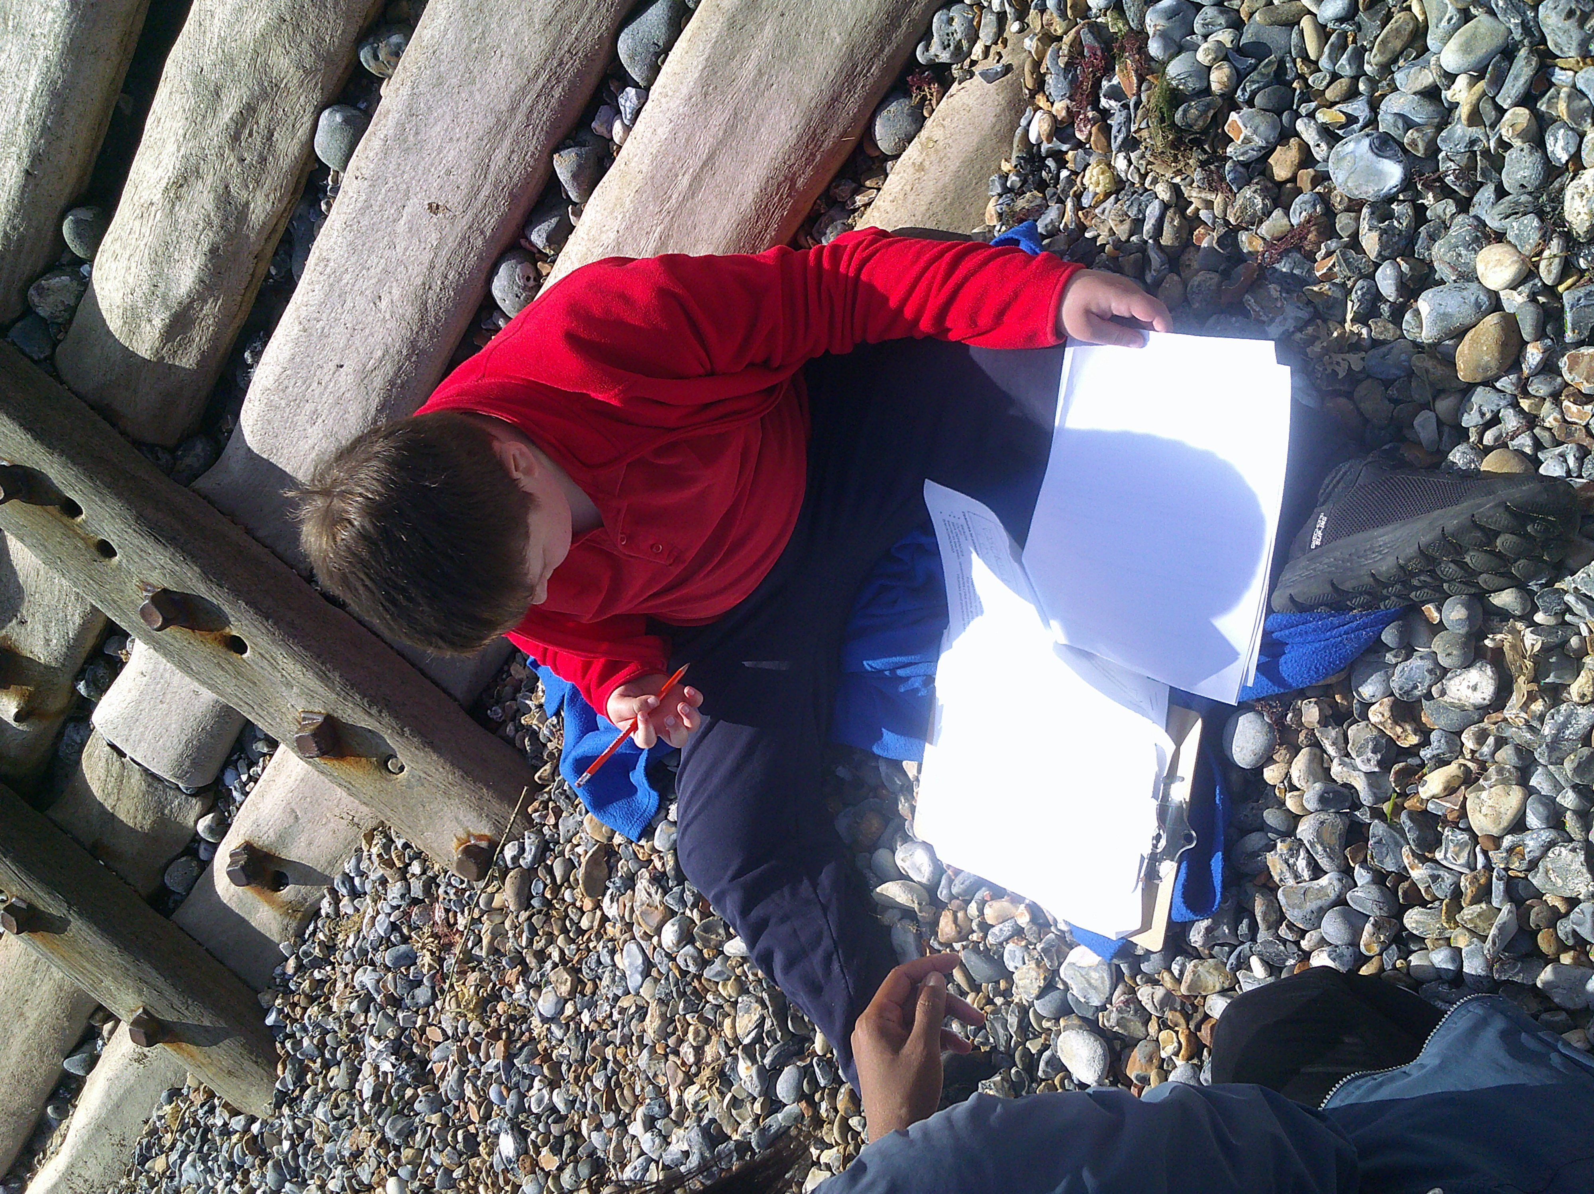
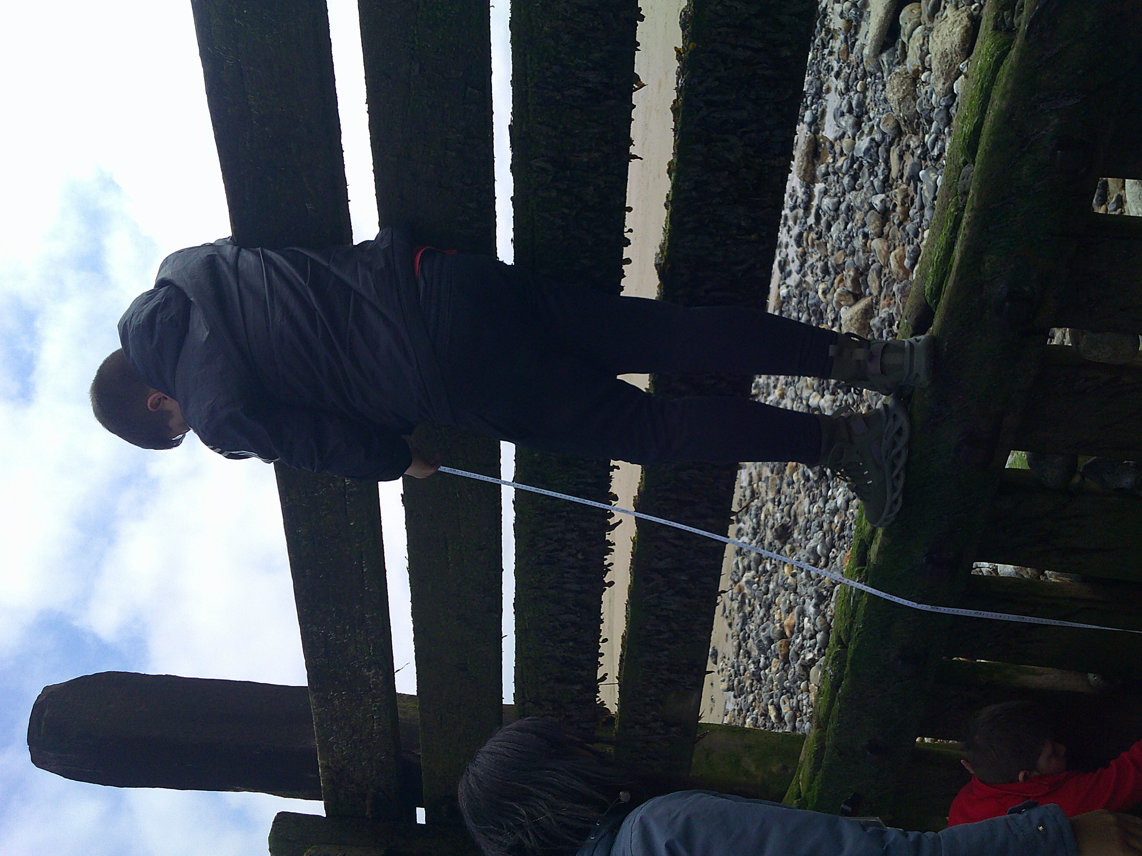
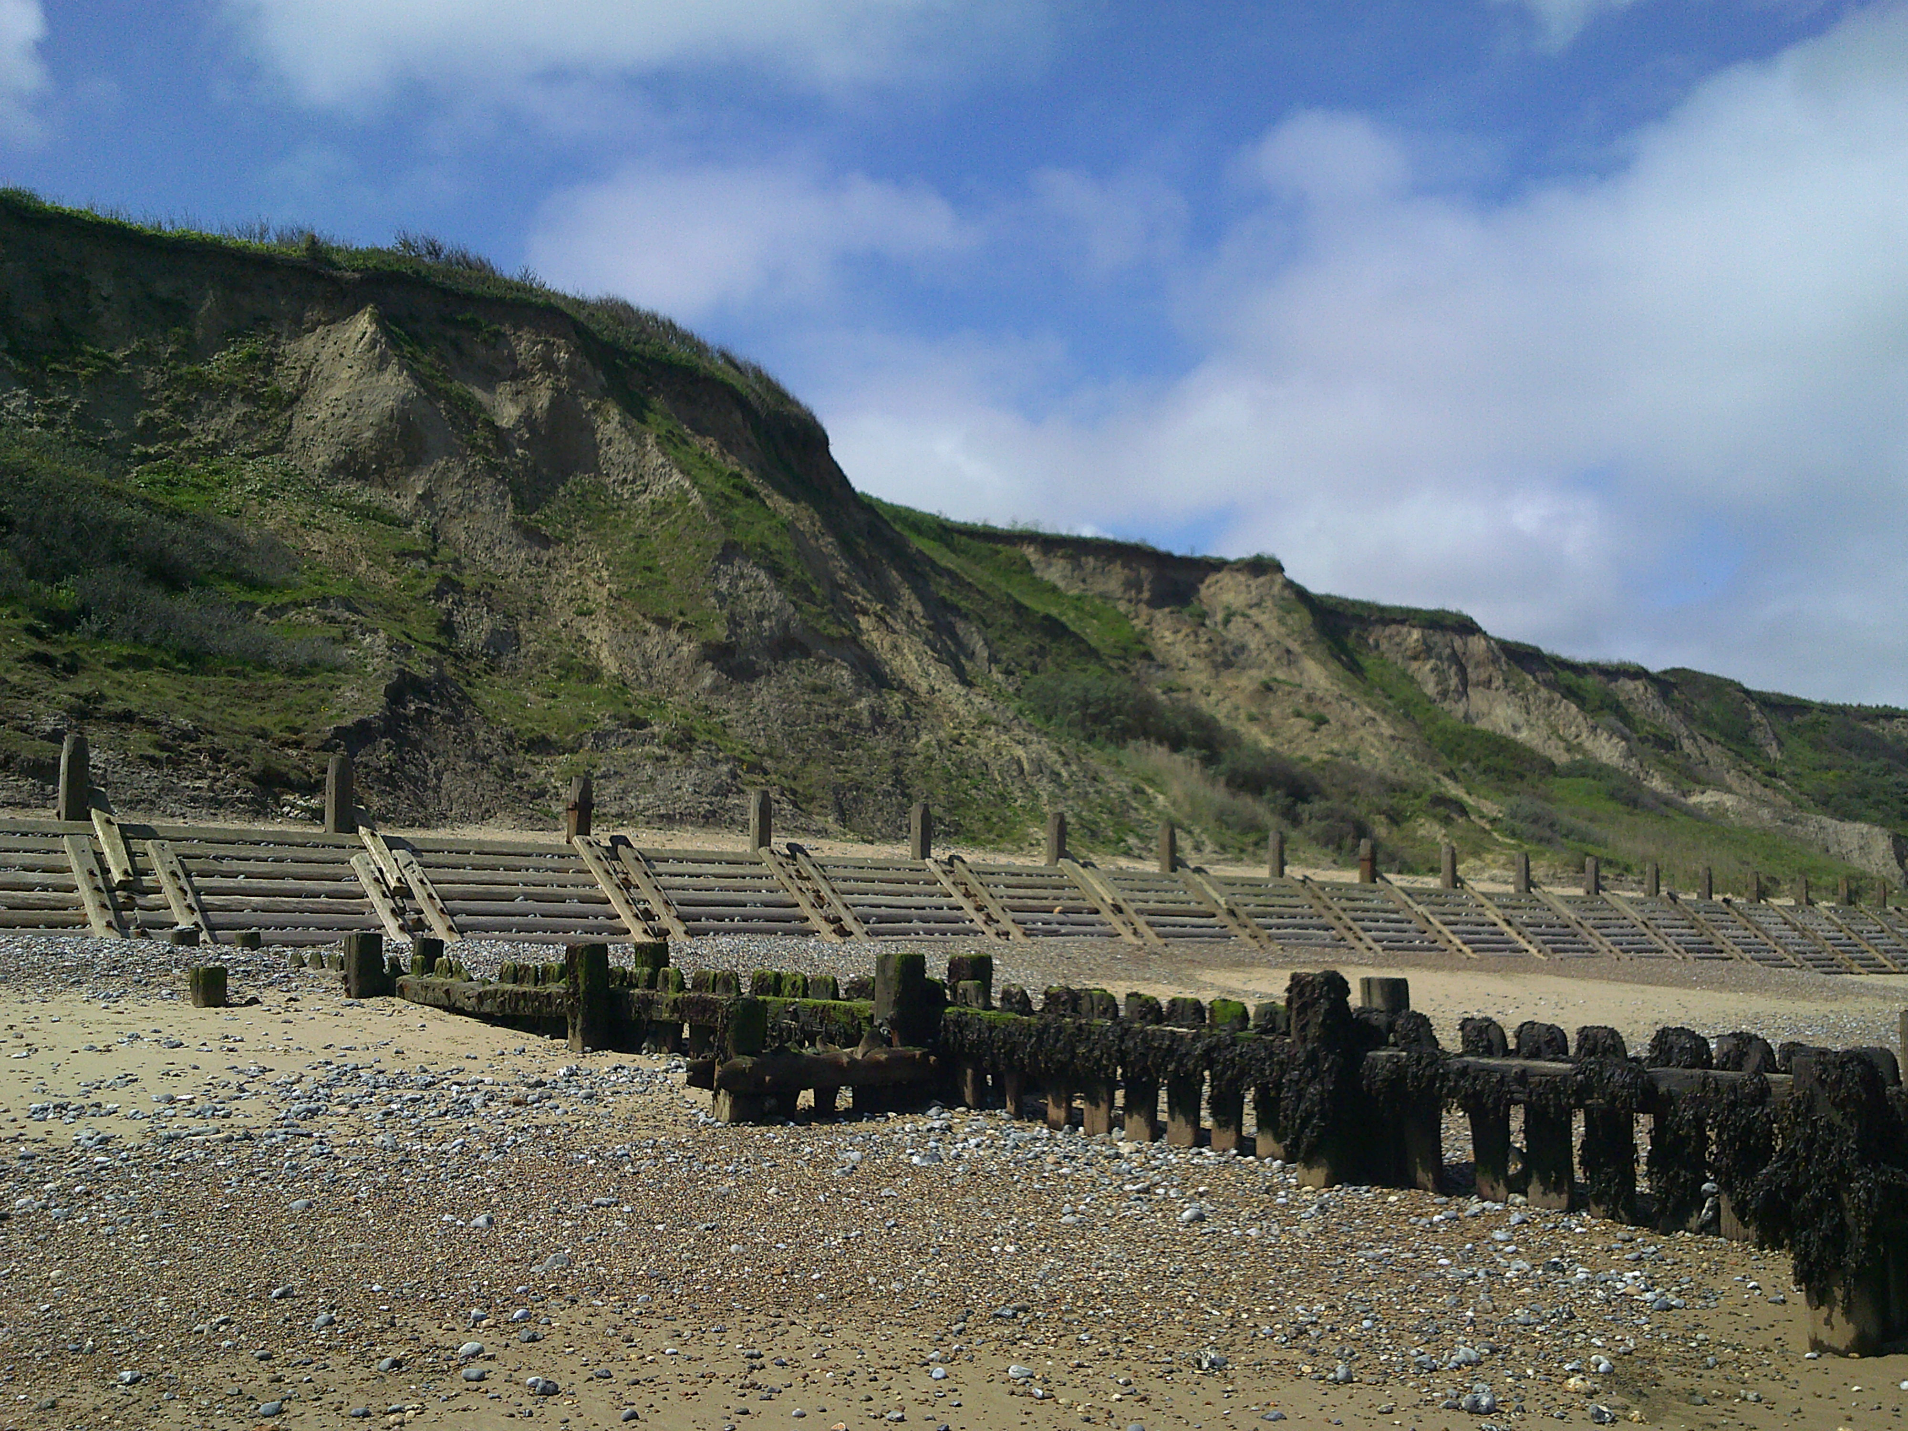
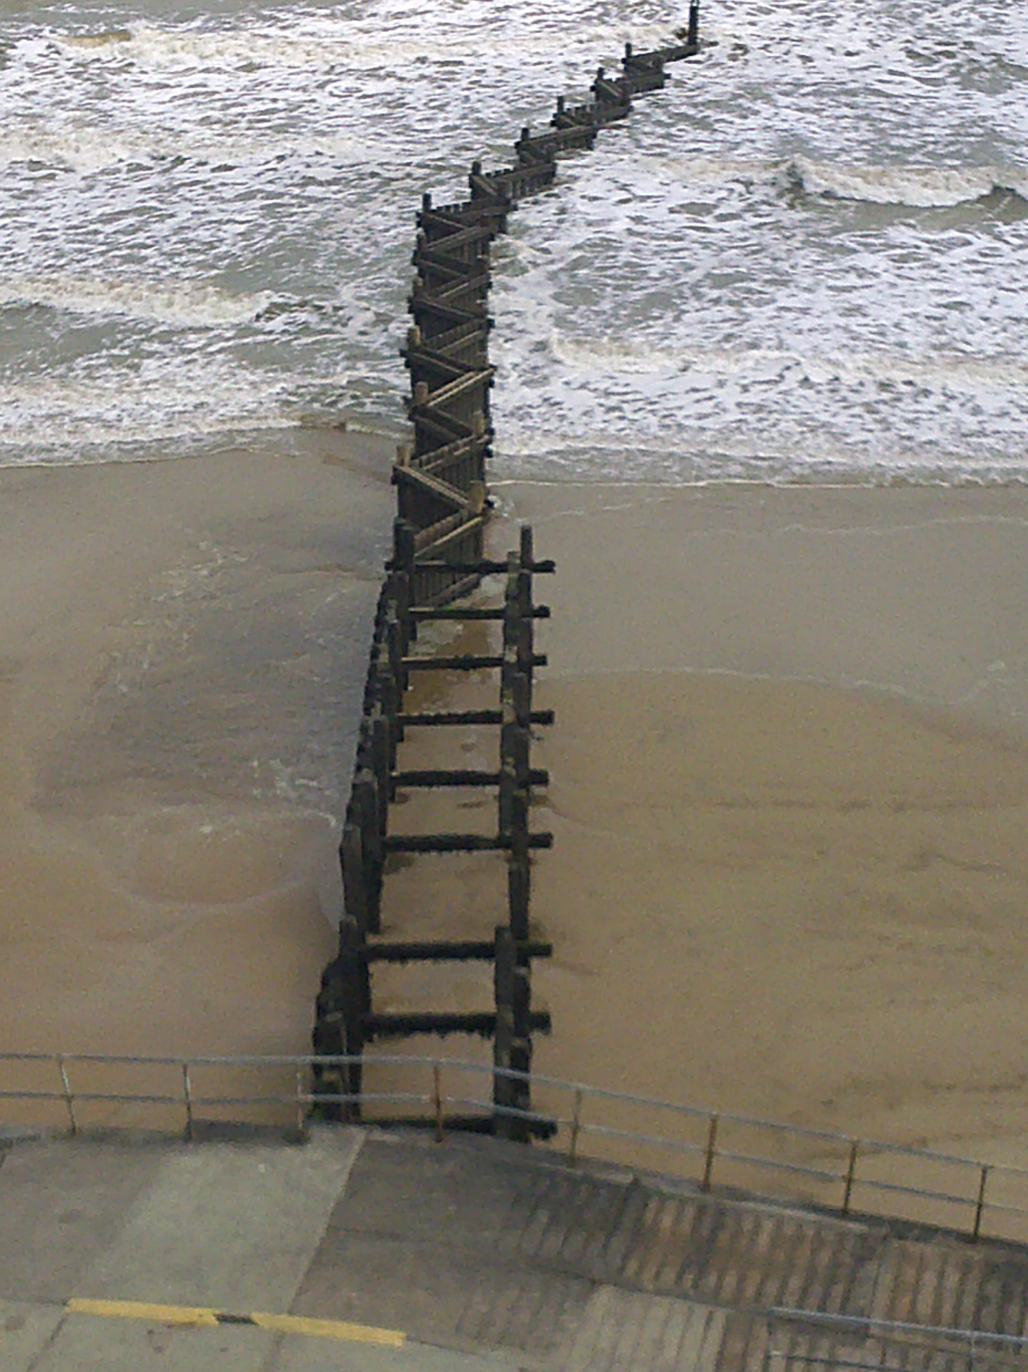
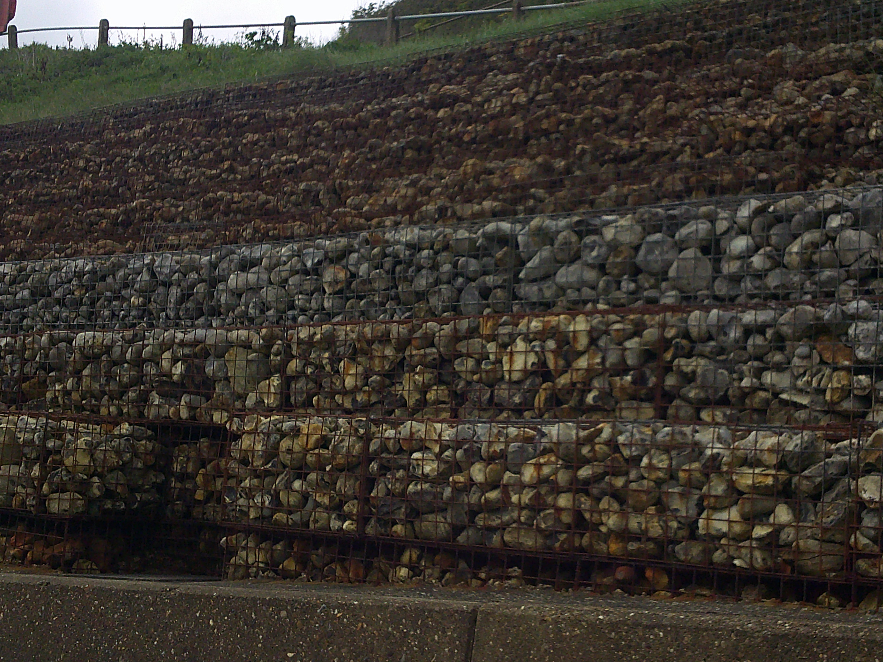
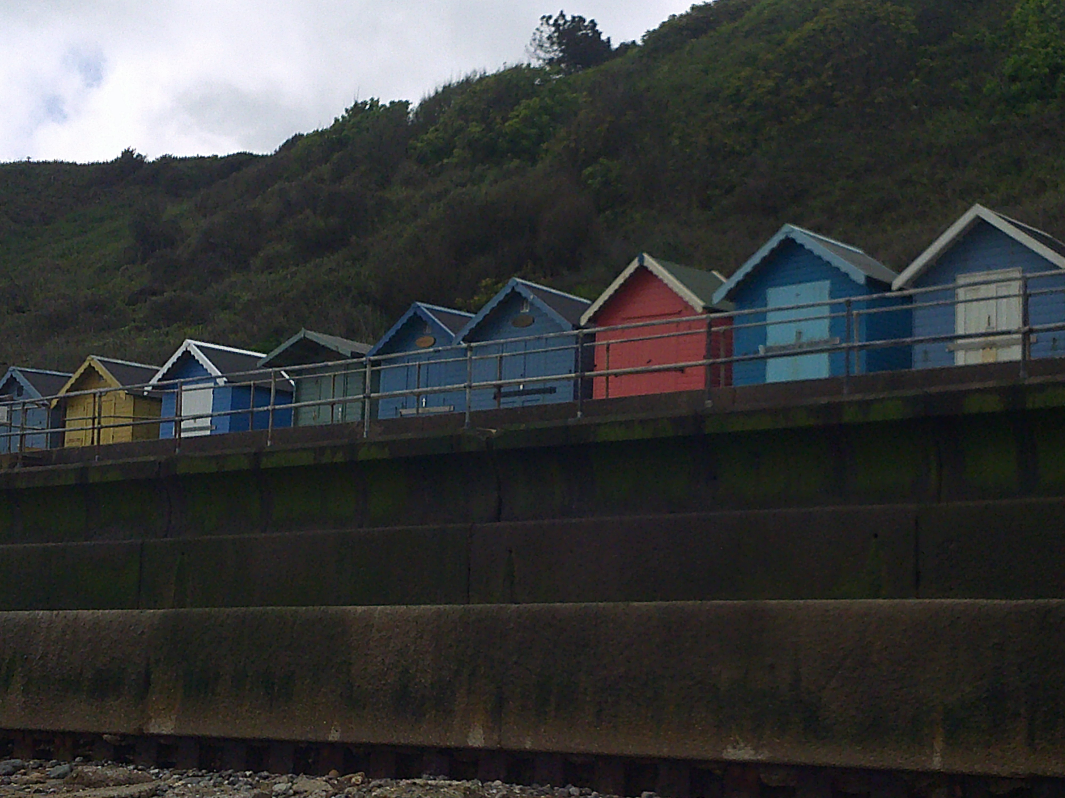
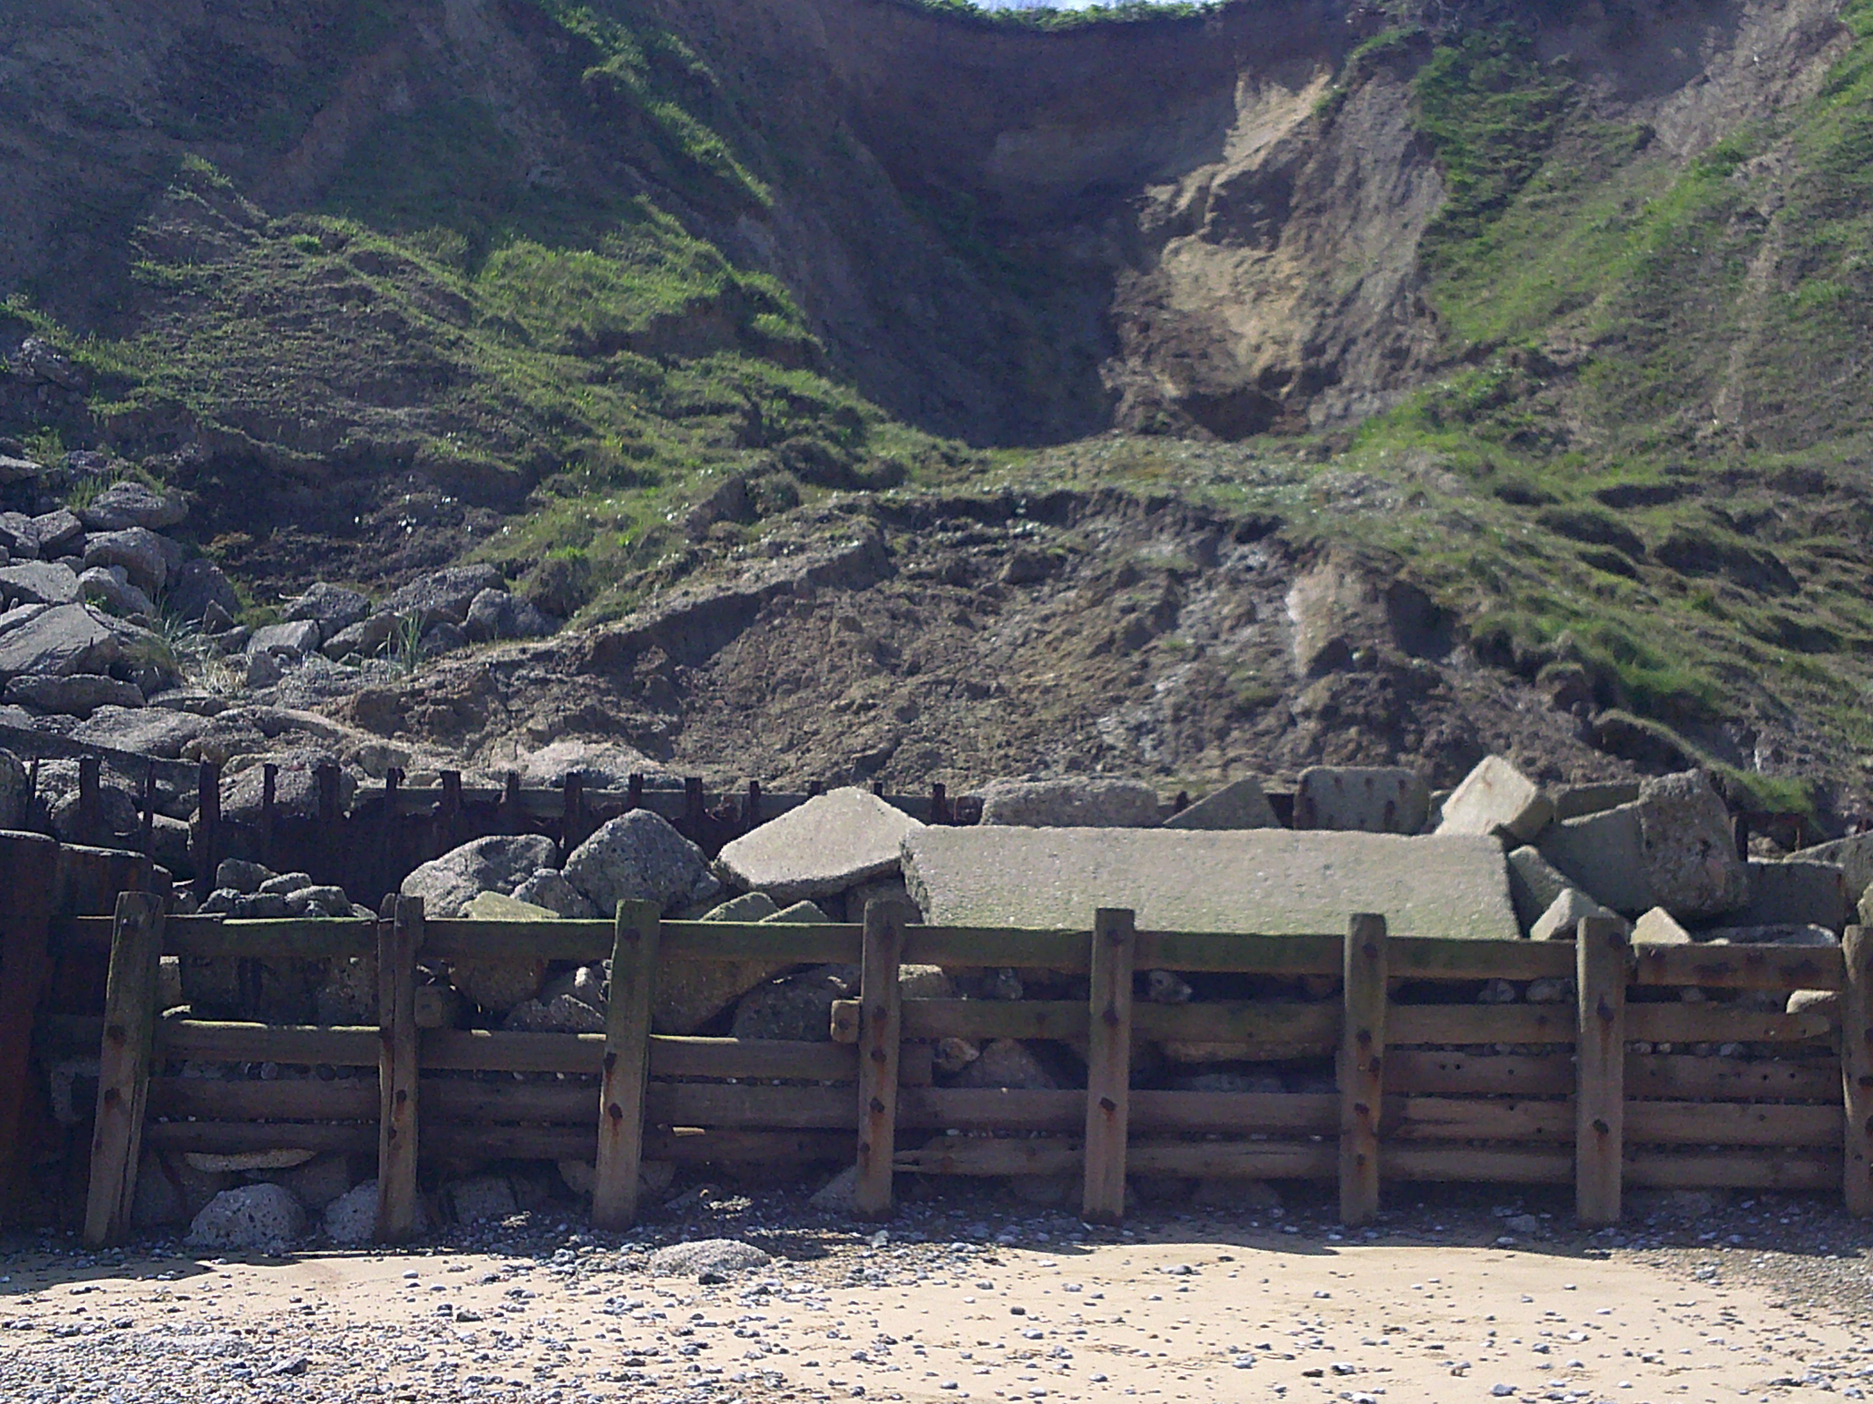
Photographs taken during the Year 8 fieldwork trip to Overstrand and Weybourne

Slide 12
 | Year 9 Curriculum
Autumn Term 1 | Autumn Term 2 | Spring Term 1
International Development | International Development | International Development
Identify how unequal the world is by interpreting evidence from photographs and data. Understand what development means; make comparisons to workout how poverty and development are linked, know how and why countries are at different stages of development. Match the meanings of development indictors with examples. Compare countries at different stages of development by interpreting data. | Understand and discuss jobs relating to international development. Describe Malawi’s history and location, compare its development indicator data with the UK and describe how life for a child in Malawi is compared to those in the UK. Research data to workout the level of development of countries. Discuss the locations and key points of Russia and the Middle East. | Undertake an enquiry project to workout the level of development. Explain reasons why some countries are more developed than others. Describe the advantages and disadvantages of transnational corporations or TNCs. Explain how COVID vaccines were developed so quickly and the links between development and the distribution of vaccines. Outline ways of putting an end to poverty.

Slide 13
 | Year 9 Curriculum
Spring Term 2 | Summer Term 1 | Summer Term 2
Earthquakes and Volcanoes | Earthquakes and Volcanoes | Earthquakes and Volcanoes
Describe what the British Isles were like 20,000 years ago during the last ice age and examine how the Earth’s climate has changed. Identify the layers which make up Earth. Describe how the pattern of earthquakes and volcano sites are linked to Earth’s plates. Explore different types of plate movement, and how they can lead to earthquakes, volcanic eruptions and mountain building. Understand and discuss jobs relating to volcanoes and earthquakes | Understand what earthquakes and the Richter Scale are, and to interpret the damage that earthquakes can cause. Explain the cause, impact and responses to an earthquake in Southwest China. Compare two earthquakes including their impact and link these to the countries level of development. | Describe the structure of a volcano, the materials thrown out during an eruption and the damage eruptions can do. Understand why people continue to live in areas which are prone to earthquakes, or with active volcanoes – despite knowing the risks.

Slide 14
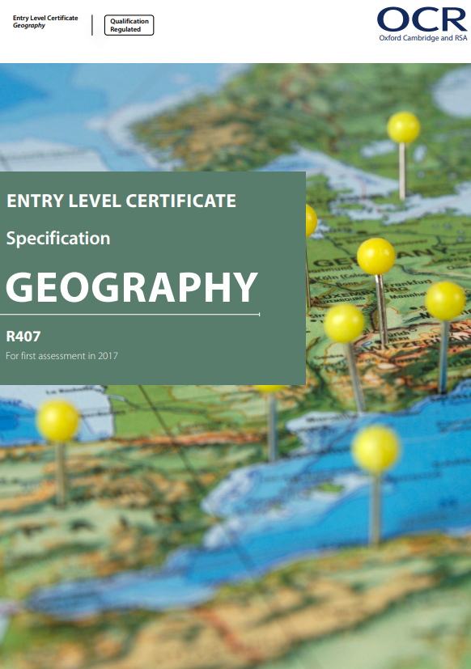
Our Key Stage 4 Provider is
Entry Level Students
These students learn the topics and undertake the fieldwork notebook, the personal project and the exam based on the OCR specification.
All other Key Stage 4 geography students
This curriculum is based around the OCR specification, but the topics taught, and the depth and order are adapted accordingly.

Slide 15
 | Year 10 Entry Level Curriculum
Autumn Term 1 | Autumn Term 2 | Spring Term 1
Tropical Rainforests | Flooding | Earthquakes and Volcanoes
Describe the types and adaptations of plants and animals that can be found in tropical rainforests. Understand how tropical rainforests are used to produce resources. Locate a tropical rainforest. Understand why the tropical rainforest is important to the planet and people. Know the reasons and impact of deforestation in the tropical rainforest. Understand how the tropical rainforest is being used sustainably. | Understand the range of natural causes of flooding. Understand how human activities increase the risk of flooding Describe the impacts of flooding. Understand how flooding can have different impacts on people in contrasting parts of the world. Locate the flood event; understand why the flood event occurred, describe the impacts of the flood event on people and the place, know the different responses to the flood event. Understand simple ways the place prepares for flooding. | Understand the structure of the Earth. Know that the Earth’s crust is broken up into tectonic plates and that these plates move. Know the location of earthquake and volcanic zones. Know the hazards associated with earthquakes and volcanoes. Understand how earthquakes and volcanoes can have different impacts on people in contrasting parts of the world. Undertake a coursework project comparing two earthquakes, including their scale, impact and responses

Slide 16
 | Year 10 Entry Level Curriculum
Spring Term 2 | Summer Term 1 | Summer Term 2
Volcanoes and Earthquakes | Food Production Fair Trade | Energy Resources
Continue volcanoes and earthquake coursework. | Food Production Describe the variety of places where food consumed in the UK comes from, at a range of scales. Understand how more food can be produced to feed a growing population. Fair Trade Describe what fair trade is. Know where a chocolate fair trade product is produced, who produces it and its journey to consumers. Know the challenges faced by producers. Know the benefits of fair trade to farmers’ and workers’ lives. Understand how fair trade can build a sustainable future for producers. | Energy Resources Know the types of energy sources used to produce electricity in the UK such as renewable and non-renewable energy sources. Understand which types of energy sources are more environmentally sustainable for the UK’s future energy supply.

Slide 17
 | Year 11 Entry Level Curriculum
Autumn Term 1 | Autumn Term 2 | Spring Term 1
Fieldwork Project | Continue fieldwork project UK Population | World Population Megacities
Fieldwork Project Understand the structure of towns and cities. Understand how Norwich fits into the Burgess Model. Understand where Riverside Entertainment Complex is located and why. Undertake fieldwork coursework on the Riverside Entertainment Complex in Norwich. | Continue fieldwork project UK Population Locate Cromer, at a range of scales Describe the variety of people, and know how Cromer has changed over time. Describe the population structure of the UK today. Understand how the population of the UK has changed over time since 2001. Locate Norwich, at a range of scales; describe diversity, understand the problems that the city faces and describe the potential solutions to one of the problems that the city faces. | World Population Know what has happened to the world’s population since 1950. Understand why more people are now living in cities than in the countryside. Megacities Know what a megacity is, including their main characteristics. Locate the world’s megacities. Describe the challenges and opportunities for people living in megacities. Locate a megacity, at a range of scales; describe what life is like for teenagers in the city, describe diversity within the city, understand the problems that the city faces, and the potential solutions.

Slide 18
Year 11 Entry Level Topics
Year 11 Entry Level Curriculum
Spring Term 2 and Summer Term 1
Revision and mock exam Final exam and coursework submission

Slide 19
Useful websites
National Curriculum - Geography key stages 3 and 4
KS3 Geography - BBC Bitesize
Jobs that use Geography, History and Religious Studies - Careers - BBC Bitesize

