Slide 1
KS2 History
Students should learn about British, local, and world history, understanding the key events and connections between different periods. They should recognize patterns and changes over time and use the correct historical terms.
Students should ask questions about how and why things changed, what stayed the same, and why certain events are important. They should be able to give thoughtful answers, using the right historical facts. They should also understand that our knowledge of history comes from different sources.

Slide 2
Living
 | KS2A Curriculum
Autumn Term | Spring Term | Summer Term
WWI & Remembrance | Riotous Royalty | Egyptians
Understand some of the differences of how Walter Tull lived, compared with today Know how Walter Tull has been remembered Name different animals used during WWI Describe what life was like for soldiers/women in WWI Explain why November 11th is Remembrance Day | Explain why William the Conqueror thought he should be king Write a Magna Carta for the school Understand why Henry VIII wanted an heir. Organise dates and monarchs on a timeline. Understand what the British Empire meant in Victorian Britain | Understand what was important to people during Ancient Egyptian times. Compare the powers of different Egyptian God. Find Egypt on a map Raise questions when confronted with an artefact.

Slide 3
Living
 | KS2B Curriculum
Autumn Term | Spring Term | Summer Term
STONE AGE TO IRON AGE | WORLD WAR II | The Kingdom of Benin
Timeline of events Homes, clothes, weapons etc Hill forts The Beaker people Skara Brae- what does it tell us about the Stone Age Stonehenge Being a copper child Topic related arts and crafts | The outbreak of war Evacuees Rationing The role of women Key events Peace WW2 – recipes and ration cooking. Topic related arts and crafts | The Kingdom of Benin Religion Housing, food and clothing Artefacts The story of Eweka The lost Kingdom African art and crafts Food tasting

Slide 4
KS3 & KS4 History
History will help pupils gain knowledge and an understanding of Britain’s past and that of the wider world. It should inspire pupils’ curiosity to know more about the past.
Lessons should equip pupils to ask perceptive questions, think critically, weigh evidence, consider different points of view, and develop perspective and judgement. History helps pupils to understand the complexity of people’s lives, the process of change, the diversity of societies and relationships between different groups.

Slide 5
Our KS3 & KS4 provider is

Slide 6
Living
 | Year 7 Curriculum 1066-1485
Autumn Term | Spring Term | Summer Term
Create a timeline 1066-1485 Identify the 3 main contenders for the throne of England in 1065/1066 – Harold Godwinson, Harald Hardrada, William Duke of Normandy Battle of Stamford Bridge Battle of Hastings William the Conqueror The Feudal System Motte and Bailey castles Domesday Book | Role of the church Role and life of monks and nuns Murder of Thomas Beckett (his relationship with Henry II) Causes and consequences behind the Crusades | Understand the events which led to the signing of the Magna Carta (King John) Explain the causes of the Black Death and its consequences Understand the events leading up to the Peasant’s Revolt

Slide 7
Living
 | Year 8 Curriculum 1500-1750
Autumn Term | Spring Term | Summer Term
Create a simple timeline of events Henry VIII and religious change Compare beliefs/rituals of Catholics and Protestants Henry VIII’s wives Understand Henry’s reasons for breaking with Rome Mary I and Edward VI Difference between Edward’s and Mary’s beliefs and how this affected the country Comparison between Catholic and Protestant churches Reasons for Mary burning Catholics | Elizabeth I and the Armada Elizabeth’s problems when she first became queen Why Elizabeth never married The problem of Mary Queen of Scots on Elizabeth’s reign Francis Drake Social Changes Reasons behind why people were poor Understand the significance of the 1601 Poor Law Differences between middle class and rich houses Tudor artefacts Compare family life and childbirth from past and present | The Stuarts Significance of James I becoming king Gunpowder plot Guy Fawkes Charles I and the Civil War Causes of the Civil War Charles’ execution Explore whether you think Parliament, or the King was in the right Why the country wanted to get rid of Oliver Cromwell

Slide 8
Living
 | Year 9 Curriculum 1750 - 1900
Autumn Term | Spring Term | Summer Term
Victorian Inventions Victorian life Create a timeline of significant Victorian inventions Reasons for the success of British Industry e.g. Josiah Wedgewood; Richard Arkwright Children in the mills; Robert Owen Factory Act ; Workhouse conditions | Compare Victorian schools with present day schools Living conditions in Victorian towns Changes in transportation; Significance of the railways Knowledge of the development of systems of transport (road, waterways, rail) Knowledge of different types of power (coal, water, steam) Understand importance/job of the navvies. | British Empire and trade Identify countries in the British Empire on a world map Identify some of the goods traded in the different countries. William Armstrong Slavery and the slave trade; Norfolk connections to the slave trade Abolition of the slave trade Conditions on board a slave ship Trade Triangle

Slide 9
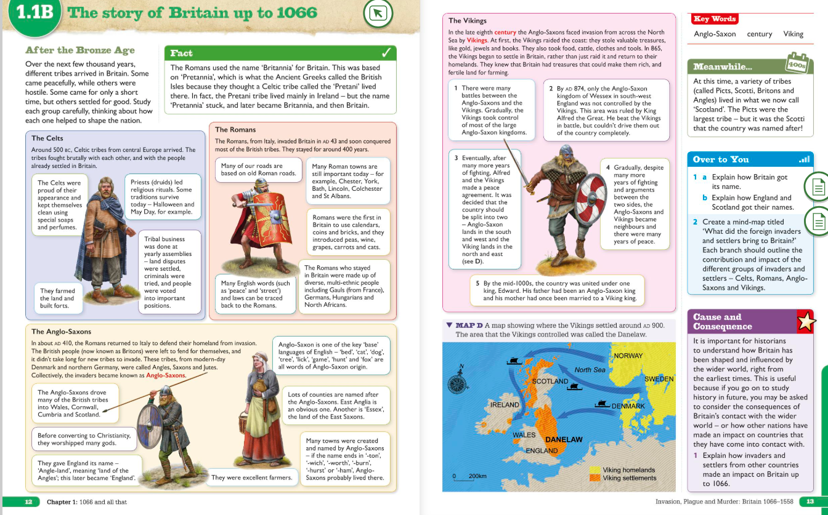
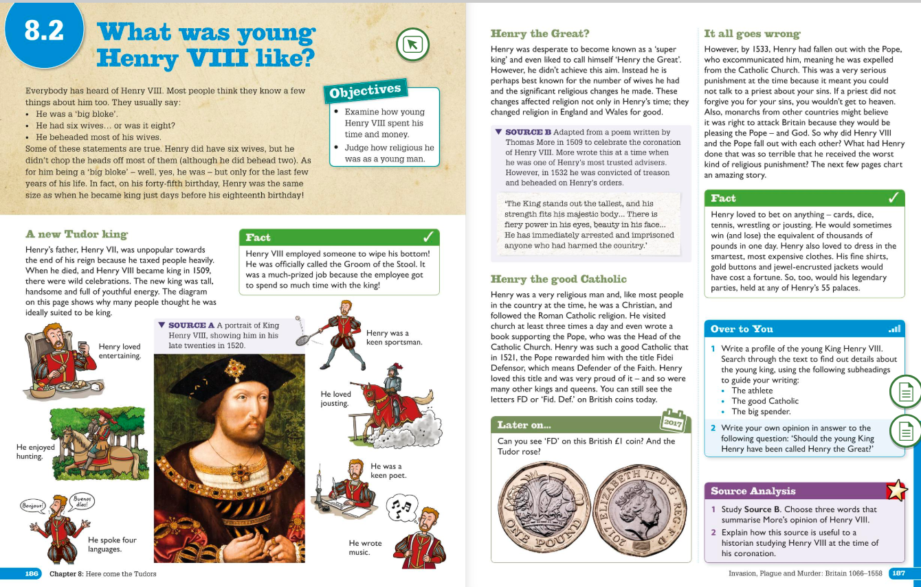
KS3 Lesson examples

Slide 10
Key Stage 4 Curriculum The aim of this scheme of learning is to introduce and research areas of history that are of interest to the student(s). This means that the scheme in-depth be adaptive to their interests, whilst embedding the skills needed for a lifelong interest in history and studying. Progression is monitored through formative assessment and through the AQA Unit award Scheme. The structure of the course: Stage 1 - to have an oversight of general history and where we can evidence this. Stage 2 - to concentrate on themes of interest within history. Stage 3 - to complete a thematic study, an in-depth study and a study of a site or an individual person
Term 1 and Term 2 Introduction to History | Starting from the Stone age we look at different eras in history and how this can be evidenced. This concludes with the end of the nineteenth century. We will look at written and visual evidence, such as documents and historical accounts, as well as environmental evidence, castles, and monuments.
Term 3 The Twentieth Century and War and Conflict | During term 3 we will look at history in a thematic process comparing some of the major events of the twentieth century with similar ones in previous historical periods.
Term 4 Thematic Study | Thematic Study 40 Marks Internally-assessed/ externally-moderated (40% of total Entry Level Certificate)
Term 4 Depth Study | Depth Study 30 Marks Internally-assessed/ externally-moderated (30% of total Entry Level Certificate)
Term 5 Study of a site or individual person | Study of a Site or Individual 30 Marks Internally-assessed/ externally-moderated (30% of total Entry Level Certificate)

Slide 11
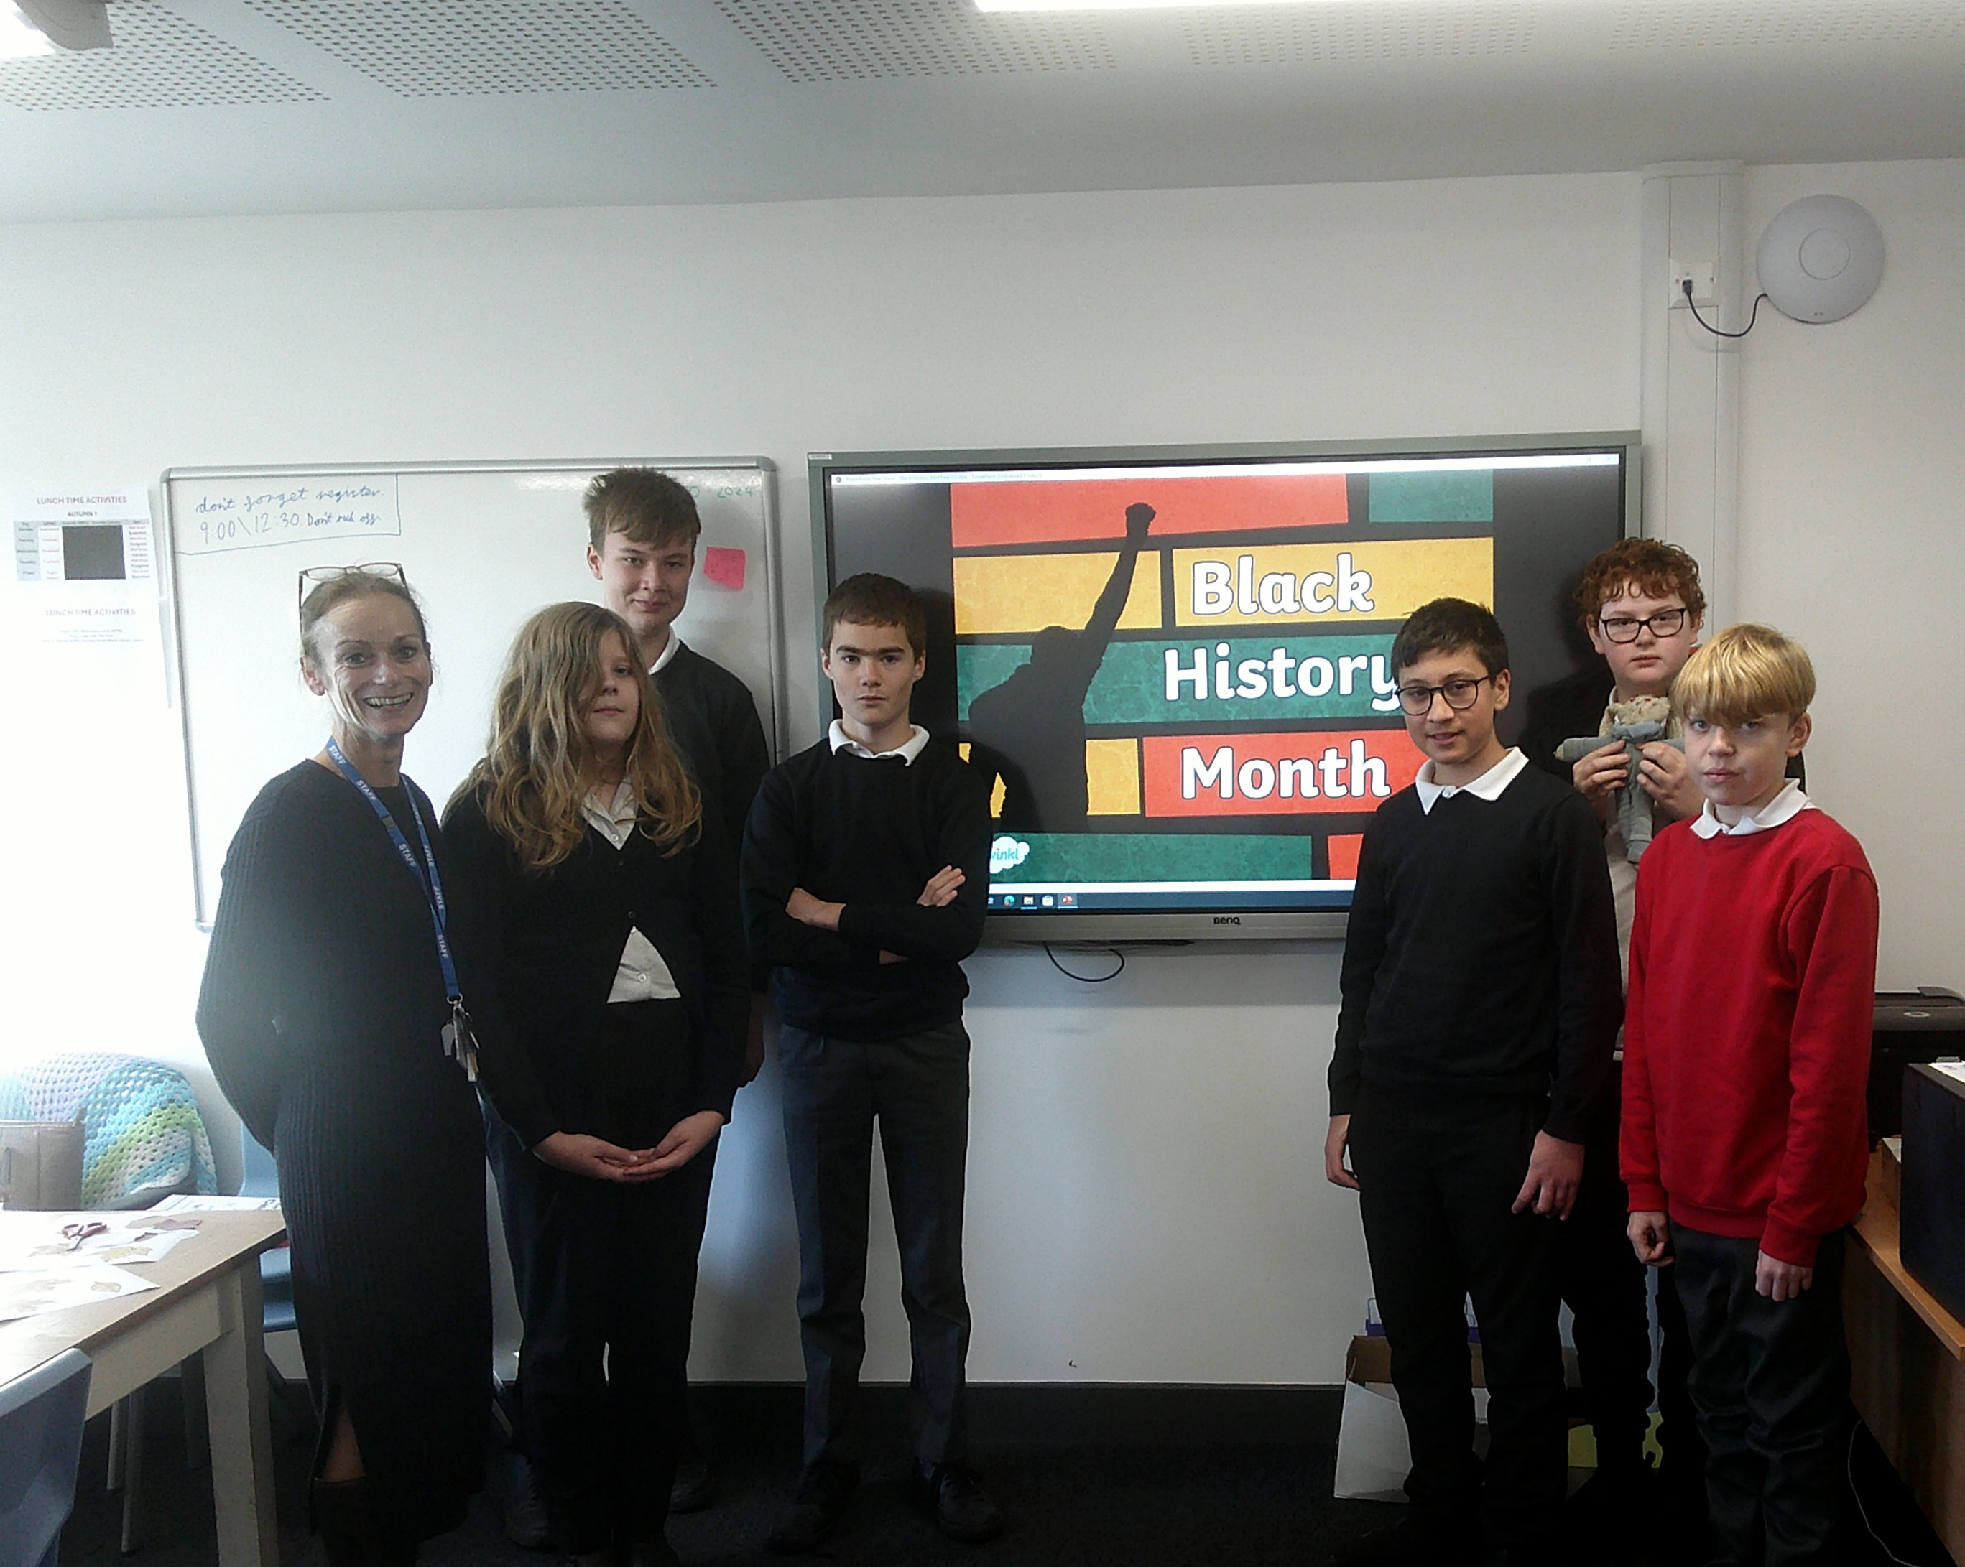
October was Black History Month
This year our focus was on Black British History. KS3 & KS4 had an insightful journey through the achievements and contributions of individuals in the UK and students have learned about figures who shaped British society.
Key Highlights:
John Kent: Students learned about John Kent, the first black policeman in Britain, who served with the Metropolitan Police in the 19th century, breaking barriers in law enforcement.
John Archer: In Key Stage 3 and 4, we explored the story of John Archer, the first black Mayor of London, elected in 1913, and his remarkable impact on local politics and racial equality.
Lillian Bader: Students also discovered the story of Lillian Bader, the first woman of African and Caribbean descent to join the RAF during World War II, challenging gender and racial norms of the time.
Claudia Jones: was a pioneering activist and the founder of the Notting Hill Carnival, which began as a response to racial tensions and has since become a major cultural celebration in London.
Moving Forward: While Black History Month has ended, we encourage continued learning and reflection. Together, let’s keep fostering an inclusive, respectful community all year round.

Slide 12
Useful websites
National Curriculum - History Key Stages 3 and 4
KS3 History - BBC Bitesize
Watch Horrible Histories Streaming Online – Yidio
BBC Teach - YouTube

