Slide 1
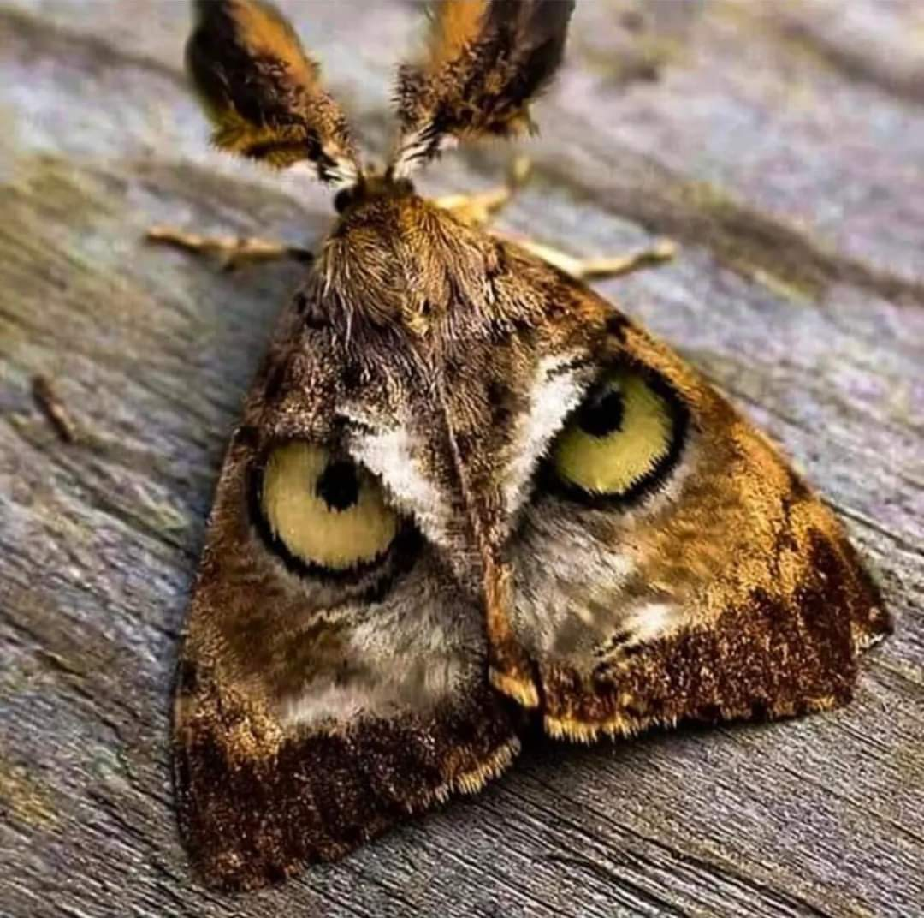
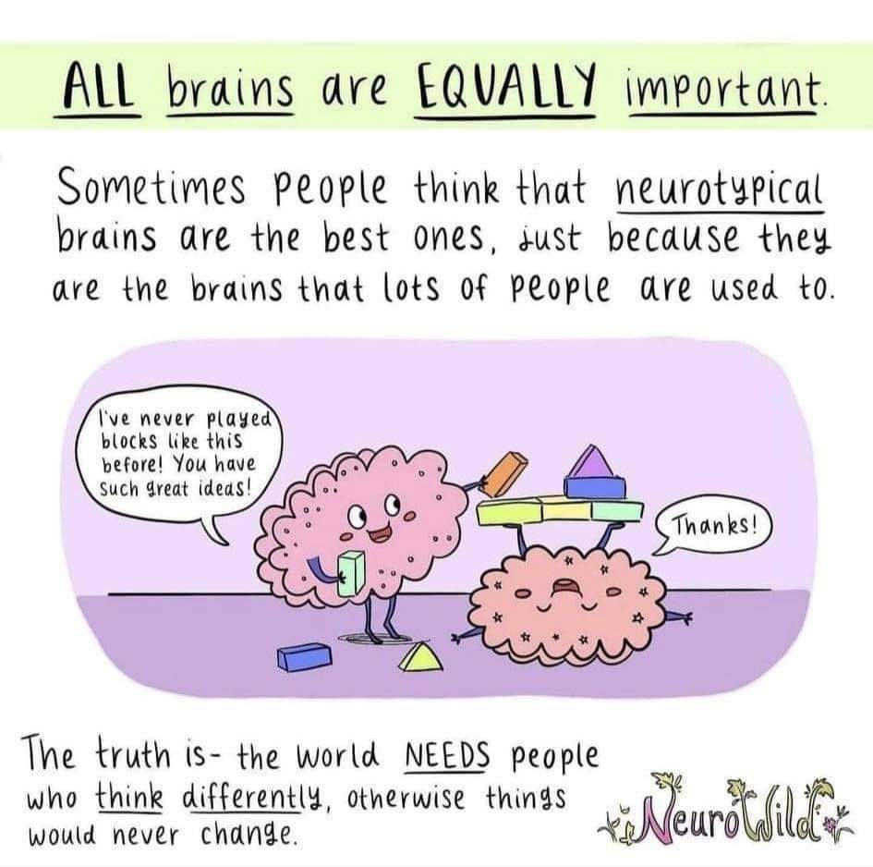
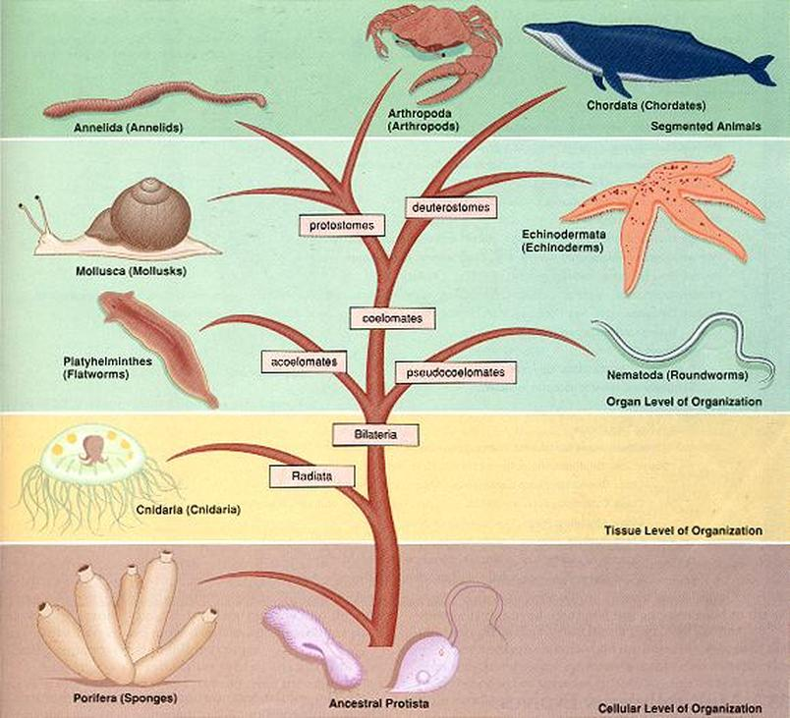
Science at St Andrew’s School
Key Stage Two

Slide 2
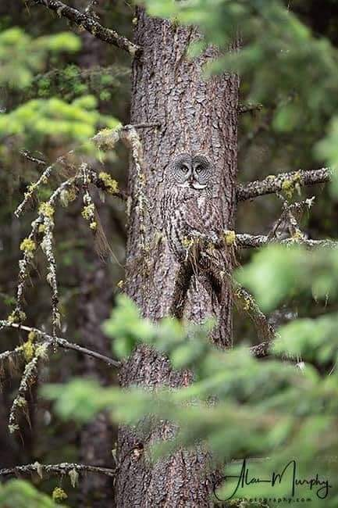
KS2 Autumn 1
Living things and their Habitats
Recognise the variety of ways that living things can be grouped, sorted and classified.
Identify similarities and differences between living things.
Recognise and classify vertebrate animals into mammals, birds, reptiles, amphibians and fish.
Describe the characteristics of different invertebrate groups.
Use and create classification keys to help group, identify and name living things;
Explain how environmental changes can impact living things.
Identify why certain species have become endangered and explain what humans are doing to help.

Slide 3
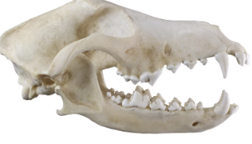
KS2 Autumn 2
Animals, including humans: Digestion and Food
Label key organs found in the digestive system and describe each of their functions.
Describe the functions of the four different types of adult human teeth using key vocabulary.
Know that good dental care involves brushing their teeth twice a day with toothpaste and a soft toothbrush.
Produce a food chain that begins with a plan and has arrows that move up the food chain.
Define a producer, predator and prey and identify examples in food chains.
Describe digestion, teeth and diets when talking about observed poo clues.

Slide 4
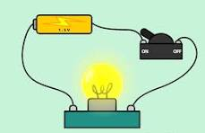
KS2 Spring 1
Unit: Electricity and Circuits
Recall a range of electrical appliances, classify them as mains or battery-powered and explain why.
Explain how to test if a circuit works and identify when simple electric circuits will work.
Identify symbols for open and closed switches and give examples of how switches are useful.
Predict whether a circuit will work based on whether the switch is open or closed and explain that it works by breaking and completing a circuit.
Describe that a material is a good electrical conductor when it is added to an electrical circuit and the bulb lights and that a material is a good electrical insulator when it is added to an electric circuit and the bulb does not light.
Recall that metals, for example, are good electrical conductors and plastics, for example, are good electrical insulators.
Describe the more bulbs added to a series circuit, the dimmer the bulbs will be and explain that they will be dimmer when more are added to a circuit, as less energy is transferred to each of them.
Describe precautions for working safely with electricity and explain some precautions using knowledge of circuit diagrams, electrical components, conductors or insulators.

Slide 5
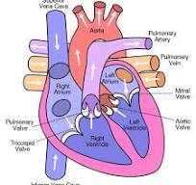
KS2 Spring 2
Unit: Animals including humans: Circulation and health
Recall factors that improve someone’s health and those that impact health negatively and suggest improvements to someone’s health.
Describe the circulatory system as the heart and blood vessels transporting blood around the body and recall that the heart is a pump that pushes blood through the circulatory system,
Describe the pathway of blood through the circulatory system, including passing through the heart twice in a complete circuit through the body.
Describe some of the functions of blood, including transporting substances like oxygen, water and nutrients around the body,
Recall what is meant by heart rate and research using multiple websiteS to find reliable animal masses.
Identify the pattern between animals’ size and heart value and quote values as evidence.

Slide 6

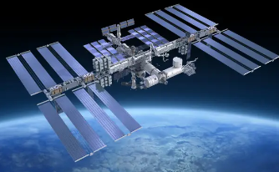
KS2 Summer 1
Unit: Forces and space: Earth and space
Describe the geocentric and heliocentric models.
Name and describe the shape of celestial bodies.
Describe the orbits of celestial bodies in the Solar System and name the force that keeps them in their orbits.
Describe the orbit of the Moon around the Earth and its phases.
Explain how day and night occur.
Explain how the seasons occur.
Explain how a sundial works.
List some of the uses of satellites and explain why space junk poses a problem to them.

Slide 7
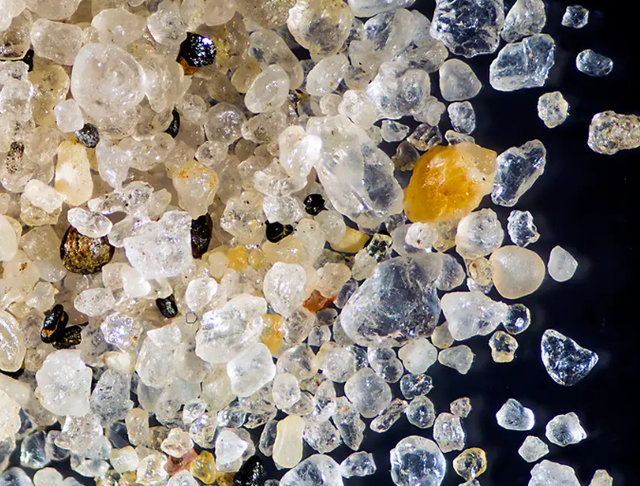
KS2 Summer 2
Unit: Materials: Mixtures and Separation
Define the term mixture and name some common examples.
Define the term sieving and explain how sieving separates mixtures.
Define the term filtering and explain how filtering separates mixtures.
Define the terms solution and dissolve and name some common examples of solutions.
Recall some factors that affect the time taken to dissolve.
Describe the effect of temperature on the time taken to dissolve.
Define the term evaporating and explain how evaporating separates solutions.
Identify when sieving, filtering and evaporating should be used.

