Slide 1

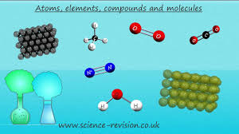
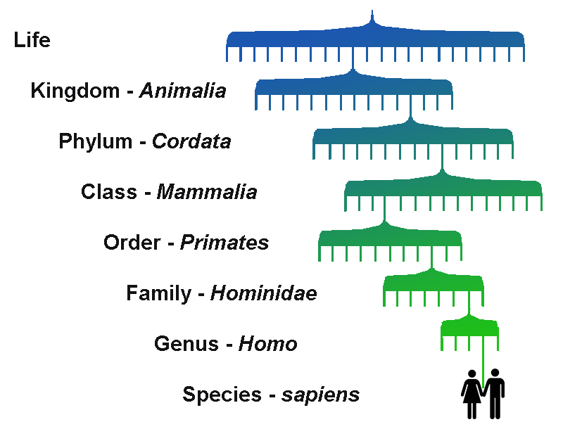
Science at St Andrew’s
KEY STAGE 4

Slide 2
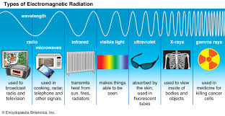
Key stage 4, Year 10
,
Path 1
AQA Single Science Biology GCSE curriculum.
This year we have changed what we are offering the students on path 1.
To help improve the students’ chances of success at GCSE level in Year 11, we have extended the time available to students to focus on the AQA Single Science Biology GCSE curriculum by starting more Biology-focused work a year early!
Students can now work on relevant AQA Unit Award Scheme units at a pace more suited to their individual ability and speed of working.

Slide 3

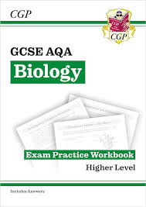
Key Stage 4,
Year 10 & 11 Path 1
Relevant AQA Unit Award Scheme units are now woven into the AQA Single Science Biology GCSE curriculum as appropriate.
This is to allow students to gain academic qualifications in the work covered and to show the progress they have achieved.
Students will bring home photocopies of their certificates gained.
The real certificates will remain in their Portfolios of Achievement in their classrooms until they leave St Andrew's.

Slide 4
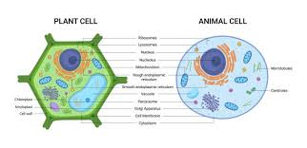
Key Stage 4,
Year 10 & 11 Path 1
Topics covered:
Topic 1: Cell Biology
Cell structure and cell division in animal & plant cells; transport in cells.
Topic 2: Organisation
Tissues, organs & organ systems; health & disease; enzymes & digestion. Practical skills.
Topic 3: Infection & response
Communicable diseases- fungi, bacterial and viral.

Slide 5

Key Stage 4,
Year 10 & 11 Path 1
Topic 4: Bioenergetics
Photosynthesis & anaerobic & aerobic cellular respiration.
Practical skills
Topic 5: Homeostasis & response
Nervous & hormonal systems.
Mocks paper 1
Practical skills & working scientifically and Maths skills.

Slide 6
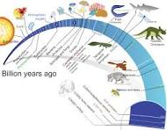
Key Stage 4,
Year 11, Path 1
Topic 6: Inheritance variation & evolution - DNA & reproduction; genetics, evolution & classification
Topic 7: Ecology
Organisms & their environment; impact of humans on the environment.
Practical skills
Revision
Mock paper 2

Slide 7

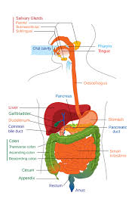
Key Stage 4,
Year 10 &11, Path 2
In Science all students are encouraged and allowed to work at a pace suitable to them and their learning.
In path 2, we especially try to foster a hands-on approach within a less pressured, slightly less academic route.
Students can cover the targets using a variety of mediums that allow their natural talents and interests to be used and further developed.

Slide 8
Key Stage 4,
Year 1, Path 2
AQA Unit Award Scheme:
A more relaxed and flexible route that allows students to go on an individually tailored framework of the KS3 Science curriculum.
The AQA Unit Award scheme covers many levels from pre-entry, to entry level and higher. There are a selection of individual certificates that allow students to cover the three main areas of Biology, Chemistry and Physics.
These allow students to have some personal choice in Science and to some extent follow their interests, whilst gaining a well-rounded understanding of its applications in the world in which we live.

