Slide 1
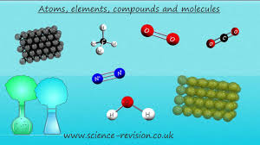
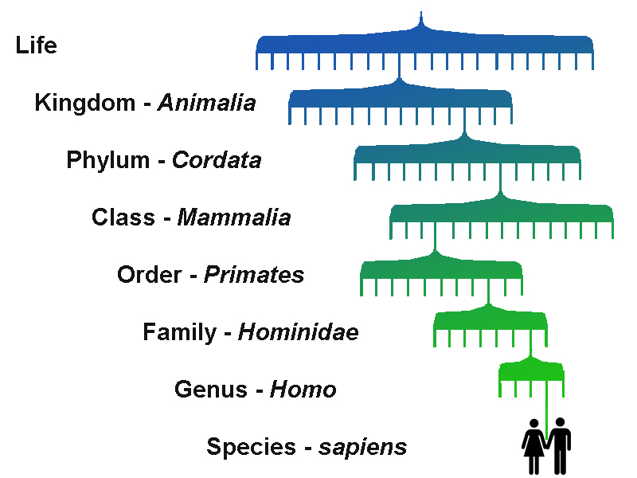
Science at St Andrew’s School
KEY STAGE 4

Slide 2
Key Stage 4 - Year 10
Students will work towards either:
The AQA Single Entry Level Certificate in Science which includes 3 units, one each of Physics, Chemistry and Biology.
Or the Double Entry Level Certificate in Science which includes 6 units:
two each of Physics, Chemistry and Biology.
For each unit, students have to complete a work pack, a practical and an end of unit written test.
Students who have successfully completed all 6 units needed to gain the Double Entry Level Certificate in Science will complete Pathway 1, AQA GCSE Single Science Biology in Year 11.

Slide 3
Key Stage 4 - Year 10
The Double AQA Entry Level Certificate in Science includes the following units:
Biology - Human Biology
Biology - Inheritance, Evolution + Environment
Chemistry - Materials from Earth
Chemistry - Oil, Earth + Atmosphere
Physics - Energy Transfer
Physics - Electricity + Waves

Slide 4
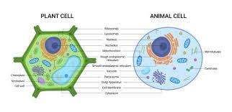
Key Stage 4, Year 11- Path 1
Topic 1 - Cell Biology
Cell structure and cell division in animal & plant cells and transport in cells.
Topic 2 - Organisation
Tissues, organs & organ systems.
Health & disease.
Enzymes & digestion and practical skills.
Topic 3 - Infection & Response
Communicable diseases- fungi, bacterial and viral.
Topic 4 - Bioenergetics
Photosynthesis & anaerobic & aerobic cellular respiration.
Practical skills

Slide 5
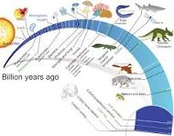
Key Stage 4, Year 11 - Path 1
Topic 5 - Homeostasis & Response
Nervous & hormonal systems
Mocks - Paper 1
Practical skills, working scientifically and Maths skills
Topic 6 - Inheritance Variation & Evolution
DNA & reproduction, Genetics, Evolution & classification
Topic 7 - Ecology
Organisms & their environment.
Impact of humans on the environment
Practical skills
Revision
Mocks - Paper 2

Slide 6
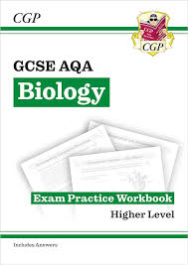
Key Stage 4, Year 11- Path 1
Relevant AQA Unit Award Scheme units are now woven into the AQA Single Science Biology GCSE curriculum as appropriate. This is to allow students to gain academic qualifications in the work covered and to show the progress they have achieved.

Slide 7
Key Stage 4, Year 11- Path 2
AQA Unit Award Scheme
The scheme enables students to go on an individually tailored framework of the Science curriculum.
The AQA units cover many levels, from pre-entry, to entry level and higher. They are a selection of individual certificates that enable students to cover Biology, Chemistry and Physics as well as cross curriculum areas such as ICT, English, Maths, Geography, Art and History.
The students have some personal choice in Science and are able to follow their interests, whilst gaining a well-rounded understanding and of its applications in the world we live.

