Slide 1
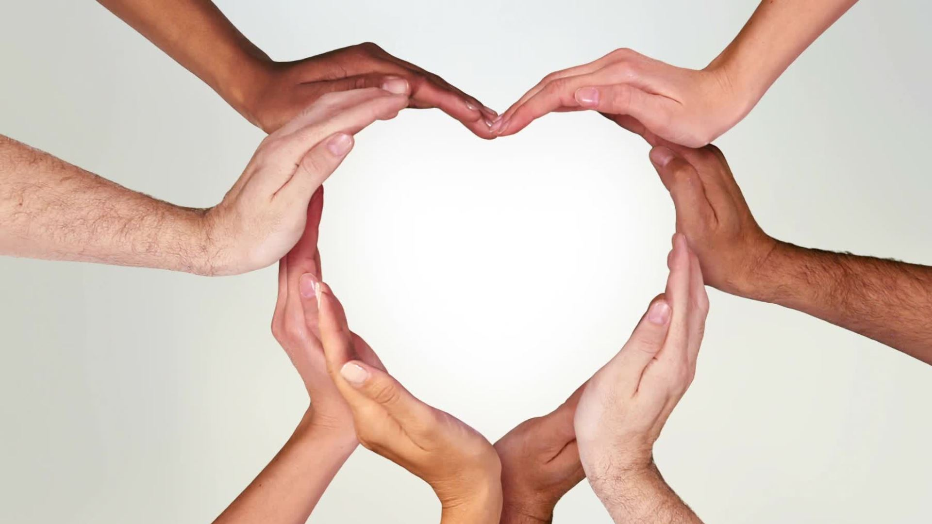
Loving God in all we do
St Anne's Catholic Primary School

Slide 2
Values:
Playing nicely
Being kind to others
Loving others
Comforting others
Sharing with friends
Trusting others
Being loyal
Helping my teacher and friends
Showing that I care and showing affection
Not being judgemental
Having consideration for others

Slide 3
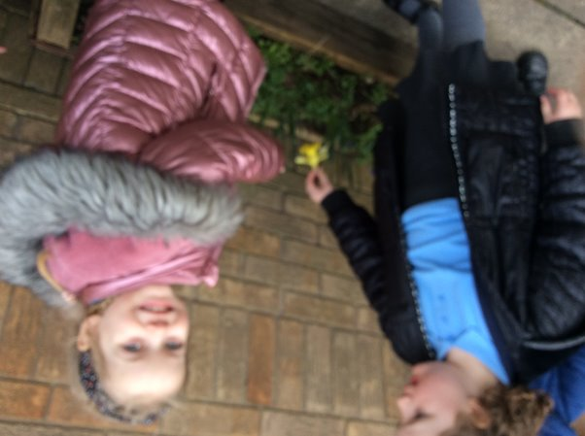
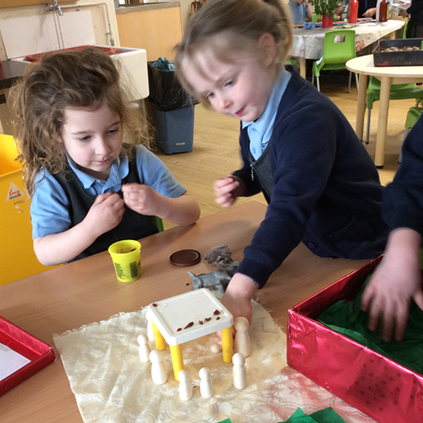
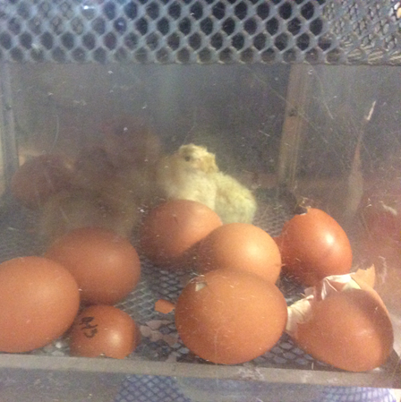
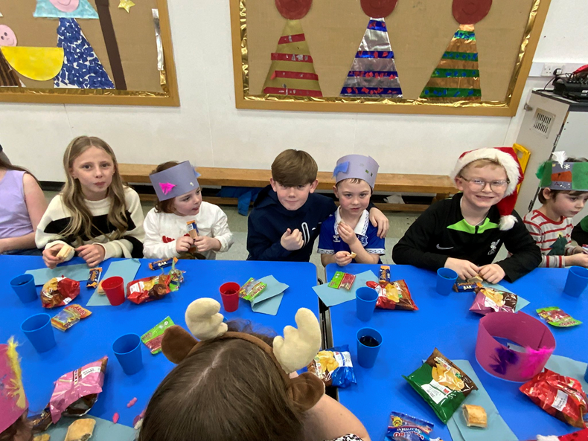
Reception
Loving others- Year 6 and Reception enjoyed a Christmas party whilst looking after each other.
Being loyal- Reception were very loyal to their chicks by taking care and looking after them
Sharing with my friends- some children shared the one playdough pot so they both had enough to play with
Showing that I care and showing affection – to our living things in our outdoor area

Slide 4
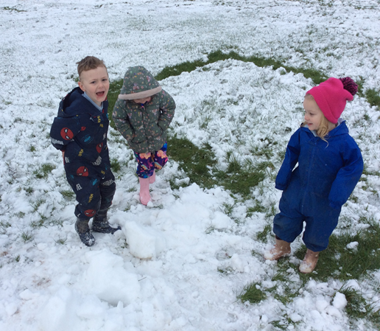
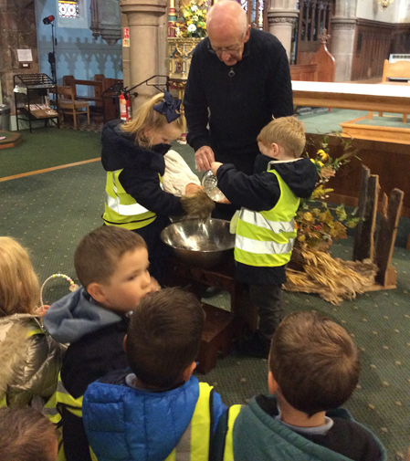
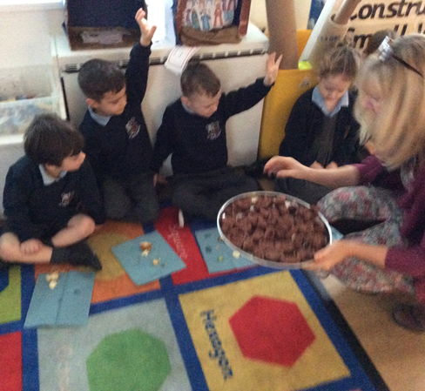
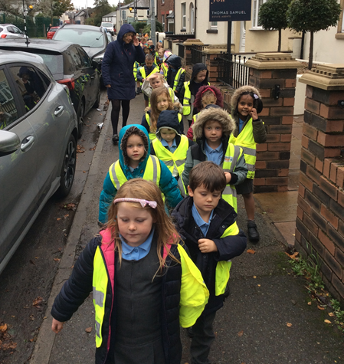
Reception
Playing nicely- in the snow with my friends
Having consideration for others- putting my hand up to wait my turn for snack
Trusting others- walking to church with our partners and helping each other cross the road
Not being judgemental-when we helped baptise the baby doll with Father Godric

Slide 5
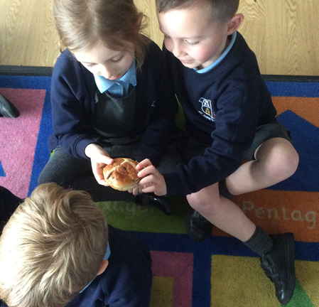
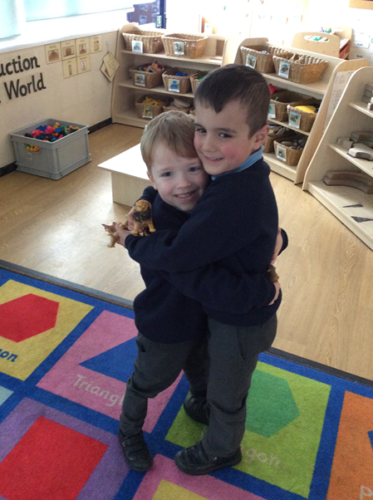
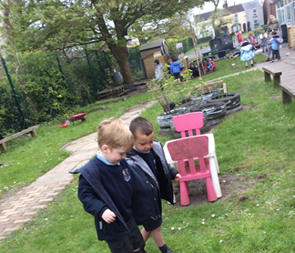
Reception
Being kind to others- sharing our snack with each other
Comforting others- giving my friend a hug when they are sad to cheer them up
Helping my teacher and friends- helping each other balance in our outdoor area

Slide 6
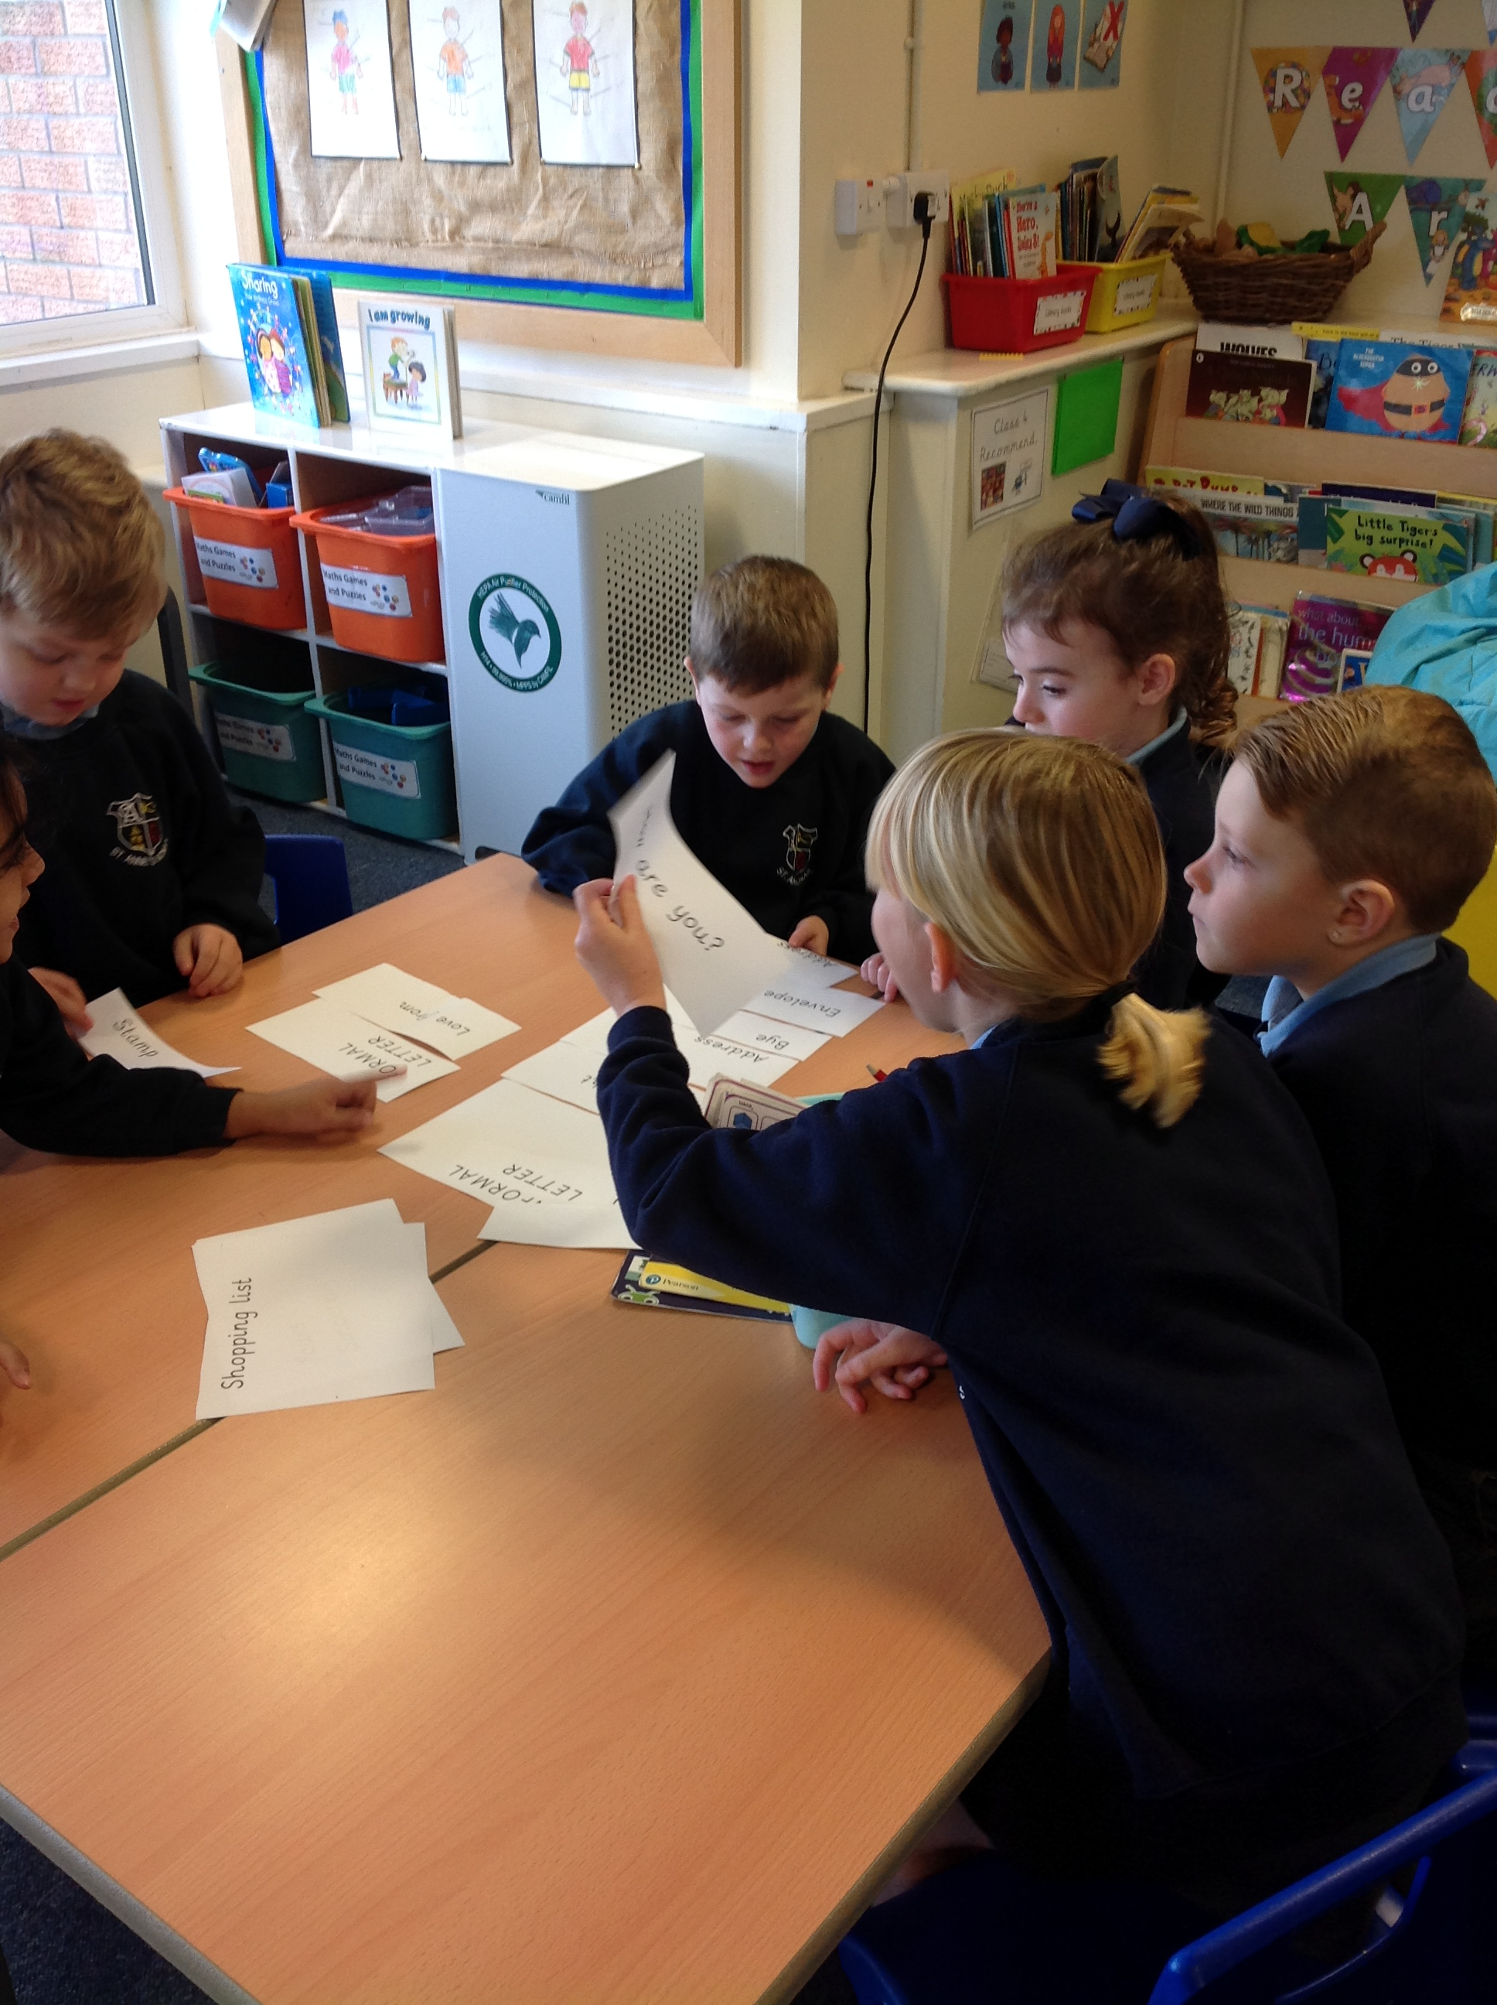
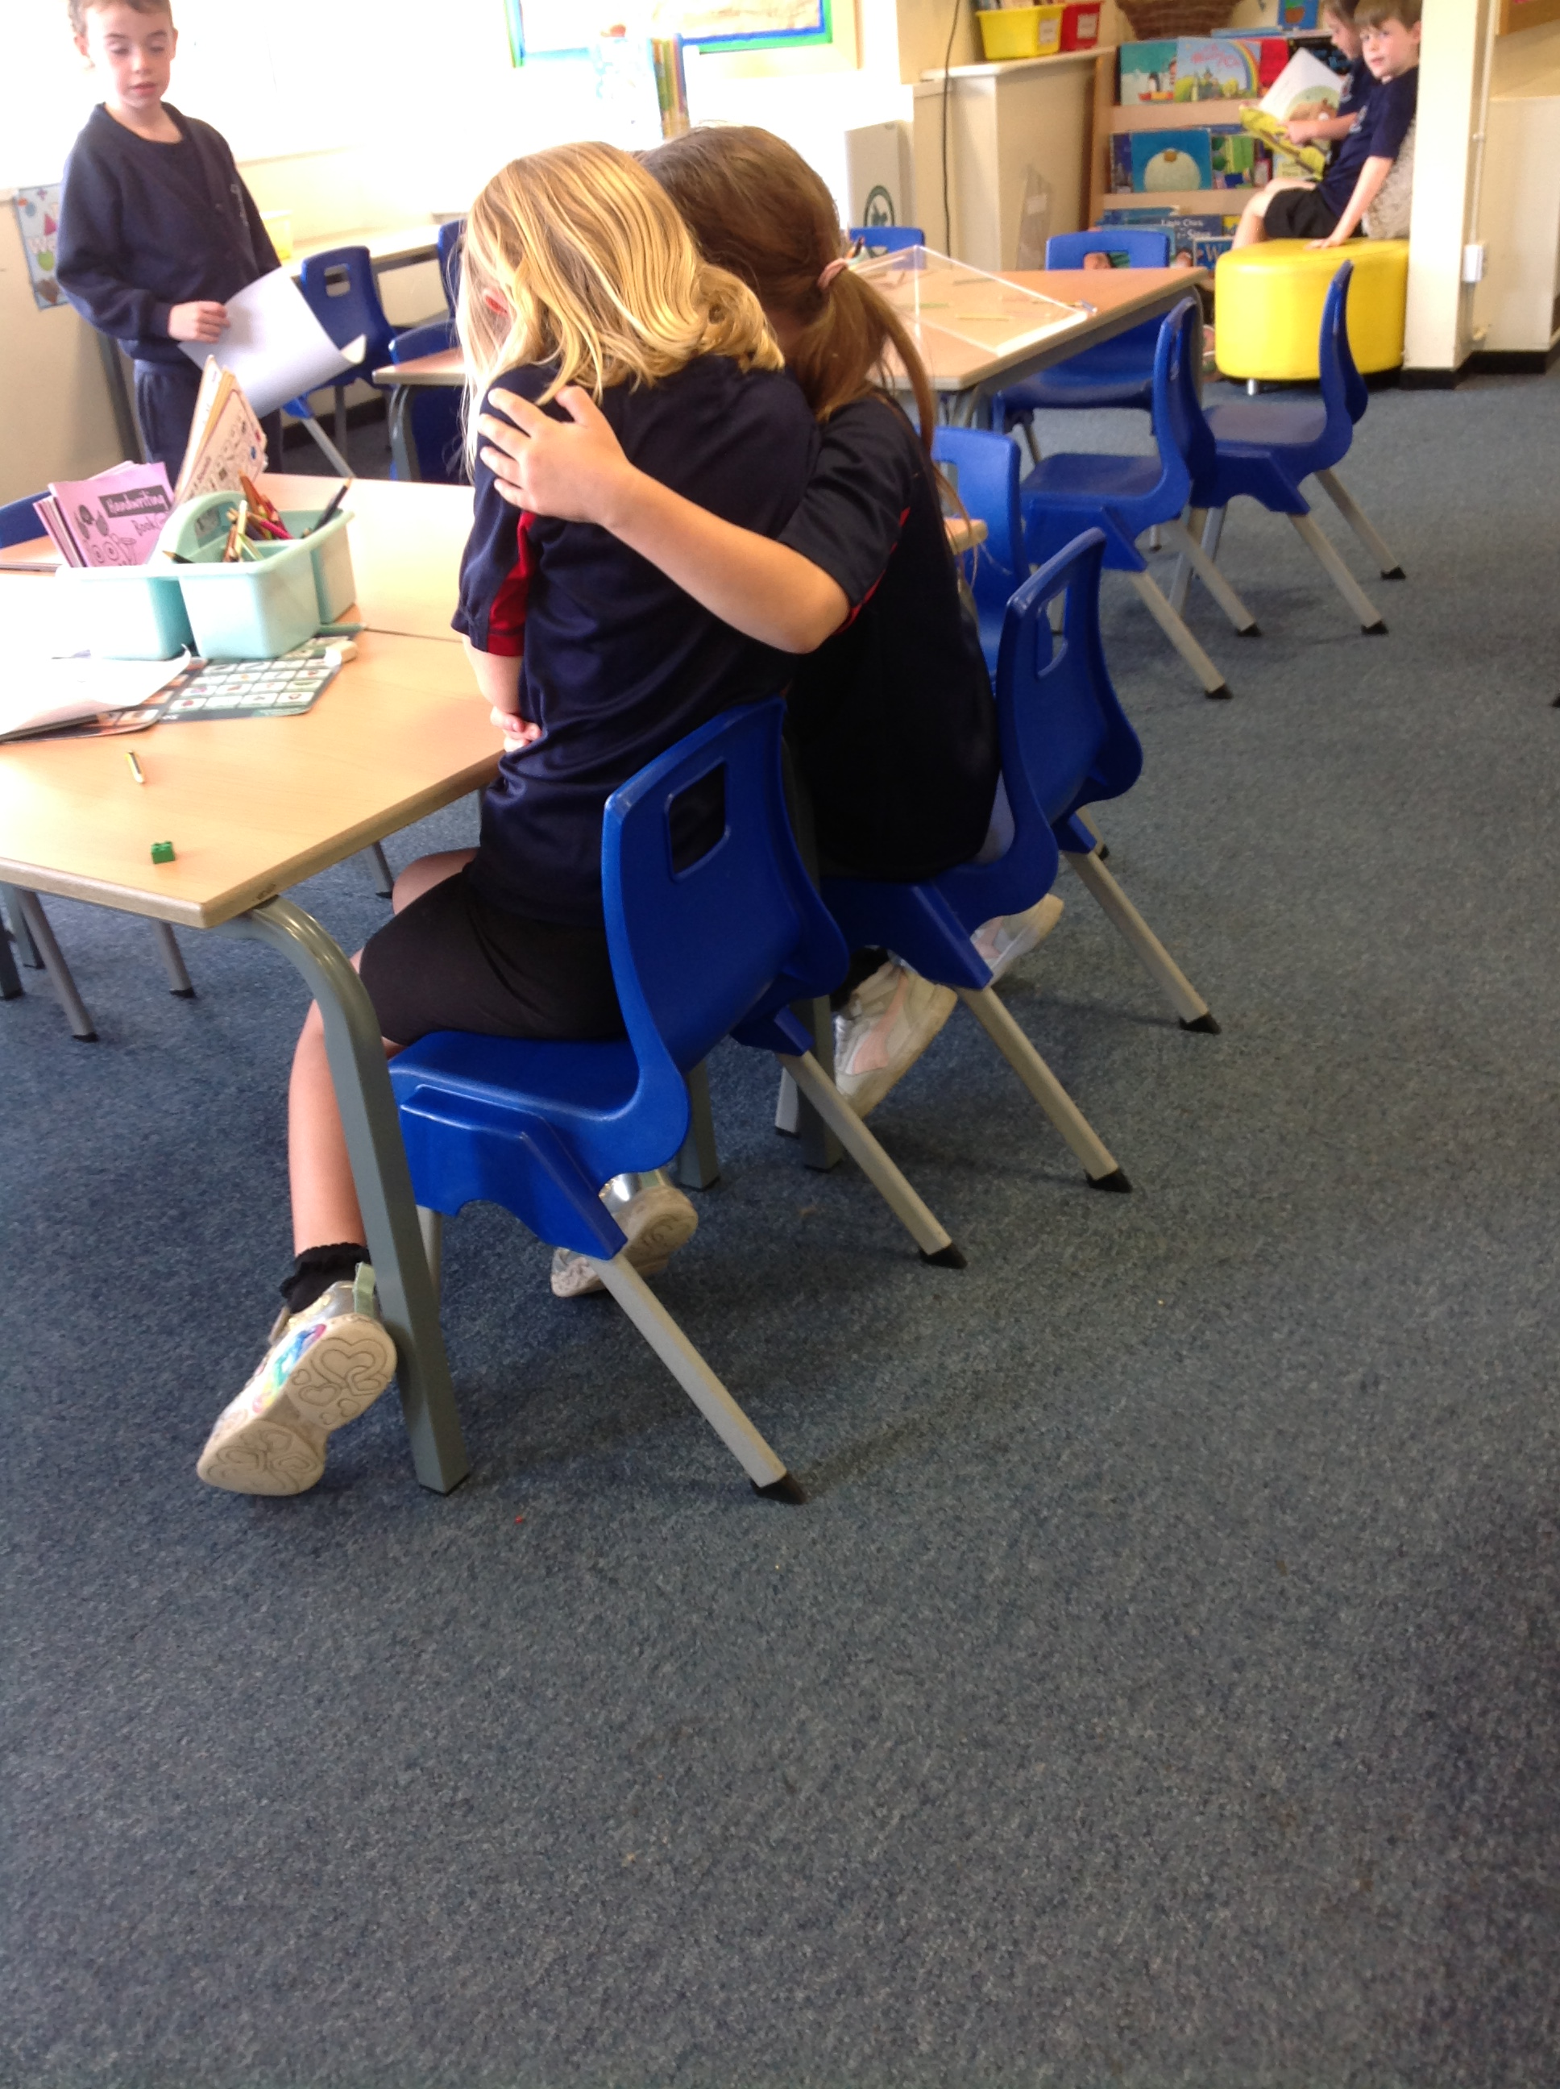
Year 1
Sharing
The children are working together as a team
and are sharing their answers together.
Comforting others
Giving my friends a hug when
they are sad or upset.

Slide 7
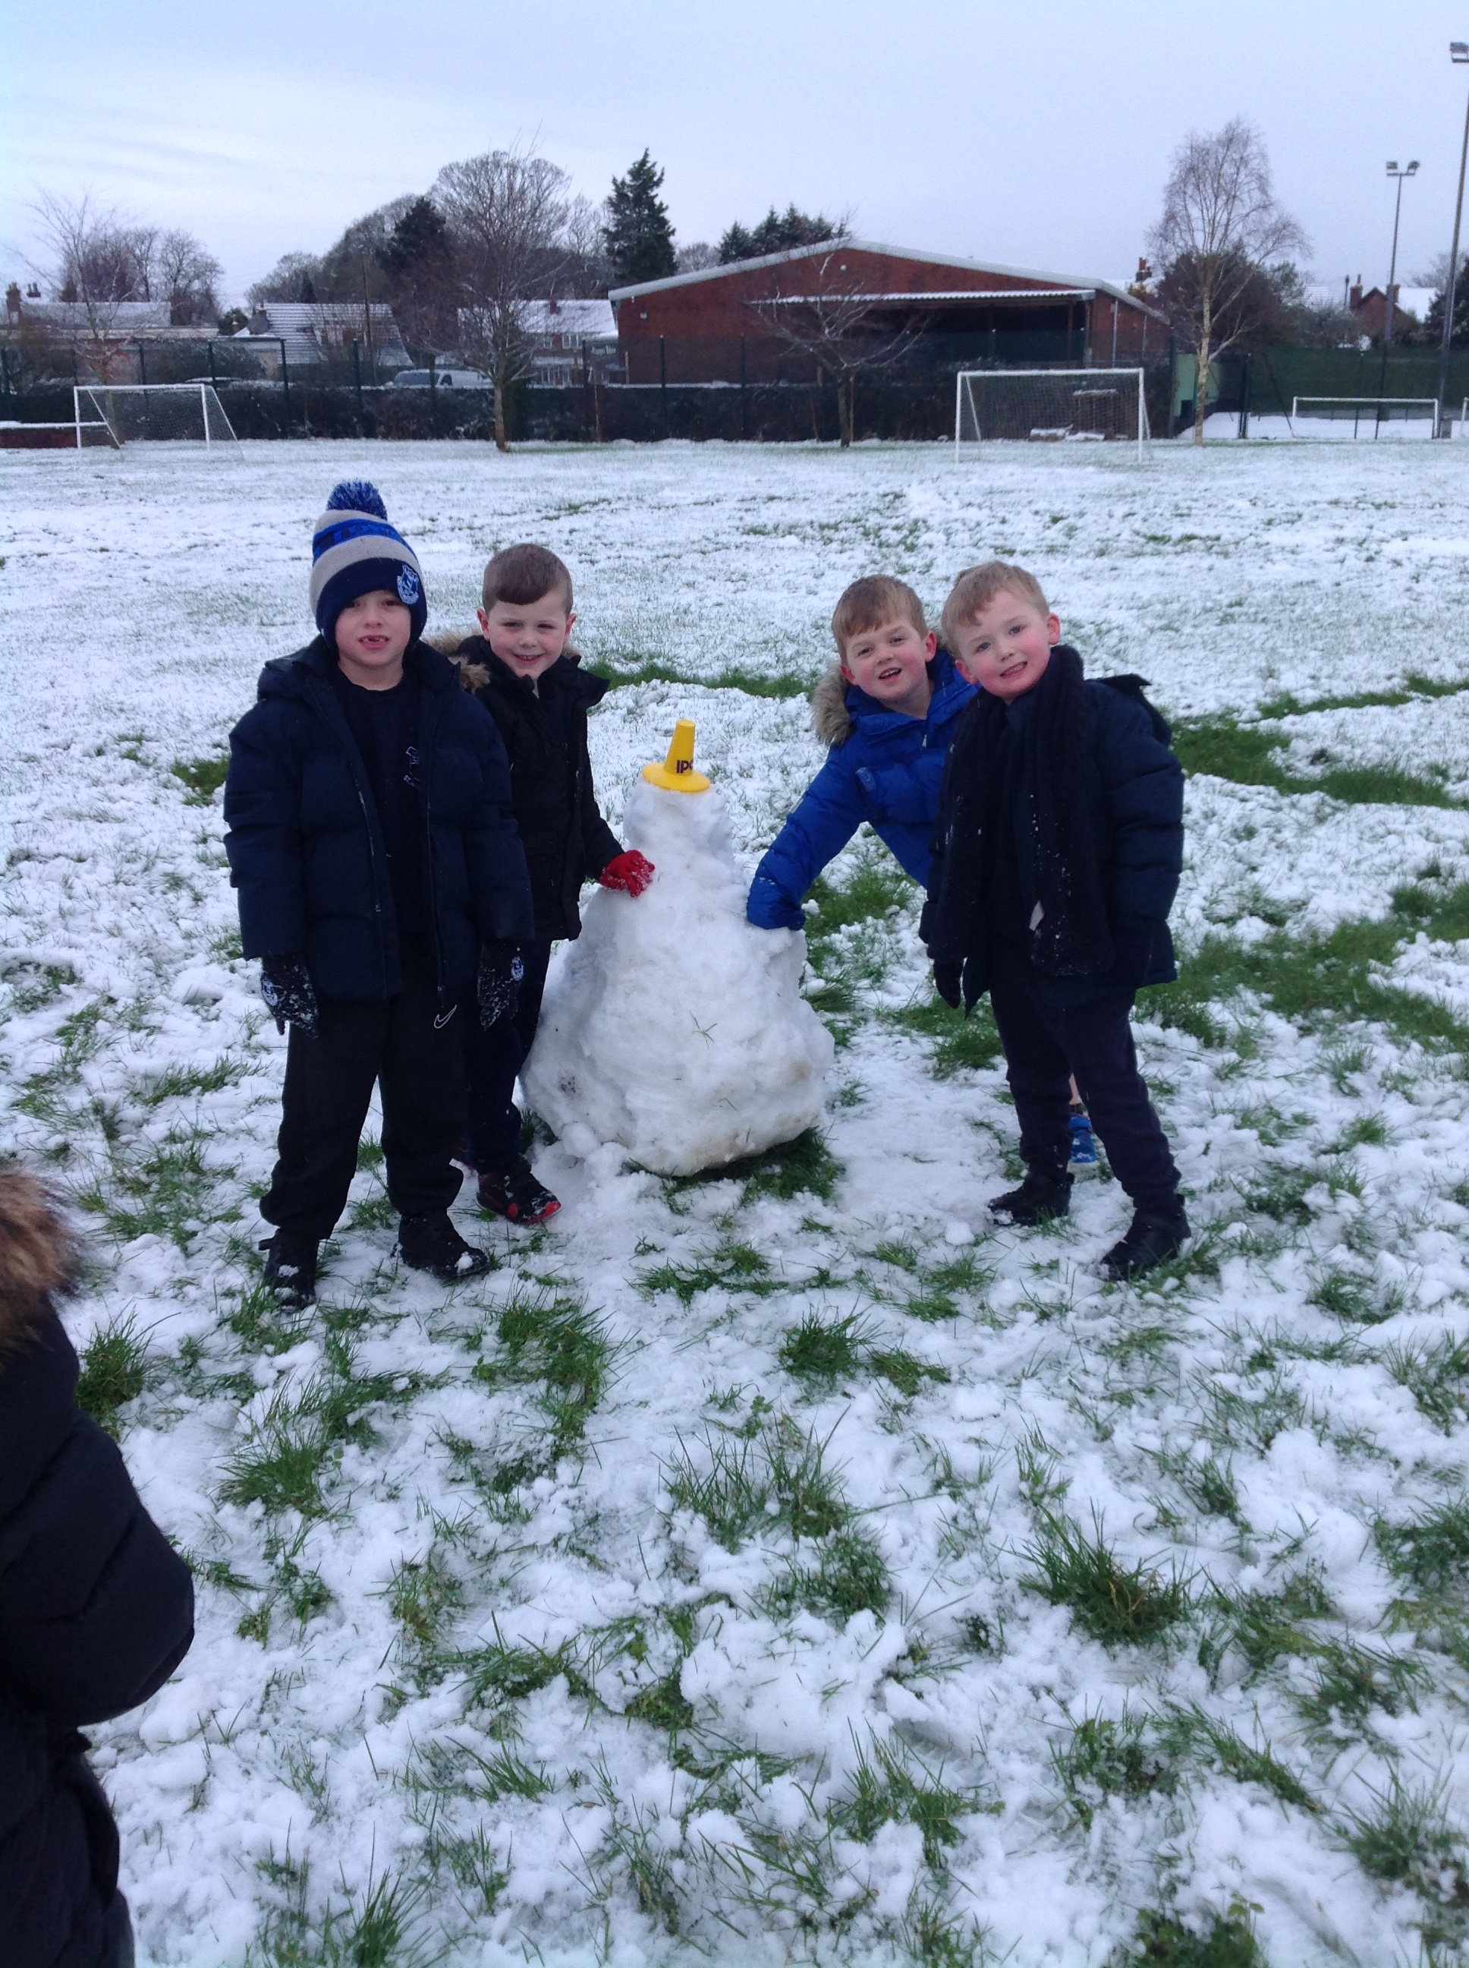
Year 1
Playing Nicely
Having fun during a snowy day and playing
nicely together by working together to
build a snowman.

Slide 8
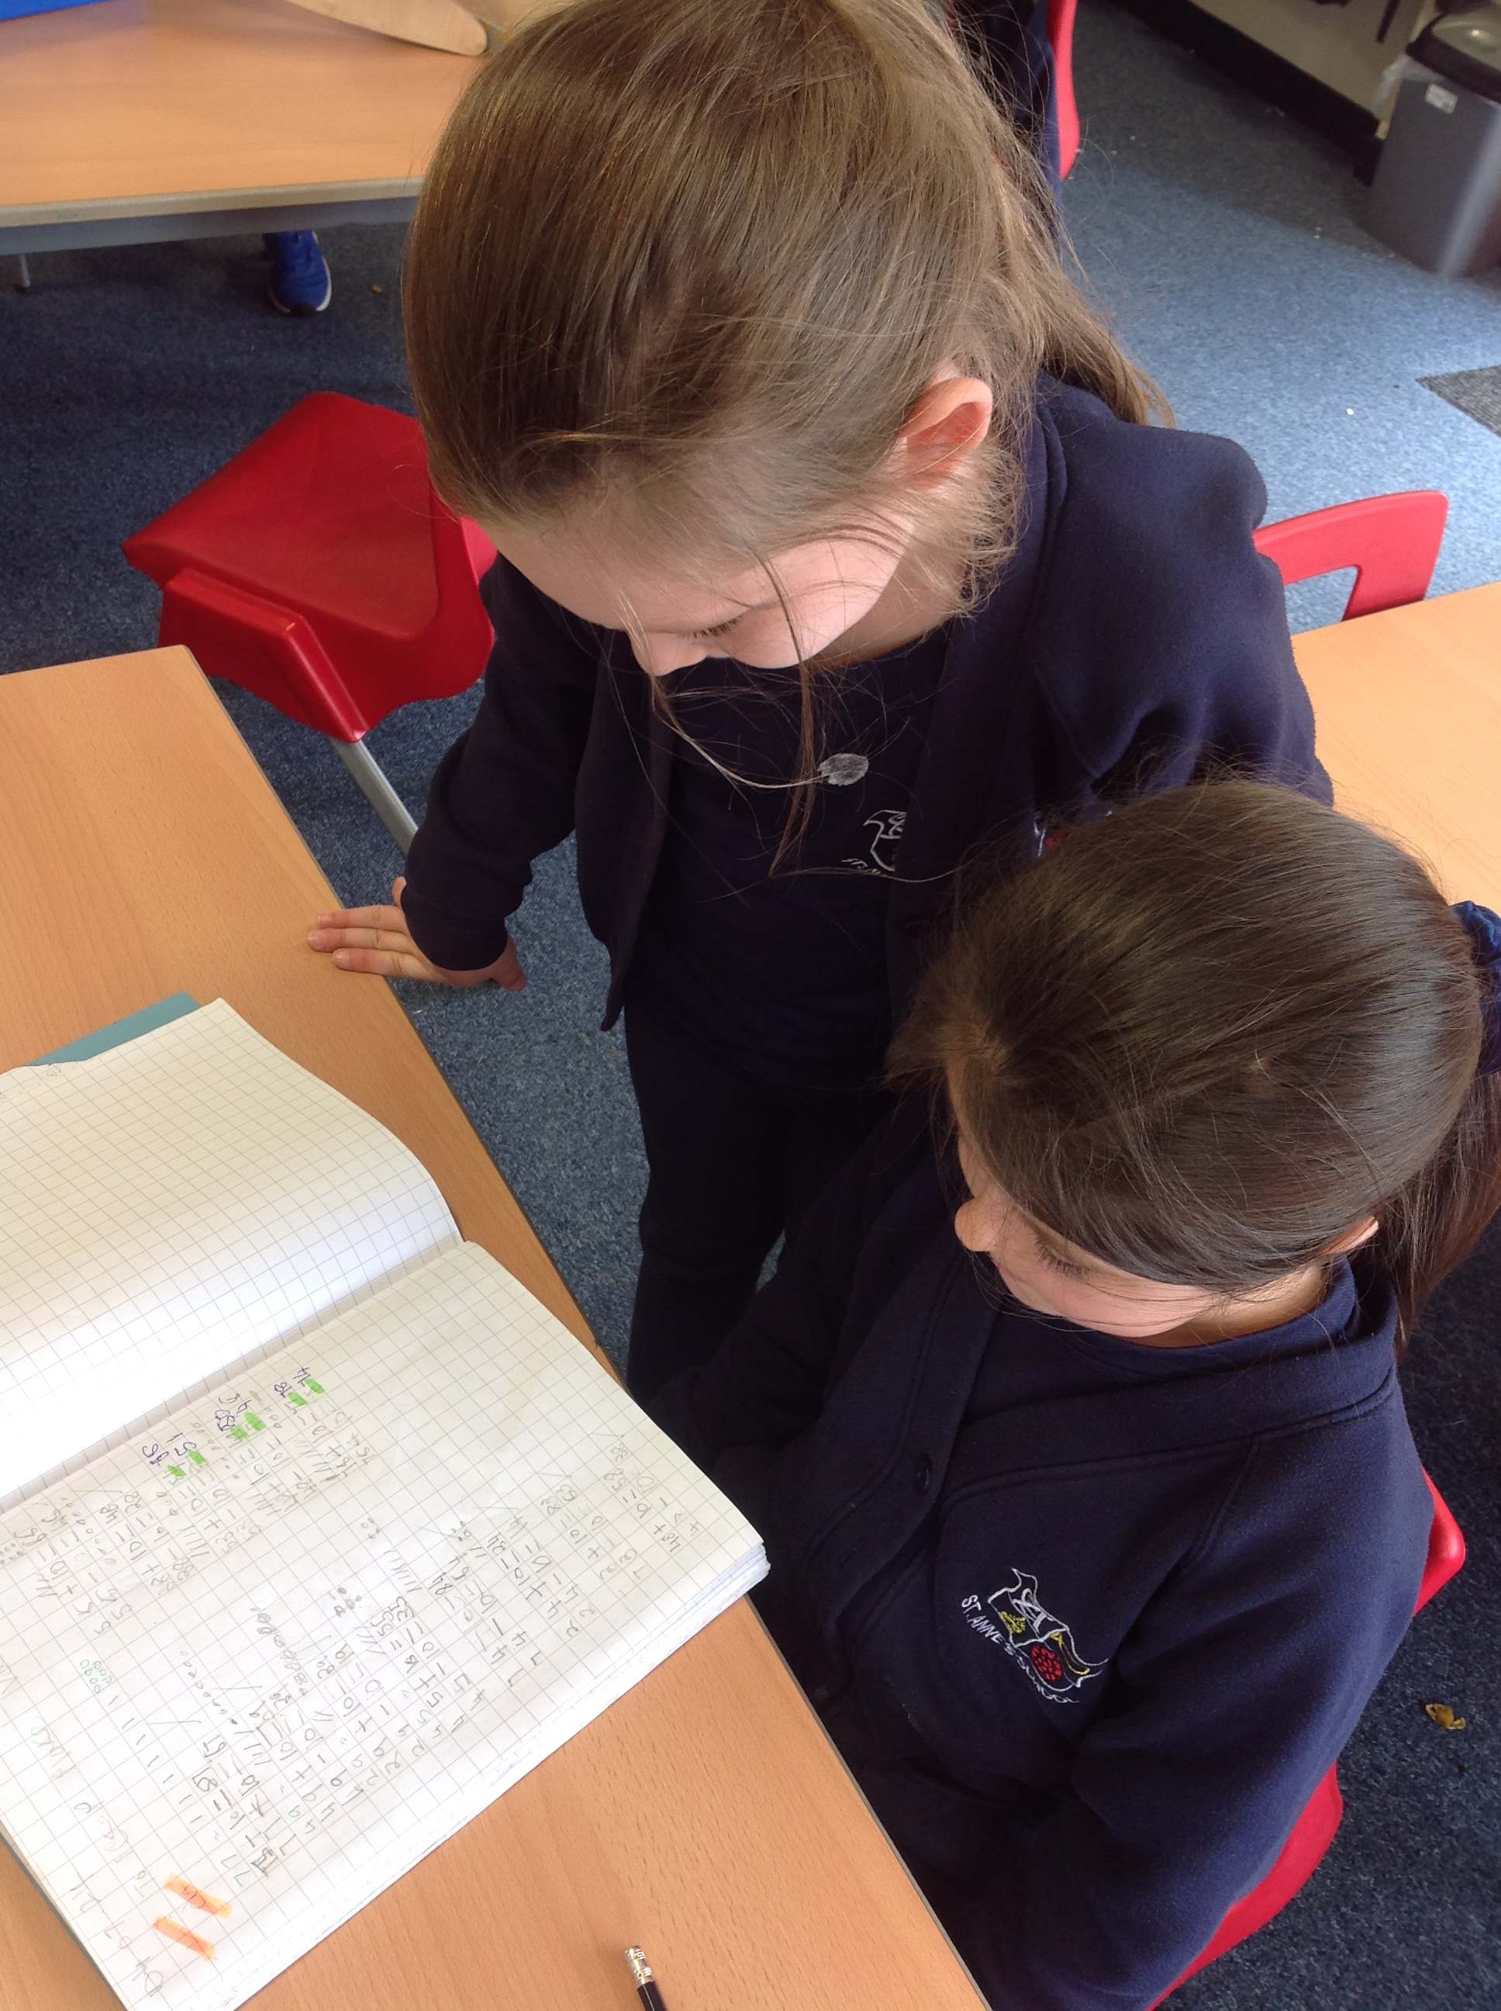
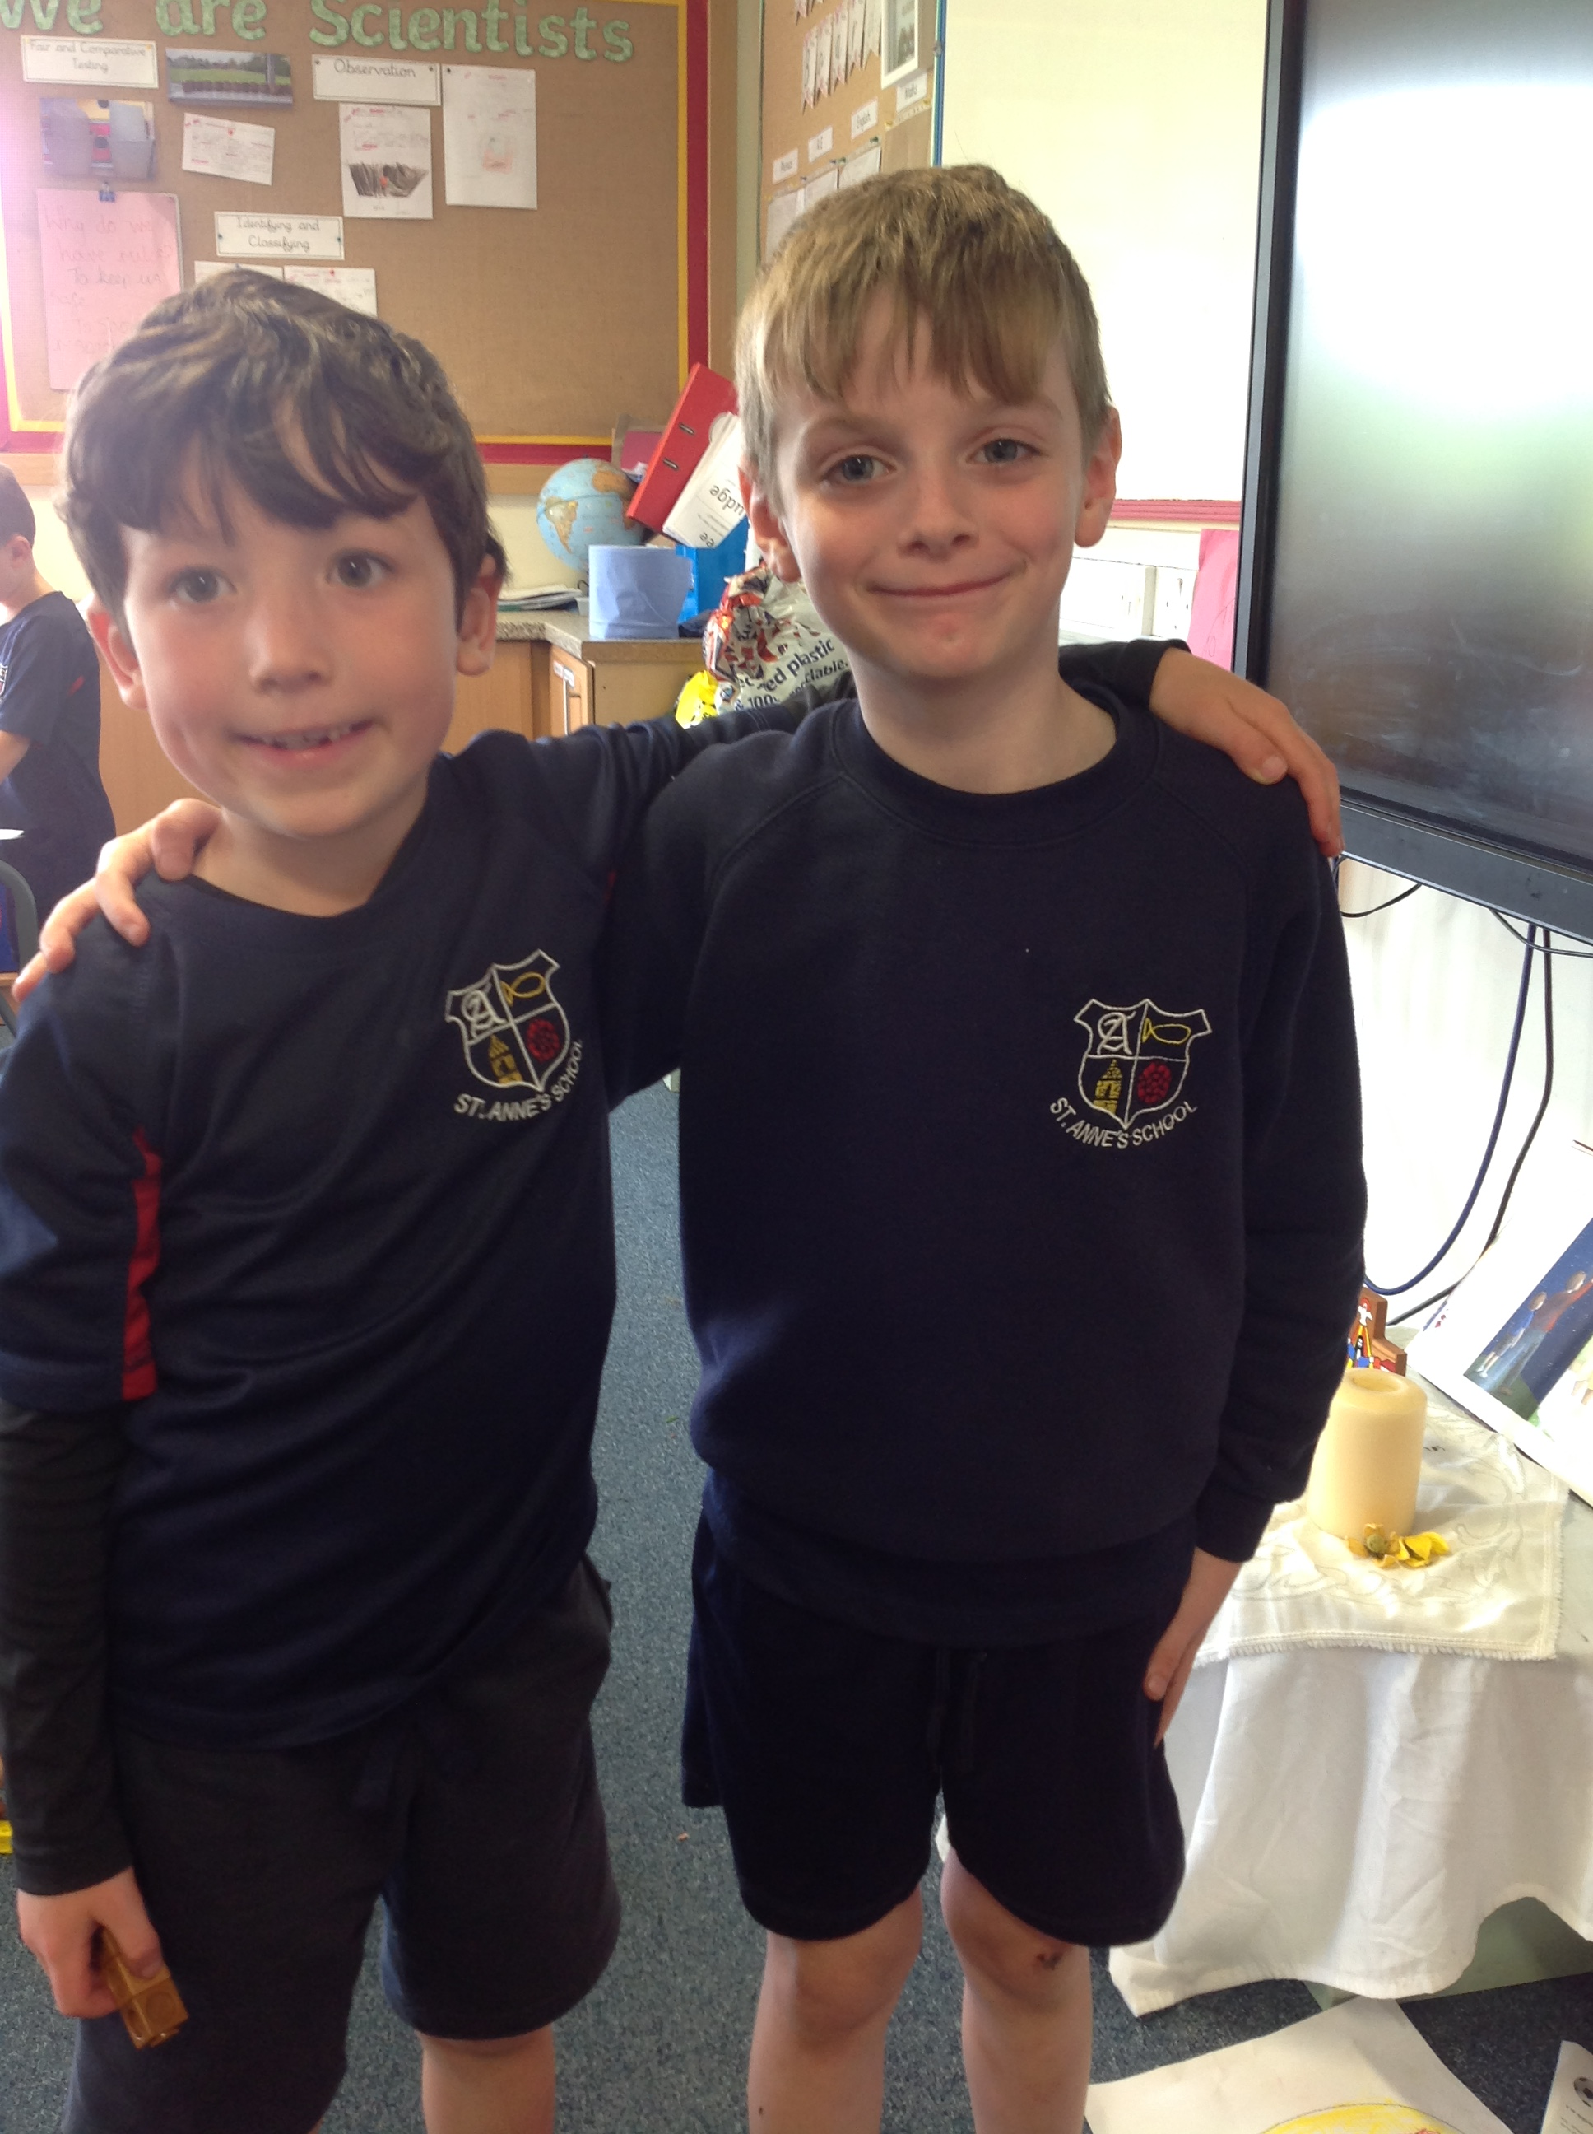
Year 2
Helping my teacher and Friends
This young lady offers to help other children with their work when she finishes her task early. She provides encouragement and support to everyone.
Showing affection
This young man always shoes affection to his friends and goes out of his way to cheer them up.

Slide 9
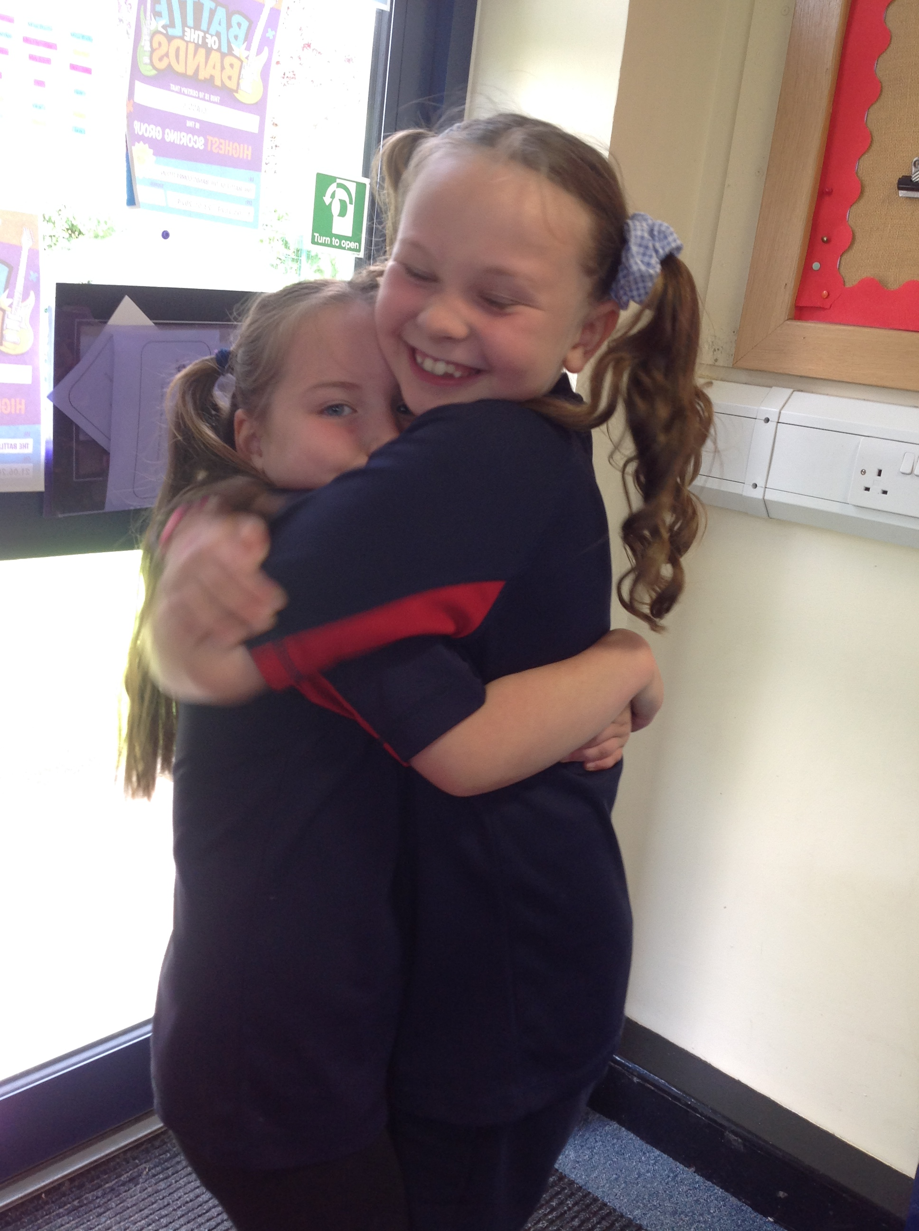
Year 2
Not being judgemental
This young lady always listens to her friends when they need help and she never shows any judgement.
Showing consideration
This young man always holds doors open for teachers.

Slide 10
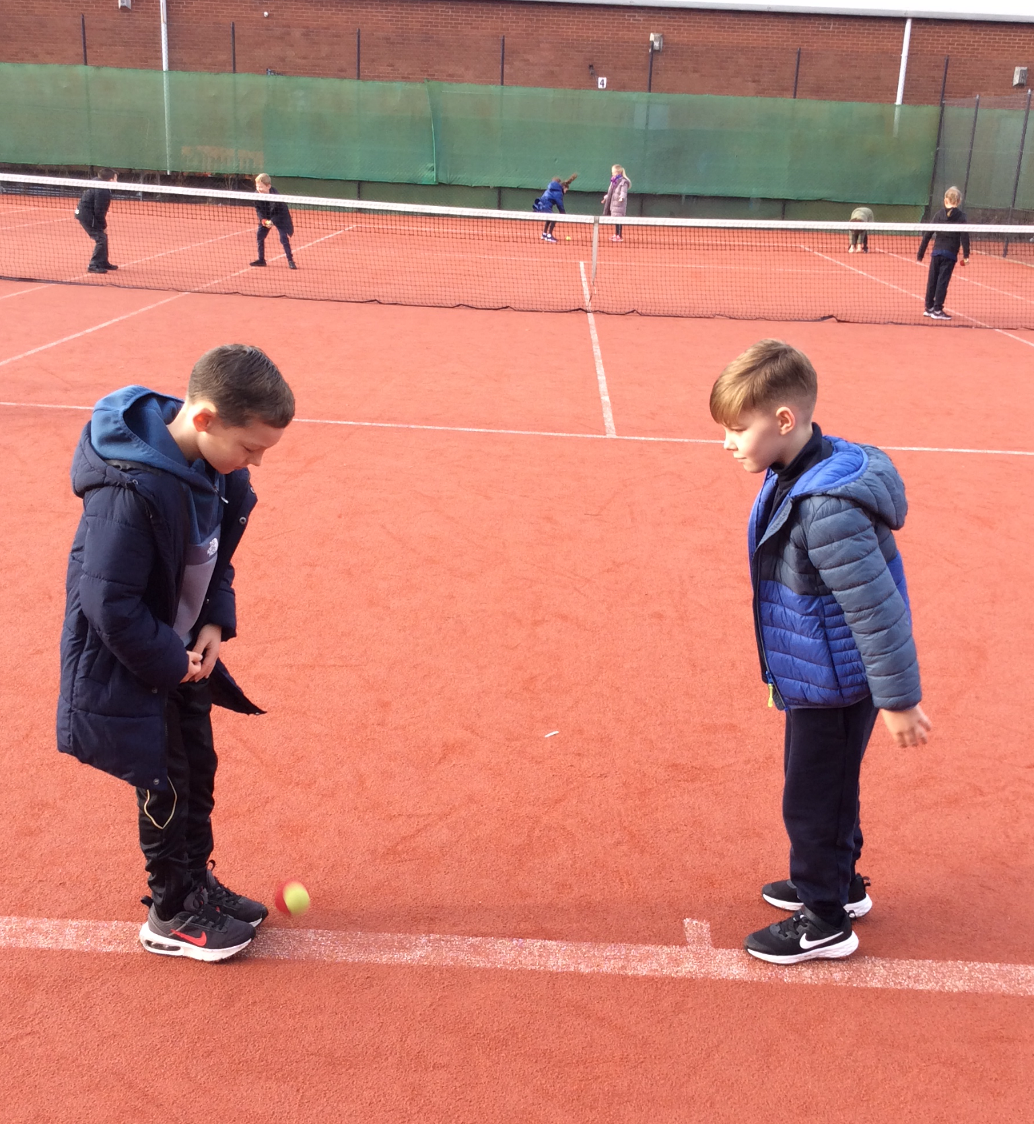
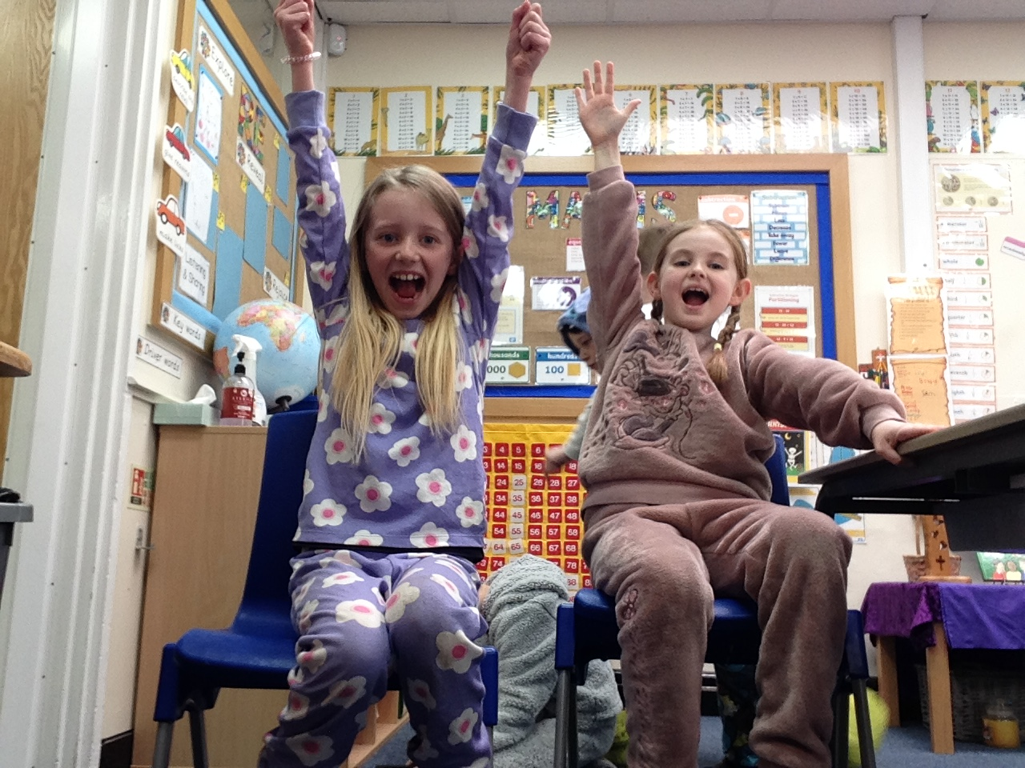
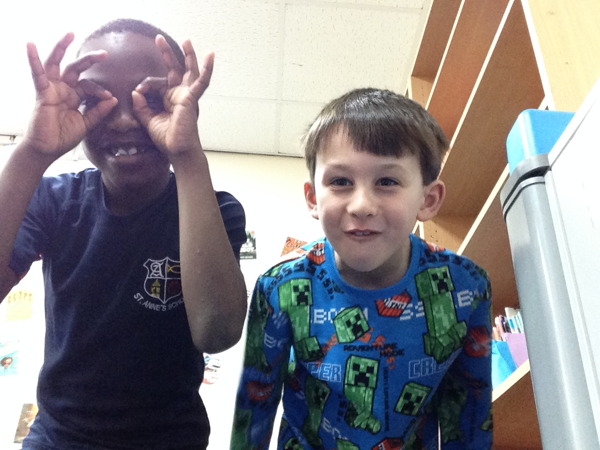
Year 3
Helping my friends-
In their tennis lessons, the children worked together to ensure they would both succeed.
Playing nicely-
The children worked with a partner taking photographs of each other to create a book trailer in computing.

Slide 11
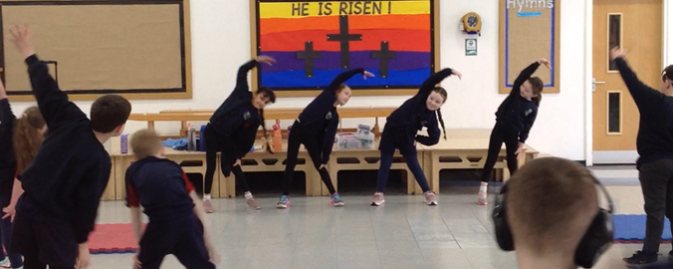
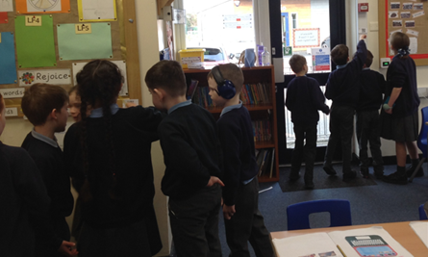
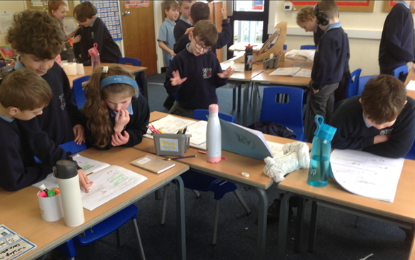
Year 3
Trusting others- The children trusted their friends to lead the warm-up for the PE lesson.
Sharing The children are sharing the clues to find the answers to questions.
Having consideration of others- The children read each other's stories and were considerate when discussing their story lines and ideas.

Slide 12
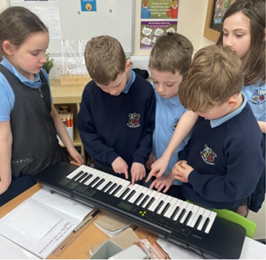
Year 4
Having consideration of others- In Year 4 we share and are considerate of others when learning to play the keyboards. We support each other and congratulate each other when we achieve

Slide 13
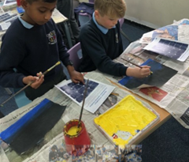
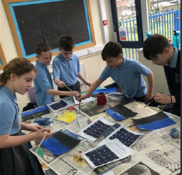
Year 5
Sharing-
The children are sharing paints in an art lesson for world book day. Working together, sharing and taking turns.

Slide 14
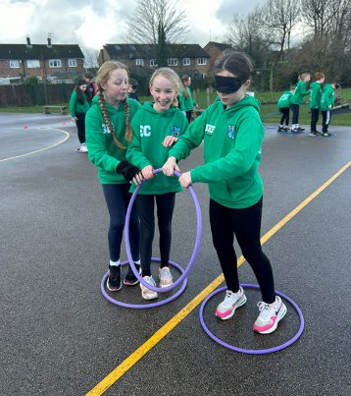
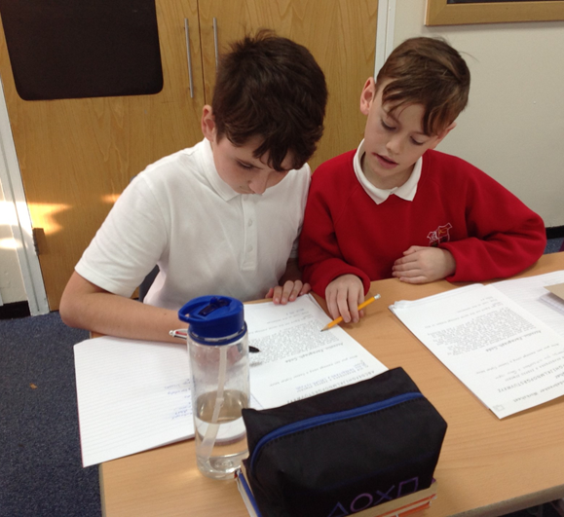
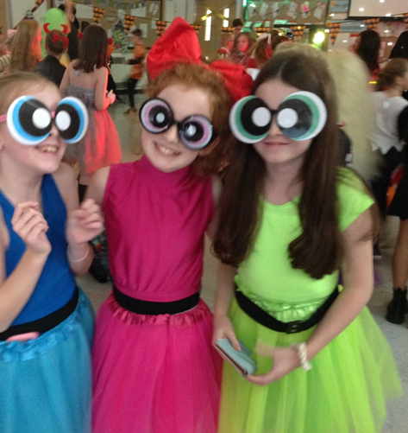
Year 6
Trusting Others- Pupils in Year 6 working together and showing great trust during an OAA PE lesson.
Playing Nicely- Year 6 having fun with friends at the Halloween disco.
Loving Others- Year 6 enjoying a Christmas party whilst looking after their buddies.
Helping My Friends- Pupils in Year 6 helping to edit each other’s work.

Slide 15
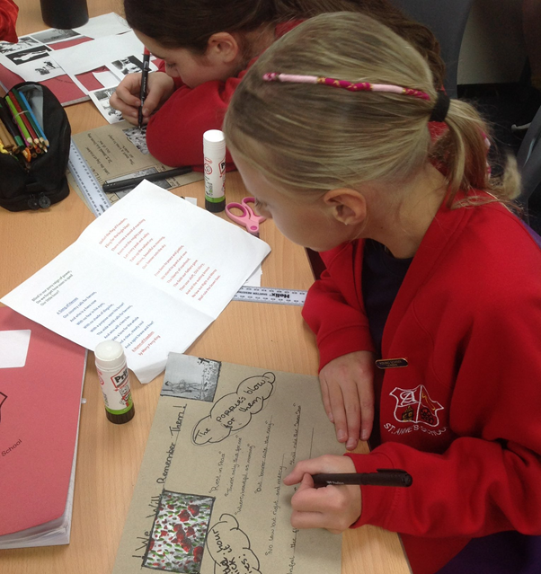
Year 6
Having consideration for others- During their war poetry English topic, the Year children showed consideration for those who fought and are still fighting for their country.

