Slide 1


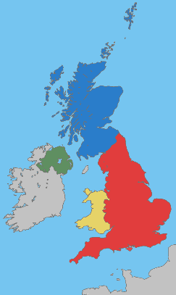
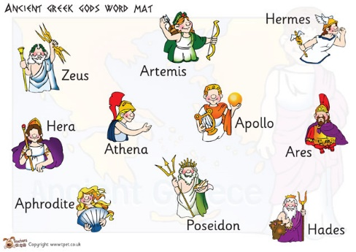

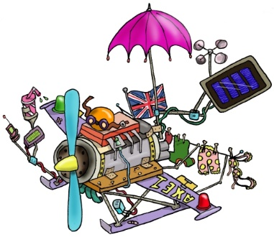
Welcome to Year 5
All information in this presentation will be on the school website in the Year 5 section.​
Class 11 – Mr Batchelor
Class 12 – Mr Knowles

Slide 2
Year 5 Team
Class 12 : Mr Knowles
Class 11: Mr Batchelor
Teaching Assistants – Mrs Tobin and Miss Martin

Slide 3
Prayer & Liturgy
Monday morning - whole school in KS2 hall followed by KS2 hymn practice.
Tuesday – Thursday Prayer and liturgy in class.
Wednesday KS1 Hymn practice.
Friday – KS2 Prayer and liturgy and awards in KS2 hall.
Year groups on a rota to attend Friday morning Mass.
‘Stay & Pray’ Friday 13th November at 3:10pm.

Slide 4
Autumn Key Dates for Church
Harvest Mass Monday 5th October 9:30am
Advent Mass Friday 4th December 9:30am
Year 5 Christmas Carol Service Wednesday 9th December 6:00pm
(children to arrive at 5:45 in Christmas jumpers.)

Slide 5
Homework
The children will receive English and Maths homework on Century every Friday (occasionally it will be linked to another area of the curriculum.)
The spelling and times tables homework will be sent via hard copy. It can be done on paper.
These pieces of homework are due back by the latest the following Friday.
Spellings will be given out on Friday to be returned on Friday, for a test but will be taught during spelling lessons during the week.

Slide 6
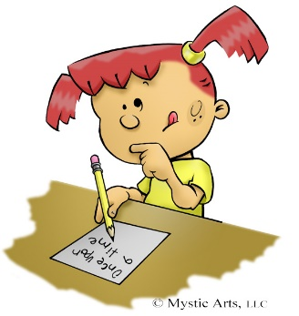

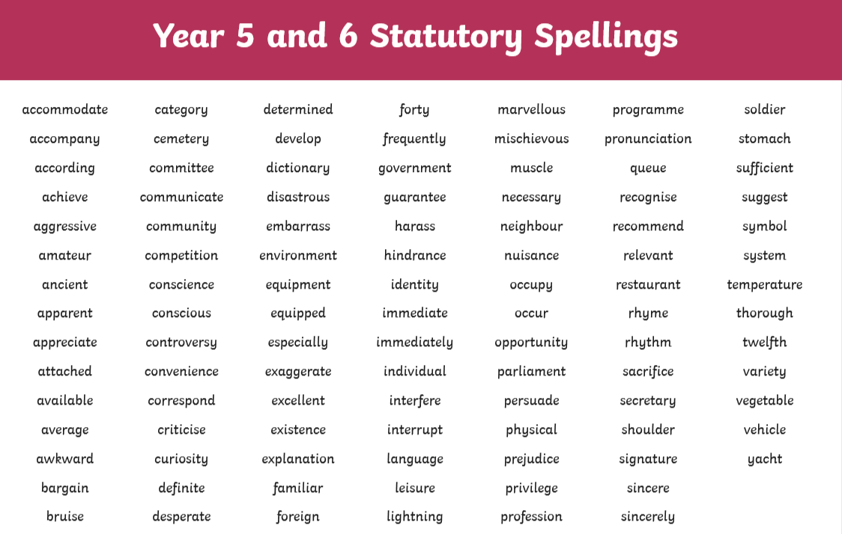
Spelling

Slide 7
PE
PE will change each term – in the Autumn Term the PE days are on a Tuesday and Wednesday for Class 12, Friday and Wednesday for Class 11.
Children need to come in their PE kits, with school jumpers and cardigans over their PE tops.
Either the school tracksuit bottoms or dark, plain coloured tracksuit bottoms or legging can be used for warmth.
Children with hair to their shoulders or longer should wear their hair back from their faces on PE days.
No jewellery please. If they must wear earrings, then studs and plasters need to go over them (provided from home).
Year 5 will go swimming in the Spring Term (after Christmas). They must have swimming caps.

Slide 8
Healthy Snacks
Breakfast/cereal Bar
Rice cakes
Fruit
Water

Slide 9
Medication
Please can all medication be in date and clearly labelled.
Written consent must be given to the office for staff to give a child medicine.
Any changes to medication please inform us.

Slide 10
Behaviour Expectations in Year 5
The children in class 11 and 12 are expected to:
be respectful of each other and all staff,
encourage and help one another,
ignore idle gossip,
do their best in lessons by staying on task,
set a good example to younger children,
be guided by what we learn from scripture,
make good choices.

Slide 11
Reading support at home.
Develop stamina for reading.
Read for understanding.
Scan for key words or phrases.
Complete the book.

Slide 12
Queries
If you have any questions or queries please get in touch with Mrs Bennett in the office and we can arrange a time to meet or a phone call to help.
We are so looking forward to the year ahead with the children!
Thank you.

