Slide 1

Welcome to our Year 6 Information Meeting
Wednesday 23rd September, 2026

Slide 2
Year 6 Team
Year 6 Team
Ms Cleary (Class 13)
Miss Greenwood (Class 14)
Mrs Noble (Class 13)
Miss Martin (PPA cover/HLTA)
Mrs Rogers (Teaching Assistant)

Slide 3
The Year 6 Learning Journey
SATs (1o^{th} – 14th May 2027)
Preparation for Year 7
Lifelong learning

Slide 4
The purpose of Year 6 is to prepare children for secondary school by building on, consolidating, using and applying their skills and knowledge from lower down in the school.
We aim to build self confidence and independence and help children to develop all their talents.
We will prepare the children for the end of KS2 assessments but this is not the most important aspect of Year 6.

Slide 5
We particularly want our children to have a positive attitude to learning, to learn from their mistakes and to develop resilience.
We encourage children to take pride in their work and achieve the highest possible individual standards.

Slide 6
Responsibilities in Year 6
Assemblies
Buddies
Assembly duty
Play Leaders (KS1)
House Captains/Vice House Captains
School Council
Library Monitors
Mission Ambassadors

Slide 7
Home Learning
Homework will be set using the online platform Century.
We expect regular spelling and times tables practice but we encourage the children to manage this themselves..
Daily reading should be encouraged.
Homework will be set on Fridays and is expected to be completed by Wednesday.
Homework should not be…
Stressful for the children or for you as parents!

Slide 8
How you as parents can support…
Talk about what your children are learning.
Question them ‘How do you know…?’
Support homework, BUT don’t do it for them.
Daily reading at home - ask questions about the text and characters.

Slide 9
Parents’ Evening
• The first parents’ evenings will take place on November 16th and 19th (there will be further communication nearer the time).

Slide 10
Prayer and Liturgy
As a Catholic School we come together twice a week for Prayer and Liturgy, focusing on the Gospel for the week and how we can live out God’s word
We have Prayer and Liturgy three times a week in class
Classes attend mass on a rota- we are attending on Friday 20th November
We attend whole school masses- Harvest Mass 5th Oct Advent Mass 4th Dec

Slide 11
P.E.
PE sessions are on Monday and Wednesday for this half term
Children attend in the PE kit and are welcome to wear tracksuit bottoms in the colder months
No jewellery
Please ensure earrings are removed or covered with tape on days children will be undertaking PE lessons.

Slide 12
Water bottles and snacks
We encourage the children to bring a water bottle in each day, and drink regularly throughout the day.
The children can bring a snack in for morning playtime. We ask that the snacks are healthy for example fruit or vegetables, yoghurt or cheese- NO NUTS
If your child develops any new allergies please ensure to inform school as soon as possible.

Slide 13
Medication
If your child is on a regular medication, such as an inhaler, school must be informed and a medical form filled out. This medication needs to stay in school at all times. It is the parents’ responsibility to check it is in date at all times.
If a child is prescribed medication by the doctor, this needs to be taken to the office and a medical form completed.
We are unable to administer any medications that are not prescribed by the doctor.

Slide 14
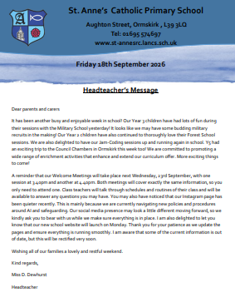
Keeping up to date
If you need to contact us please email via the office office@st-annesrc.lancs.sch.uk
Refer to the weekly newsletter to see what has been happening in school and also to keep up to date with new information

Slide 15
Secondary School Transition
Deadline date to apply by is 31st October
Faith forms
Visits to secondary schools.
Visits by staff from the secondary schools.
Additional visits in a small group if required.
Transition Day
PSHCE lessons on transition and secondary school.

Slide 16
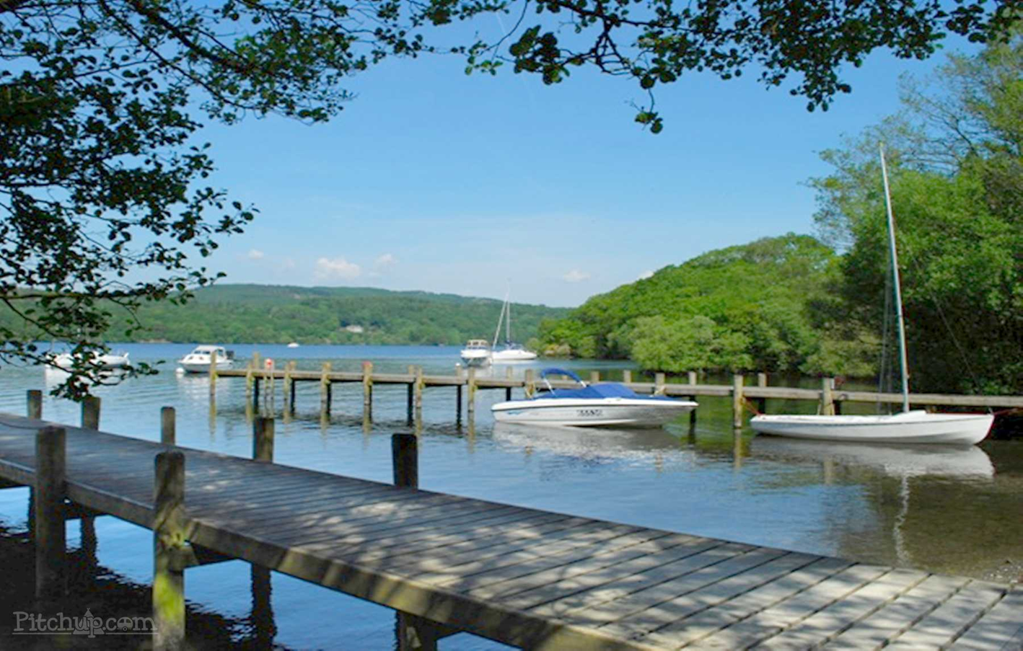
Tower Wood
26th – 28th May 2027

Slide 17


