Slide 1
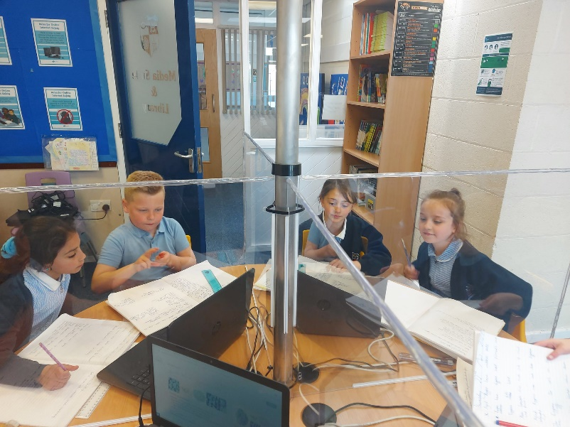
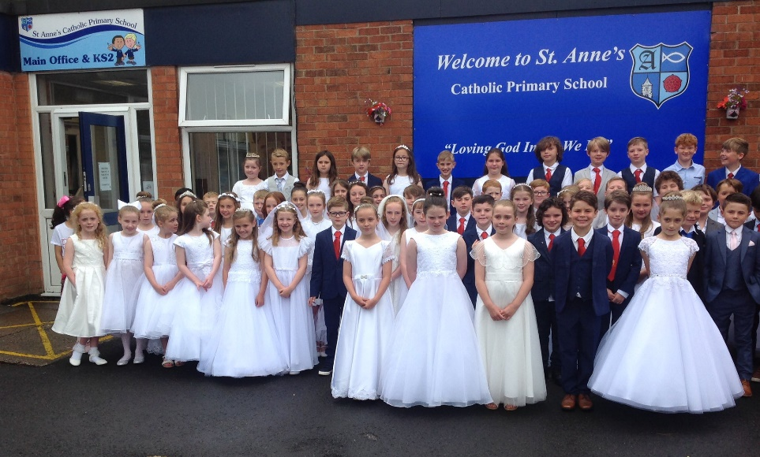
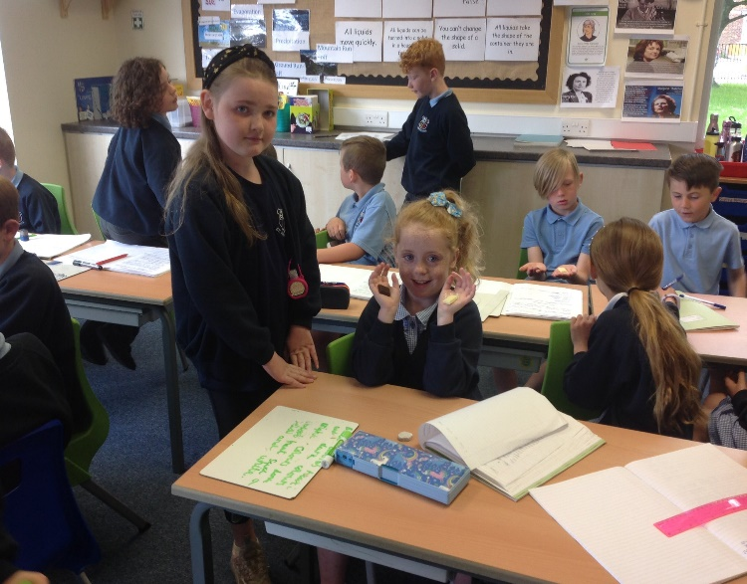
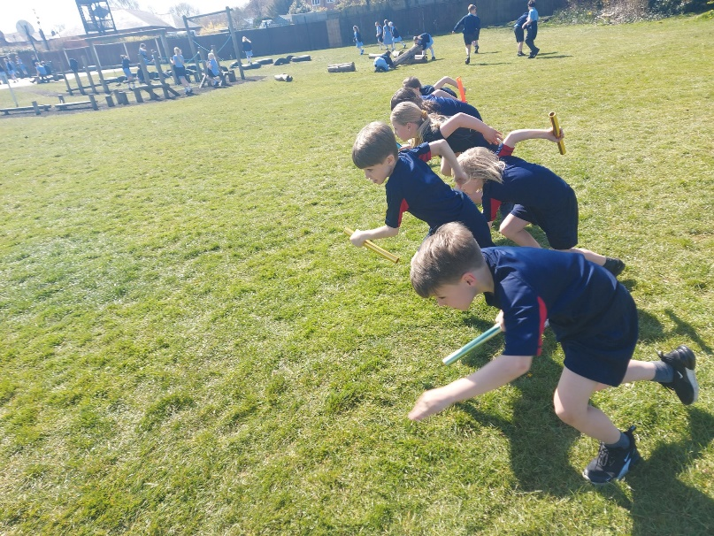
Welcome to Year 4

Slide 2
Year 4 Team
Mrs Brookfield. (Class 9)
Mr McCarten (Class 10)
Mr Birchall - HLTA (Reading and Maths intervention for both classes. PPA Thursday and Friday afternoons.)
Mrs Barton – SEND, Reading, GPS and Maths intervention.

Slide 3
Weekly Timetable
Every day, we will be focusing on Guided Reading, English, GPS and Maths.
Most afternoons are devoted to R.E., Science, and the wider curriculum, including History, Geography, Music, P.E., PSHE, RSHE, Art, Design Technology, and Computing.

Slide 4
Mr Birchall will teach French and Music to both classes​.
During the Autumn term, the children will participate in tennis sessions at Ormskirk Tennis Club and the children will go swimming on a Thursday afternoon (we will give you updates throughout the year).​

Slide 5
Please remember children can come into school wearing their PE kit on these days, but shouldn’t be wearing any jewellery as we don’t want it to get lost, damaged or cause an injury.

Slide 6
At break time, healthy snacks can be eaten, which should be either a piece of fruit, a protein snack or a dairy-based snack.
Medication should be brought in (clearly labelled and in date).

Slide 7
Prayer and Liturgy
Whole school – Monday
Class – Tuesday, Wednesday and Thursday.
KS2 – Friday.
Stay and Pray - Tuesday 24th November at 3:15 pm.

Slide 8
Reading
Reading is an integral part of the school day. The school has now adopted a whole-class guided reading session. There are three 30-minute sessions each week.
The skills that will be focused on are:
Vocabulary
Inference
Predict
Explain
Retrieve
Summarise
VIPERS for short.
.

Slide 9
Accelerated Reading:
The children take a baseline test called Star Reader.
They are given a variety of comprehension questions and as they take the test, the algorithm can identify the ability of the child’s reading.
This then gives them a reading level appropriate for their capability.

Slide 10
Accelerated Reading (Continued)
Once your child has a level, for example, 2.2 -3.2. They can read any book within that level. If they bring one in from home, we can check it.
When the book is read and finished, your child can then take an online quiz in school or at home to see how much they have understood the content of the book.

Slide 11
Accelerated Reading (Continued)
They should be getting a minimum of 80% of the questions correct in order to show progress. If they get, for example, 5 out of 10, this means they are falling behind their target and either they haven’t read the book properly or they haven’t understood the content (comprehension).

Slide 12

Accelerated Reading (Continued)
Your child will then be advised on a book to choose next based on their previous test’s results.
If your child has chosen a lengthy book, then we would expect it to be read within a 2 to 2$\frac{1}{2}$ week window. We ask you to help monitor their reading at home.
We will closely monitor your child’s progress and contact you if we have any concerns.
At the end of every half term, certificates will be given out if your child has achieved their target.

Slide 13
Your child can complete the quizzes in school or at home.
We will send you the URL for the website. It is called Renaissance.
Your child will log in using the first letter of their first name and the first four letters of their surname. (All lowercase)
For example: Rachel Brookfield
Username: rbroo
Password: abc

Slide 14
Homework
Every Friday, Maths or English homework will be given out via email and will be due on the following Wednesday.
This work will be based on what your child has been learning in class that week and they should be able to complete it independently.
The online platform for the homework is called Century. We will set at least 2 nuggets per week but the children can go onto their pathway at any time and complete learning that they need to be pushed on or focus on.
The box is titled Focus and Stretch. If your child doesn’t have any data in this box, it means they haven’t been on the platform enough times. Please encourage them to go on.

Slide 15
Times Tables Test
During the Summer term, the children will take part in a statutory times tables test known as MTC – Multiplication Times Table Check.
The government have decided that all Year 4 children are to know all the multiplication facts from 2 to 12.
This test is online and gives each child 6 seconds to answer each fact. In the test, there are 25 facts.

Slide 16
Times Table Rock Stars
This scheme really helps the children with their timing of the facts.
The children will be set a variety of games to play to enhance their skills.
This will be set on a Thursday night and due the following Wednesday. The amount set is around 30 minutes per week. We encourage the children to log in for 5 minutes per night and then they will complete the homework steadily rather than a mad dash on the night before it is due.

Slide 17
If for any reason your child can not complete their homework, then you must contact the class teacher to tell us the circumstances.

Slide 18
Spellings
The spelling scheme that St Anne’s follows is NNS (No Nonsense Spelling), which teaches and reminds the children of spelling rules.
The children will be tested every two weeks at school.
The children will also learn the Year 3/4 statutory spellings (5 individually assessed spellings) each week.

Slide 19
Handwriting and Presentation
The children will use either a pen or a pencil when working. All children must use a pencil for Maths, drawing and sketches.
Our policies for school insist on neat, cursive handwriting. We will have a focused practise in class on a weekly basis. If your child needs extra help, then further tasks will be sent home.

Slide 20
Sacrament of Reconciliation
This usually takes place in April./May before the Sacrament of Holy Communion.

Slide 21
Sacrament of Holy Communion
Potential dates
Saturday 19th June – Class 9
Saturday 26th June – Class 10
We are awaiting confirmation from Father Godric.

Slide 22
With You Always Programme
As part of your child’s faith journey, the church expects them to attend lessons that are dedicated to guiding their understanding of the importance of receiving this sacrament.
Therefore, after Christmas, there will be 7 weeks allocated to implement this sacramental programme.
Due to curriculum time constraints and the Archdiocese’s views of education, the sessions will take place after school from 3:30- 4:30 pm.
If you wish for your child to make their First Holy Communion as part of their class, then attendance at all of these sessions are mandatory.
The option for making the sacrament is only allowed for baptised Catholics.
Please send in your child’s Baptism certificate so we can send it to St Anne’s Church.

Slide 23
Awful Egyptians
Thursday 15th October.
Afternoon performance at Blackpool Grand Theatre
Children will be back at school at approximately 4:30 pm.

Slide 24
Young Voices 2027
Thursday 28th January 2027
As the children are going to the wonderful 'Young Voices' concert at the end of January, they will need to practise the songs and dances to be ready to perform.
The concert is on Thursday 28th January 2027. The children will come to school at the usual time. Lunch will be at the earlier time of 11:15 am
The children will leave school at 11:45 am so they can rehearse in the afternoon with all the other children ready for the finale!
This usually starts at 7 pm and lasts for around 2 hours. The children will arrive back at school on the coach at around 10:15 pm.

Slide 25
In order for you and your child to access the website, your child's name needs to be entered by you. If you do not register your child's name, then your child cannot access the website and you can not access your account.
The Music Room will be used to learn the songs and dances at home. In addition to this, we will provide sessions after school from November to the end of January for those children who want to sing and dance with their friends.

Slide 26
This will start on Thursday 4th November, from 3:30 – 4:30 pm in Class 9.
Please see the email sent for all the other information.

Slide 27
It is extremely important for the staff , parents and pupils to build up a partnership in September. Our weekly award winners will be shared on the school X page.
We will also provide half termly Knowledge 0rganisers via our school website (http://www.st-annesrc.lancs.sch.uk/) and emails for important reminders will continue to be sent home.
Please read the newsletter each week for updates and reminders.
If you have any questions, please contact us through the school office. We really care greatly about your child and appreciate your continued support.

