Slide 1
Phonics Workshop

Slide 2
What is Phonics?
Phonics is when we match sounds (phonemes) of spoken English to the way we write them (graphemes).
A sound can be written as an individual letter or a group of letters.

Slide 3
What is Phonics?

Slide 4
Our Scheme
Bug Club is our core reading program to help you develop confident and motivated readers.
GOV validated
Teaches fluency in reading by segmenting and blending
Progressive
Links to Guided Reading
Supports letter formation

Slide 5
Segmenting and Blending
c a t
Segmenting – saying each individual phoneme.
Blending – saying the whole word.

Slide 8
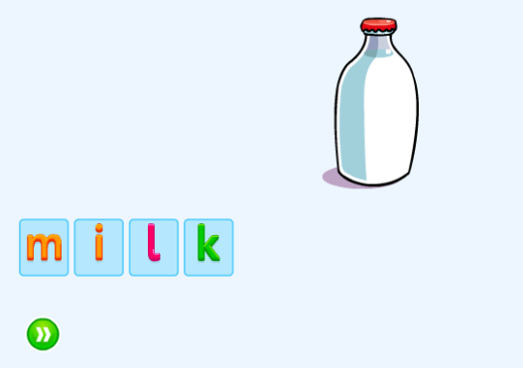
Phase 4
Adjacent consonants
Teaches how to blend consonants
and vowels together.

Slide 10
Pure Sounds
'Pure sounds' refers to the way of sounding phonemes without adding an extra 'uh', known as a schwa, at the end of each letter. Using pure sounds helps children to blend sounds for reading and segment words for writing, as no extra sounds are accidentally inserted into words.

Slide 11
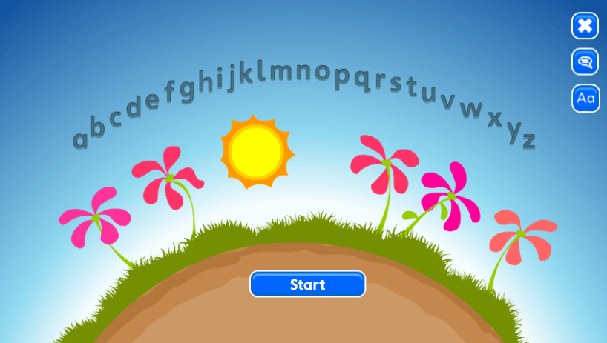
Letter Names
These are known as the sounds of the alphabet.

Slide 12
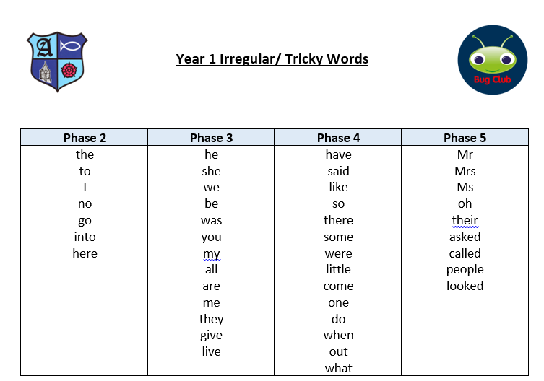
Irregular / Tricky Words

Slide 13
Guided Reading
Links to the phonemes that the children are learning that week.
Gives children a chance to practise reading to gain fluency.
Links to the irregular/tricky words.
A mixture of fiction and non-fiction.
Comprehension questions.

Slide 14
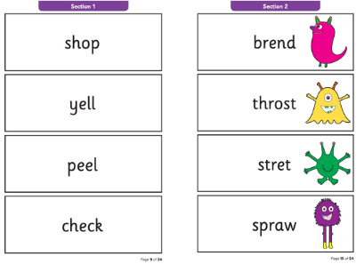
Phonics Screening
The phonics screening check is a check of your child's phonics knowledge. This takes place in Y1 (June).
Threshold is usually 32/40.
They are tested on real and nonsense words.
What happens if my child doesn’t pass?

Slide 15
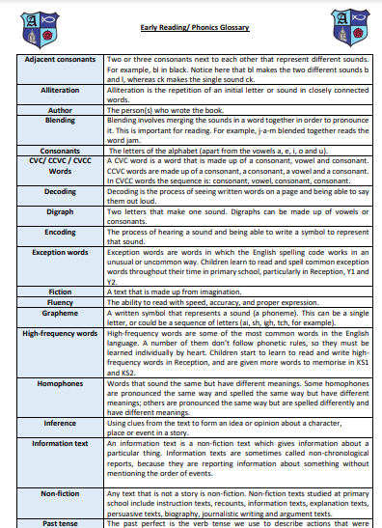
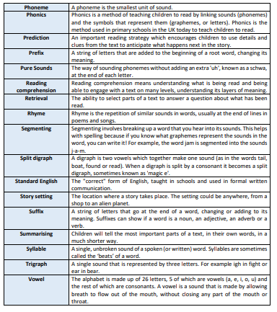
Phonics Glossary
Our Phonics Glossary can be found on our school website.

Slide 16
How you can support at home
READ – Active Learn
Play tricky word games
Show them flashcards
Get them to read signs when you are out
Write a shopping list together
Practise segmenting and blending new words too

Slide 17
We are always happy to help, so please ask if you are unsure.

