Slide 1

Welcome to our EYFS Unit
Reception Curriculum Evening
“Together, may we give your children the roots to grow and the wings to fly.”

Slide 2
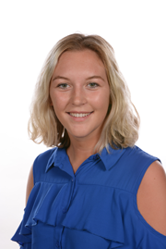
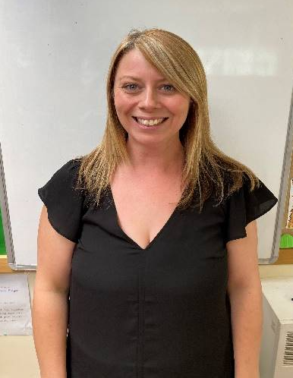
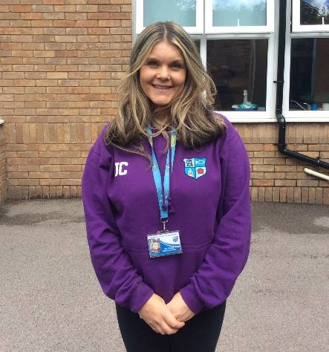
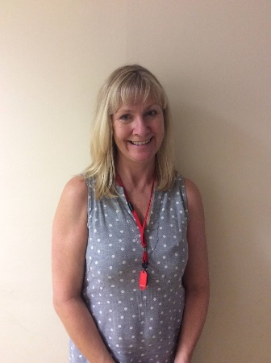
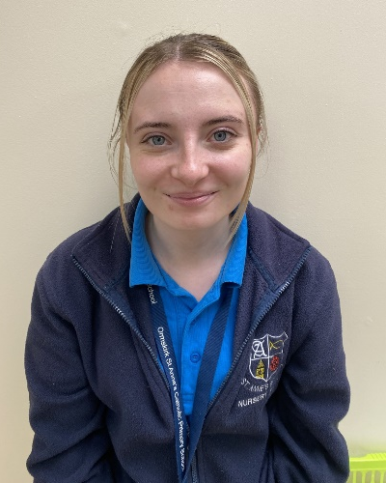
The EYFS Team
Miss Whiteside
Mrs Litherland
Mrs Carter
Mrs Scott
Miss Clarke
Notes:
Welcome, hopefully ch have settled into class and are starting to understand the rules and routines of the setting. (share pictures of ch in areas).

Slide 3
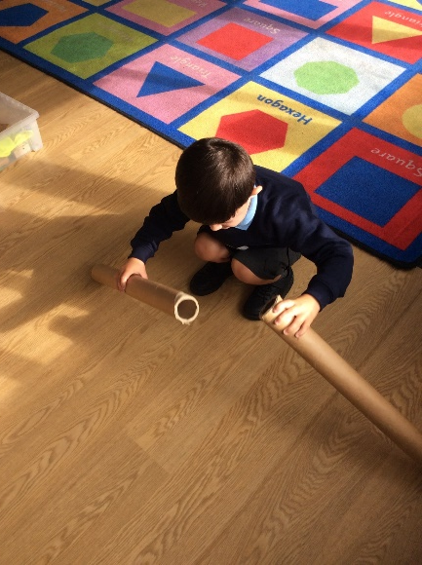
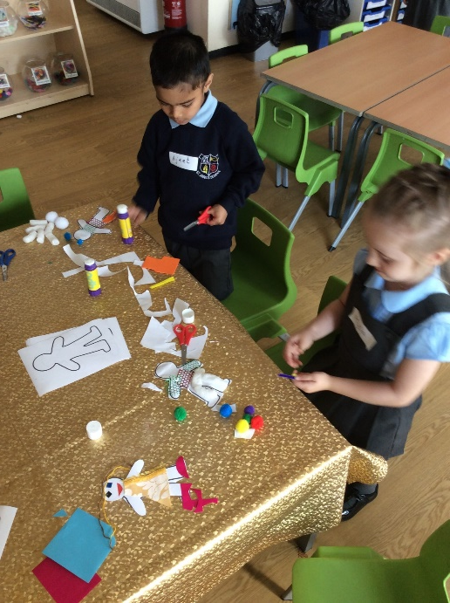
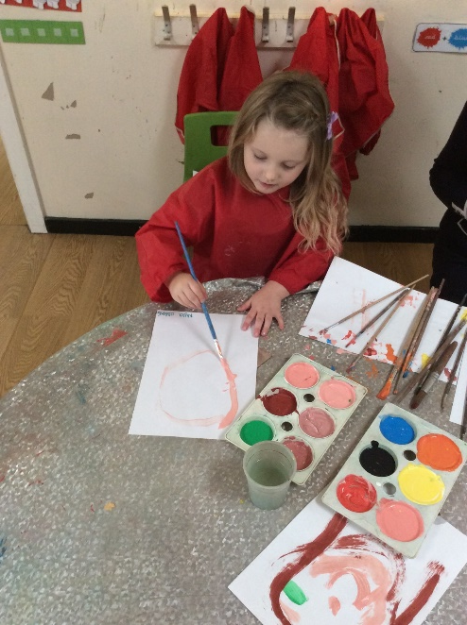
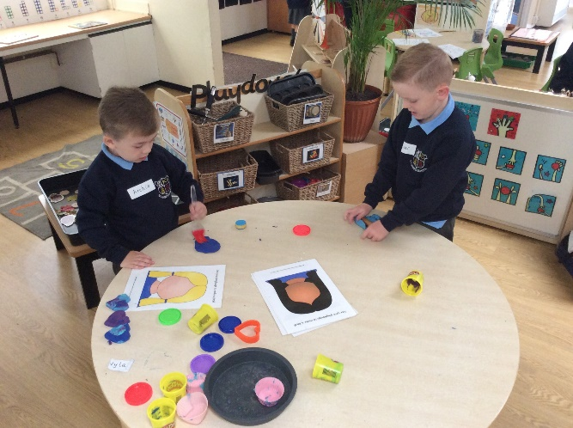
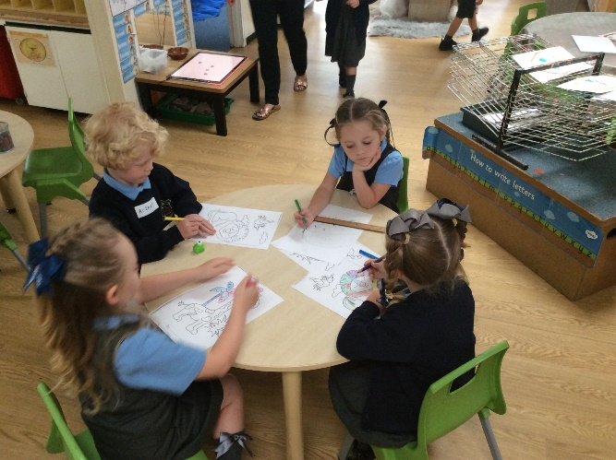
We have been having so much fun…

Slide 4

Communication
Parents as partners- most influential people in children’s lives.
Website - https://www.st-annesrc.lancs.sch.uk/
Class pages, Curriculum documents
Termly ‘Knowledge Organiser’ posted with information about upcoming topics and activities to support at home.
Documents to support Literacy and Maths
Newsletters and calendar for upcoming events and information
Twitter – school page
Timeline display

Slide 5
Baseline
Over the last couple of weeks we have been getting to know your children and their level of learning and development.
Statutory Government Baseline
Starting point – plan for next steps

Slide 6
Early Learning Goals
In the final term of the Reception Year the EYFS Profile will be completed for each child.
Each child's level of development is assessed against the ELG’s.
Children are assessed as meeting or not yet meeting the expected level of development.

Slide 7

Phonics
Daily Phonics Lessons
Letter Formation- Lowercase letters
Children are assessed on a half termly basis, and may have interventions depending on their knowledge and skills of blending and segmenting.
Important – to use the pure sounds with the children at home.
https://youtu.be/0dCRWLLNXPo
Parent workshop for phonics

Slide 8
Individual/Guided Reading at St Anne’s School
Initially, your child will read on a one to one basis on a book based on the sounds they have been previously taught and know.
During the sessions the children learn how to talk about a book, make predictions and comment on characters and plot.
The reading books are fiction and non-fiction.
Children will begin to complete small group guided reading sessions alongside a activity linking to the book.
Notes:
Could show the parents some of our Guided Reading materials

Slide 9
Home Reading
Children will be allocated Books online each Tuesday.
We will inform you of your child’s progress at parents evening, but if your child needs extra help we will work closely with you to support their progress.
Demonstration of bug club
Usernames and Passwords are included in packs.

Slide 10
St Anne’s Reading Award
Children are rewarded for their home reading throughout the year, but need your help to get their points, so please don’t forget to read each week and complete the bug club challenge at the beginning and end of the book!
Children receive prizes and can create their own world on bug club.
When your child reads 15 books, they will receive a bronze certificate.
When your child reads 30 books, they will receive a silver certificate.
When your child reads 45 books, they will receive a gold certificate and a reading book.

Slide 11
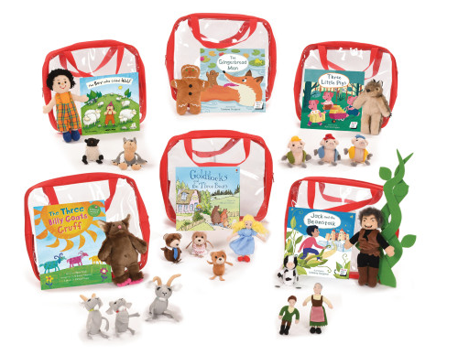
Story bags
Children who receive the ‘Star of the Week’ and ‘Mission Statement’ award on a Friday are able to take one of our Story Bags home for a week.
They contain a story and some props to go with it.
In each one it has a contents list to help you bring everything back.
Take home Friday bring back on the following Thursday.

Slide 12
Mathematics
Follow White Rose Scheme
Practical activities – concrete/pictorial – abstract
What can you do?
Count with your children
When children count a group of objects, ask them the question ‘How many?’. Encourage them to use the counting techniques we will be teaching them in school e.g. touch count, putting in a line etc.
Discuss mathematical vocabulary such as: big, small, heavy and light.

Slide 13

Weekly Homework
We will use Class Charts to inform you of homework (Login Details in pack). You will also be directed to Bug club for Phonics activities alongside your reading book and Maths shed for maths activities.
The homework will be linked to what is covered during the week and will be set on Tuesday for completion by the following Tuesday.
Daily reading on bug club.

Slide 14
General
Positive Behaviour management system – bucket fillers.
Water bottles not to be placed in bags. No juice- Water only
Waterproof clothes for outdoor play – practice getting changed at home so they can do this independently.
Names in ALL clothes/shoes and on water bottles
Small colouring book for wet weather.
Donations of spare clothes and underwear (replenished)
Family photos for our display
Baby picture/present individual picture for our topic
PE lessons Wednesday and Thursday: Come to school in PE kit and jumper/cardigan. Please no hooped earrings and either remove or cover studded earrings with plaster.
Cool Milk – sign up

Slide 15

Reception McMillan Coffee Morning
Thursday 3rd October 9.30am (Cash donations collected on the day to buy cakes)
Donations of cakes and biscuits will be collected from Monday 30th September.

Slide 16
Volunteers
Volunteers for school trips throughout the year.
People Who Help Us topic

Slide 17
Thank you for listening
Please take your child's pack which includes:
Bug Club Phonics Logins
Class Charts and Mathsshed Logins
Phonics sound mat- with actions
Please feel free to speak to us if you have any questions.

