Slide 1
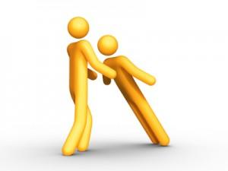
During the month of February we will try to …
Trust others

