Slide 1
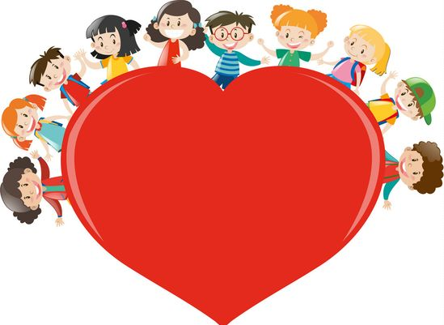
During the month of November we will try to …
Love others

